Slide 1

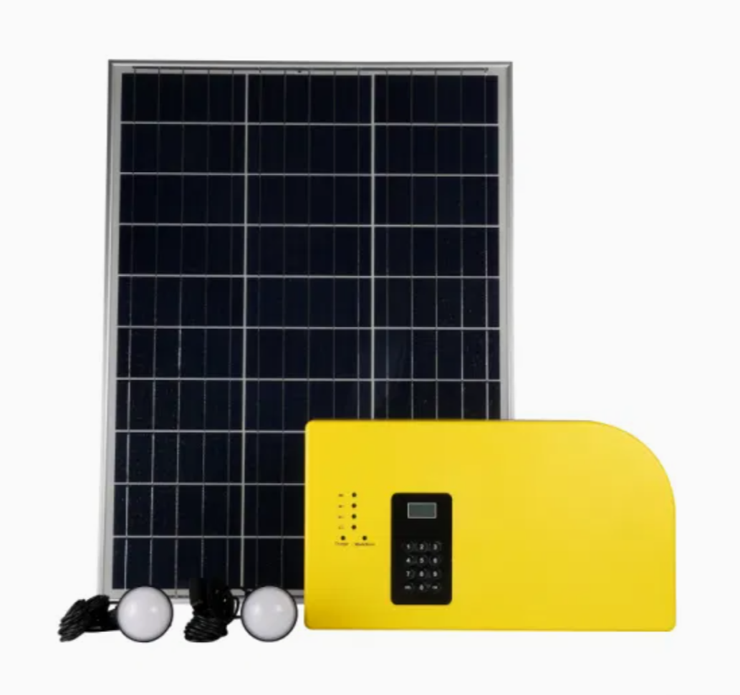
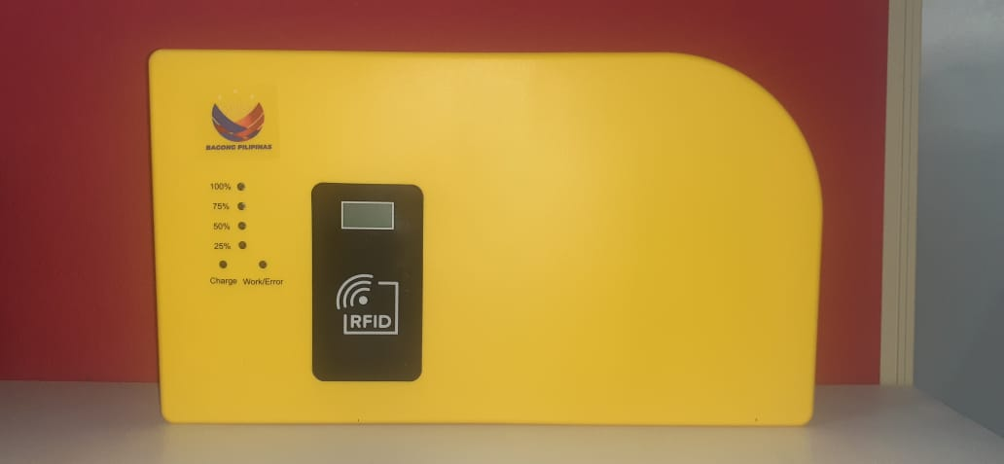
SOLAR HOME SYSTEM
ZANECO
TRAINING REPORT
Training Period:
February 11, 2025 (1pm – 5pm)
Venue:
ZANECO Main Office, Echaves St.
Dipolog City
Conducted & Prepared By:
Aldren P. Delos Santos

Slide 2
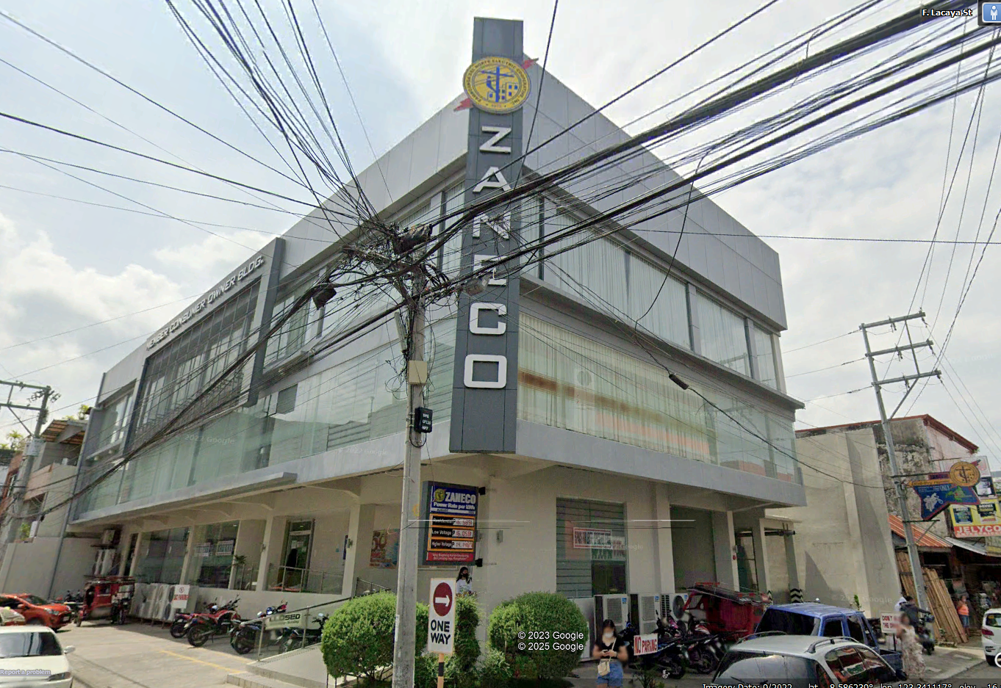


Slide 3

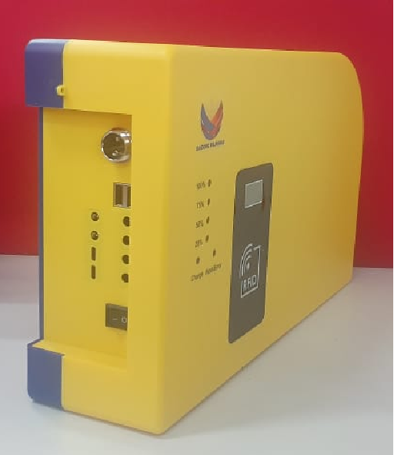
TRAINING TOPICS
BEST LOCATION FOR INSTALLATION
INSTALLATION TECHNIQUES
TESTING AND COMMISSIONING
CREDIT LOADING PROCESS
MCO INSTRUCTION
ADVANCED TROUBLESHOOTING
EXPORT AND DATA BACK-UP
INSTALLATION EVALUATION

Slide 4

TRAINING PHOTOS

Slide 5
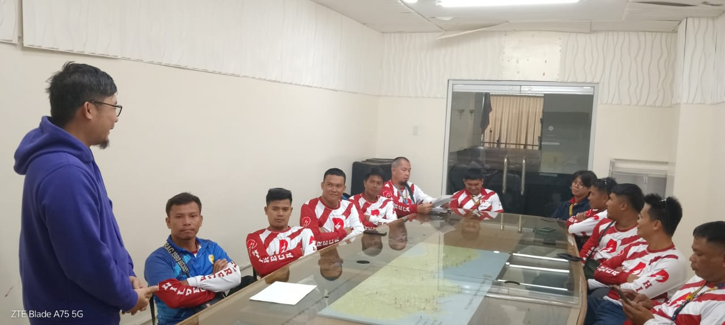
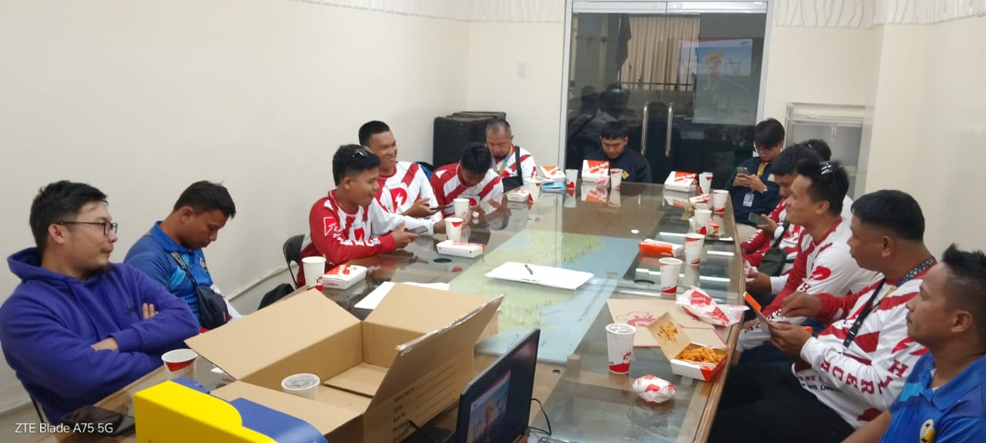

Slide 6
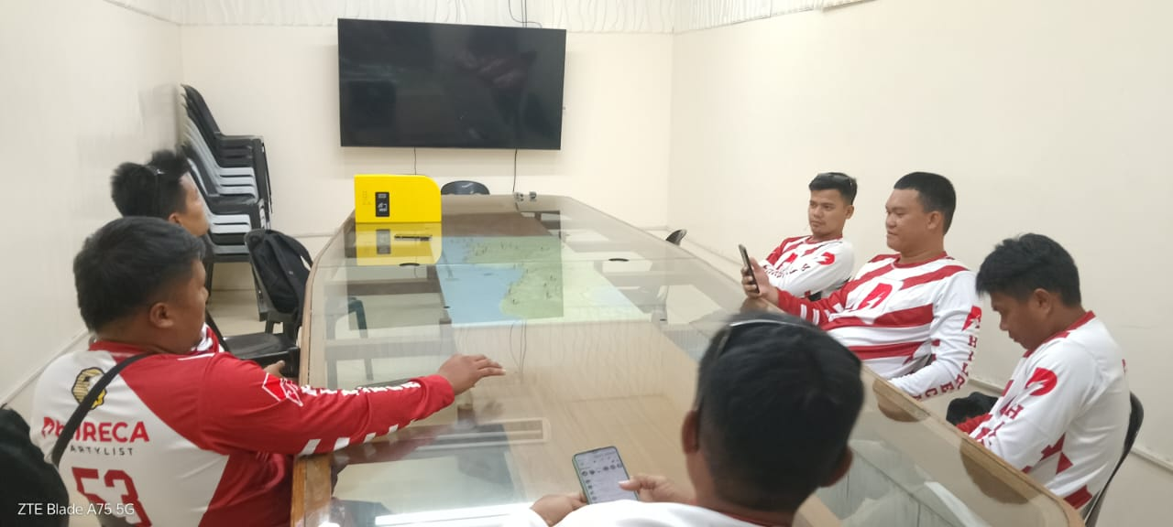
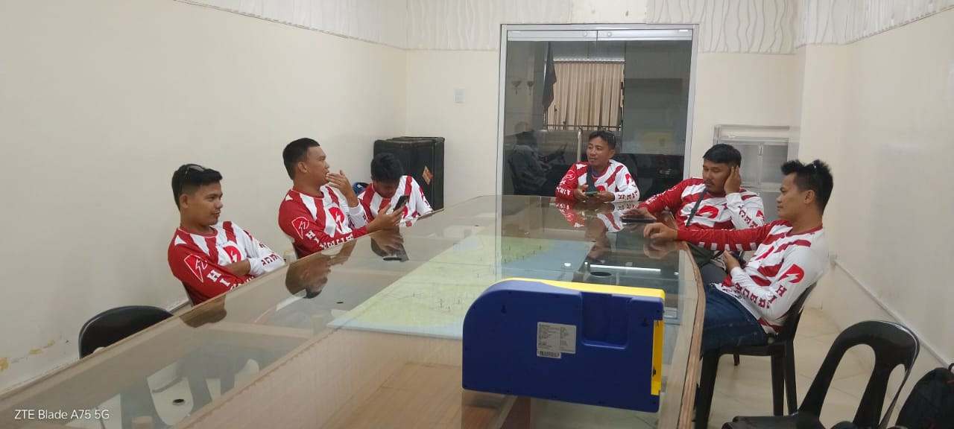

Slide 7
ATTENDANCE SHEET
PARTICIPANTS & ATTENDEES : 12

Slide 8
