Slide 1

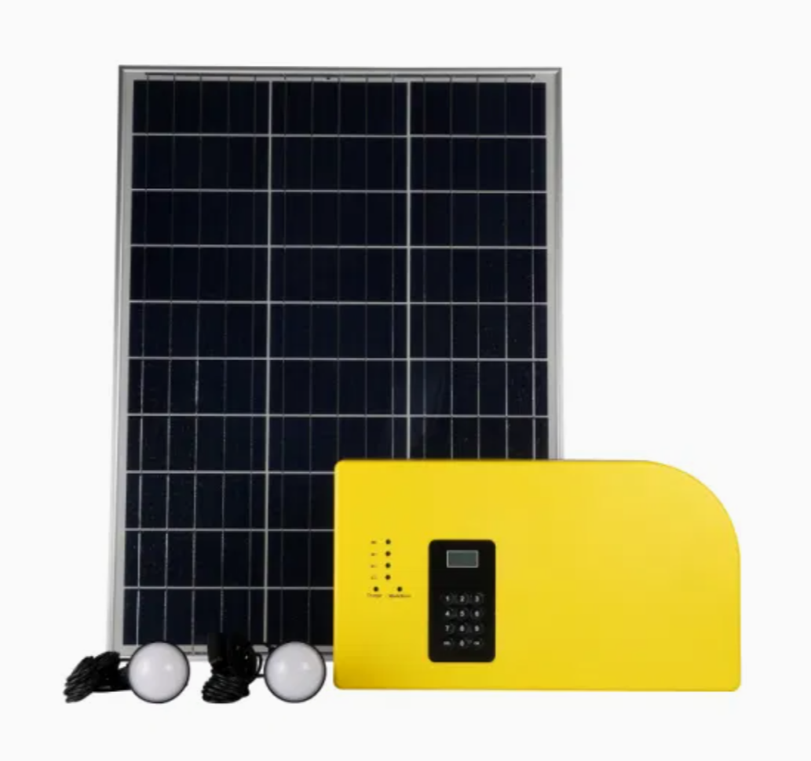
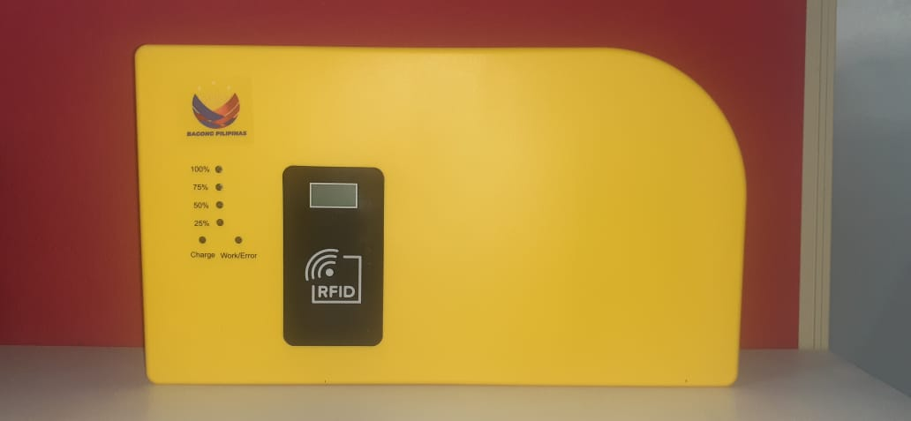
SOLAR HOME SYSTEM
ZAMSURECO - 1
TRAINING REPORT
Training Period:
February 13-14, 2025 (8am – 5pm)
Venue:
ZAMSUREO – 1 Main Office, Alano Ave.
Pagadian City
Conducted & Prepared By:
Aldren P. Delos Santos

Slide 2
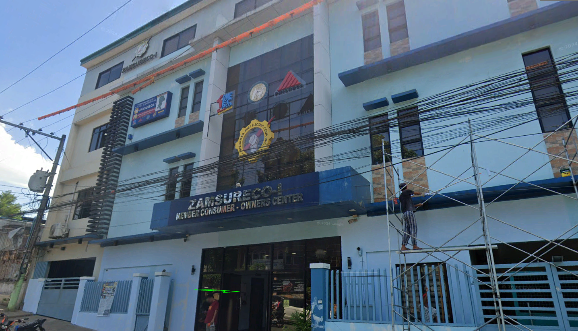

Slide 3

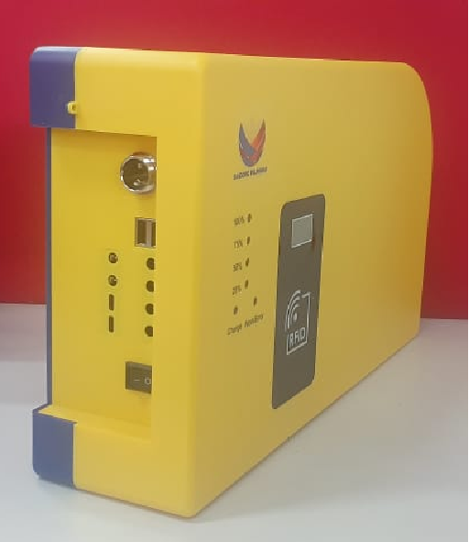
DAY 1
BASIC ON SOLAR ENERGY, SOLAR SYSTEM AND OTHERS
SYSTEM COMPONENTS AND FUNCTIONS
BASIC INSTALLATION AND OPERATION
RFID ACTIVATION AND LOADING SYSTEM
MAINTENANCE AND TROUBLESHOOTING
WARRANTY
INSTALLATION EVALUATION

Slide 4

TRAINING PHOTOS

Slide 5
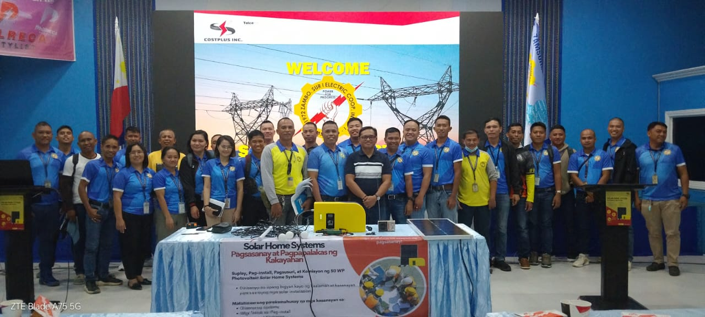
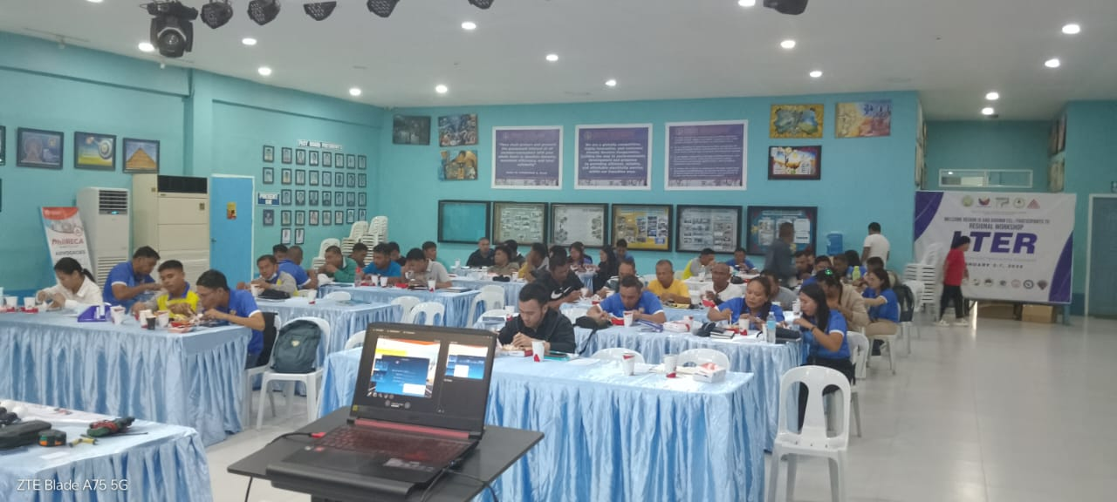

Slide 6
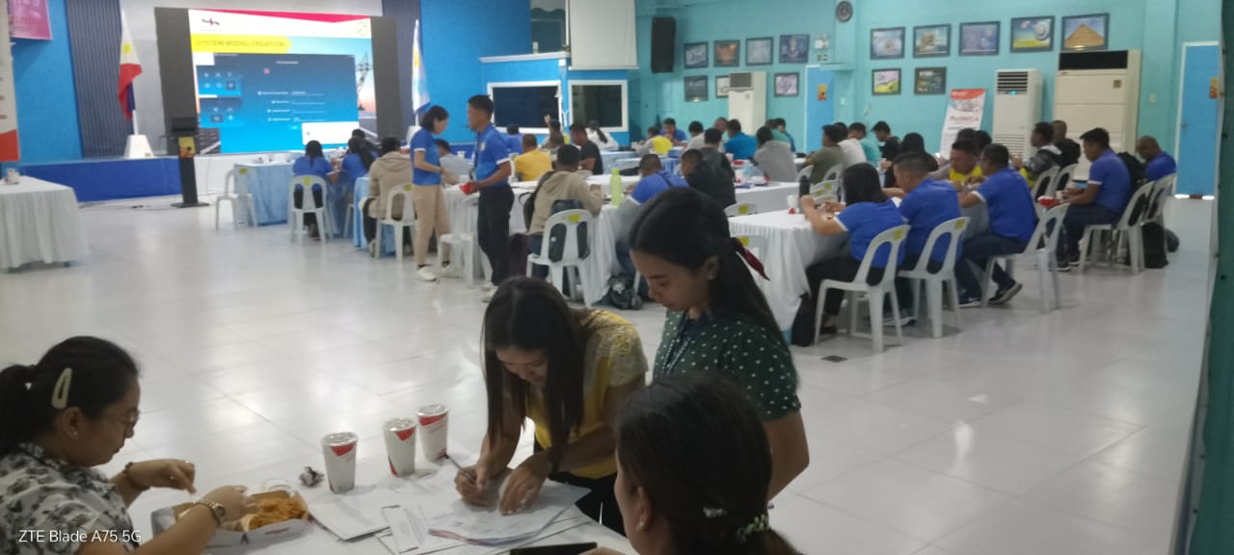
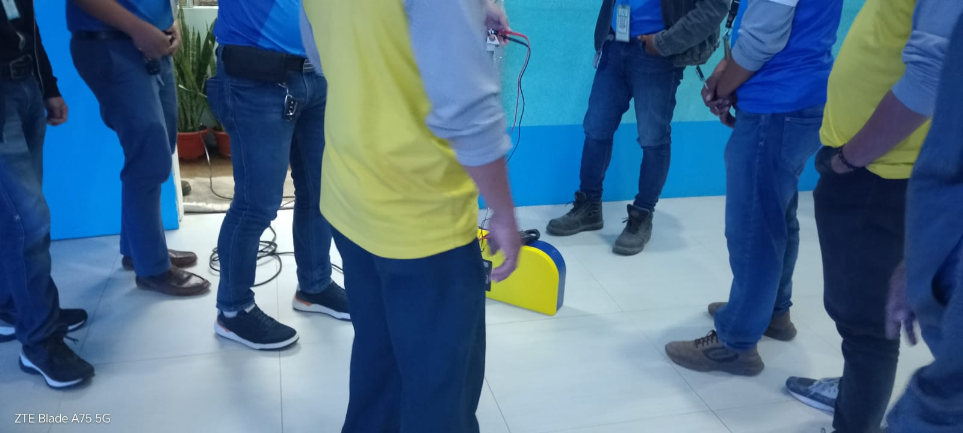

Slide 7
ATTENDANCE SHEET
PARTICIPANTS & ATTENDEES : 75

Slide 8
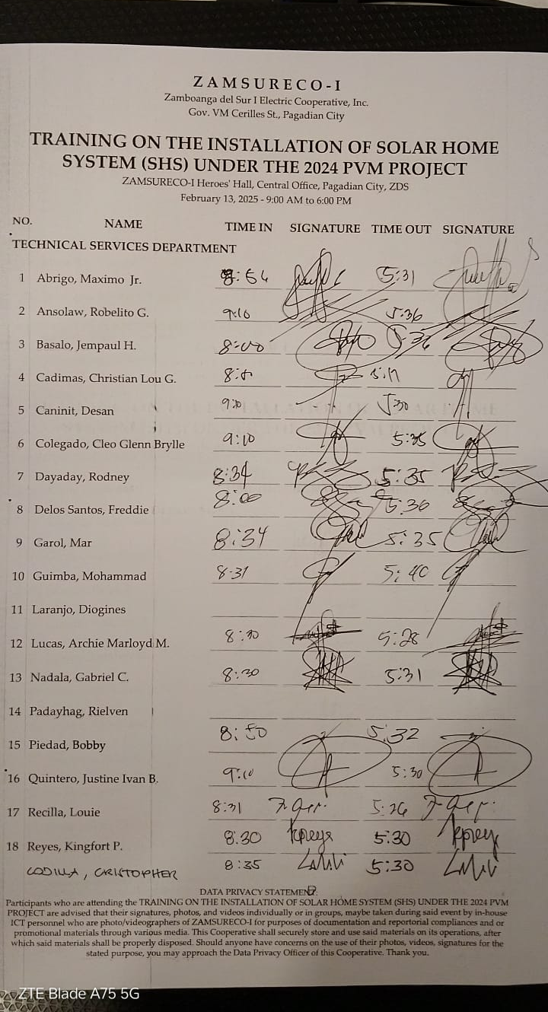
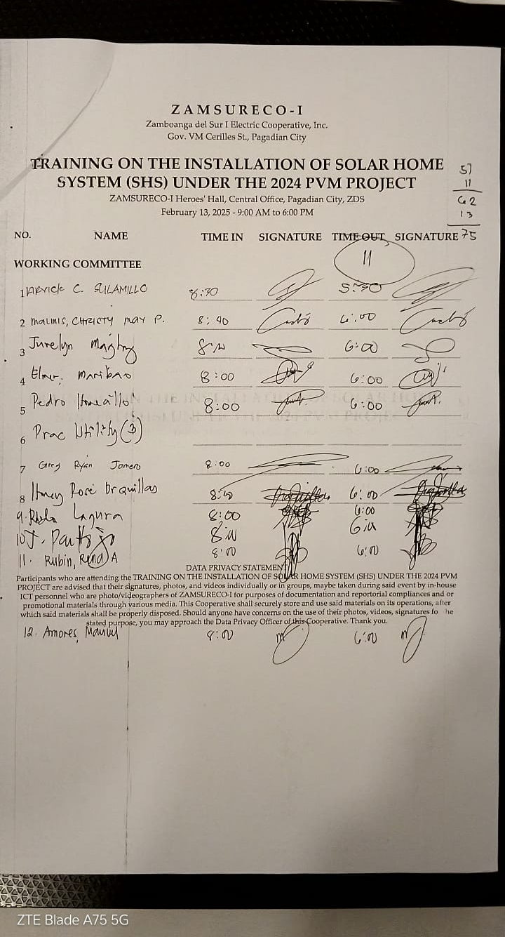
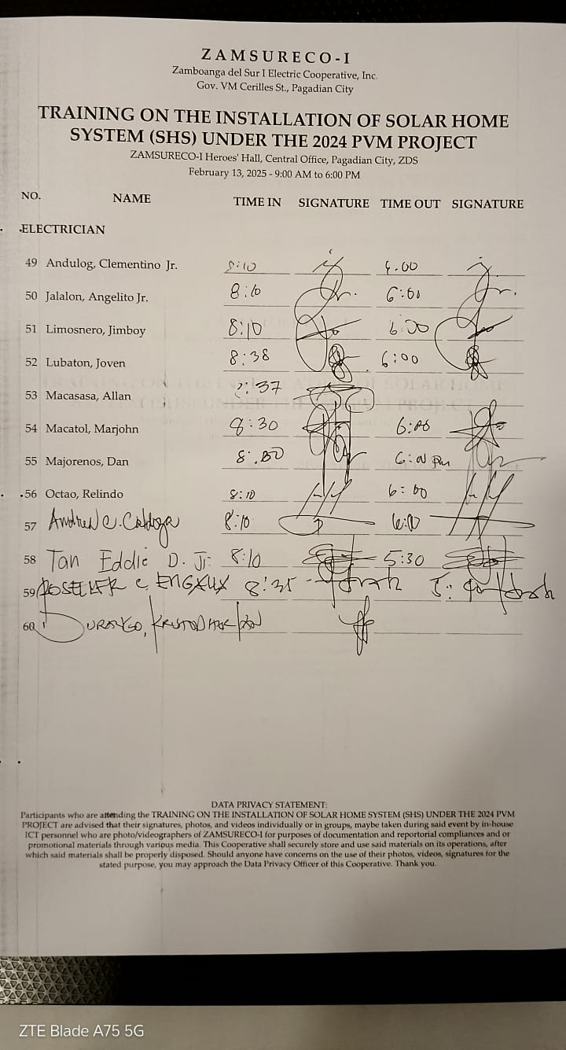

Slide 9
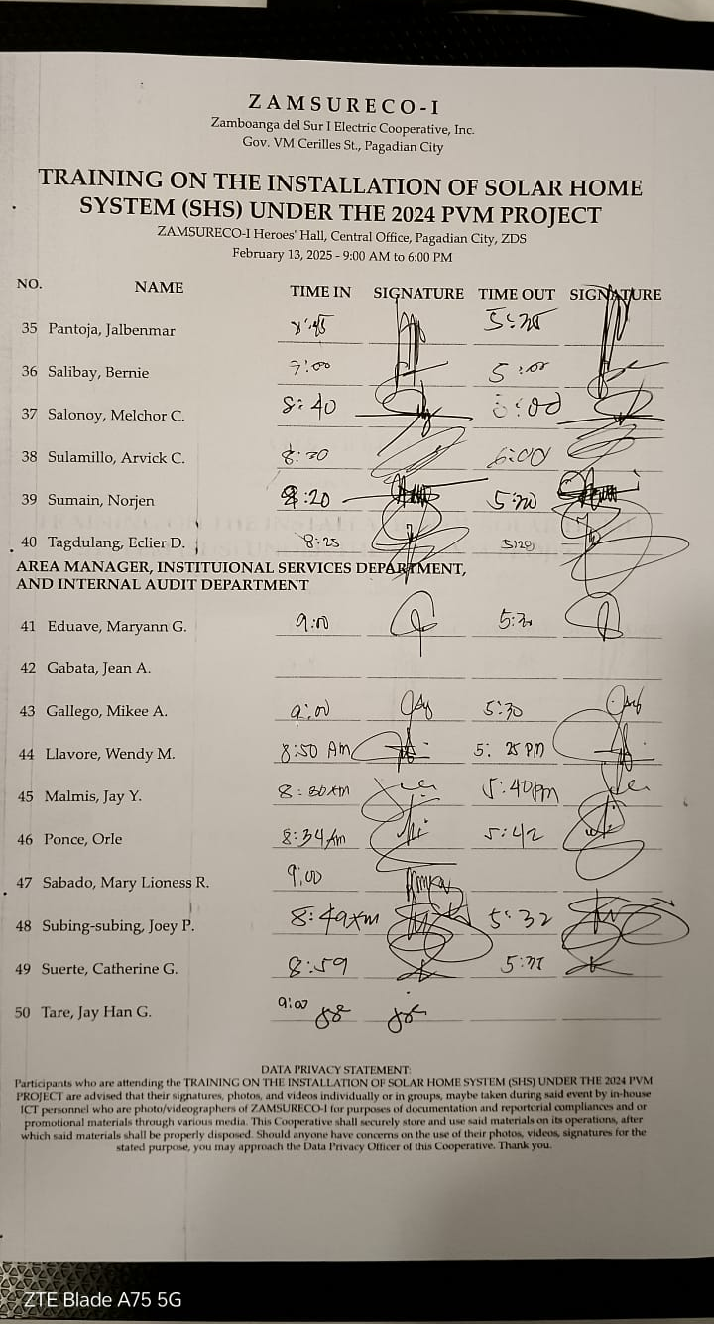
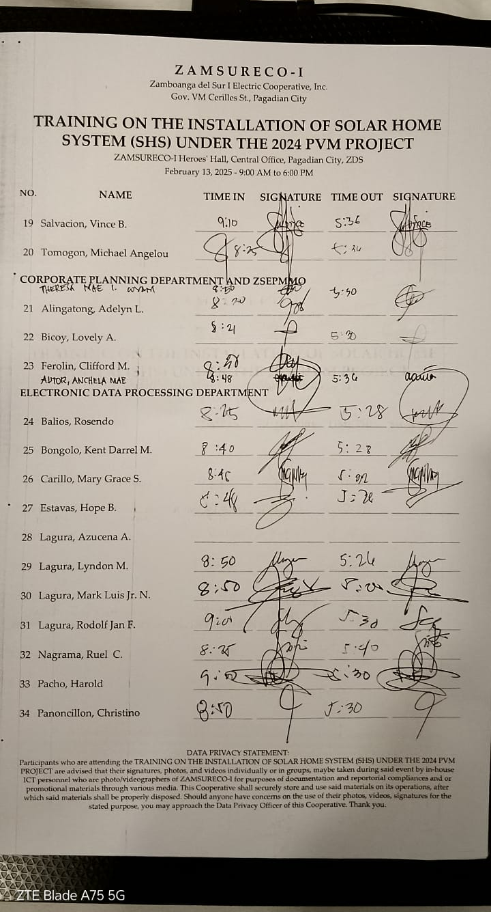

Slide 10
DAY 2
WORKSHOP OF RFID ACTIVATION, LOADING SYSTEM, SIMULATION OF COMMON ERRORS AND OTHER ADVANCED TROUBLESHOOTING
WORKSHOP OF SOLAR HOME SYSTEM COMPONENT AND FUNCTIONALITIES
COMPLETE REVIEW OF SOLAR HOME SYSTEM

Slide 11
TRAINING PHOTOS

Slide 12
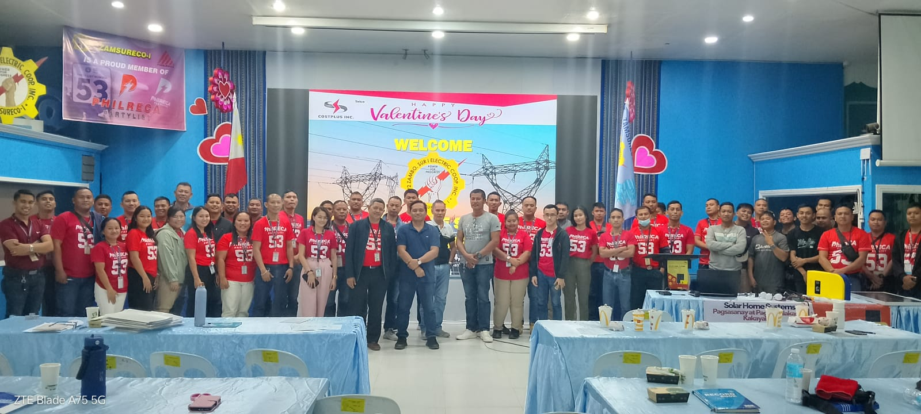
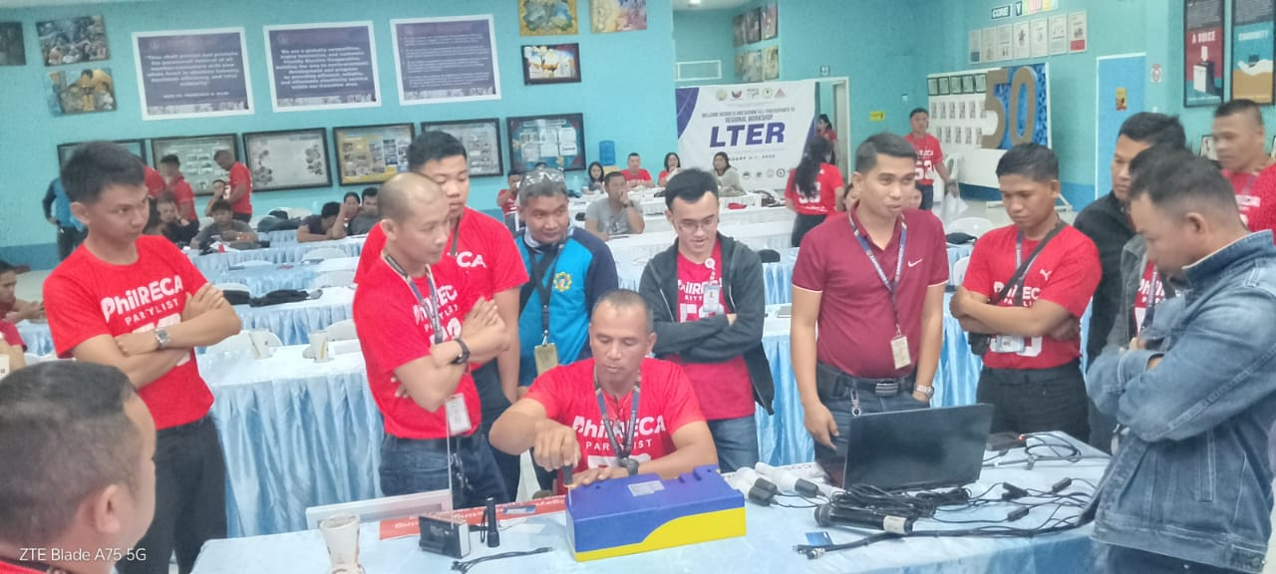

Slide 13
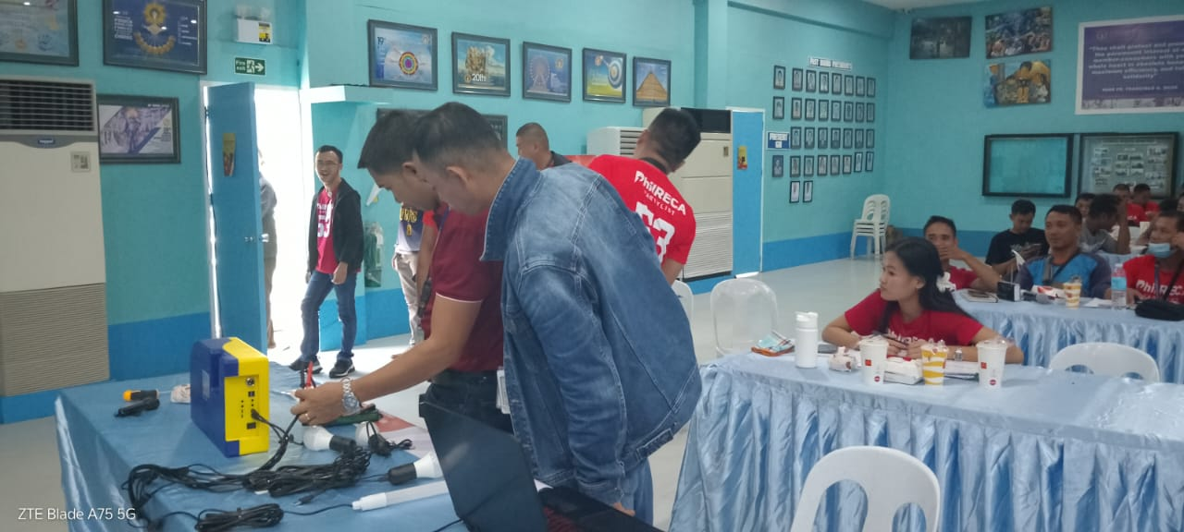
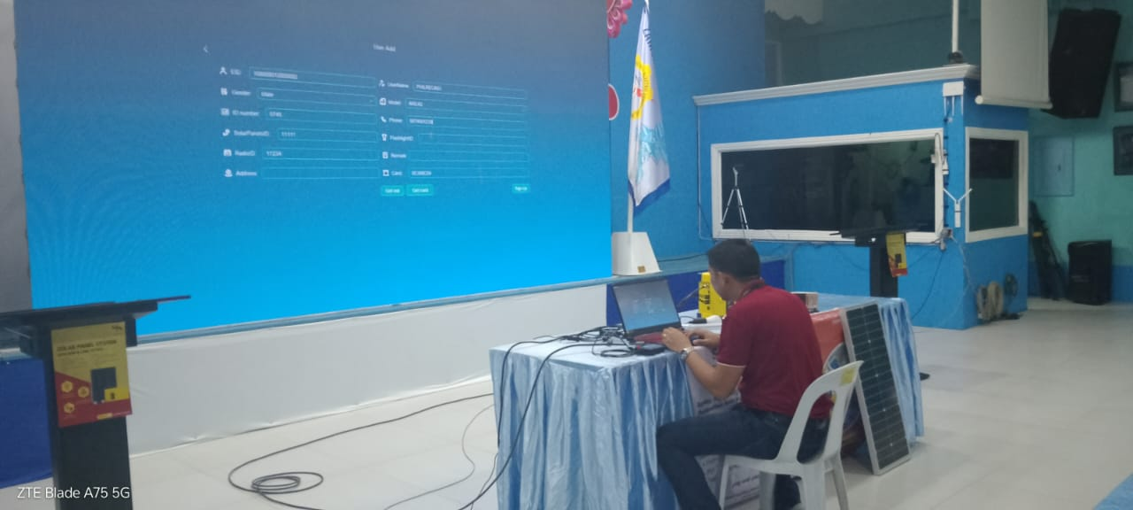

Slide 14
ATTENDANCE SHEET
PARTICIPANTS & ATTENDEES : 67

Slide 15
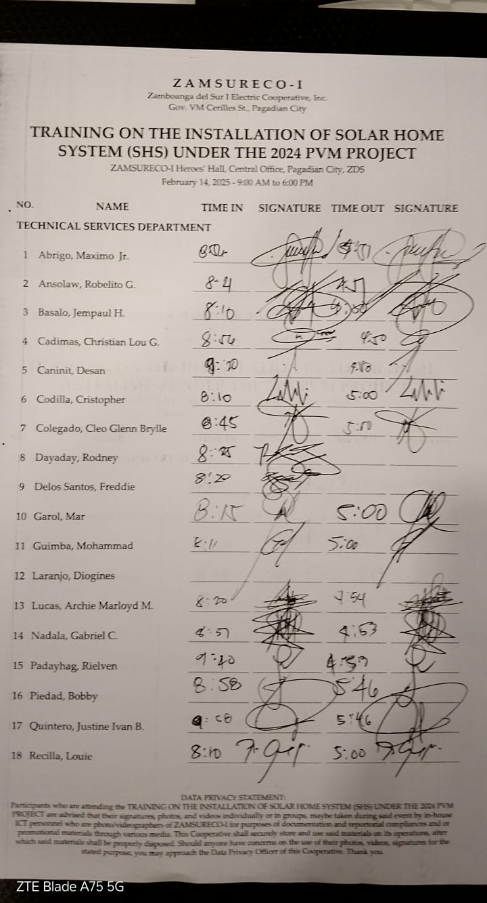
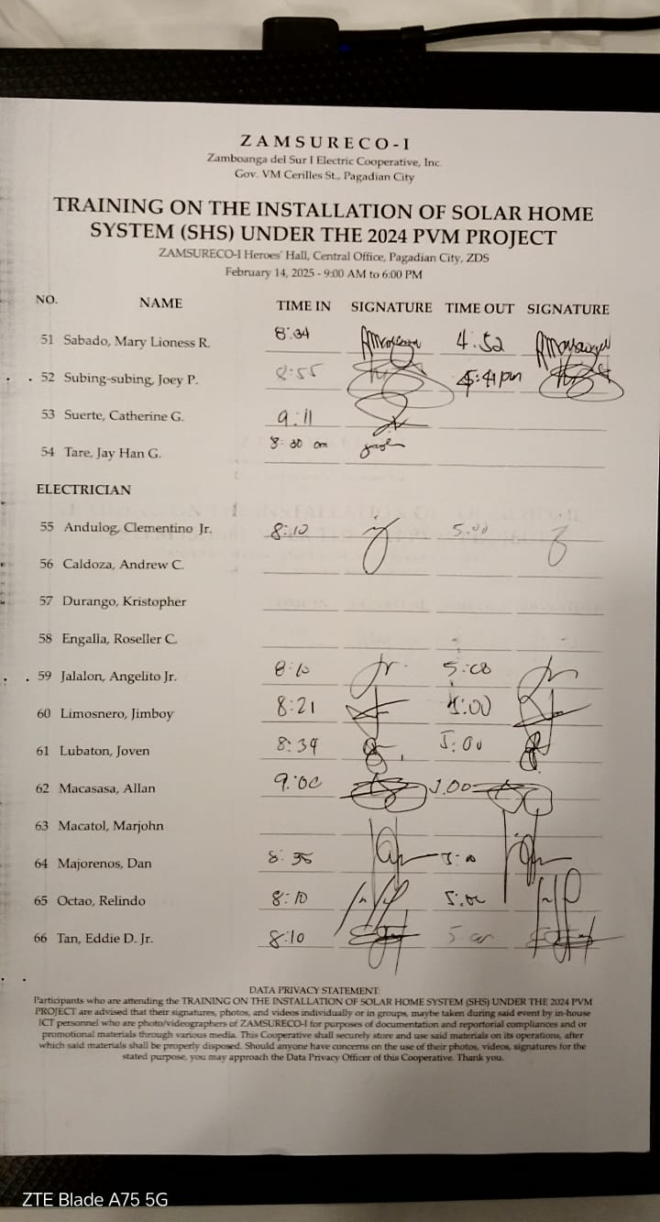
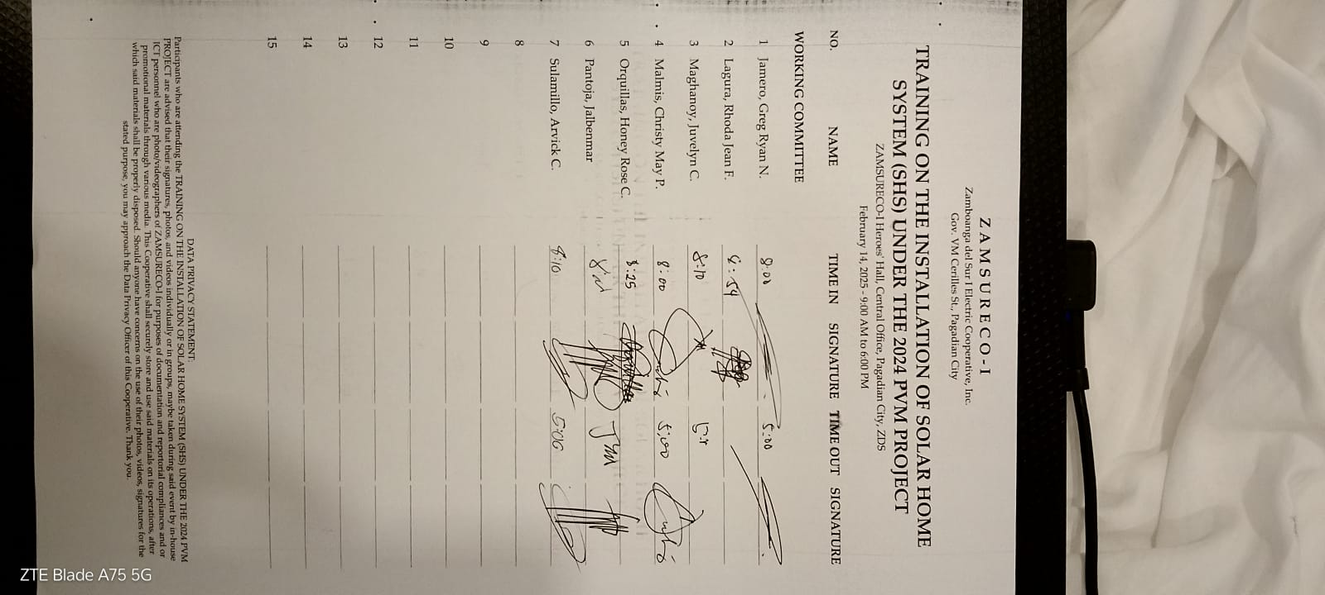

Slide 16
