Slide 1


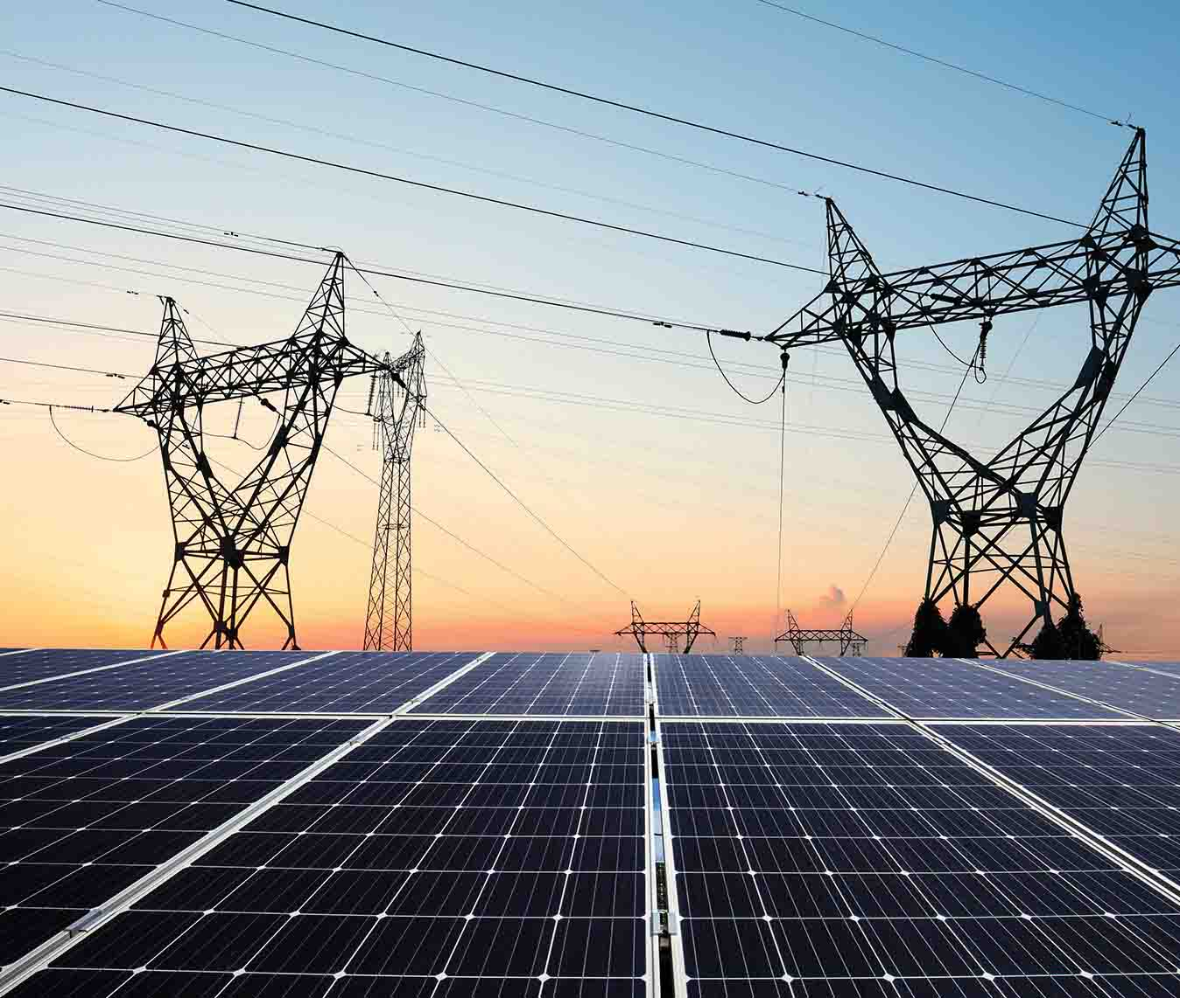
WELCOME
SULU ELECTRIC COOPERATIVE
COMMUNITY BASED TECHNICIAN
SOLAR HOME SYSTEM
TRAINING
MARCH 2 2025
Prepared By:
Engr Joseph Obusn IEE A.M.O.
Amir Mudag
Senior Tech Engineer

Slide 2
TRAINING OF SOLAR HOMES SYSTEM
SOLAR HOMES SYSTEM
8000am 9 am Basic on Solar Energy & others
9:30 -12 00pm – Basic Installation & others
SOLAR POLE
SOLAR BRACKET
SOLAR PANRL AZIMUTH
INSTALLATIONS PROCEDURE AND STANDARDS

Slide 3
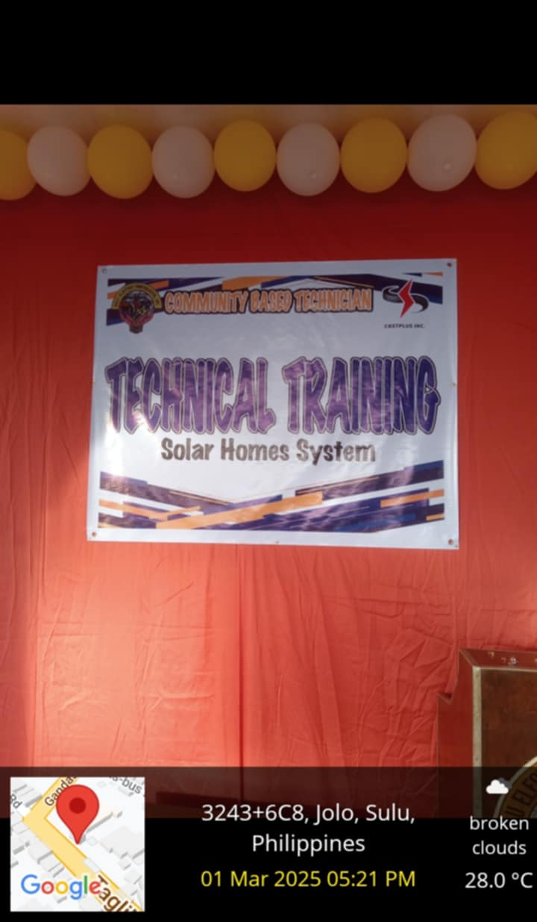
Solar Home System
PPT PRESENTATION TO SULECO SBU AND TECHNICIANS
HANDS ON TRAINING ON ASSEMBLY OF SOLAR POLE AND BRACKET

Slide 4
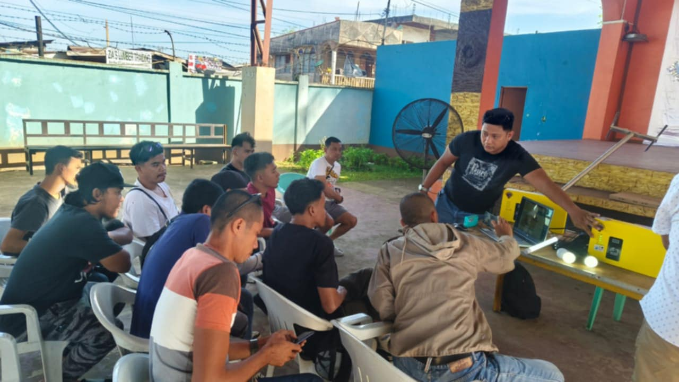
Solar Home System
DISCUSSION OF SOLAR HOMES SYSTEM TO SULECO TECHNICIANS AND SOLAR BUSSINESS UNITS

Slide 5
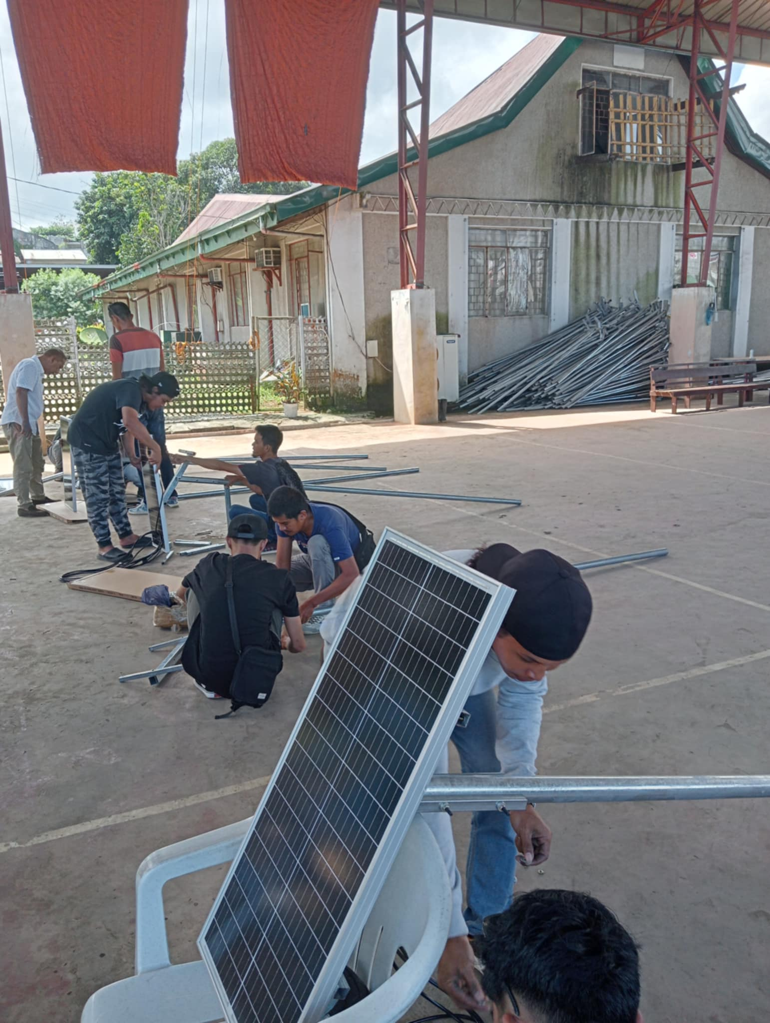
Solar Home System
ASSEMBLY HANDS ON TRAINING
SOLAR POLE ASSEMBLY BRACKET VERSION 3 (BOLT AND NUT TYPE )
GATHERING OF TOOLS AND EQUIPMENT USE FOR ASSEMBLY
HANDS ON TRAINING TO ITS SOLAR BUSSINESS UNITS AND TECHNICIANS
ASSEMBLE OF BRACKET
FIXATION OF BRACKET TO SOLAR PANEL AND SOLAR POLE

Slide 6
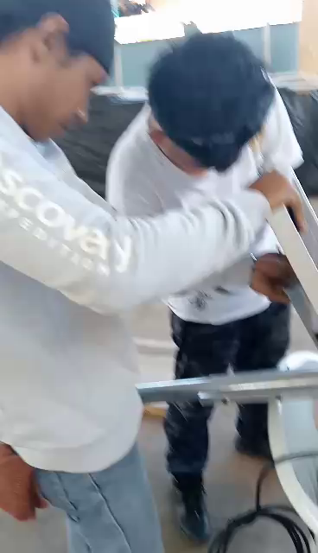
Solar Home System
SOLAR POLE AND BRACKET ASSEMBLY TRAINING

Slide 7
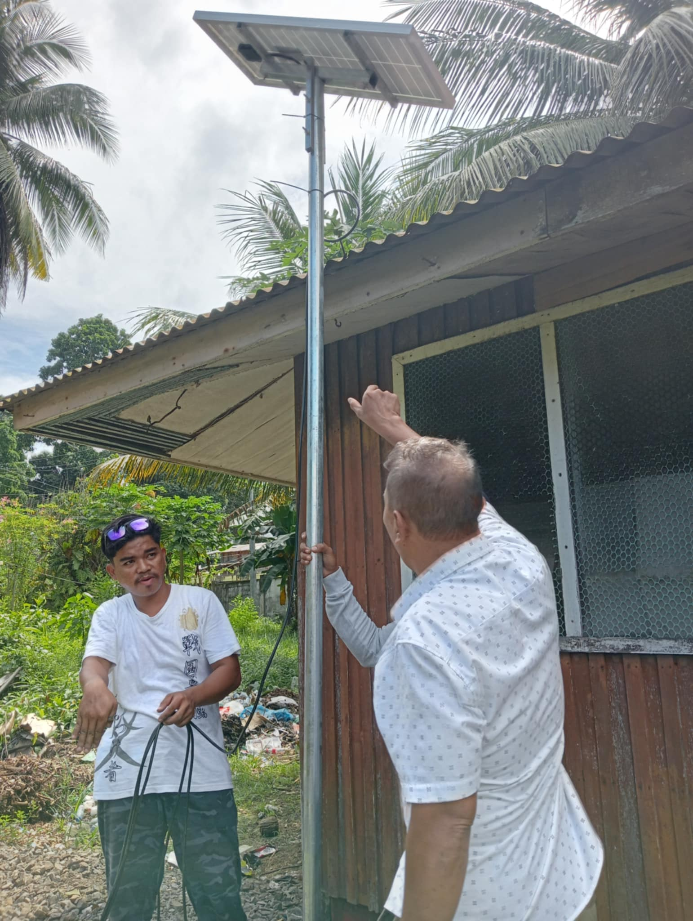
Solar Home System
SIMULATION OF PROCESS OF SOLAR POLE ASSEMBLY INTO BENEFICIARIES HOUSEHOLDS
EXECUTE BY TEAM CONSIST OF 3 MANPOWER FROM TECHNICIANS
& SBU

Slide 8
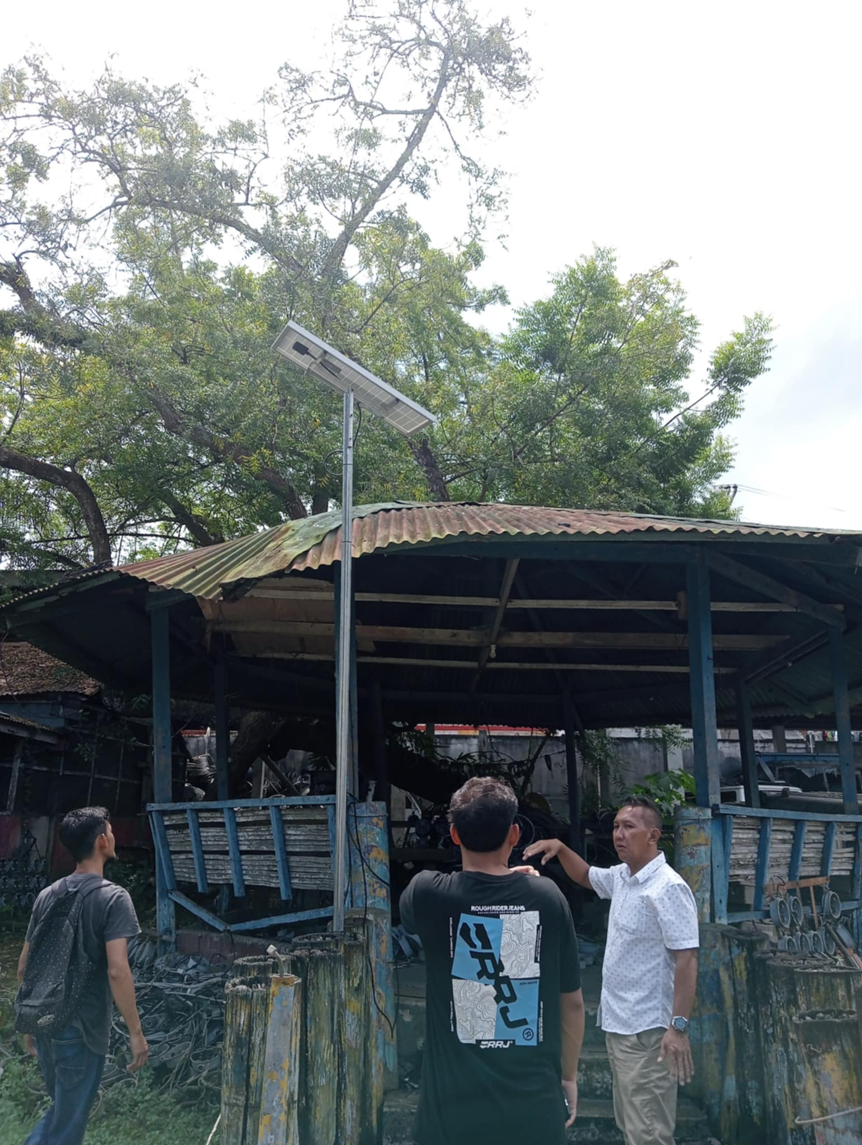
INSPECTIONS AND REVIEWING OF SIMULATIONS FOR WIRES CONNECTIONS AND ESTABLISHING FIRM INSTALLATIONS ON HOUSEHOLDS

Slide 9
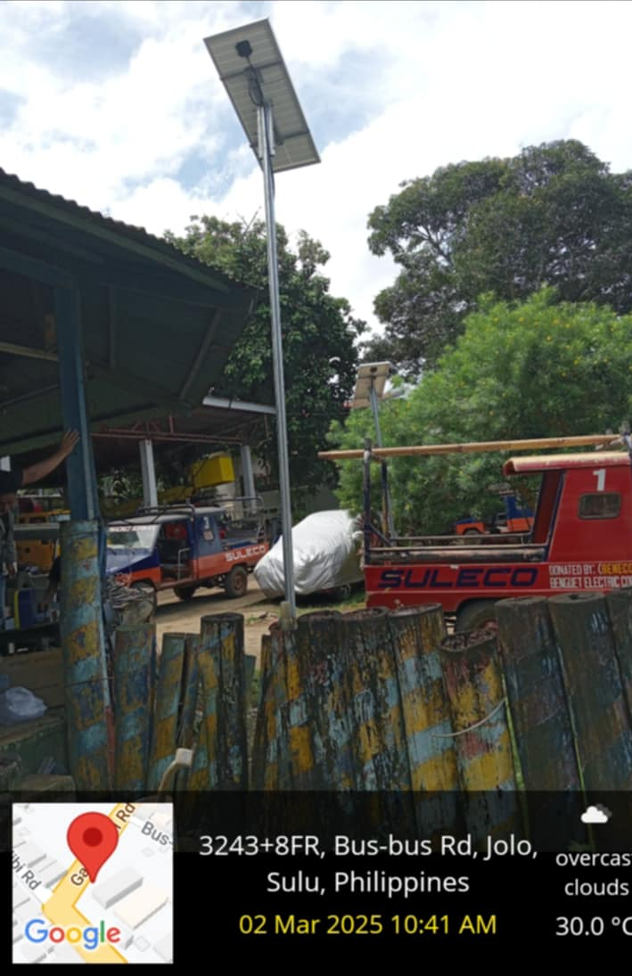
AZIMUTH AND STANDARD POSITIONING OF SOLAR POLE AND SOLAR PANEL FOR MAXIMIZE SOLAR PANEL RENEWABLE ENERGY GATHERING

Slide 10
Solar Home System
SOLAR POLE AND BRACKET ASSEMBLY
END OF TRAINING

