Slide 1




WELCOME
SULU ELECTRIC COOPERATIVE
SOLAR BUSSINESS UNITS
SOLAR HOME SYSTEM
TRAINING
MARCH 10 2025
Prepared By:
Engr Joseph Obusn IEE A.M.O.

Slide 2
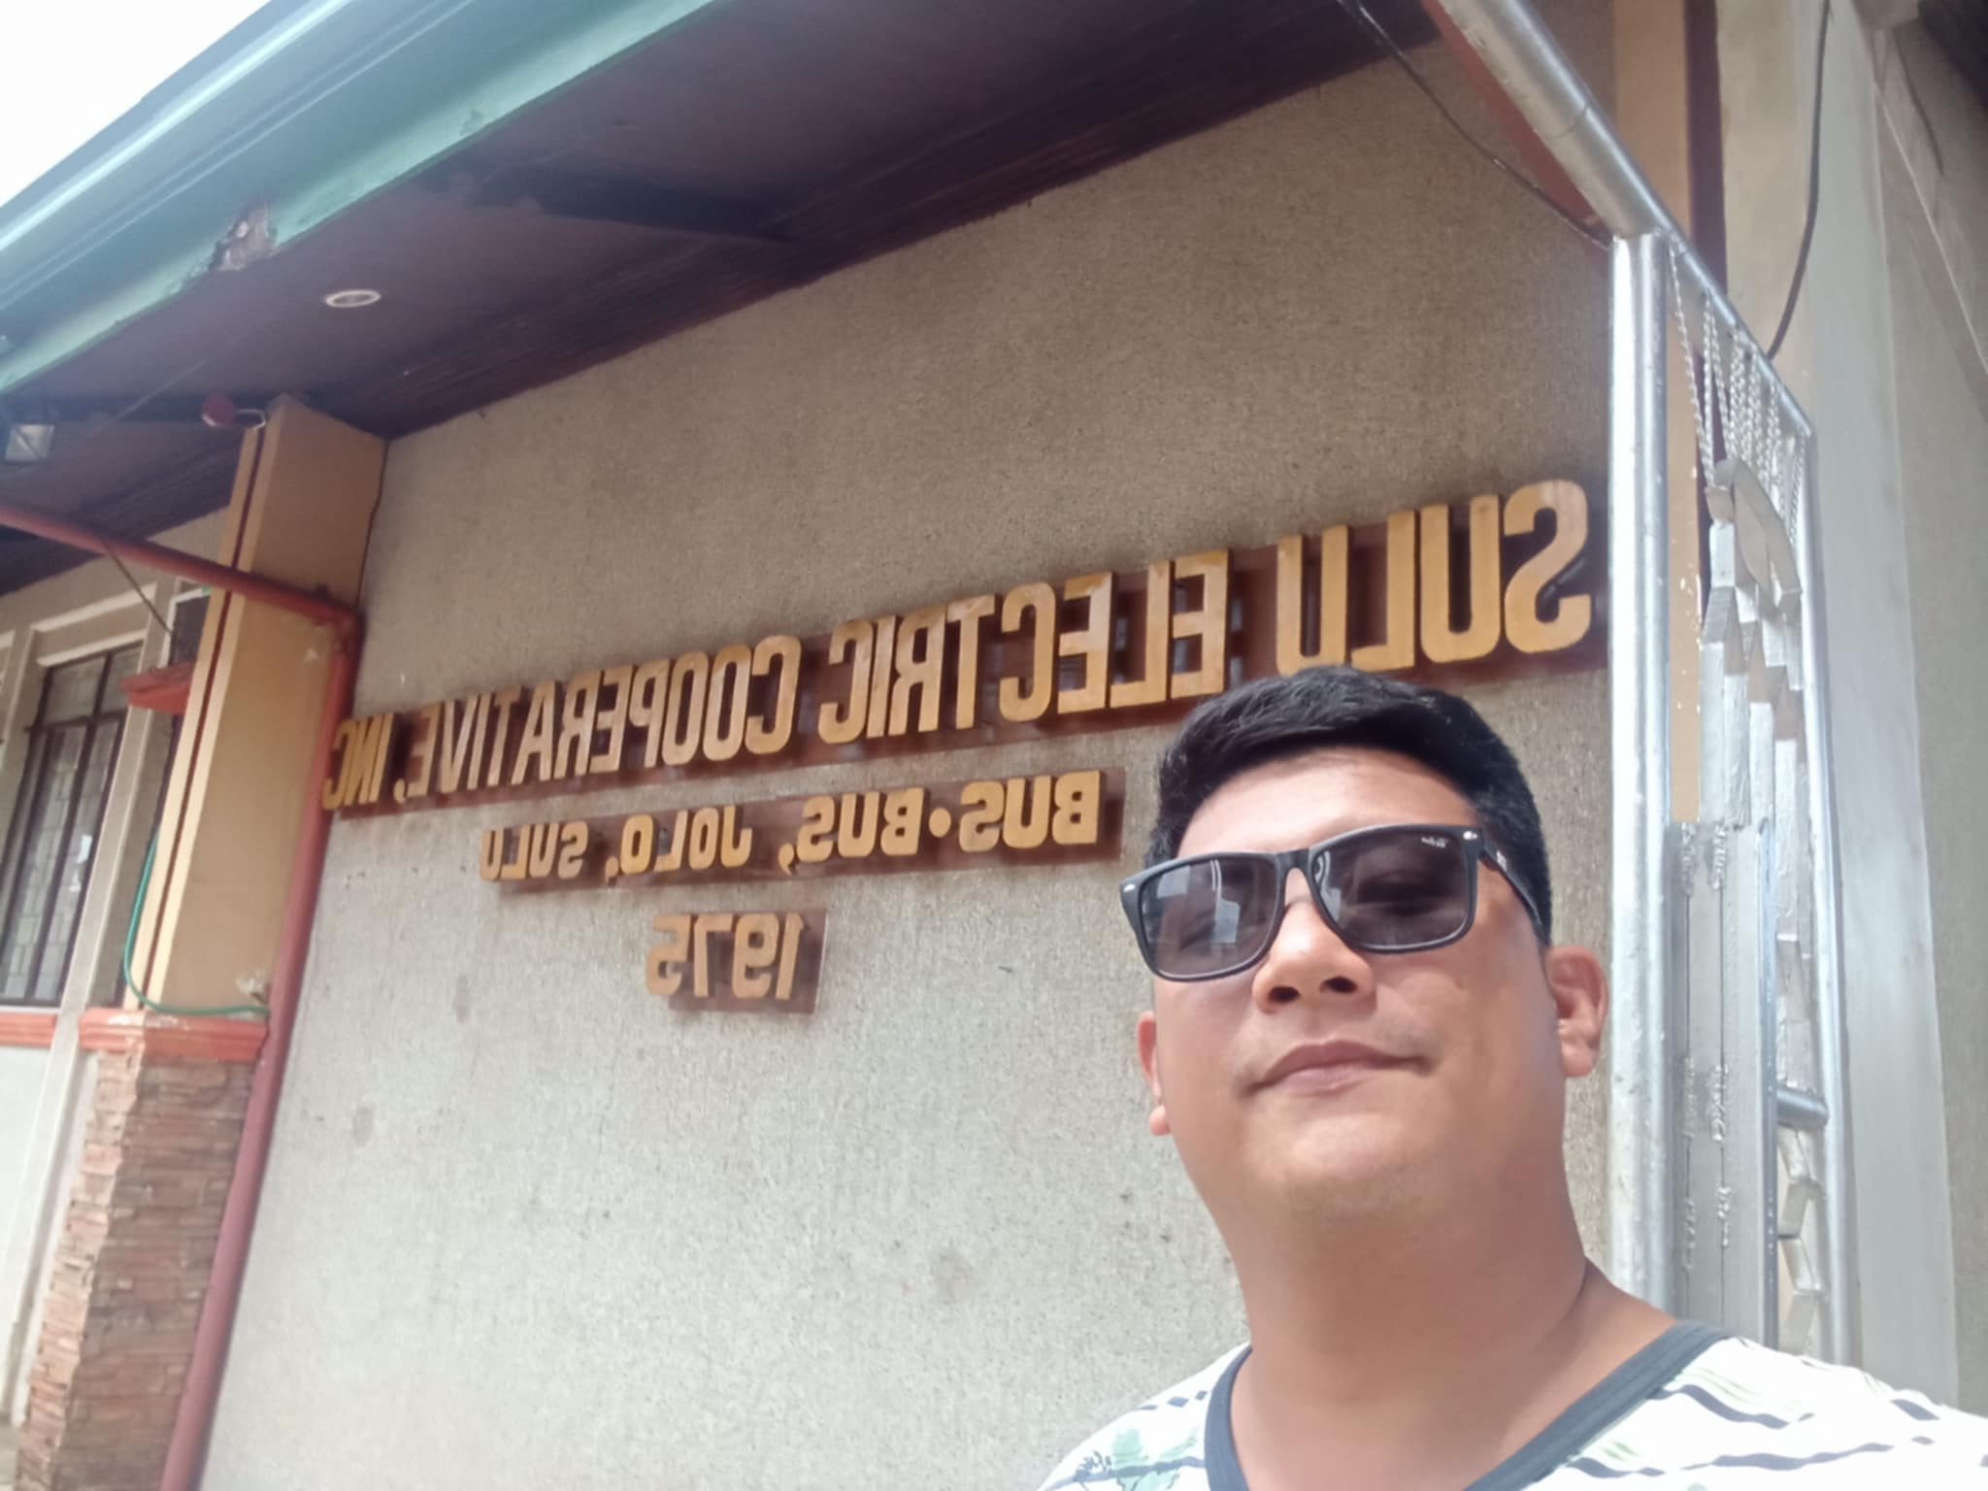

Slide 3
TRAINING OF SOLAR HOMES SYSTEM
SOLAR HOMES SYSTEM
8000am 9 am Basic on Solar Energy & others
10-3PM POS INTRODUCTION AND HANDS ON TRAINING

Slide 4
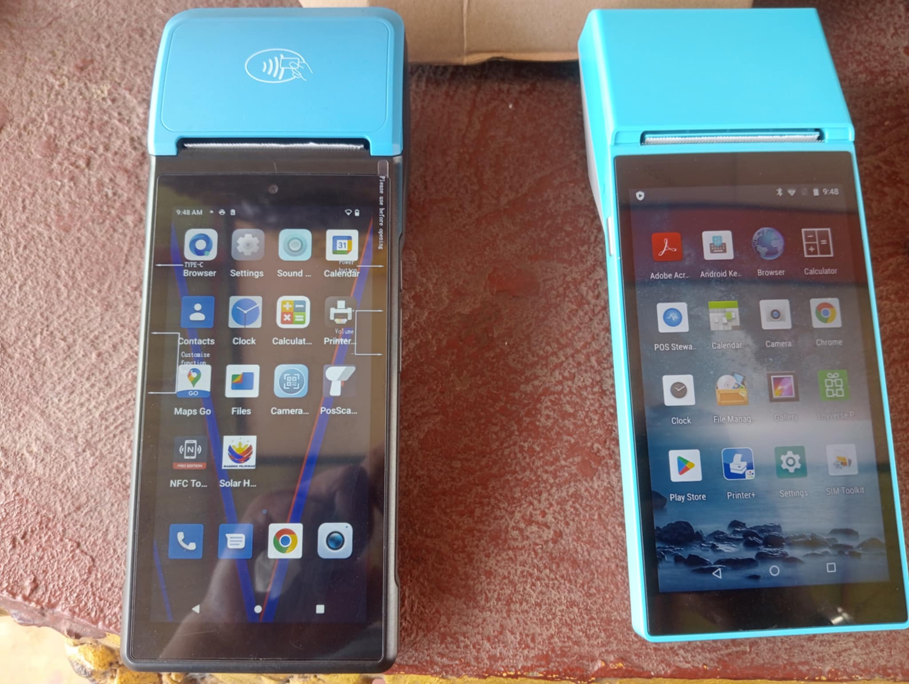
BRIEF INTRODUCTION OF POS TO PARTICIPANTS
ACTUAL DEMONSTRATION OF POS
ITS CAPACITY:
-SPECIFICATIONS
-OPERATING SYSTEM
-ADVANTAGES
-BATTERY CAPACITY 5000MAH
-NFC CAPABILITY
-ADD & REGISTER BENEFECIARIES
-PRINTING RECEIPTS
-PROVIDE ACCURATE DATA
-ONLINE OFFLINE LOADING SYSTEM
-LOADING TOKEN AND GENERATING RESET TOKEN
-MODIFY CARD / REPLACEMENT OF CARD

Slide 5
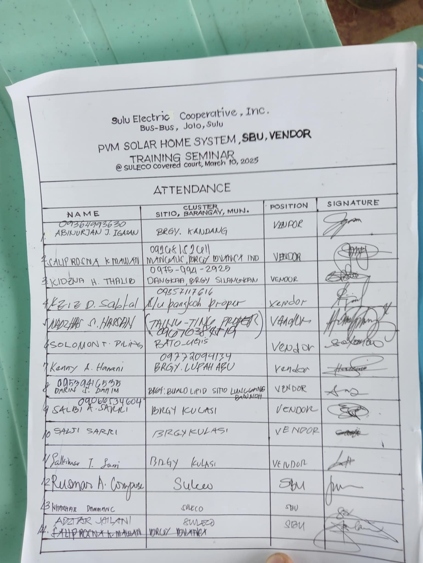
INITIAL PARTICIPANTS ARE 14 OTHER COMES LATER DUE TO DIFFERENT ASSIGNED WORKLOAD AND FROM DIFFERENT DEPARTMENTS

Slide 6
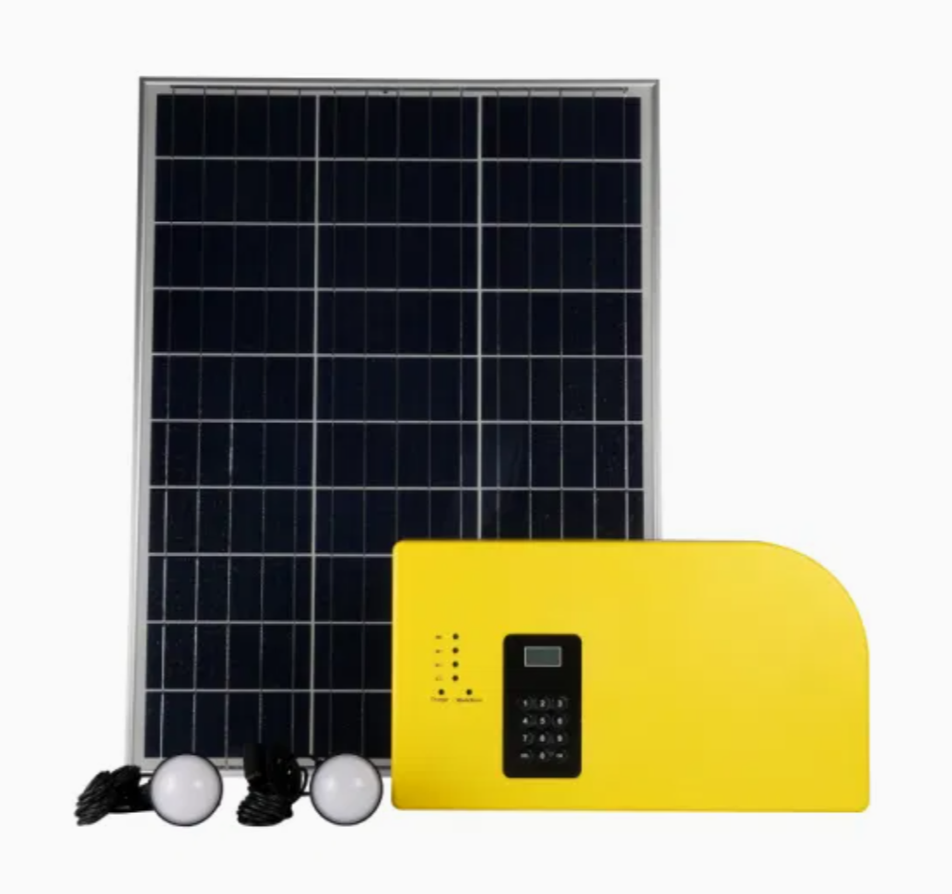
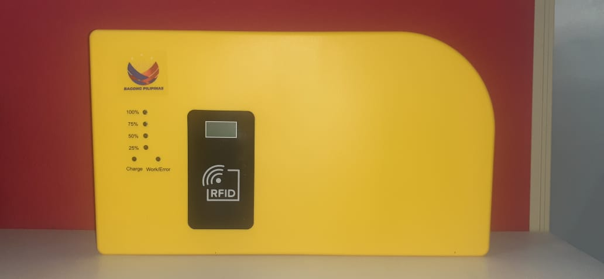
Solar Home System

Slide 7
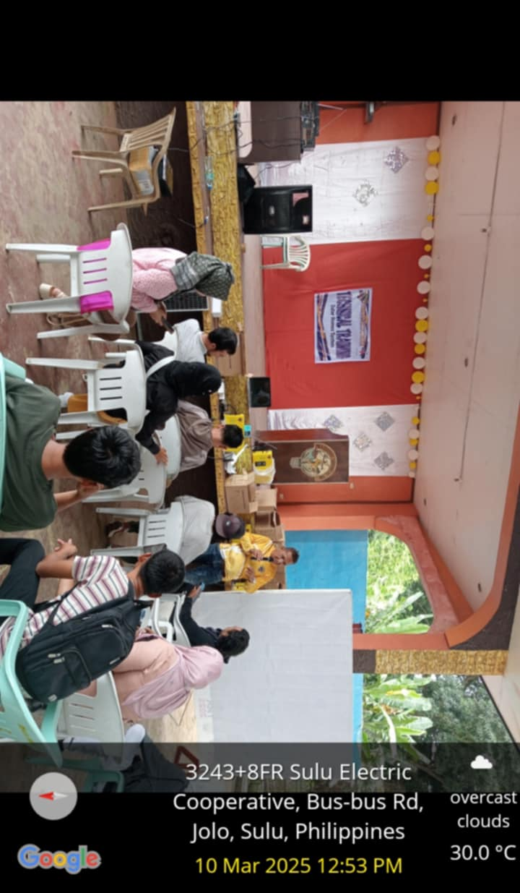
SULECO ADMIN REMARKS BEFORE I START INDIVIDUAL TRAINING OF POS SHS FOR SBU VENDORS

Slide 8
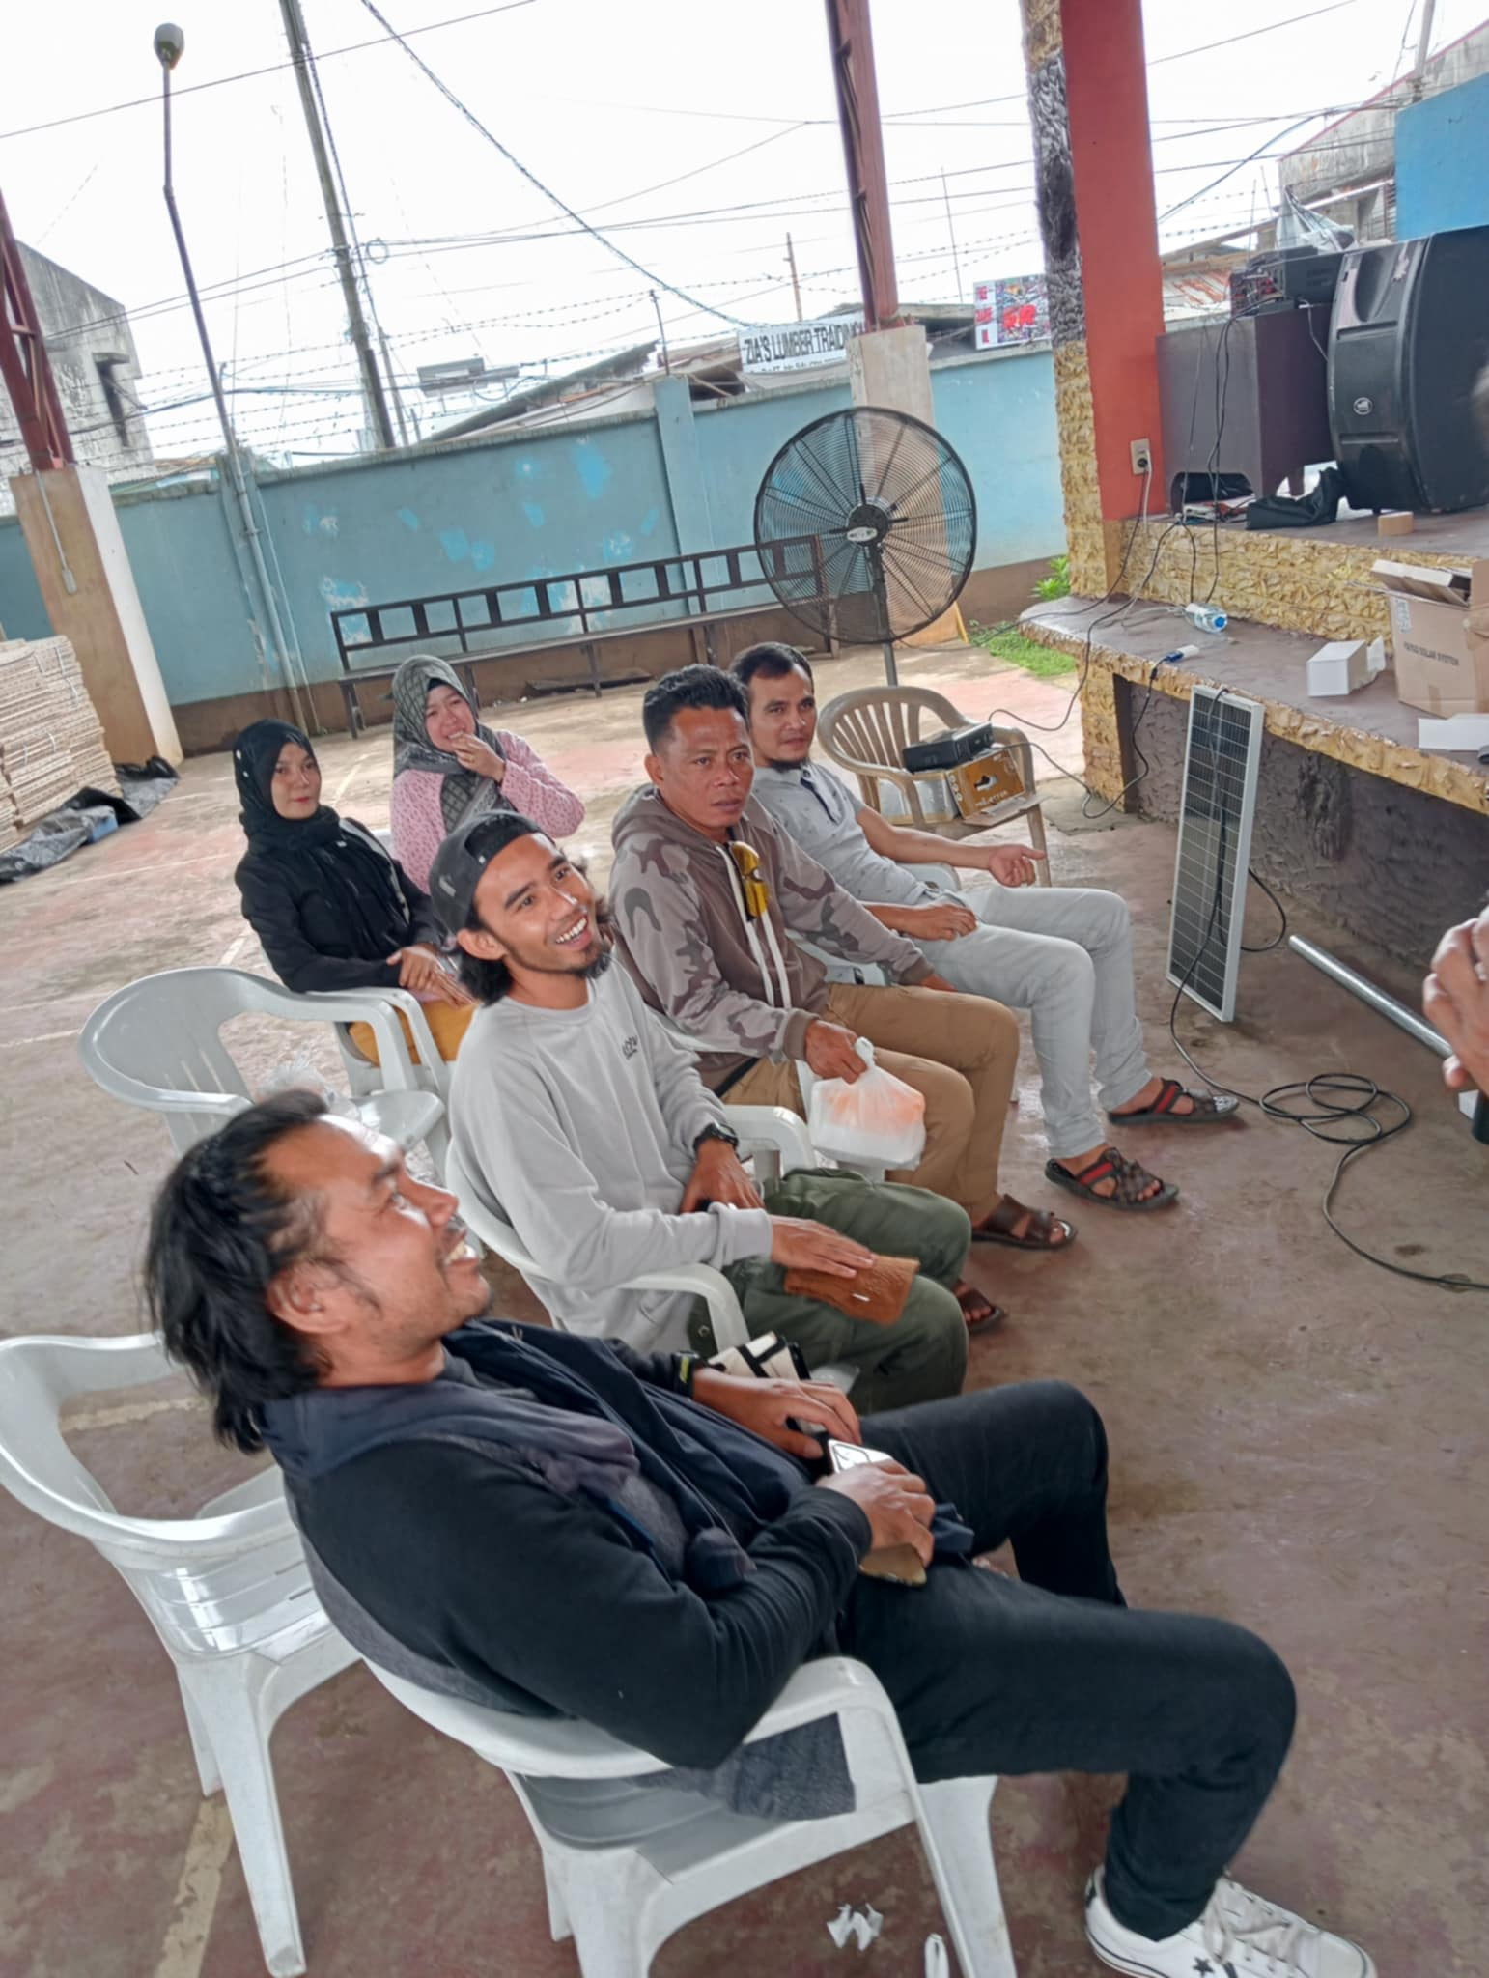
INTRODUCTION OF SOLAR HOMES SYSTEM INTO COMMUNITY BASED SOLAR BUSSINES UNITS
THIS IS THE INITIAL TRAINING DONE ON POS FOR SBU VENDORS OF SULECO

Slide 9
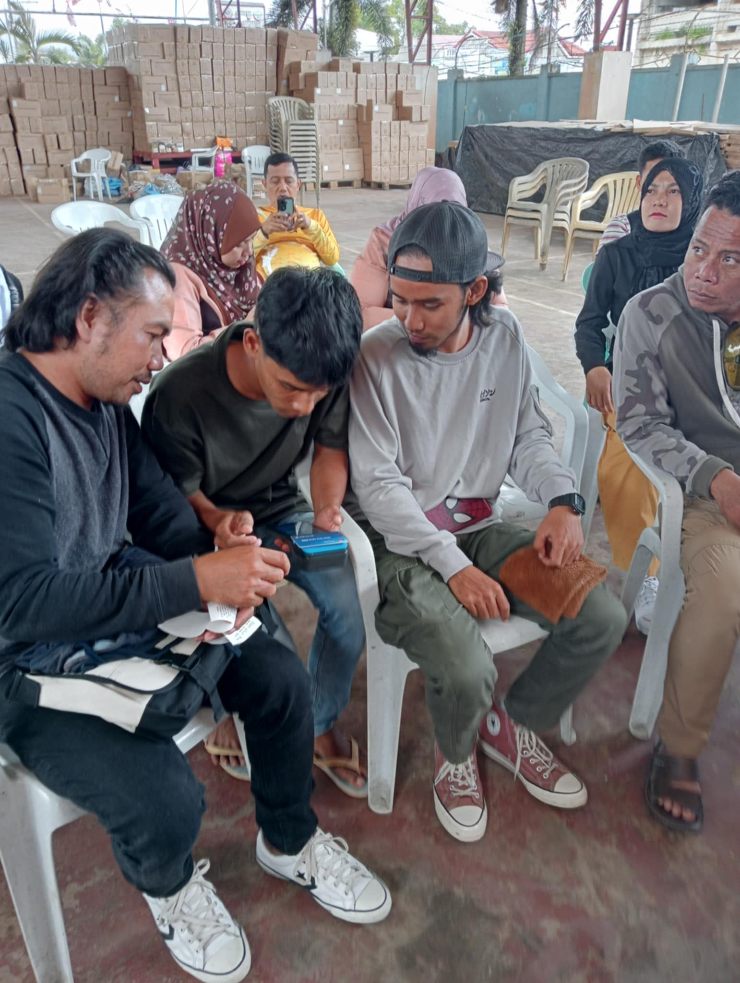
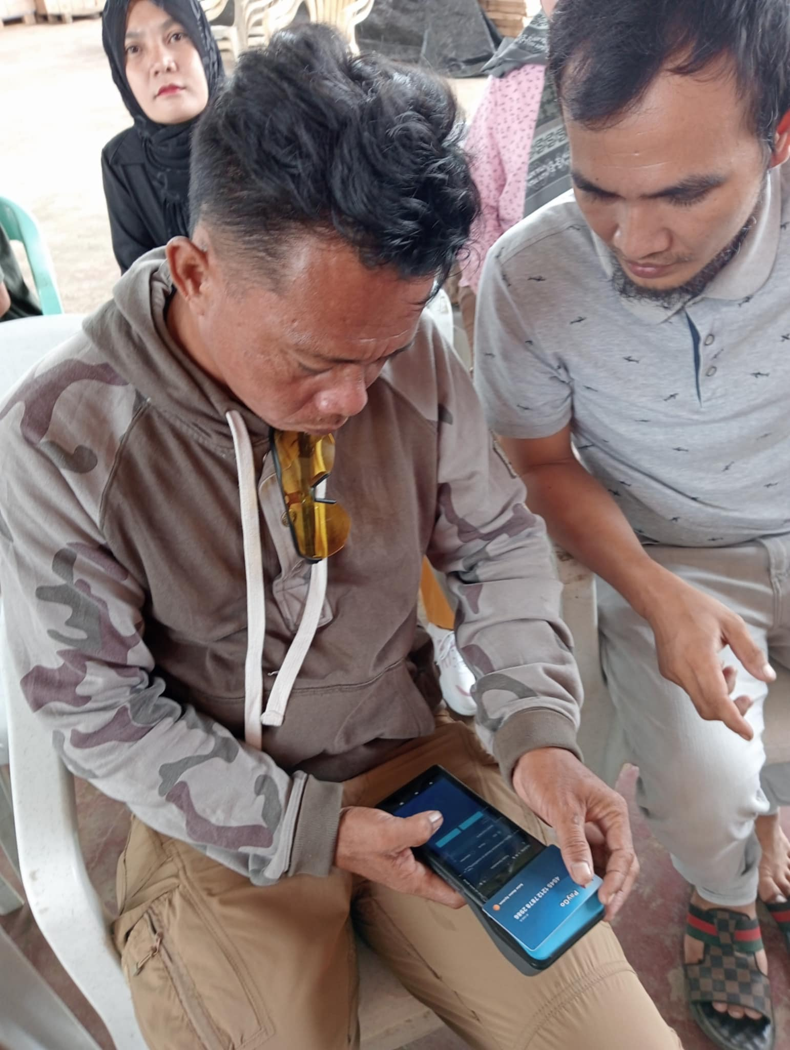
ALL PARTICIPANTS ARE ORIENT WITH POS CAPABILITY AND ADVANTAGES AND ITS ROLE ON SHS LOADING SYSTEM

Slide 10
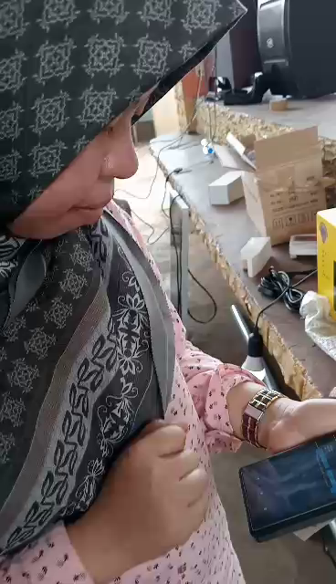
ACTUAL VIDEO HANDS ON TRAINING ON SBU VENDORS FROM BATCH 1

Slide 11
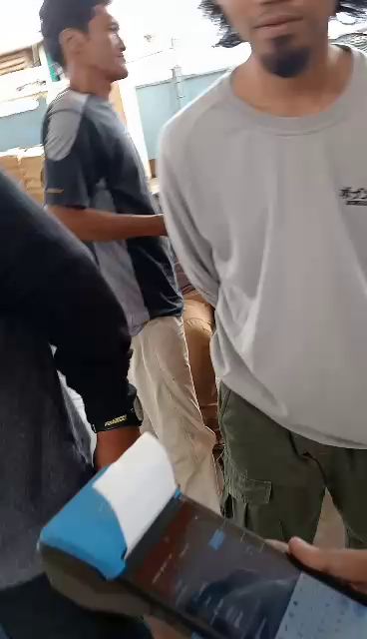
ACTUAL VIDEO OF TECH TRAINING USING POS DEVICE

Slide 12
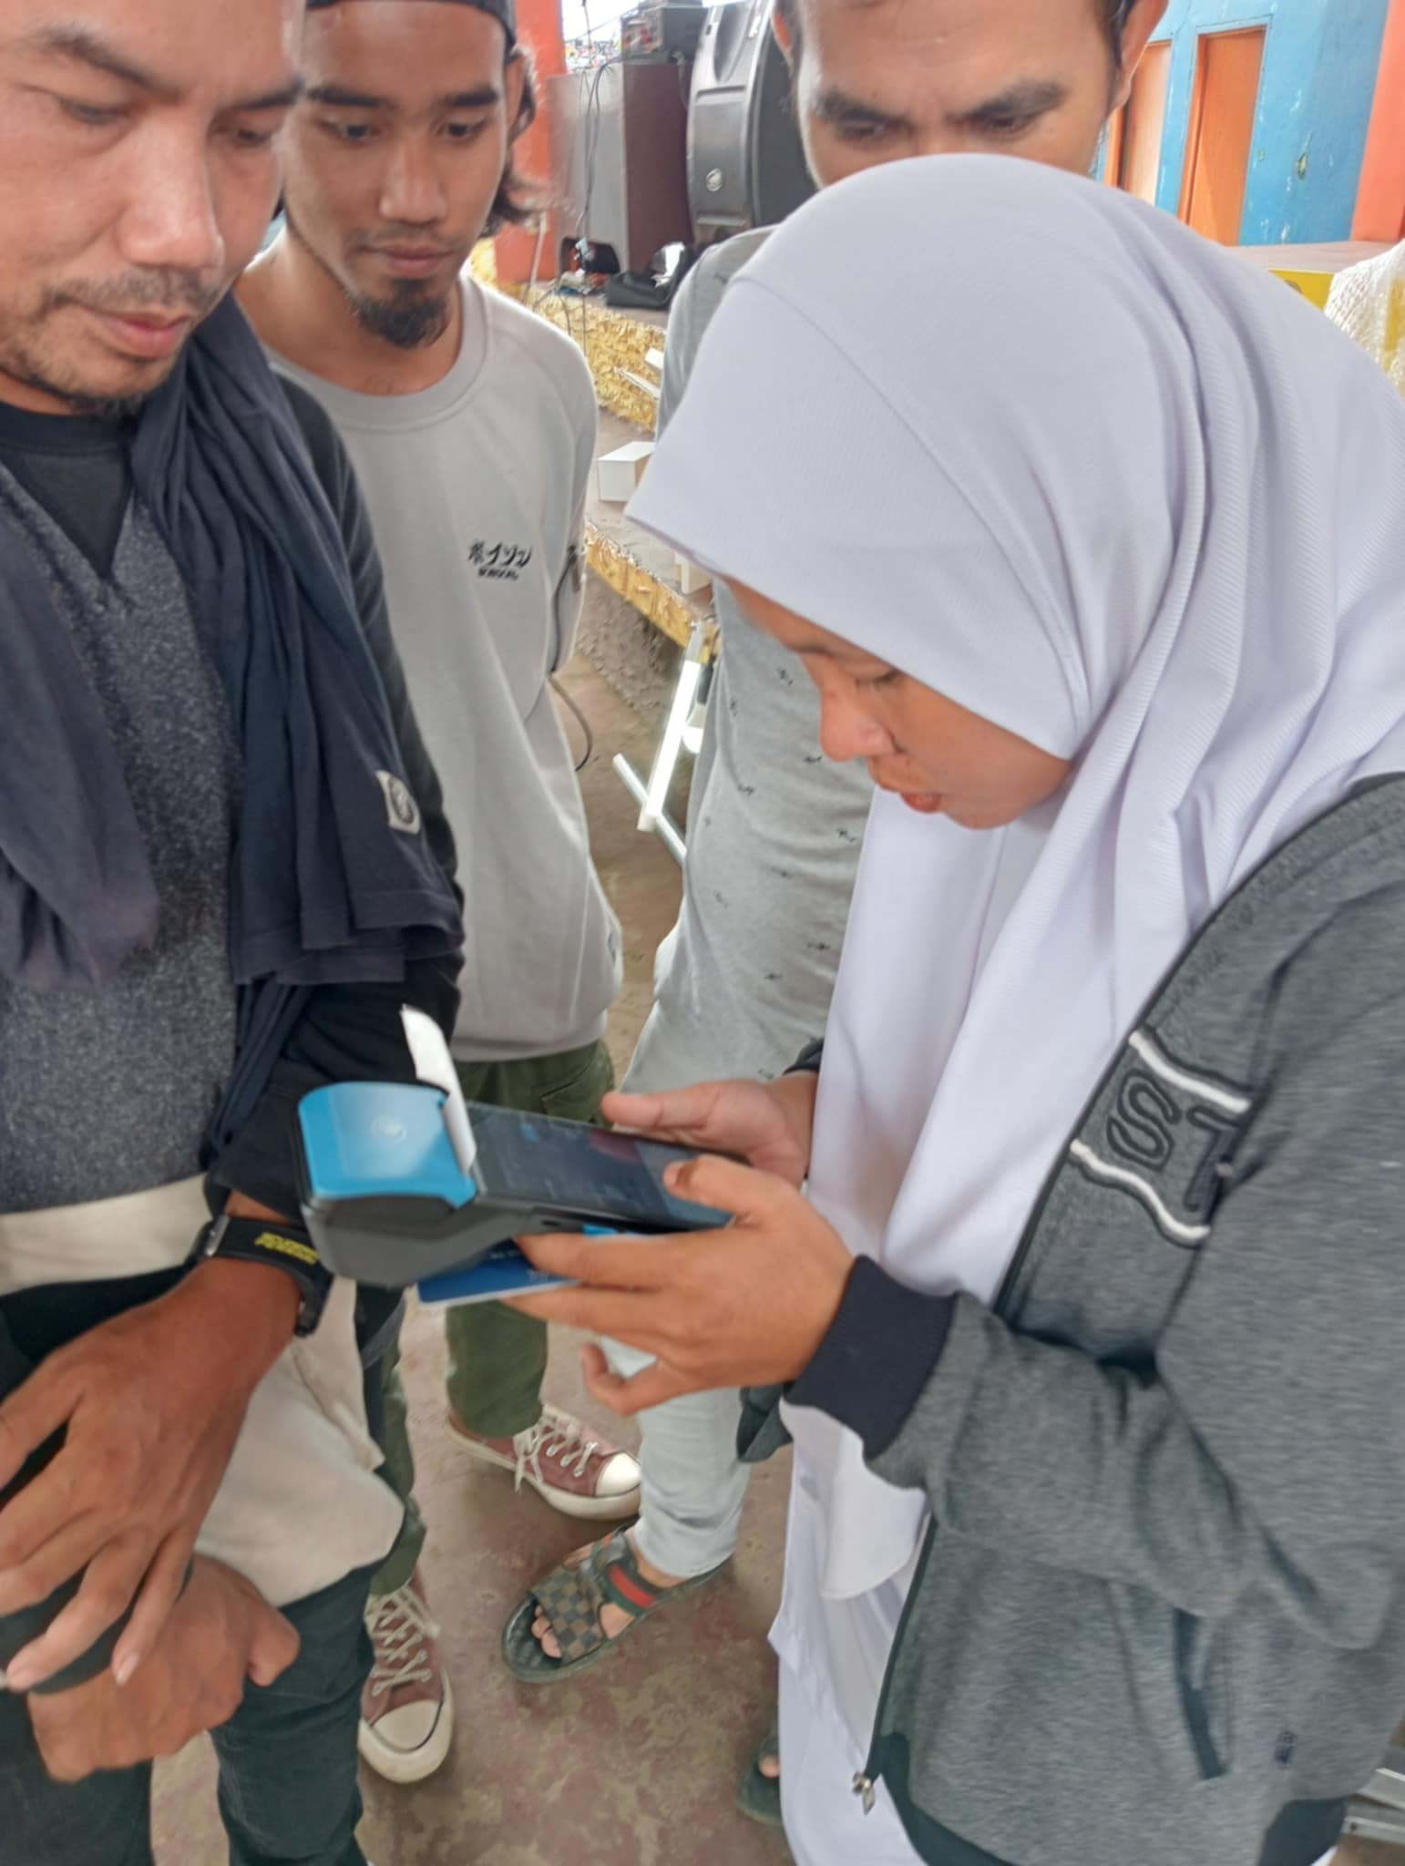
INDIVIDUAL TRAINING OF SBU VENDORS USING POS
REGISTERING BENEFICIARIES AND LOADING OF TOKEN TO SHS MODULE ARE OBJECTIVE ON TECHNICAL TRAINING

Slide 13
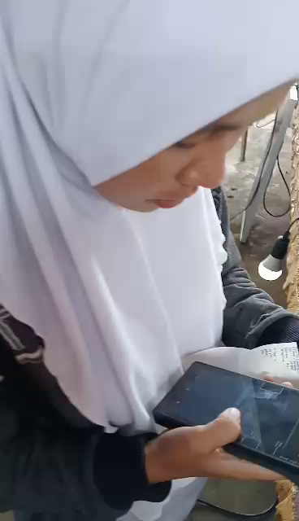
ACTUAL VIDEO HANDS ON TRAINING ON LOADING TOKEN TO SHS MODULE USING POS DEVICE
ALL SBU VENDORS ARE DONE TECHNICAL TRAINING ON POS FROM BATCH 1

Slide 14
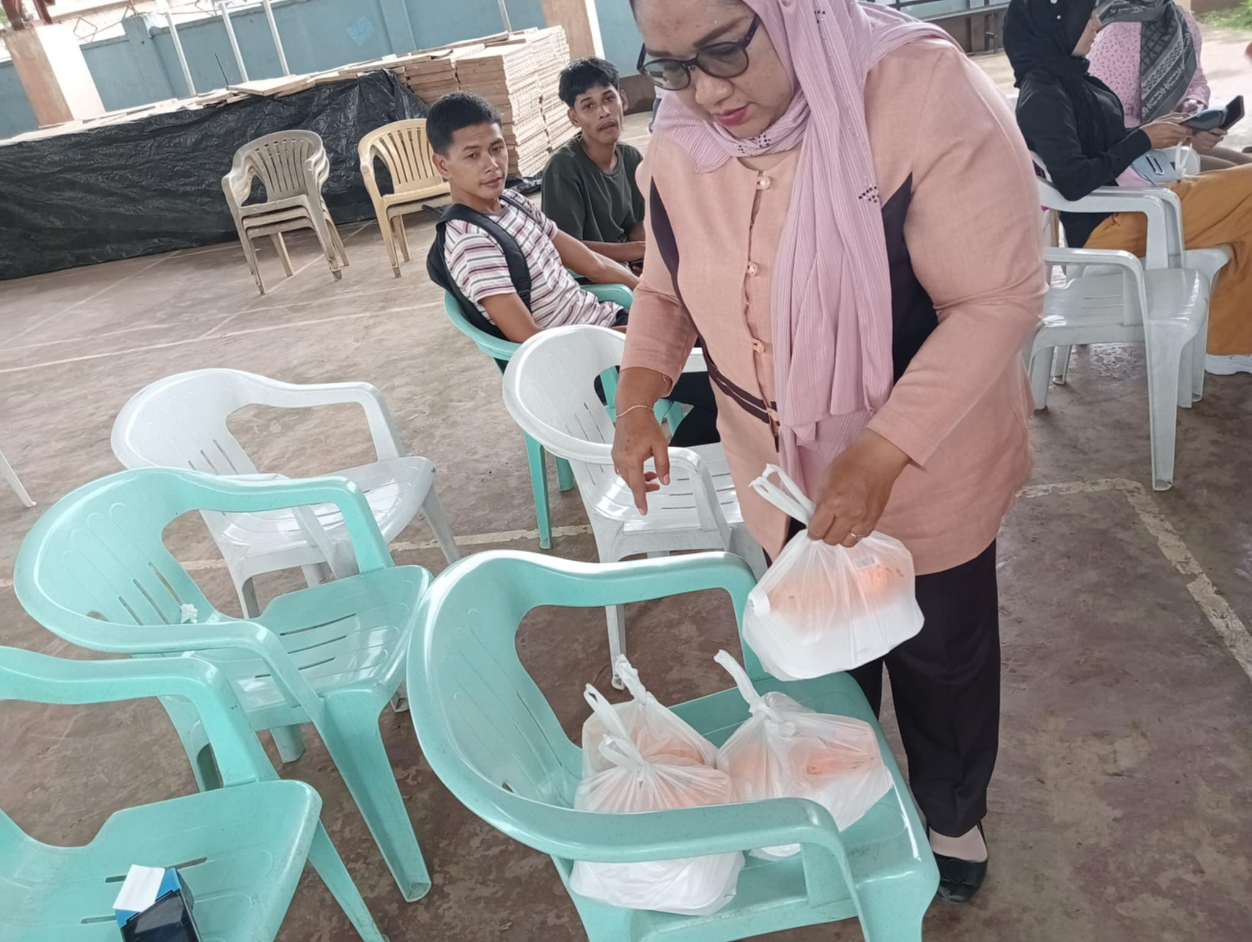
FOOD DISTRIBUTION ON EACH TECHNICAL TRAINING PARTICIPANTS
SINCE ITS RAMADAN THE FOOD ARE PACK FOR TAKE OUT

Slide 15
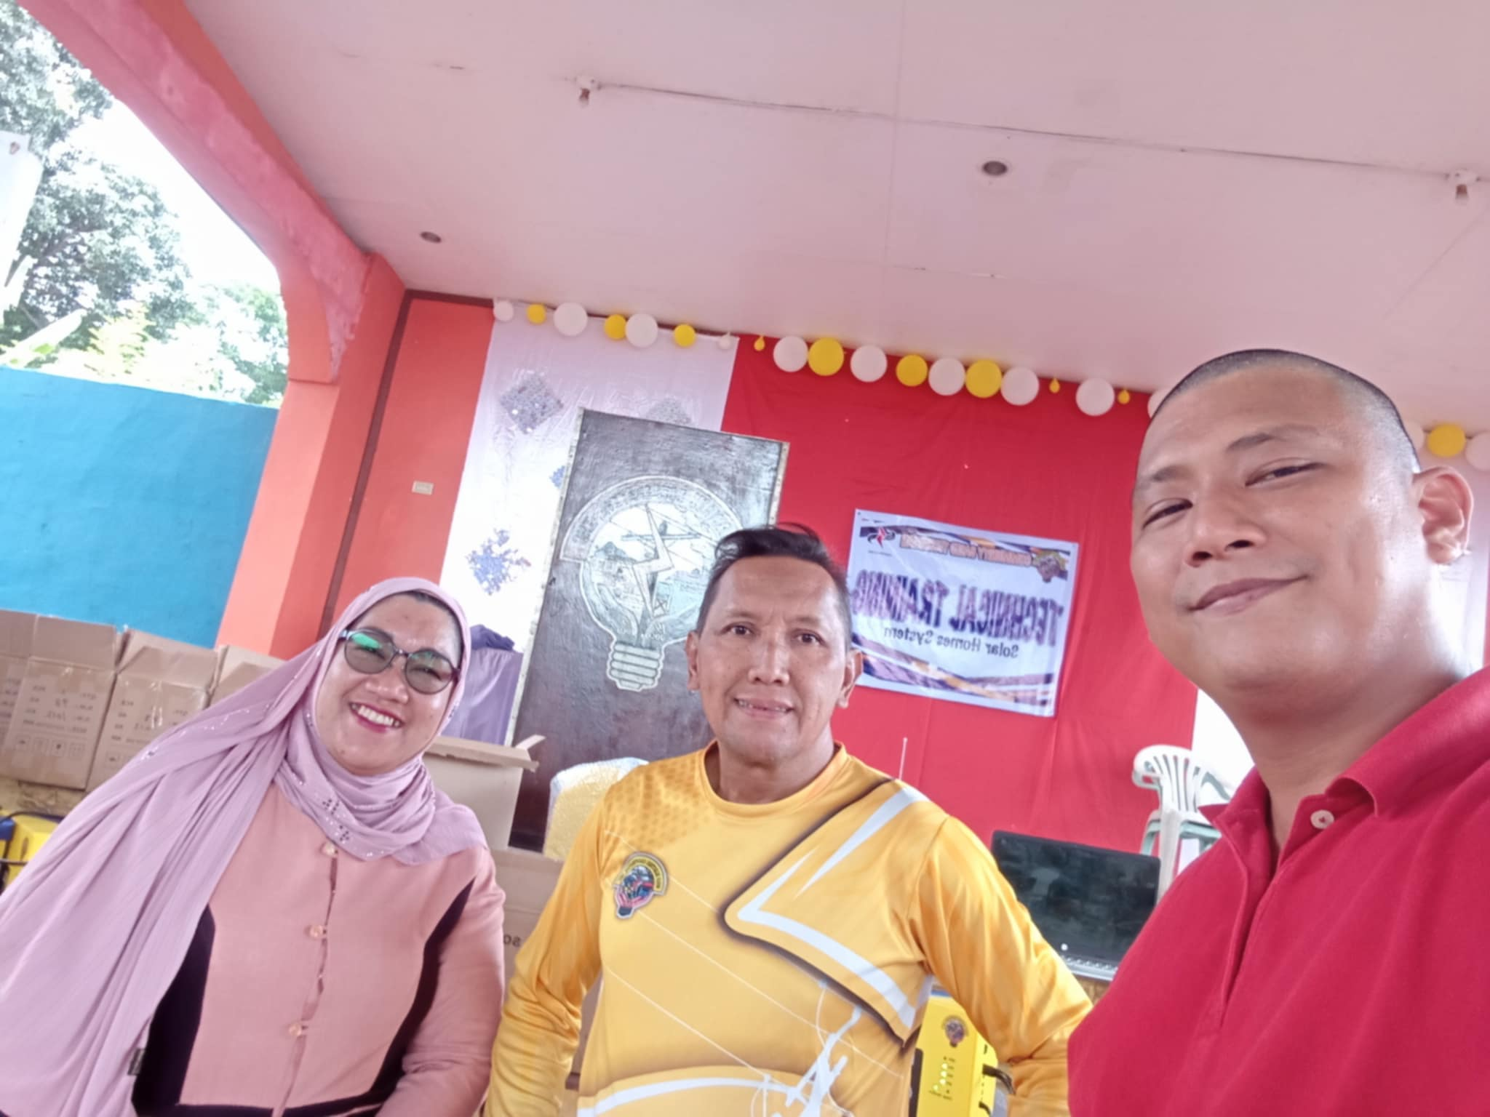
SUCCESSFULL TECHNICAL TRAINING ON POS FROM SULECO BATCH 1 SBU VENDORS AND TECHNICALS

