Slide 1

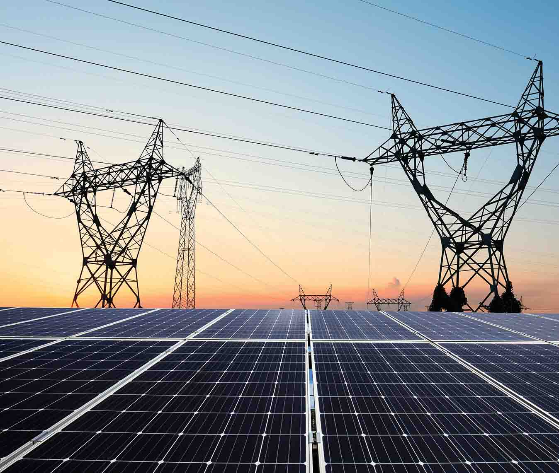

WELCOME
SULU ELECTRIC COOPERATIVE
TCHNICALS & VENDORS
SOLAR HOME SYSTEM
(POINT OF SALE) POS TRAINING
MARCH 15 2025
Prepared By:
Engr Joseph Obusan
IEE A.M.O.

Slide 2
TRAINING OF SOLAR HOMES SYSTEM
SOLAR HOMES SYSTEM
8000am 10 am Basic on Solar Energy & others
1000AM - 4 PM POS INTRODUCTION
AND
INDIVIDUAL HANDS ON TRAINING

Slide 3
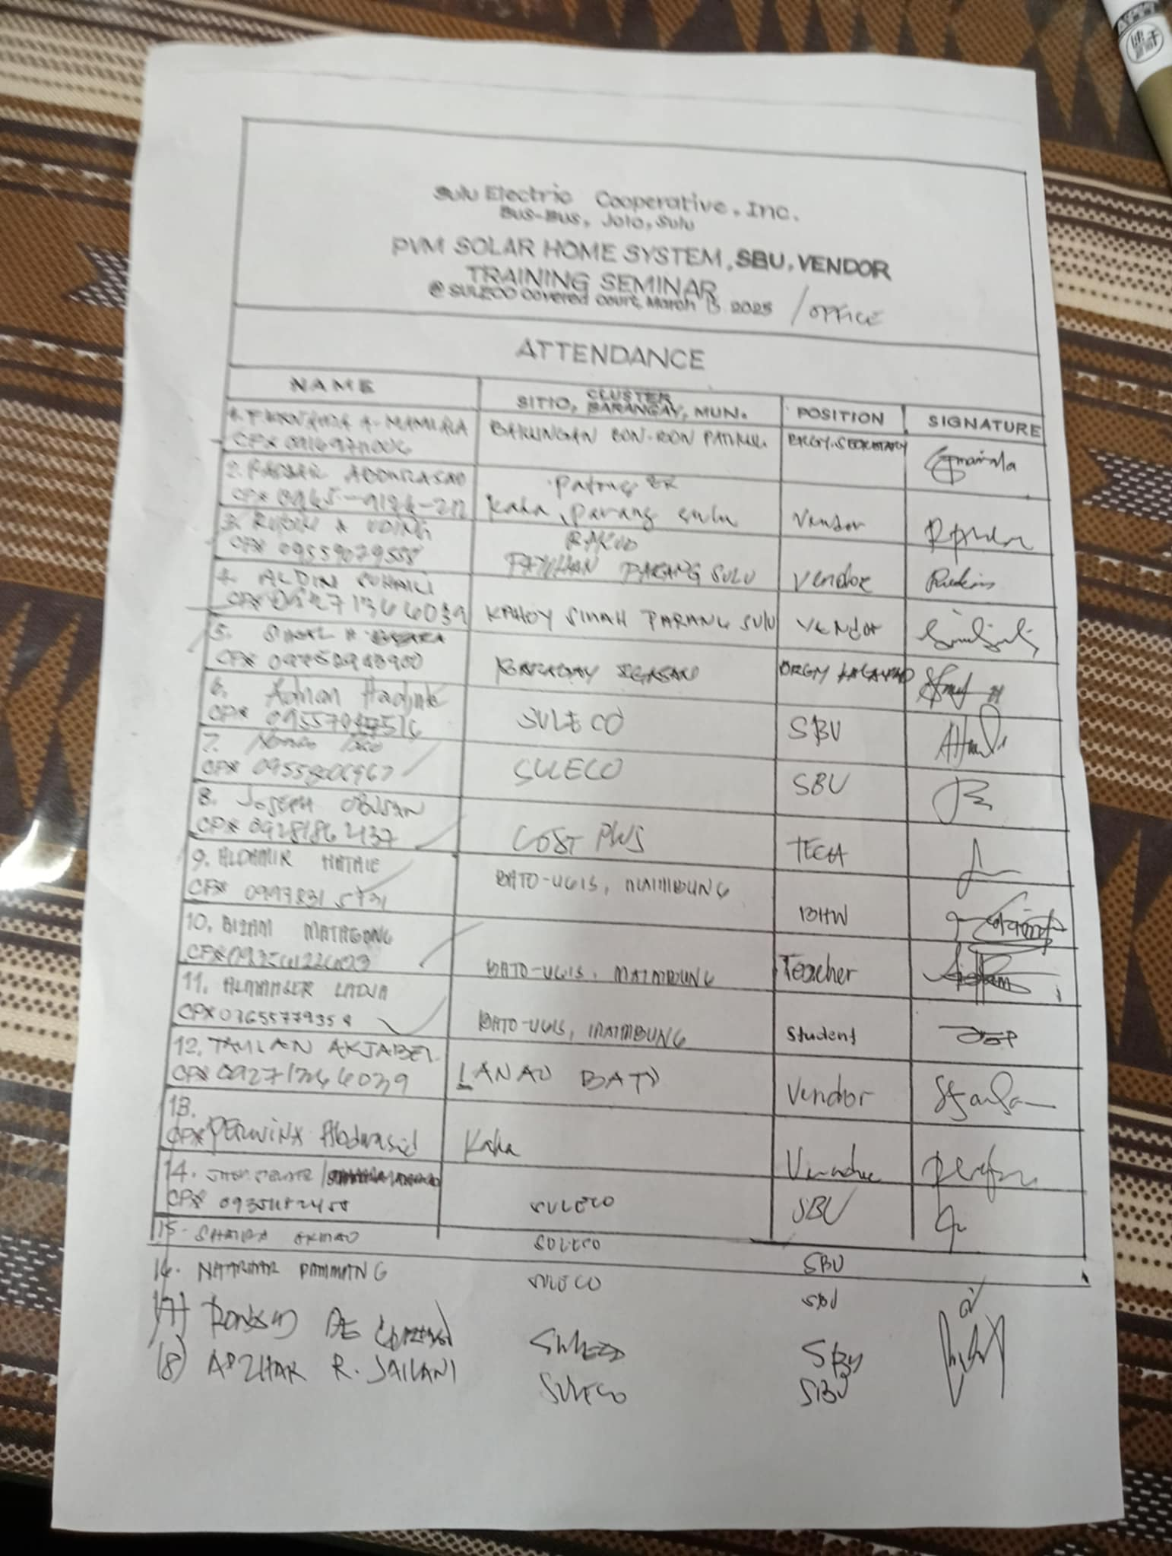
INITIAL PARTICIPANTS ARE 18 OTHER COMES LATER DUE TO DIFFERENT ASSIGNED WORKLOAD AND FROM DIFFERENT DEPARTMENTS

Slide 4
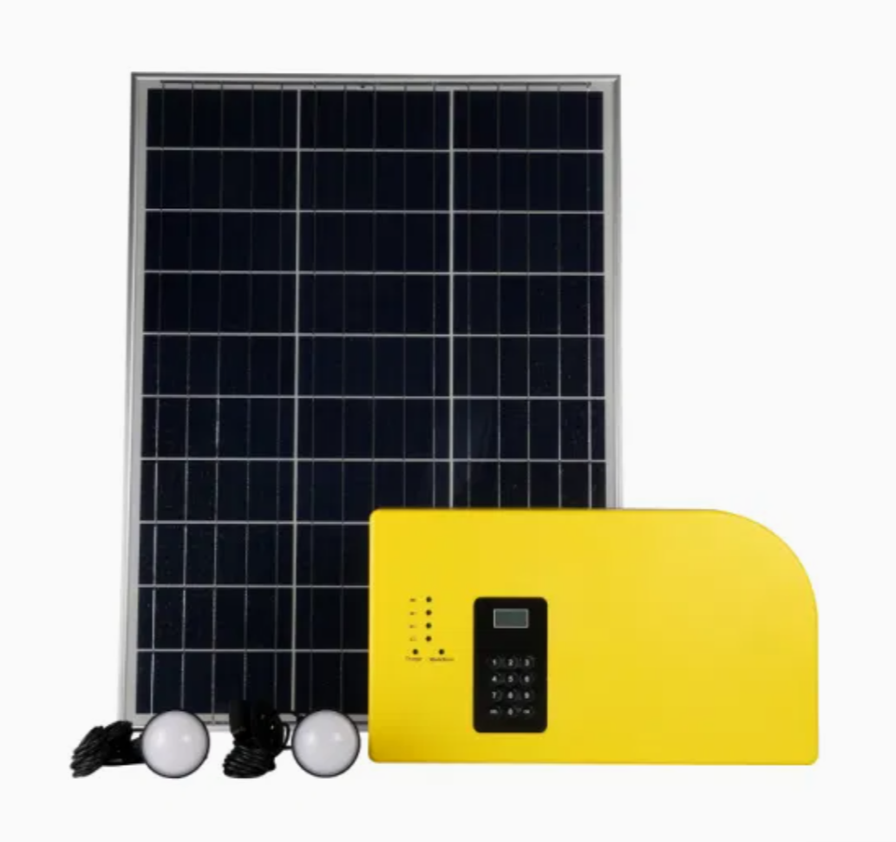
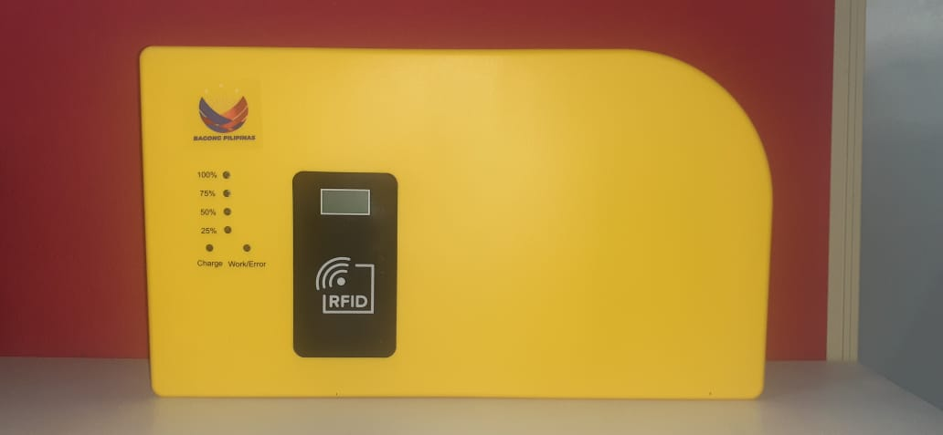
Solar Home System

Slide 5
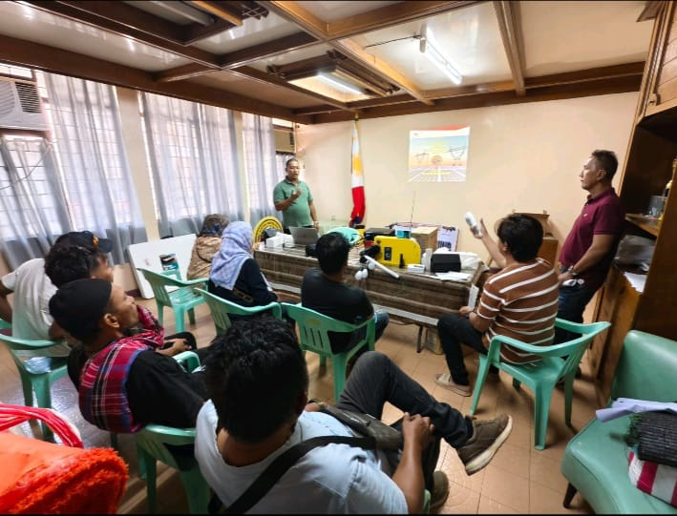
TRAINING START WITH THE INTRODUCTION AND DEMONSTRATION OF HOW SOLAR HOMES SYTEM WORKS
PARTICIPANTS ARE SULECO HEAD TECHNICALS AND VENDORS FROM DIFFERENT BRGYS AND SITIOS

Slide 6
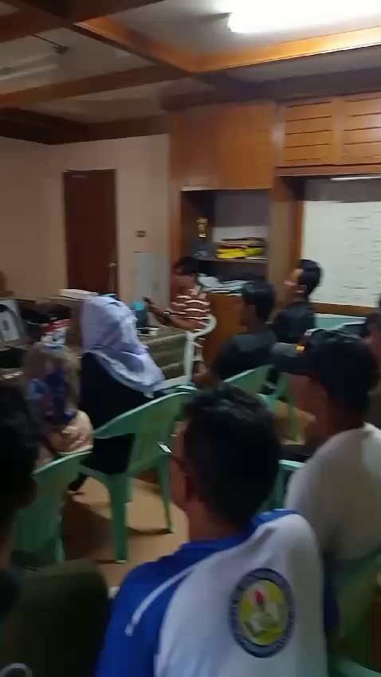

Slide 7
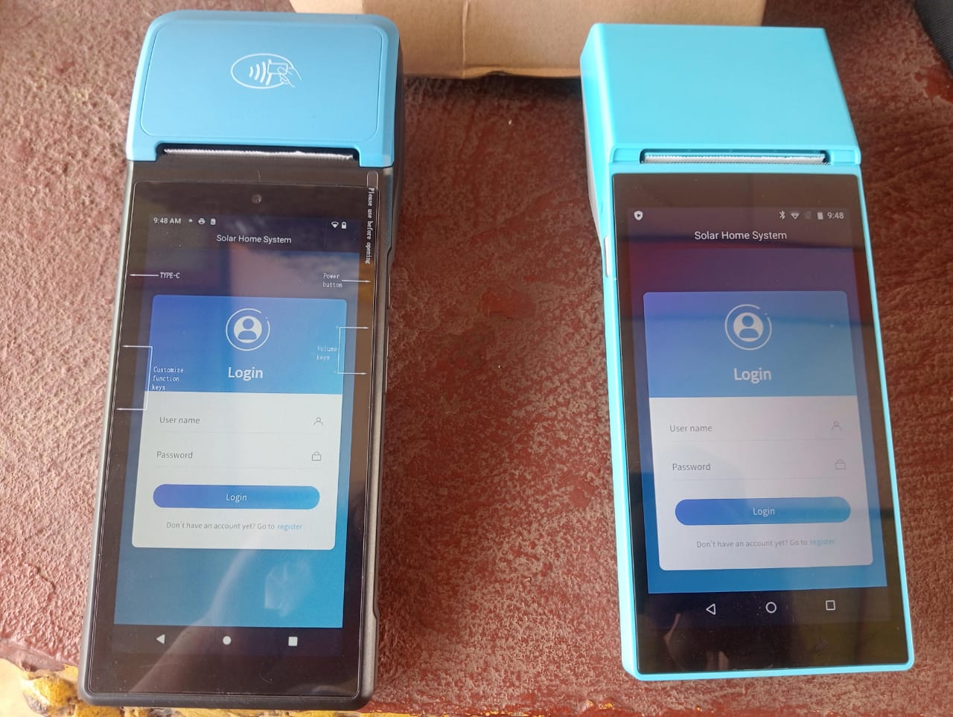
POS MODEL V510
POS MODEL SP02
AFTER A BRIEF DISCUSSION OF SOLAR HOMES SYSTEM THE TOPIC STARTS WITH THE INTRODUCTION OF POS ( POINT OF SALES) AND WHAT IS THE ROLE OF POS TO SOLAR HOMES SYSTEM AND ALSO DISCUSSION OF ITS ADVANTAGES TO THE LOADING SYSTEM OF SOLAR HOMES SOFTWARE PAYGO

Slide 8
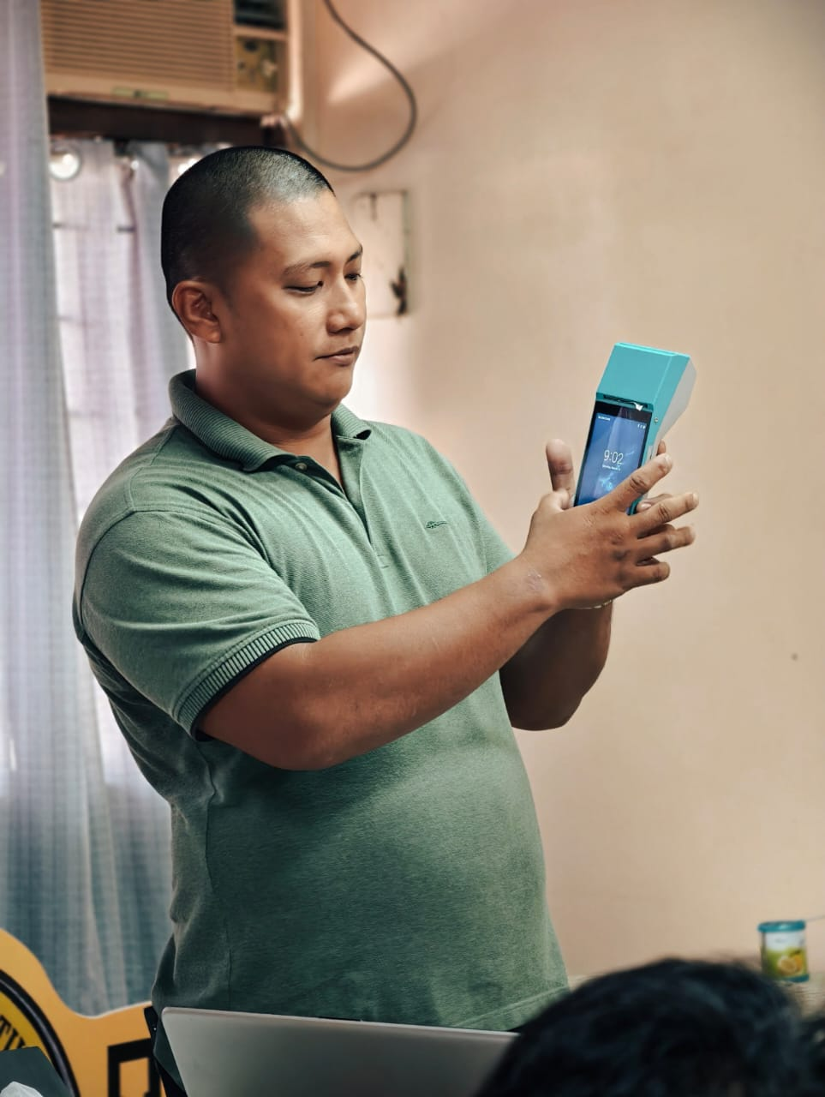
ACTUAL DEMONSTRATION OF POS
ITS CAPACITY:
-SPECIFICATIONS
-OPERATING SYSTEM
-ADVANTAGES
-BATTERY CAPACITY 5000MAH
-NFC CAPABILITY
-ADD & REGISTER BENEFECIARIES
-PRINTING RECEIPTS
-PROVIDE ACCURATE DATA
-ONLINE OFFLINE LOADING SYSTEM
-LOADING TOKEN AND GENERATING RESET TOKEN
-MODIFY CARD / REPLACEMENT OF CARD

Slide 9
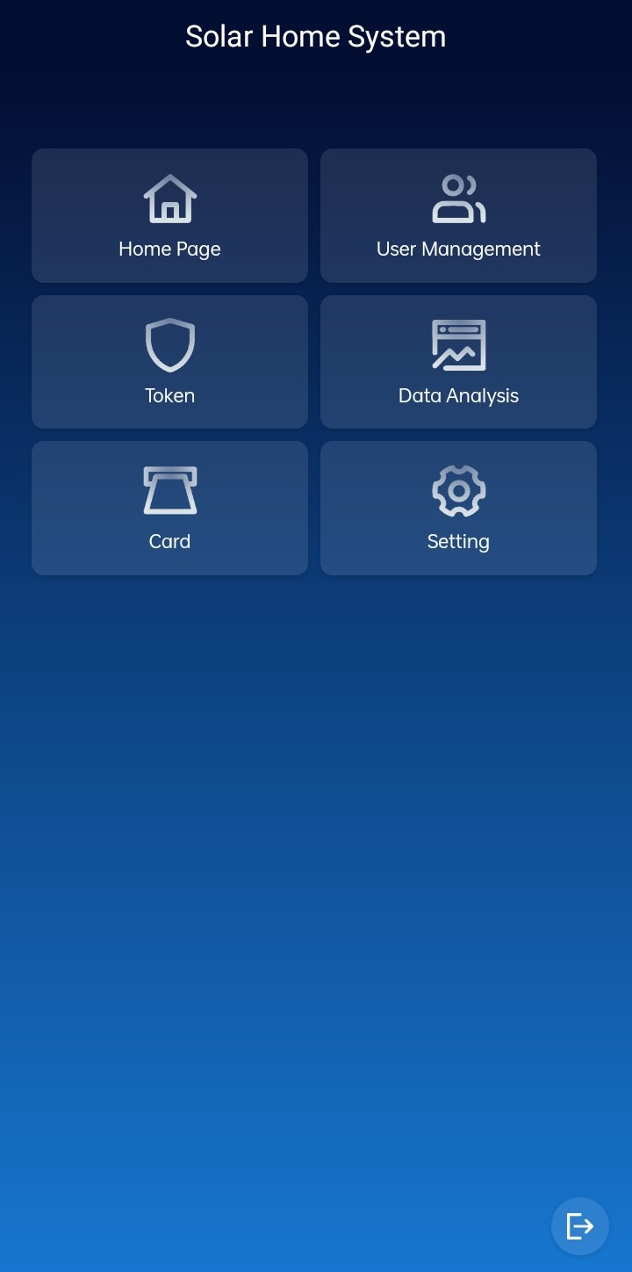
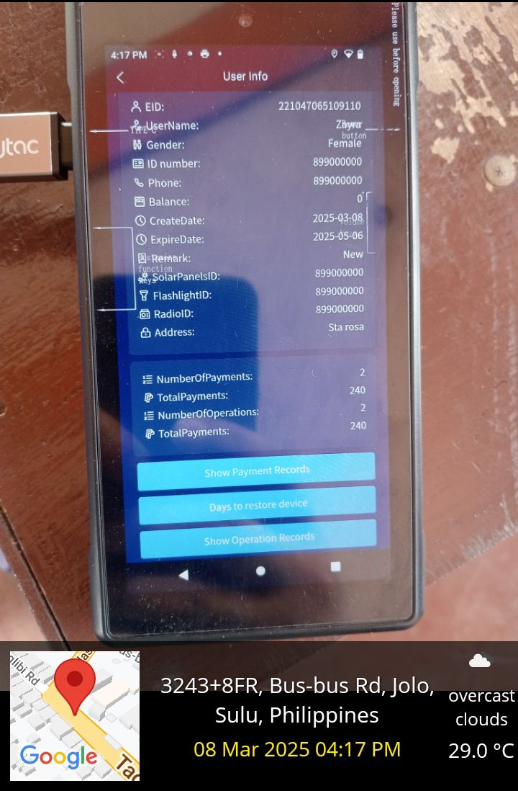
DEMONSTRATION OF POS INTERFACE AND ITS CAPABILITY TO PROVIDE ACCURATE DATA WITH BENEFECIARIES REGISTERED ON POS

Slide 10
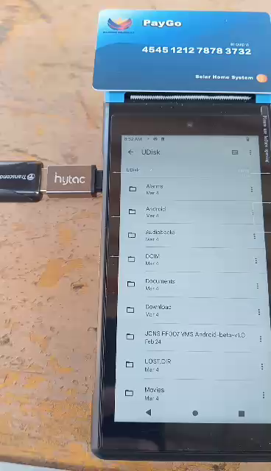
SHOW PARTICIPANTS BOTH MODEL OF POS PROVIDE AND PRINT RECEIPTS
WHICH BENEFITS BOTH BENEFECIARIES AND SBU VENDORS AND ALSO TECHNICAL ADMINS FOR DATA REFERENCE

Slide 11
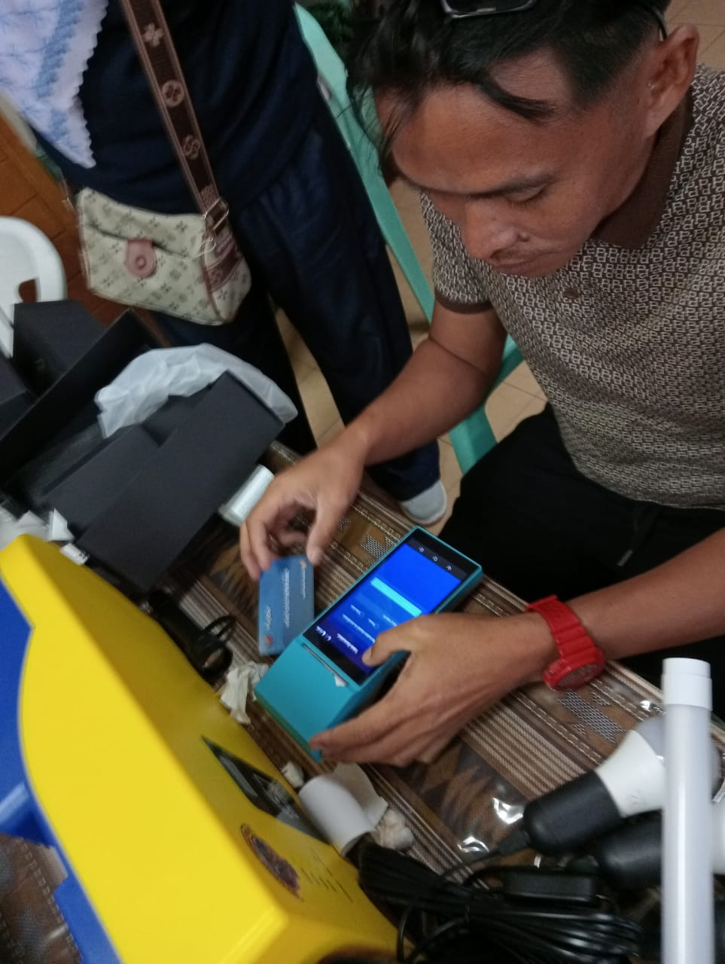
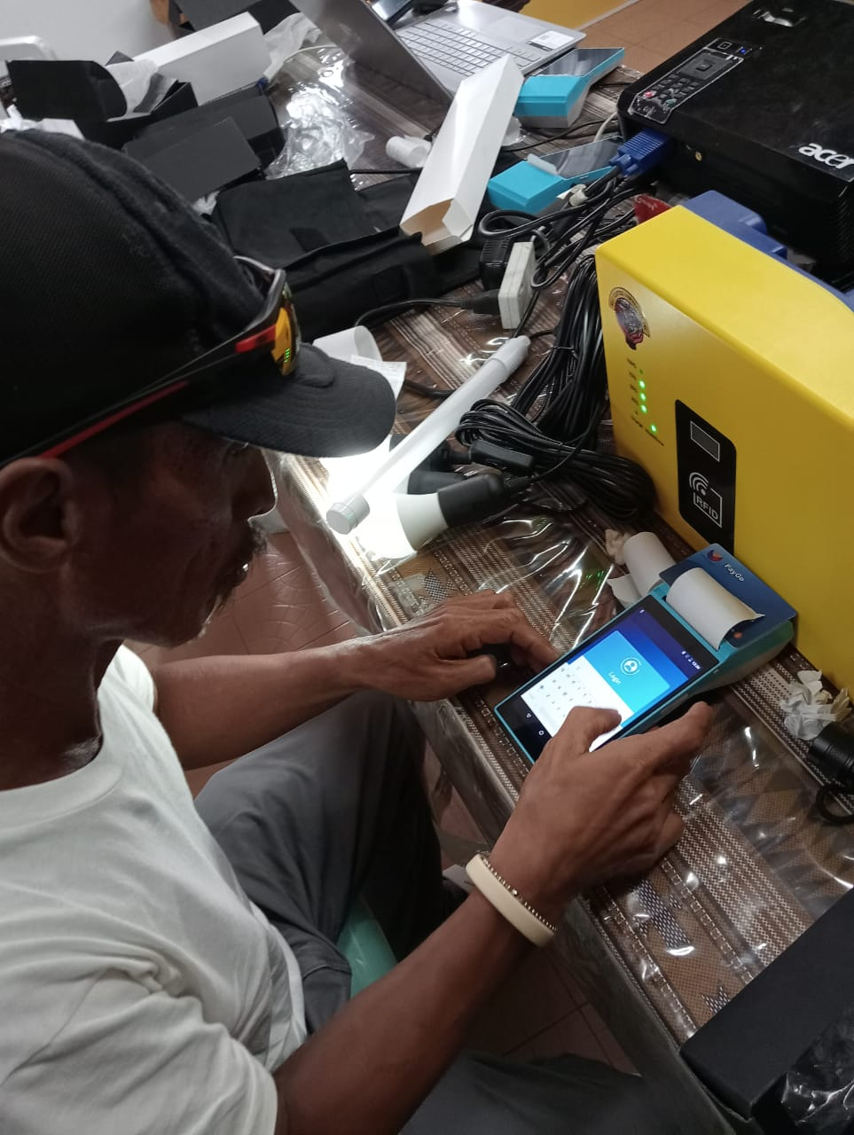
INDIVIDUAL TRAINING FOR SBU VENDORS ON HOW TO ADD AND REGISTER BENEFECIARIES ON POS OFFLINE AND ONLINE MODE SYSTEM

Slide 12
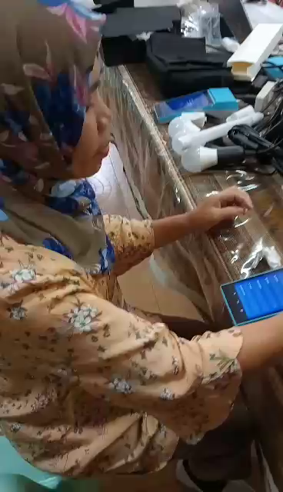
ACTUAL HANDS ON TRAINING OF POS INTERFACE AND ITS CAPABILITY TO PROVIDE ACCURATE DATA WITH BENEFECIARIES REGISTERED ON POS

Slide 13
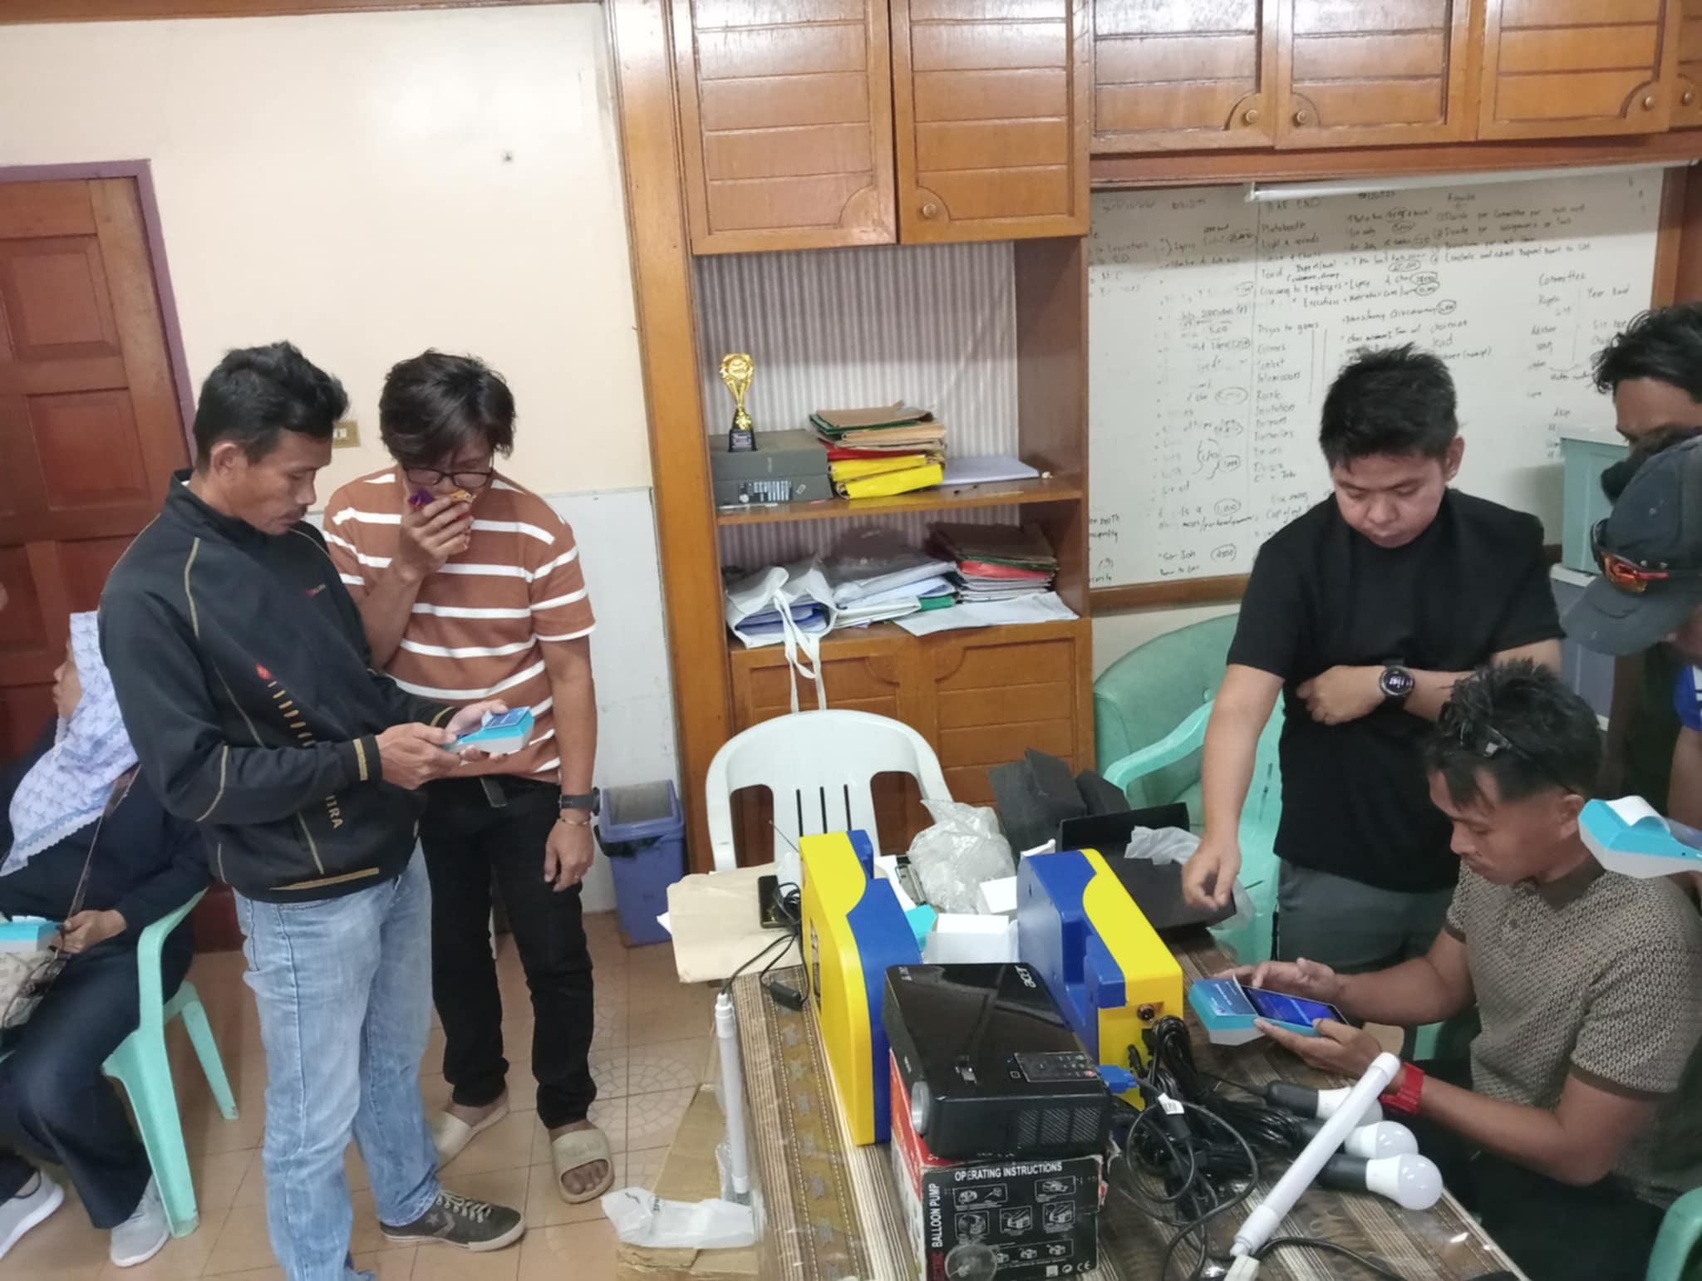
TEAM 1
TEAM 2
TECHNICAL TRAINING DIVIDED INTO TWO TEAMS WITH TECHNICALS HEAD SO THAT ALL PARTICIPANTS SBU VENDORS ARE WELL TRAINED ON POINT OF SALE DEVICE

Slide 14
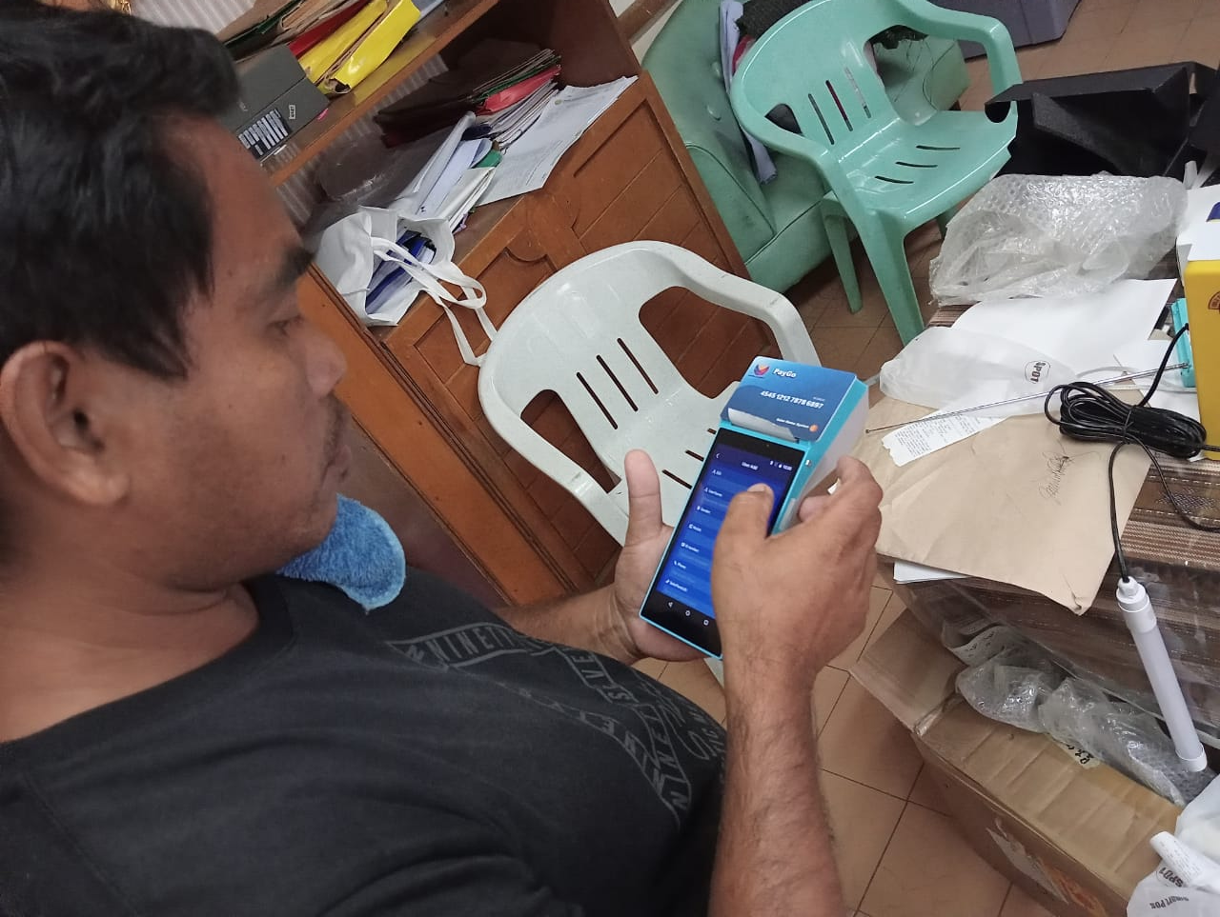
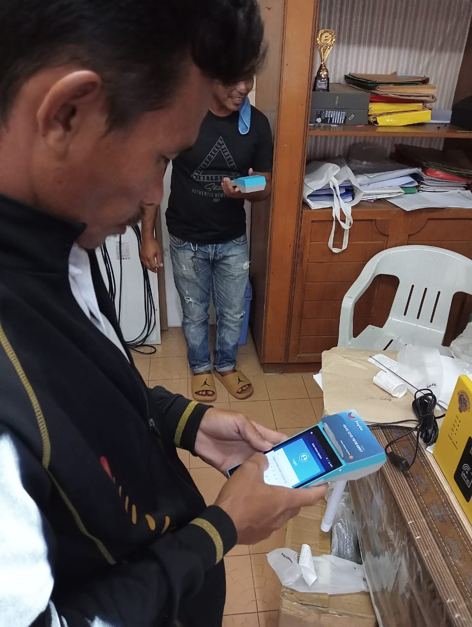
ACTUAL HANDS ON TRAINING OF GENERATING OF TOKEN FOR LOADING OF SHS , EACH PARTICIPANTS FROM SBU VENDORS DO ADD AND REGISTER BENEFICIARIES , AND ALSO LOAD TOKEN FROM OPERATORS ACCOUNT

Slide 15
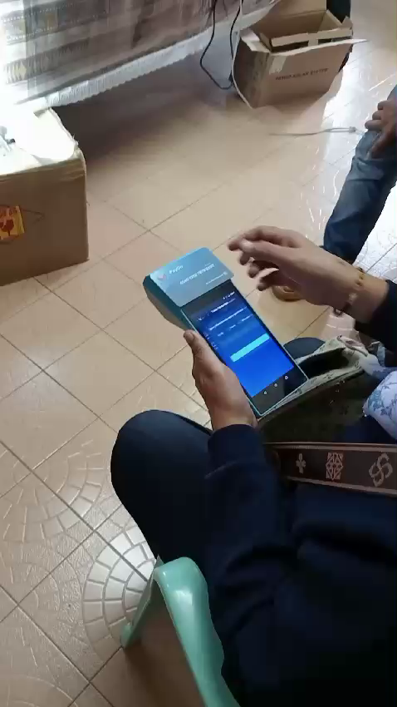
ACTUAL VIDEO TECHNICAL TRAINING FOR SBU VENDORS ON HOW TO GENERATE TOKEN USING POS

Slide 16
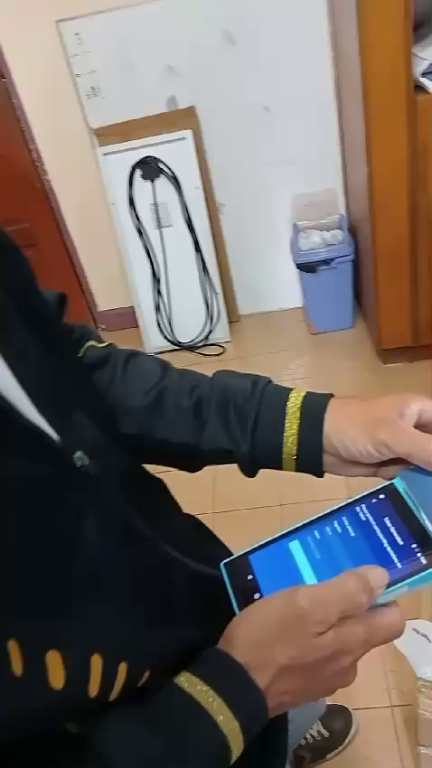
ACTUAL VIDEO HANDS ON TRAINING FOR PARTICIPANTS ON LOADING OF TOKEN TO SOLAR HOMES SYSTEM MODULE , EACH PARTICIPANTS INCLUDING TECHNICALS WELL TRAINED FOR LOADING TOKEN AND TROUBLESHOOT ALSO USING POS DEVICE

Slide 17
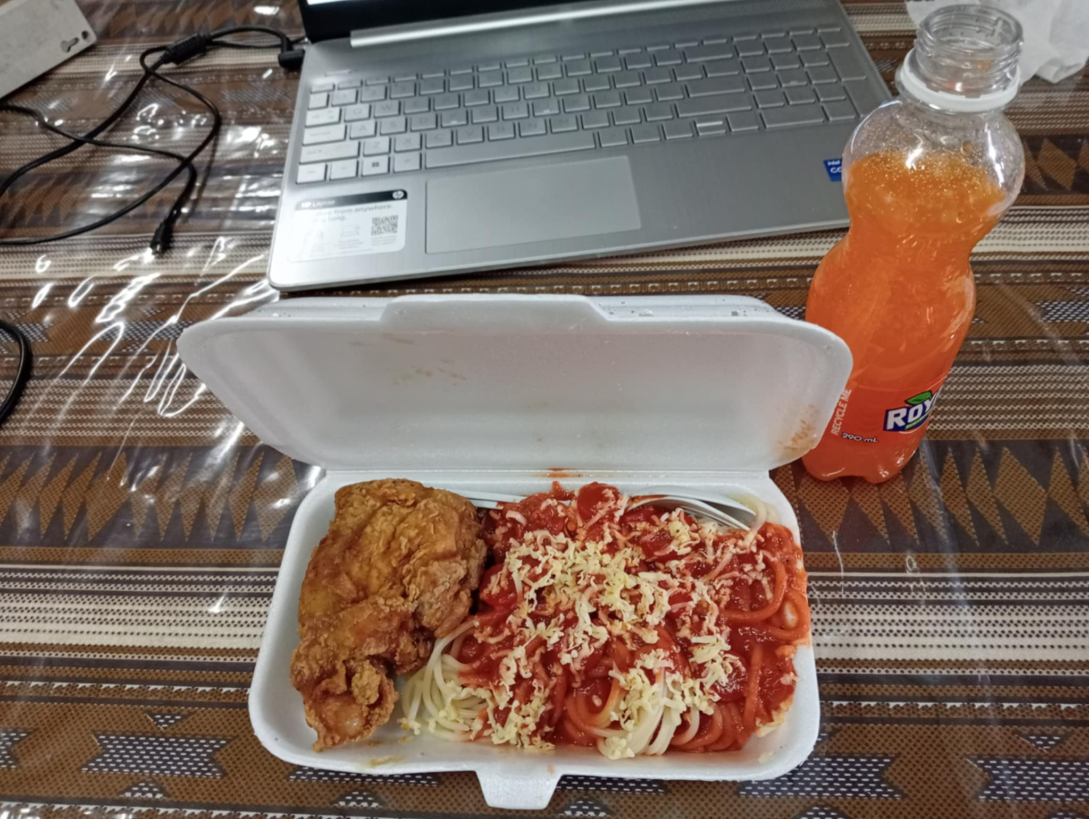
FOODS PROVIDED FOR TECHNICAL TRAINING ARE ON PACK BECAUSE OF CELEBRATION OF RAMADAN MEAL PACKAGE SOFTDRINKS

Slide 18
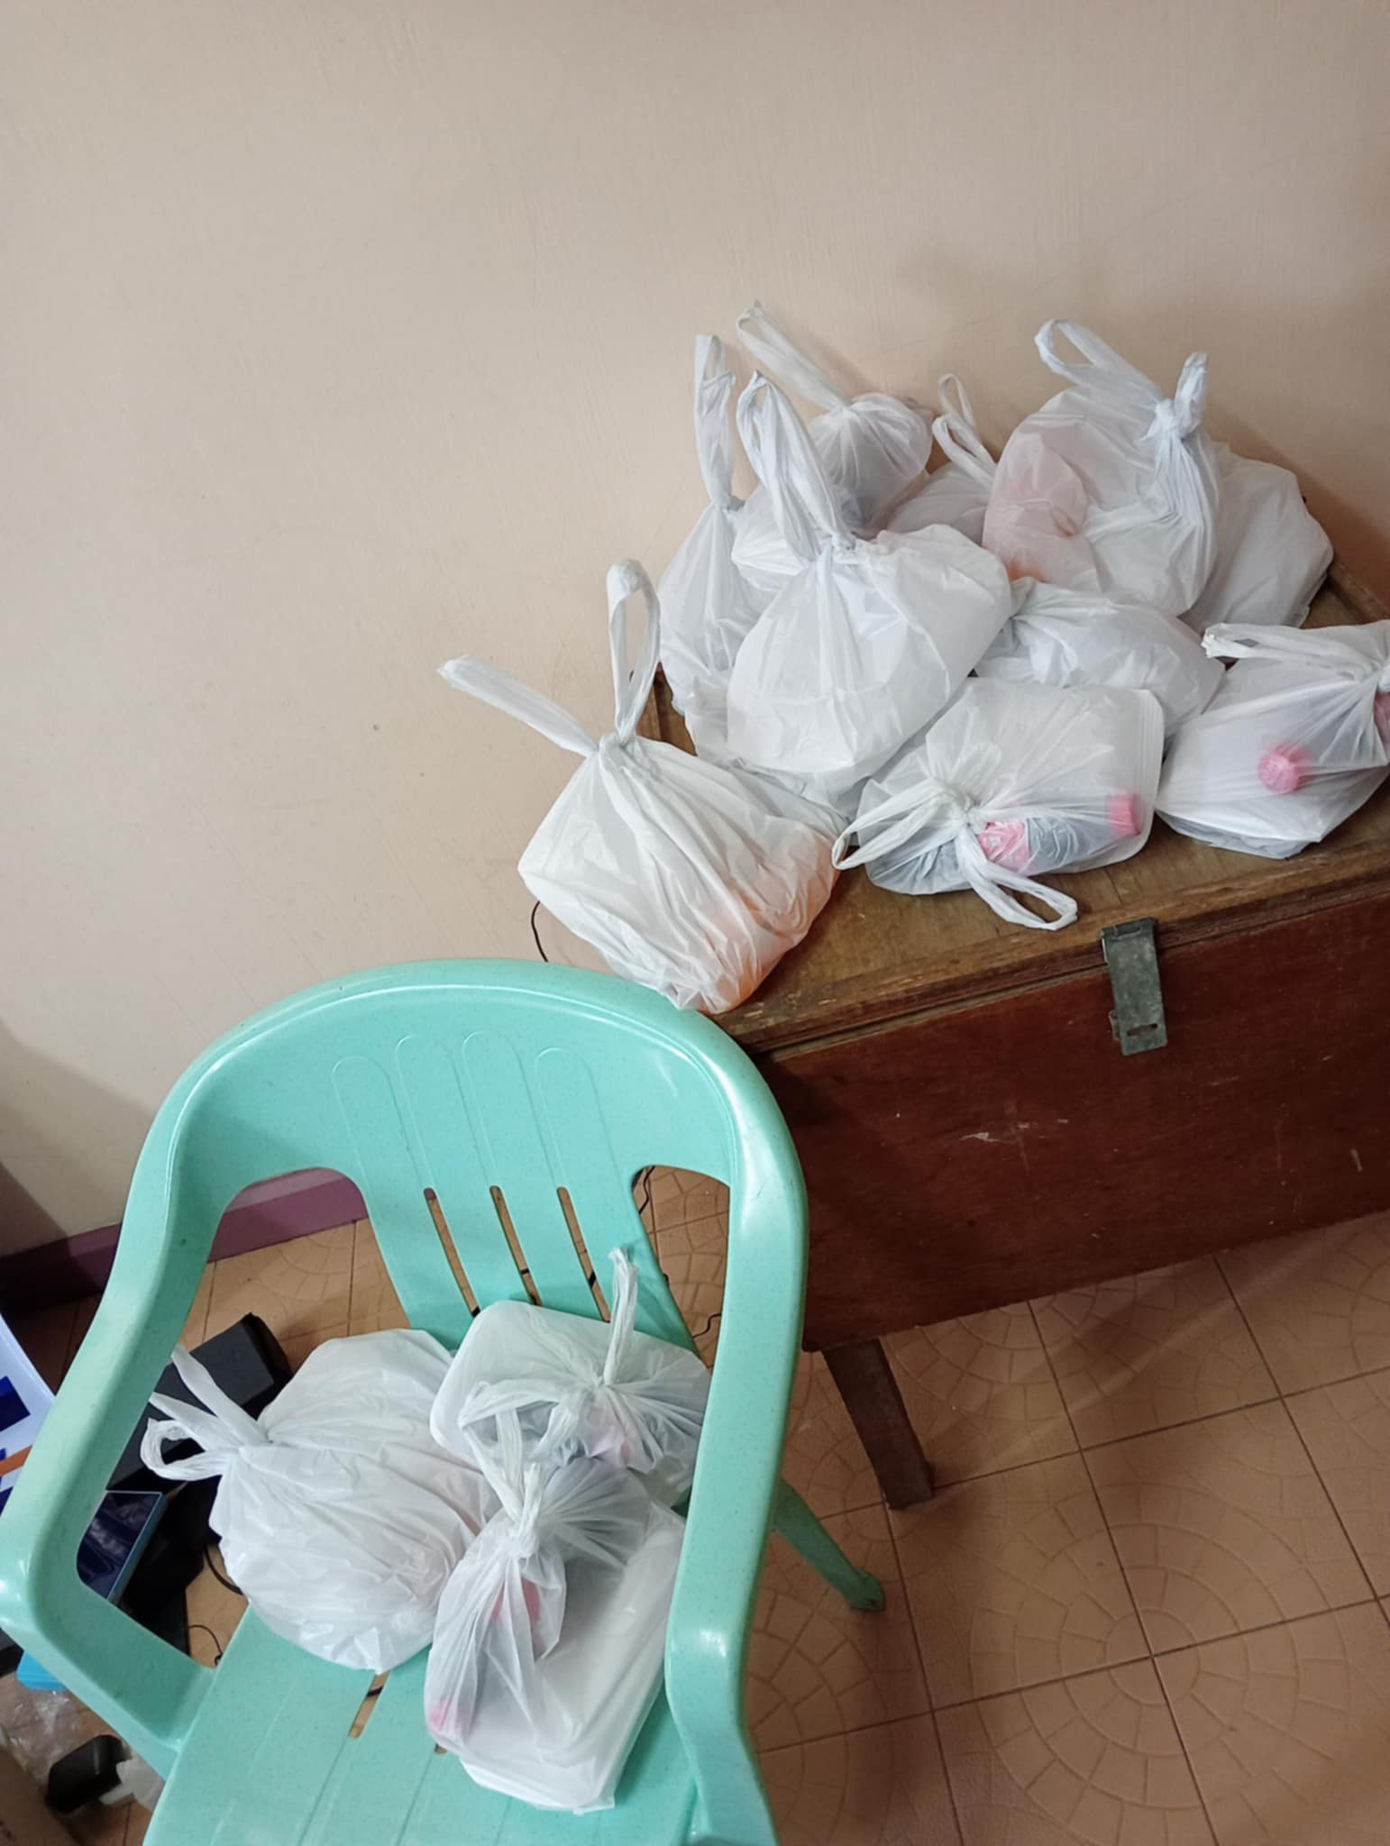
EACH PARTICIPANTS INCLUDING SULECO TECHNICALS AND HEAD
SOLAR BUSINESS UNITS VENDORS RECEIVE A PACK OF MEAL SINCE ITS RAMADAN IT IS ON PACK FOR TAKE OUTS

Slide 19
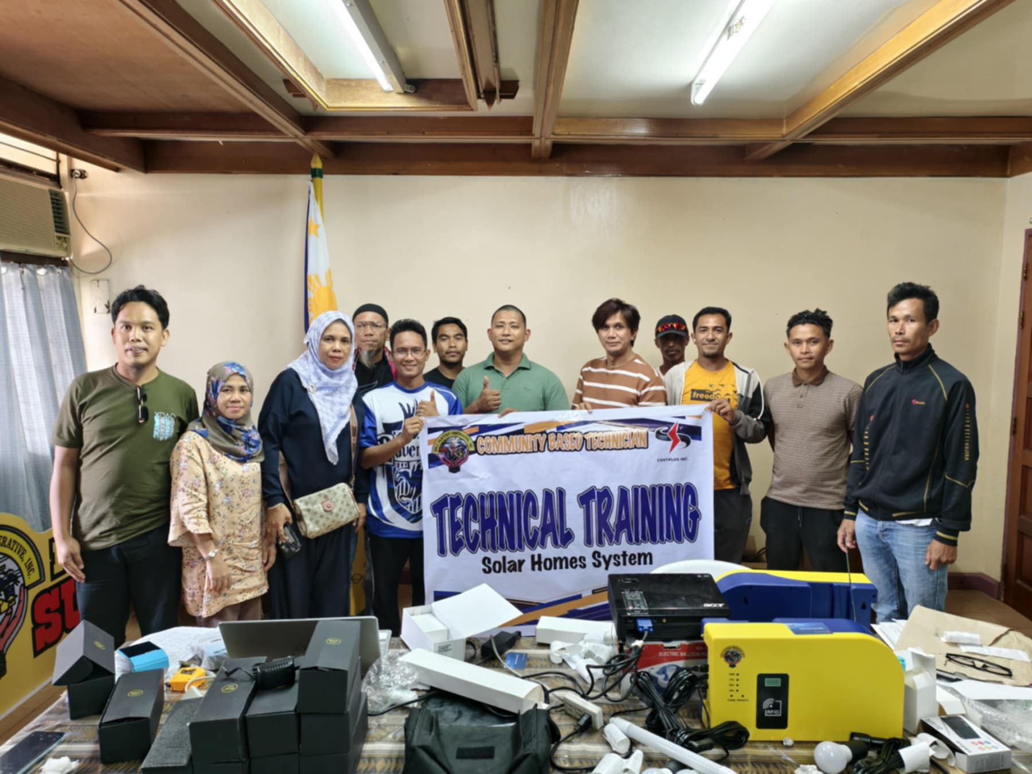
TECHNICAL TRAINING FOR POS DEVICE ON SULECO TECHNICAL HEADS AND SOLAR BUSSINES UNITS VENDORS ARE SUCCESFUL

