Slide 1

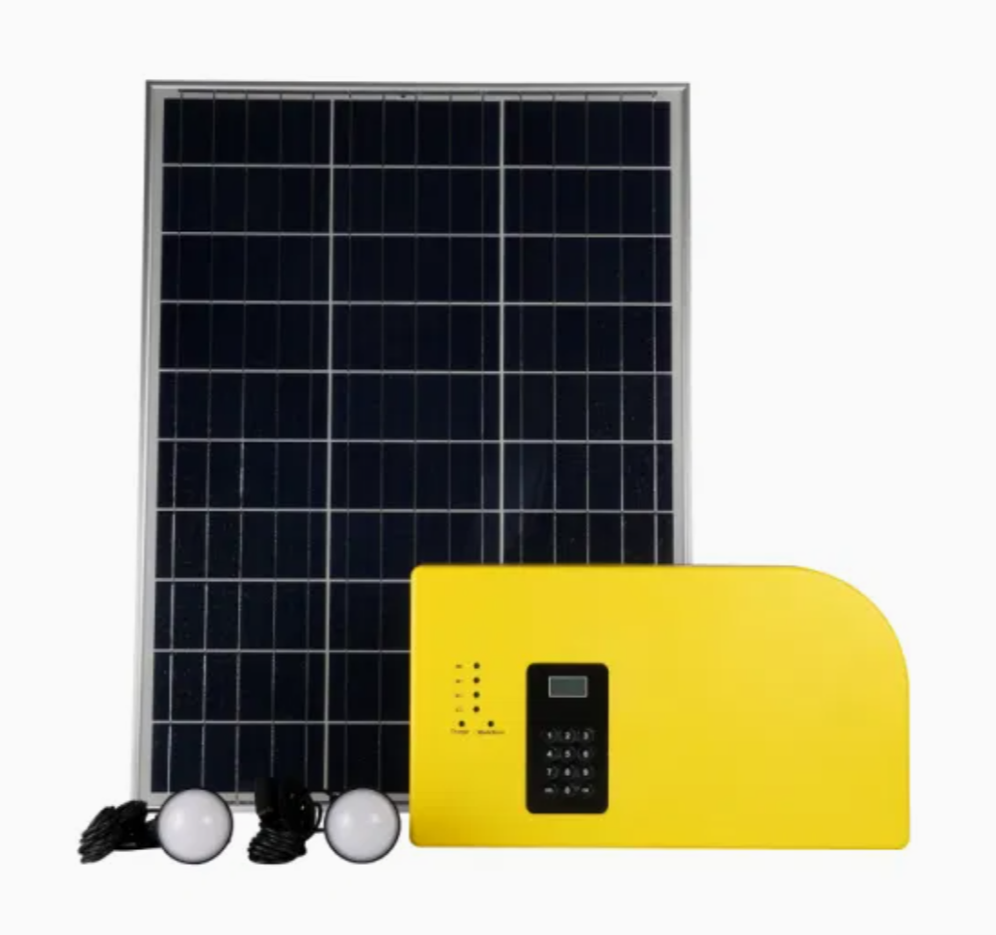
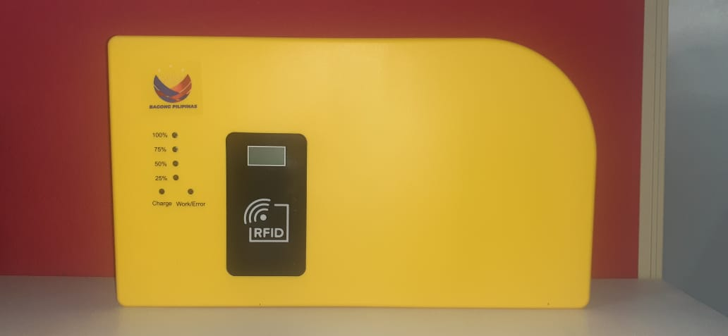
SOLAR HOME SYSTEM
ORMECO
TRAINING REPORT
Training Period:
MARCH 29, 2025 (8Am – 5pm)
Venue:
ORMECO Main Office, Brgy. Sta. isabel
Calapan City Oriental Mindoro
Conducted & Prepared By:
Alfredo d. Tarepe jr.

Slide 2

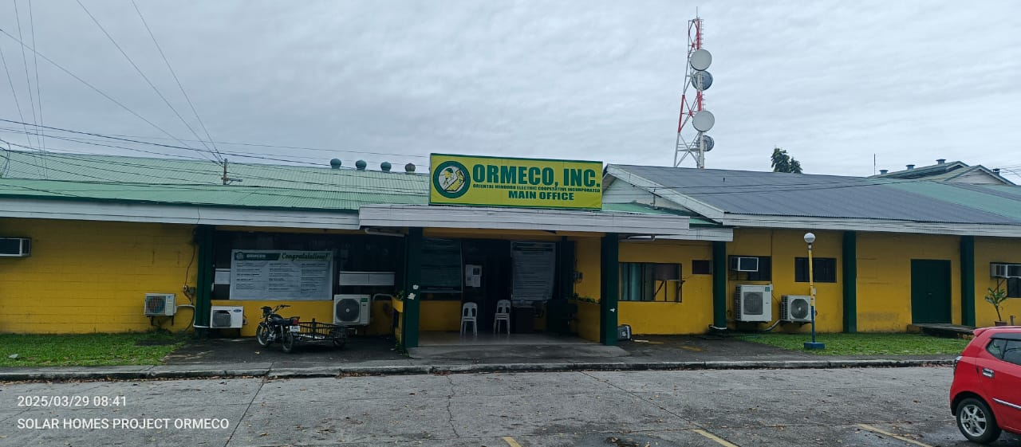

Slide 3
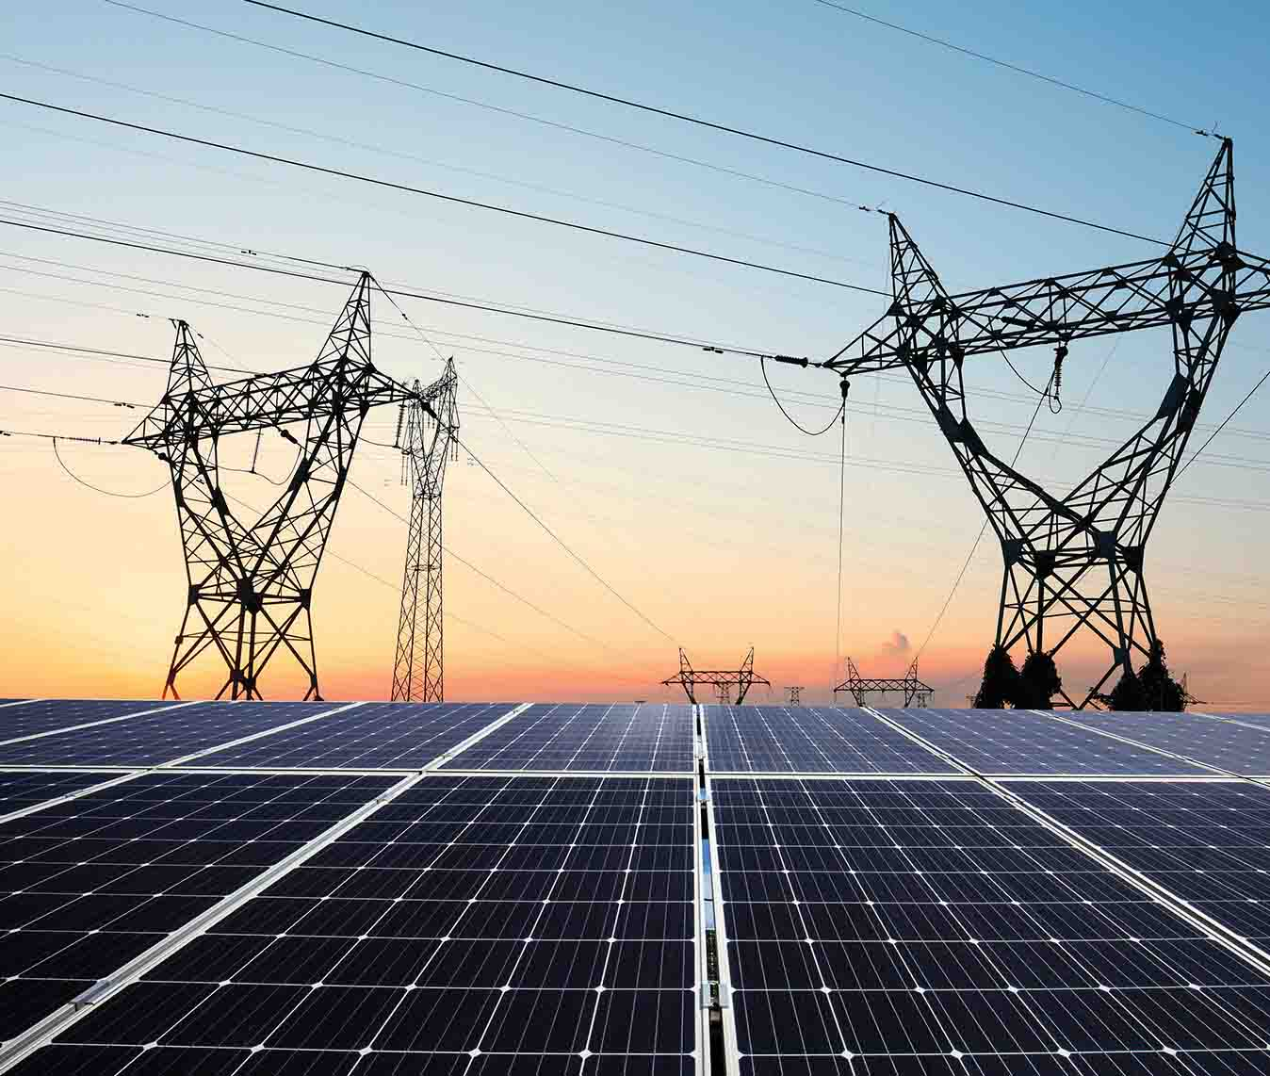
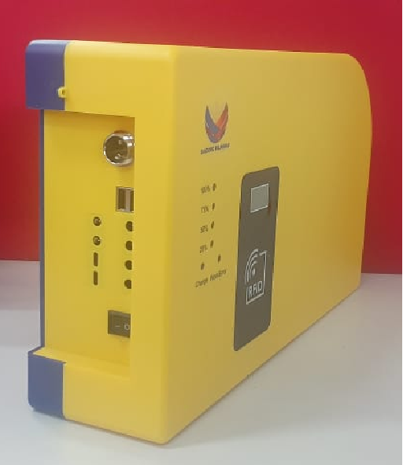
TRAINING TOPICS
BEST LOCATION FOR INSTALLATION
INSTALLATION TECHNIQUES
TESTING AND COMMISSIONING
CREDIT LOADING PROCESS
MCO INSTRUCTION
ADVANCED TROUBLESHOOTING
EXPORT AND DATA BACK-UP
INSTALLATION EVALUATION

Slide 4

TRAINING PHOTOS

Slide 5
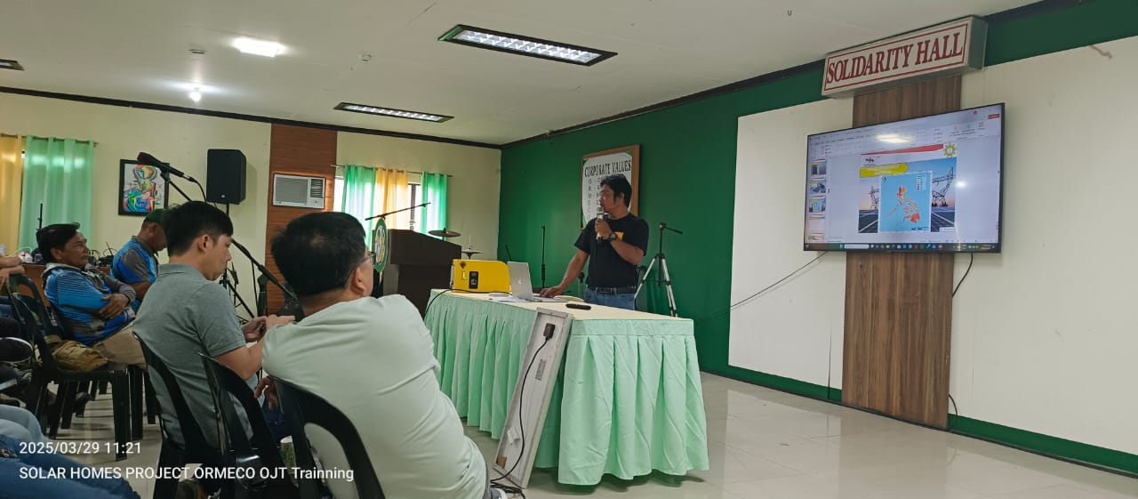
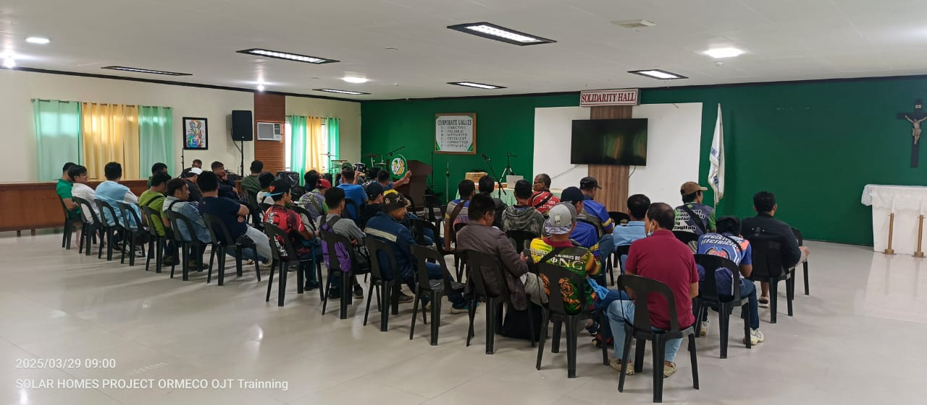

Slide 6
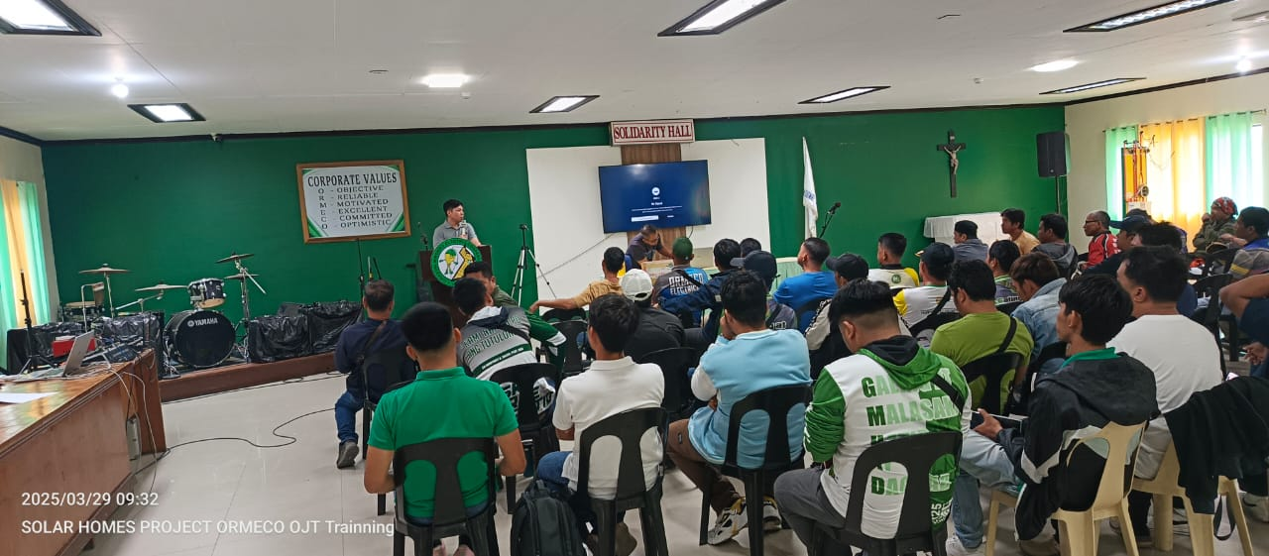
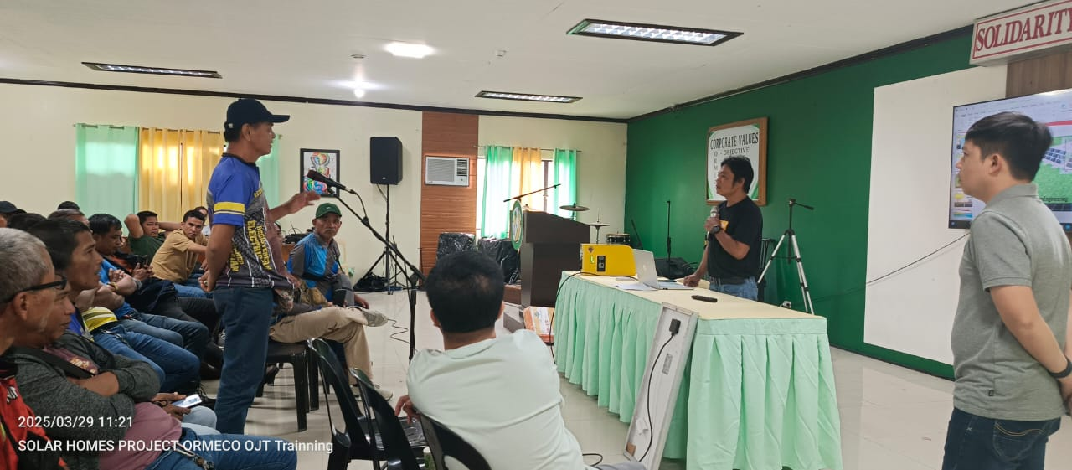

Slide 7
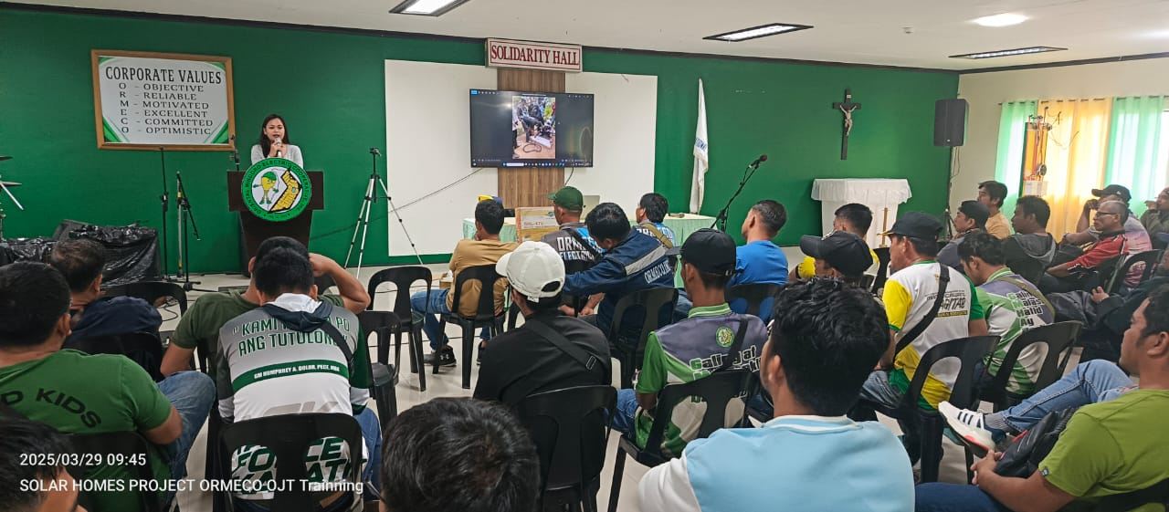
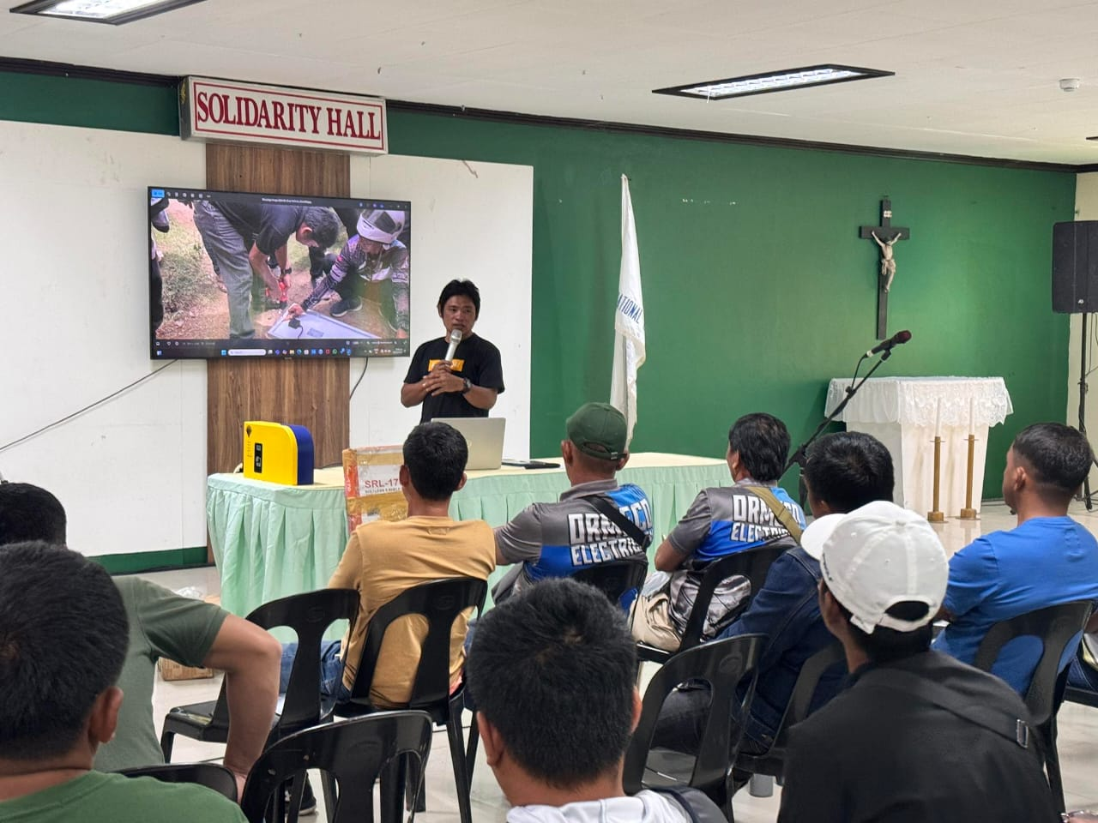

Slide 8
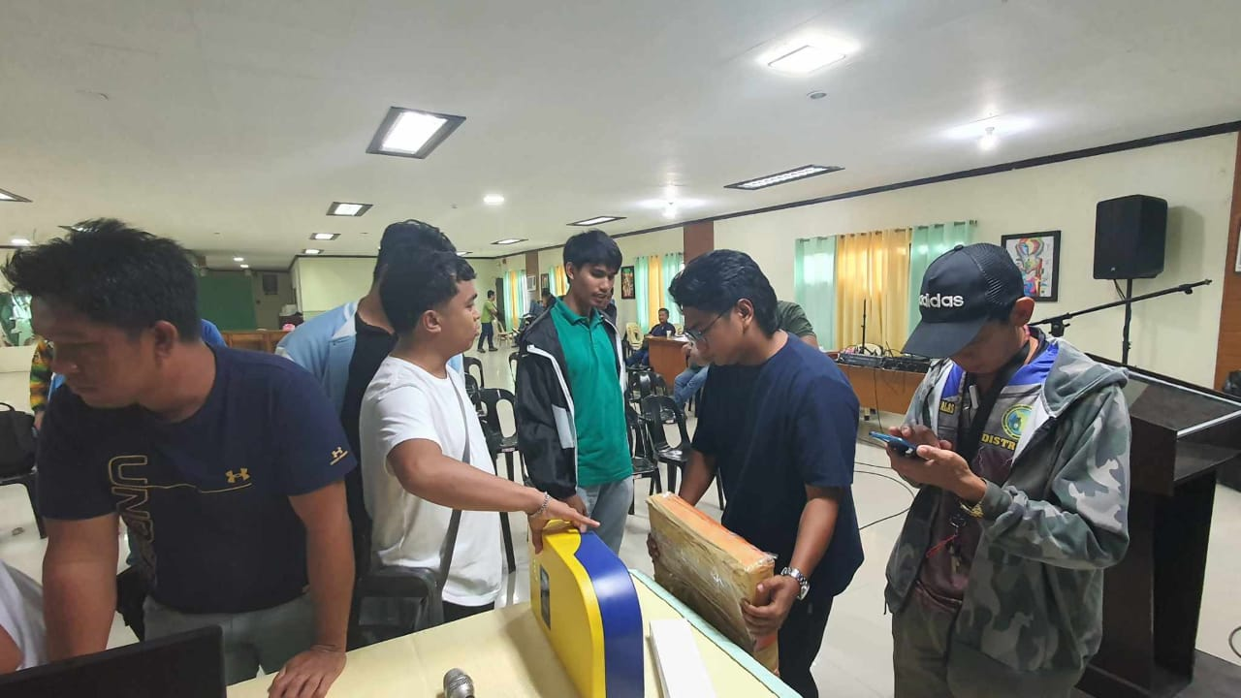
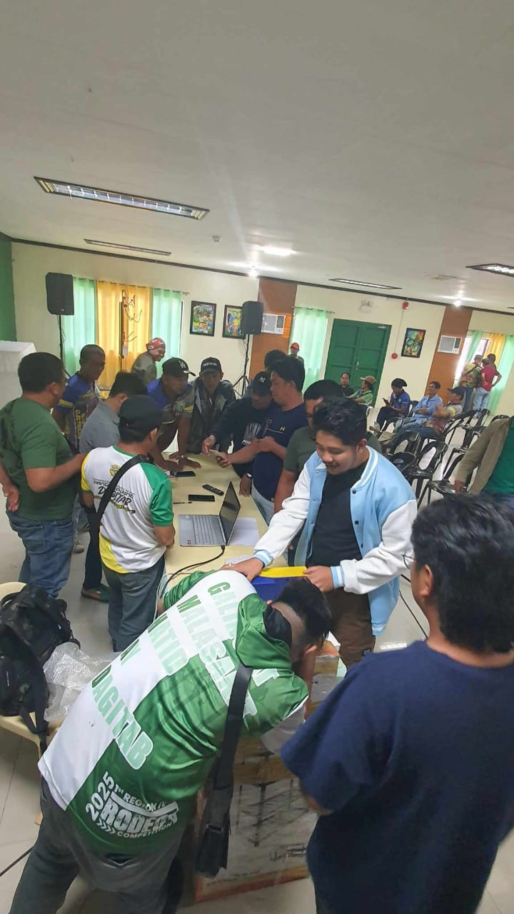

Slide 9
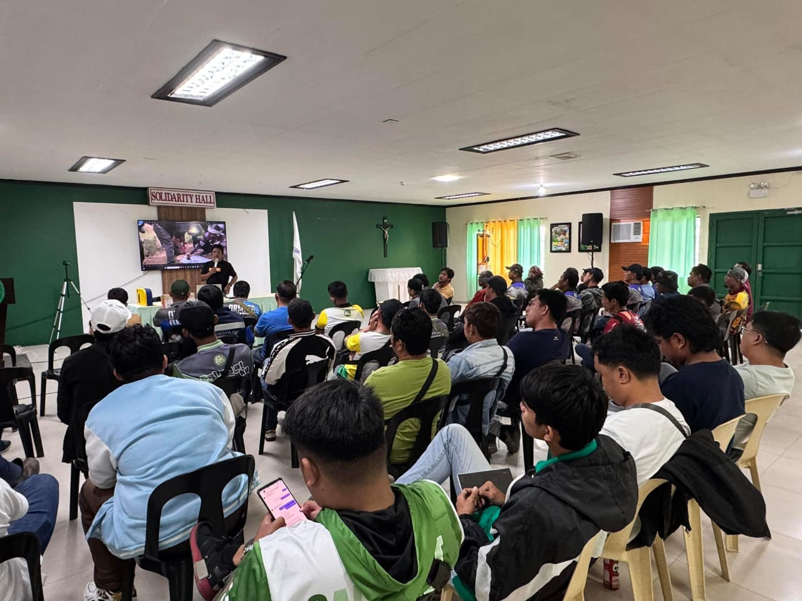
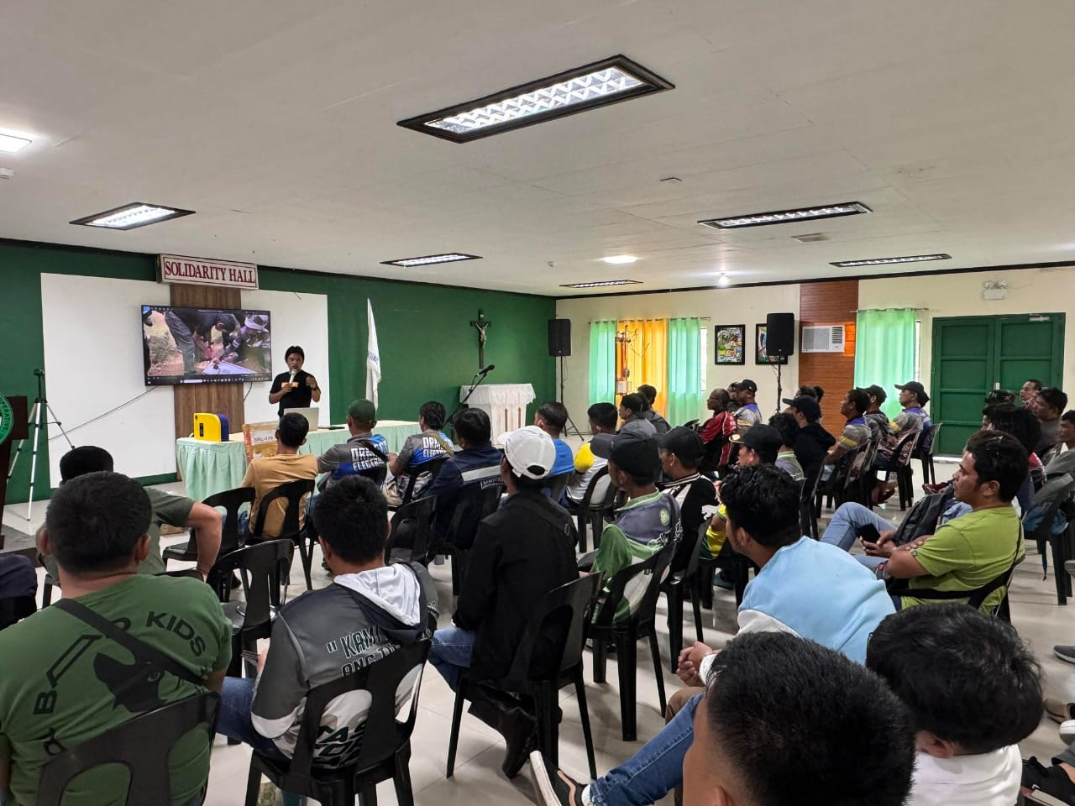

Slide 10
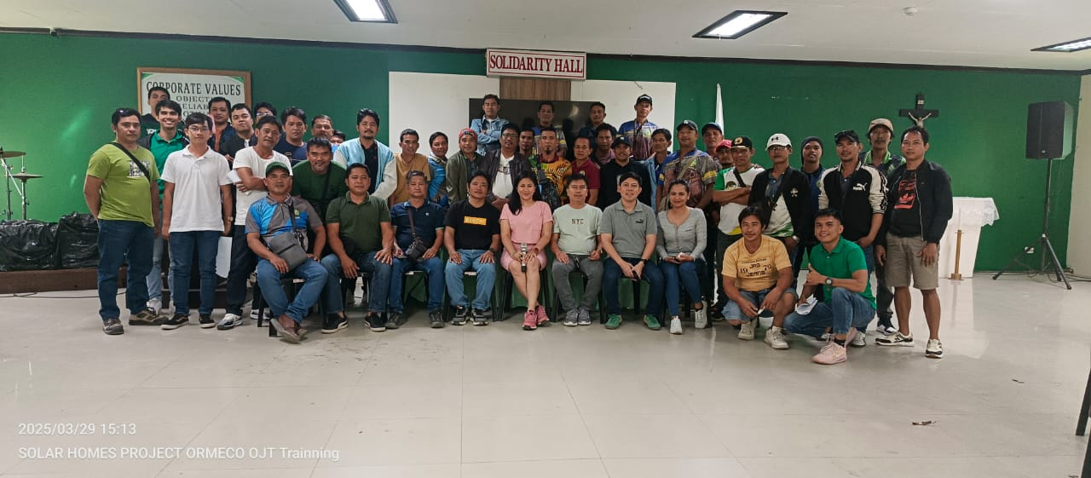

Slide 11
PARTICIPANT’S
TOTAL ATTENDEES : 61

Slide 12
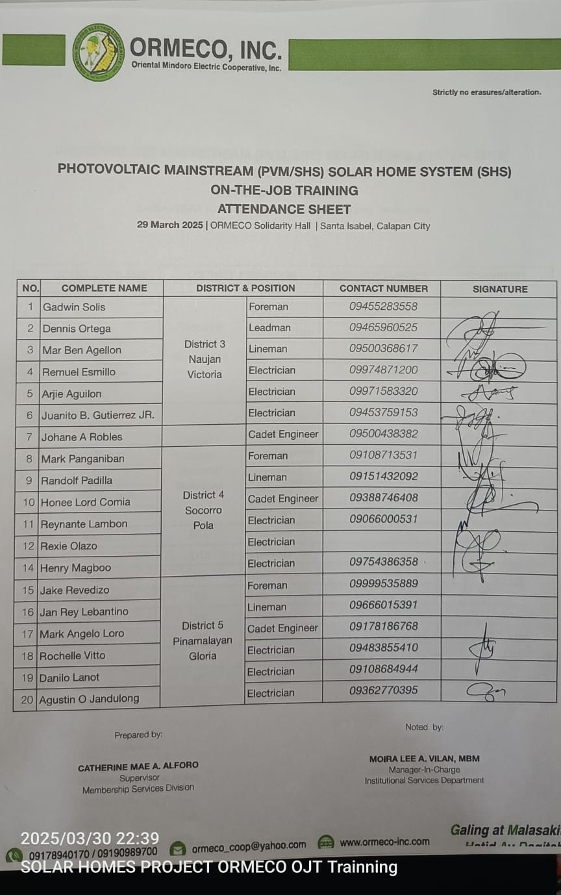
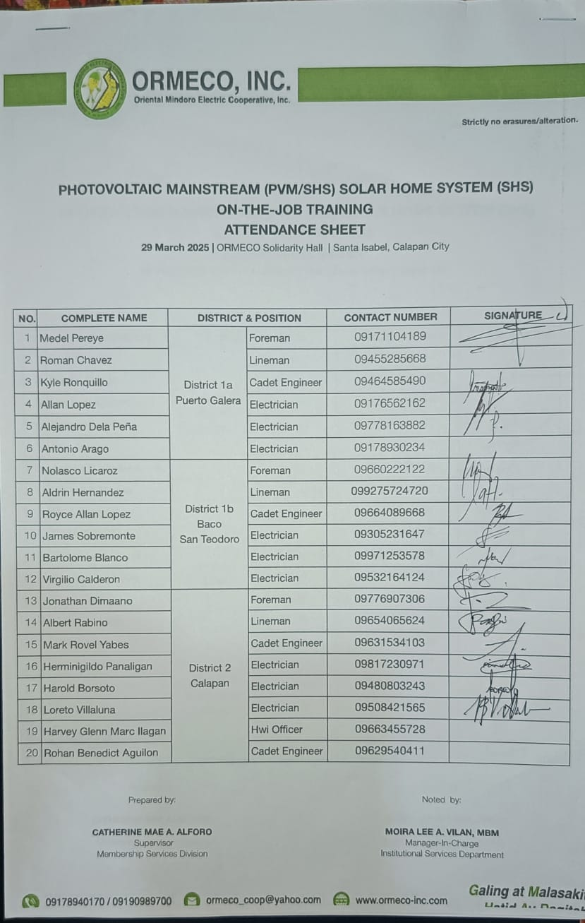
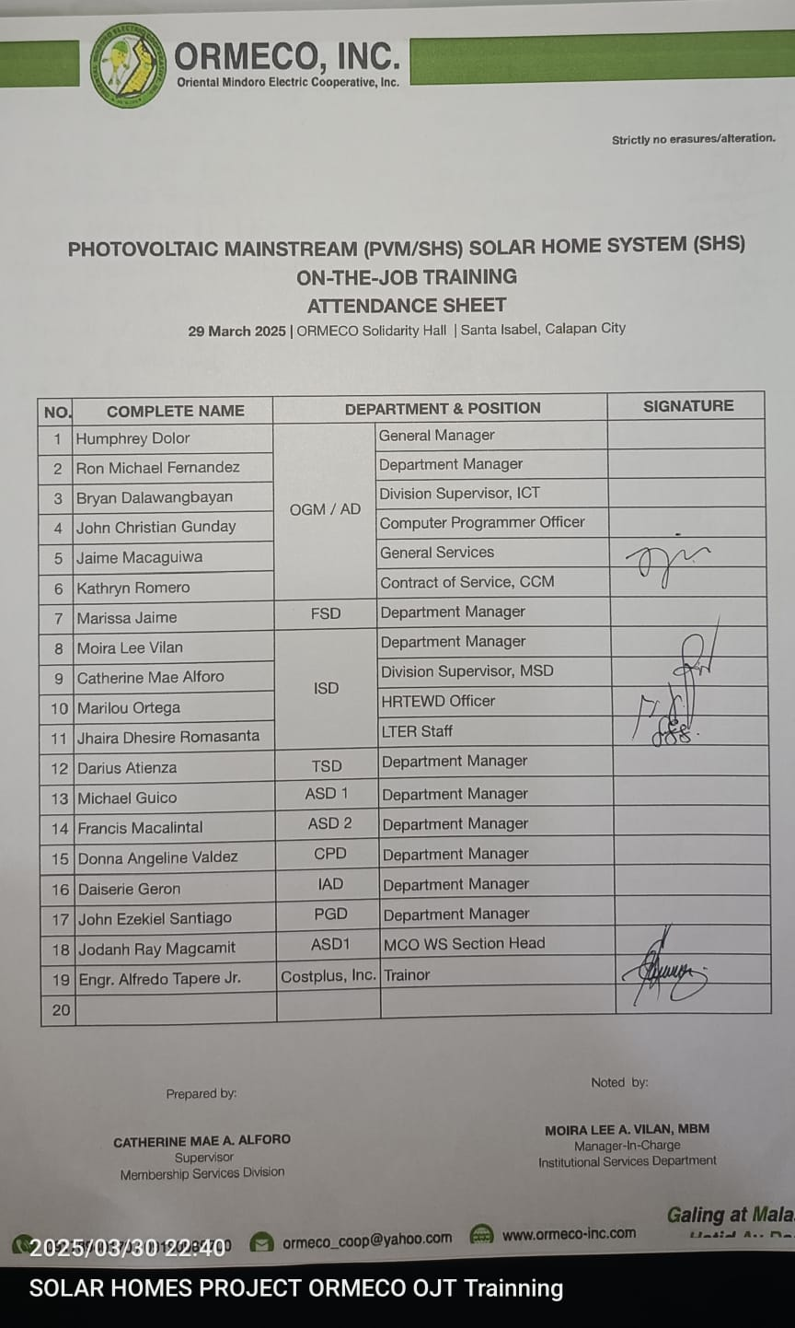
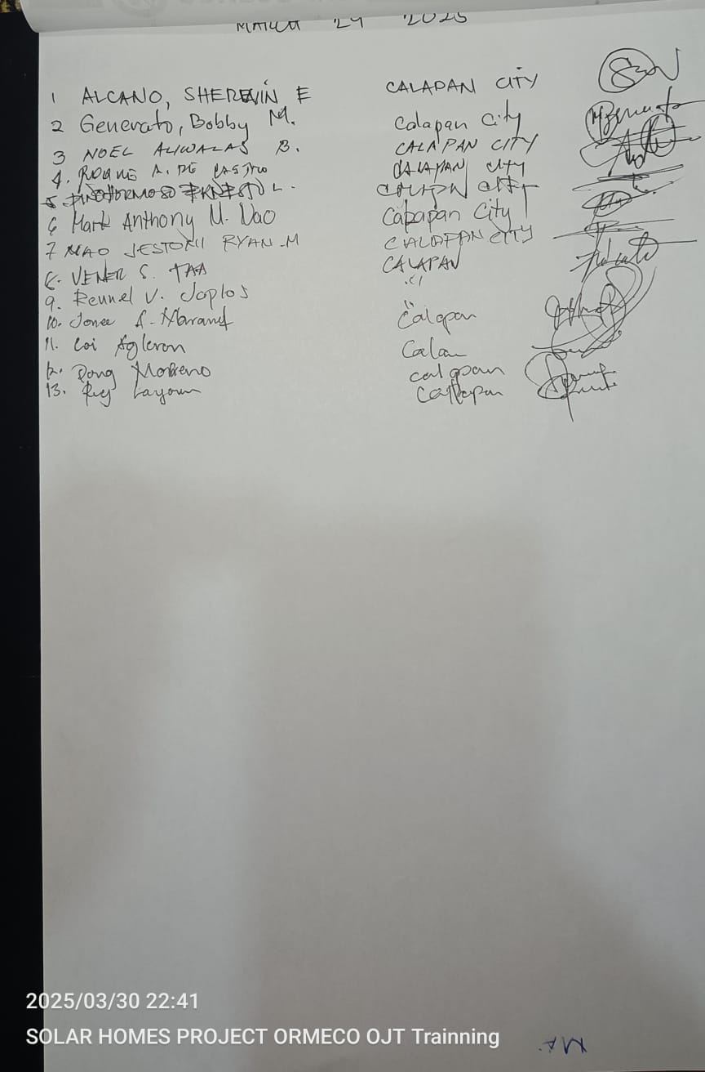
PARTICIPANT’S
TOTAL ATTENDEES : 61

Slide 13
THANK YOU

