Slide 1




WELCOME
SOLAR HOME SYSTEM
2 DAYS TECHNICAL TRAINING
FEBRUARY 10 AND 11 2025
Prepared By: Engr Joseph Obusan IEE A.M.O.

Slide 2
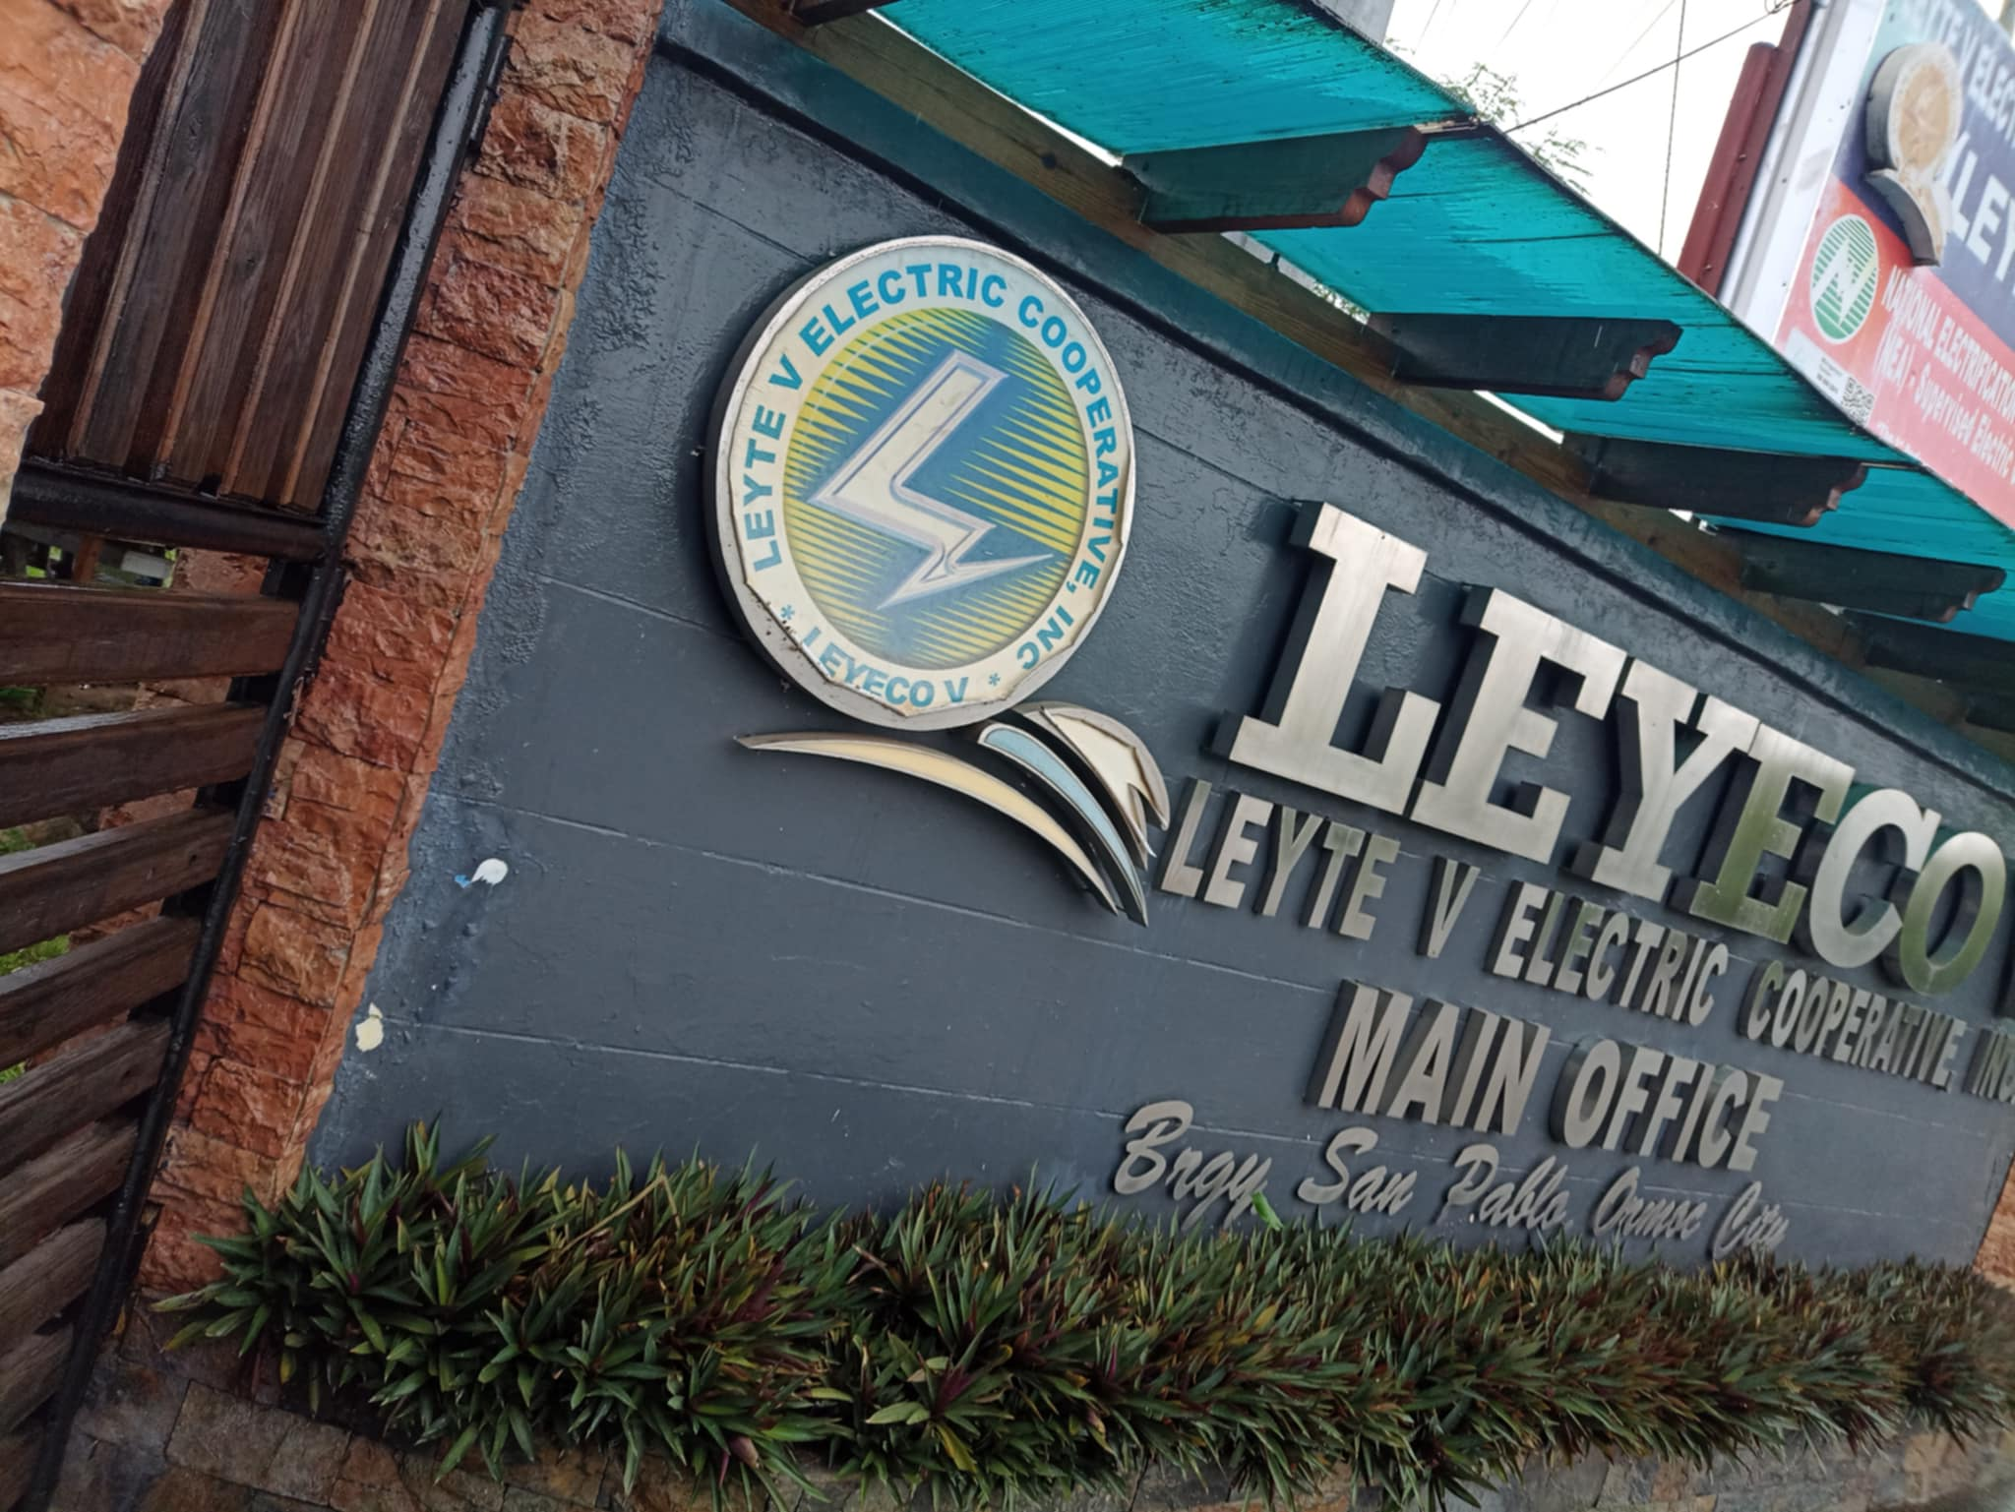

Slide 3
SHS Training
Day 1
AM
930am -12:00pm Basic on Solar Energy & other
12:00pm – 1:00pm – Lunch
PM
1:00PM - 1:30pm Basic Installation & others
1:30pm – 3:30pm – RFID Activation & Loading
3:30pm – 3:45pm – Snacks
3:45pm – 5:00pm – Testing/ Q & A
5:00pm - 6:45pm overtime traning hands on
shs troubleshoot hardware & shs software

Slide 4
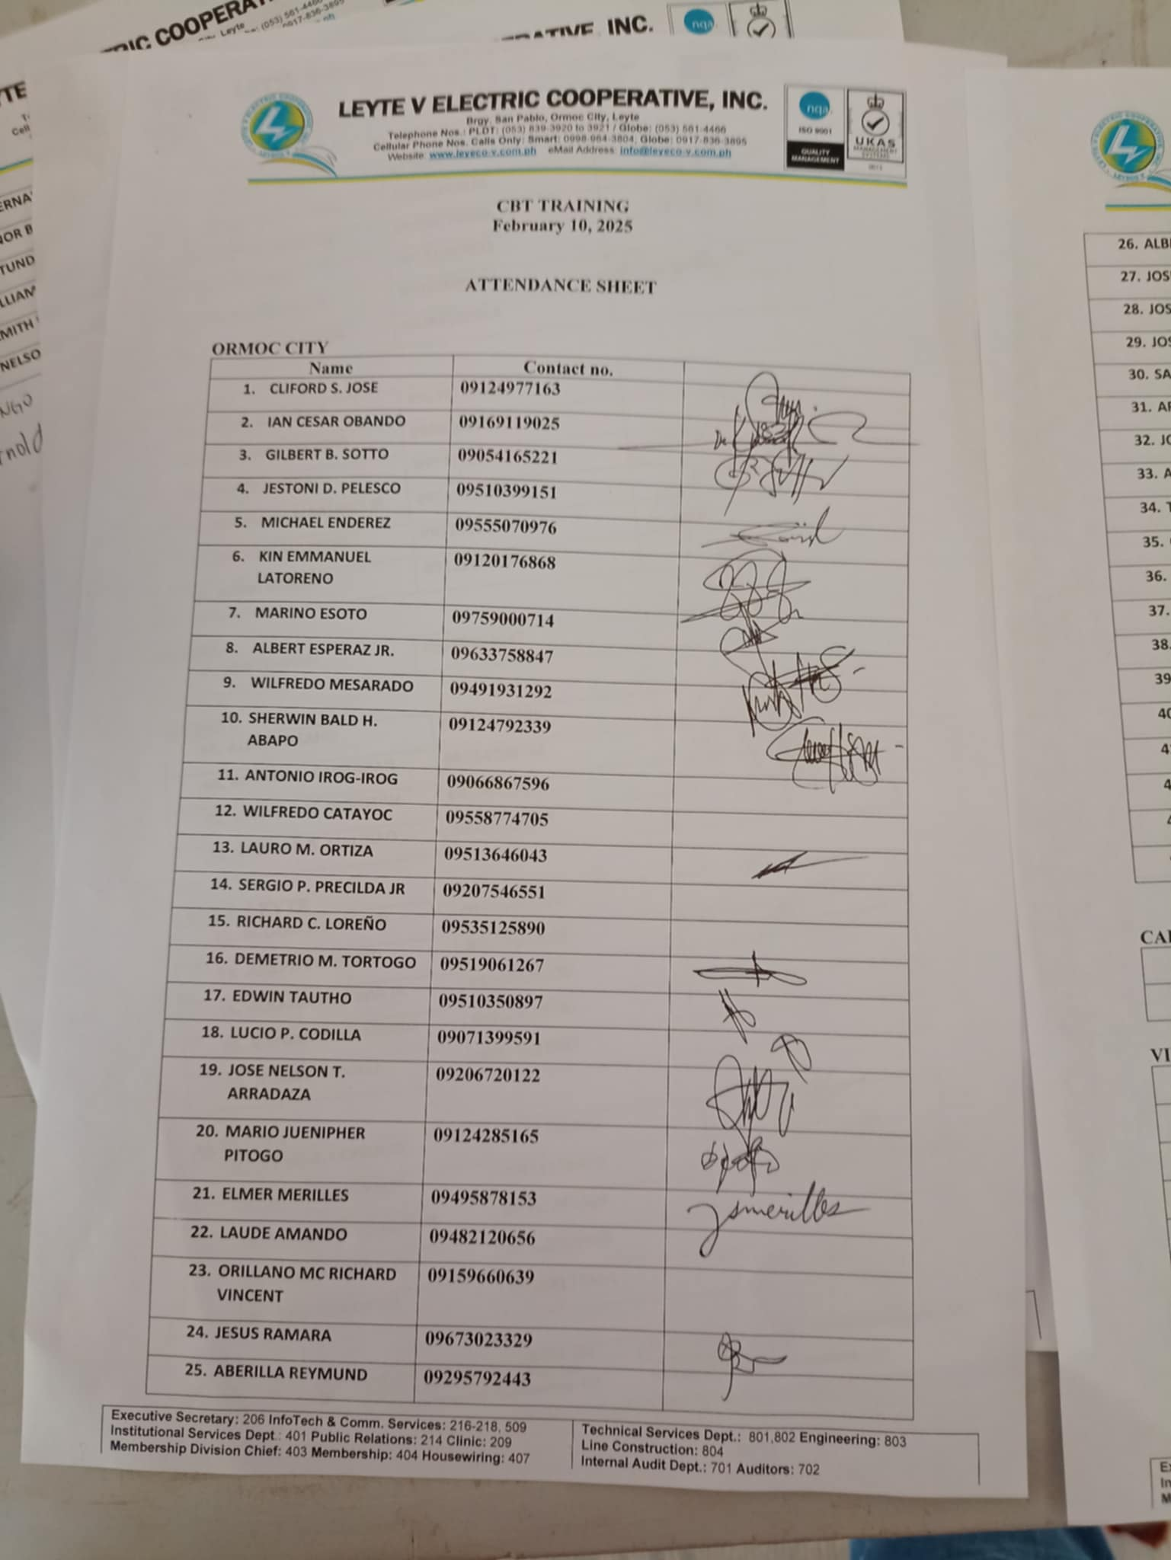
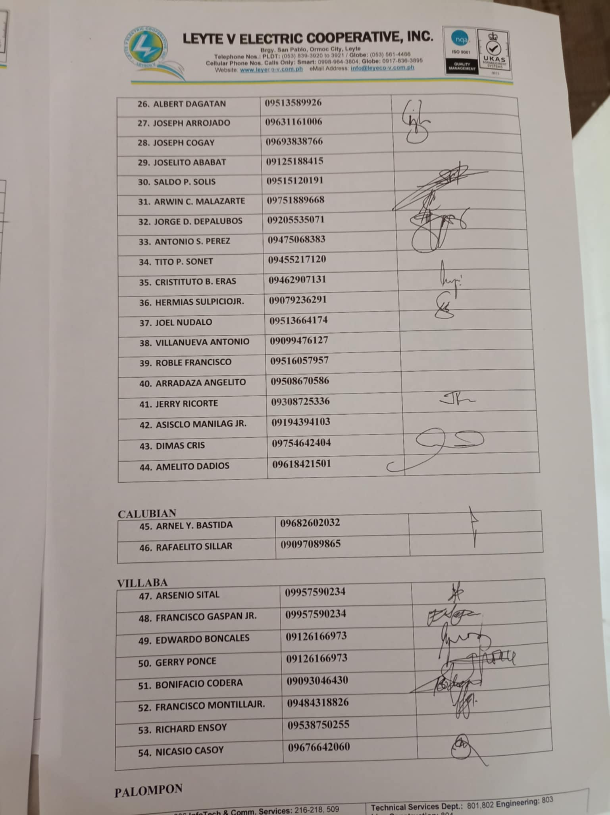
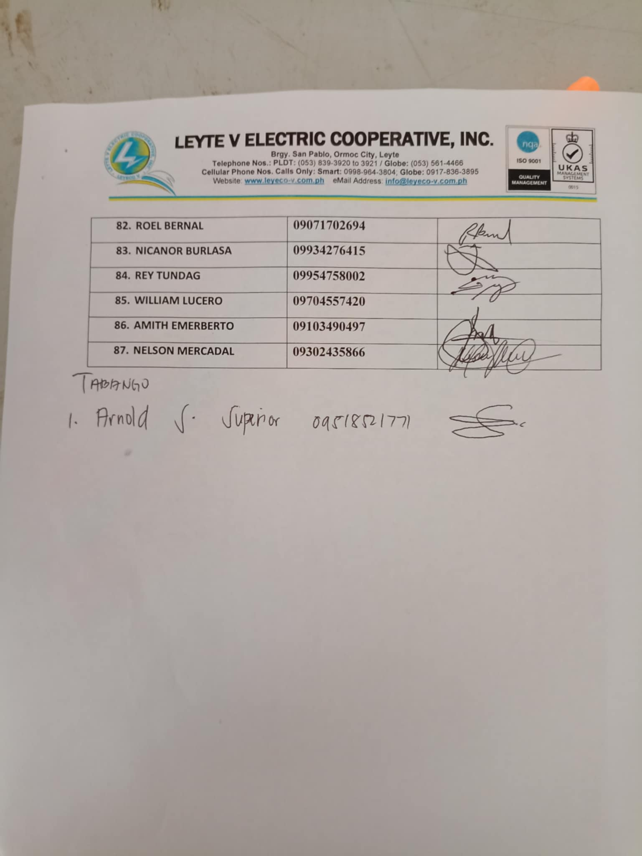
Day 1 training participants : 71 in the morning and in the afternoon theres additional a total of 87 total with overtime

Slide 5
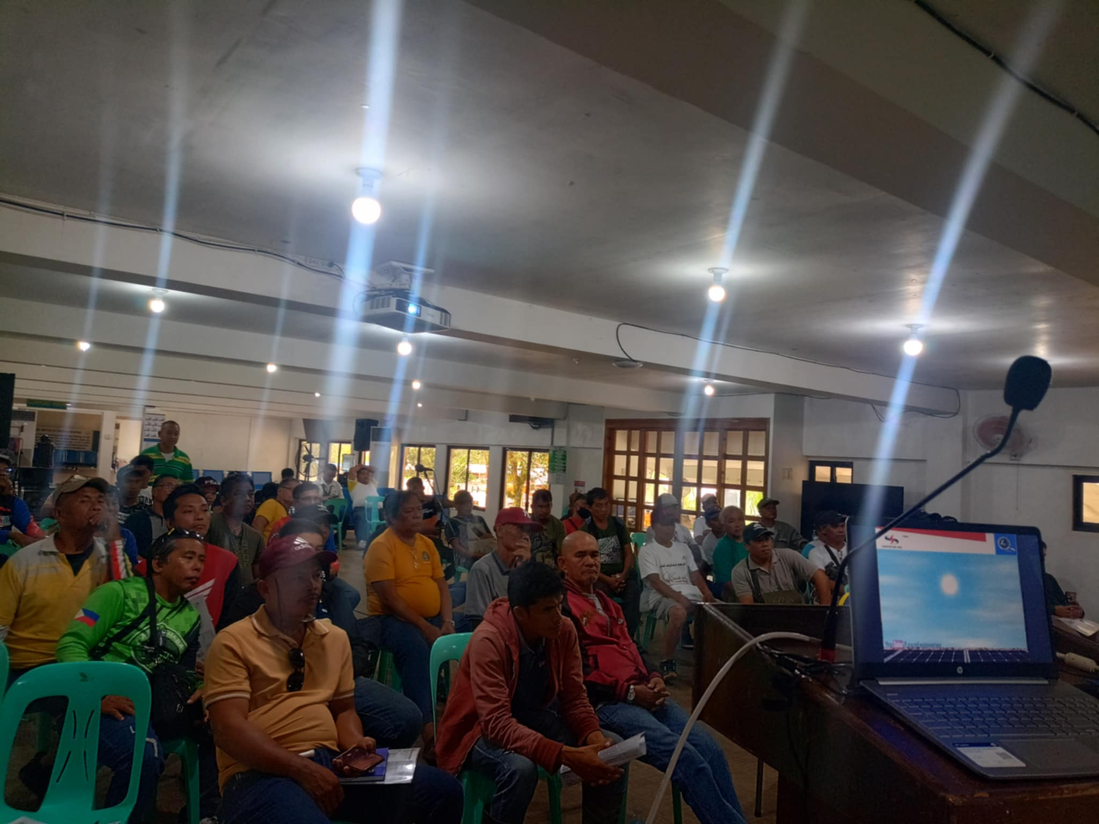
Morning and partial afternooon time is more on lecture as i introduce shs to participants SBU ec technician and admin team

Slide 6
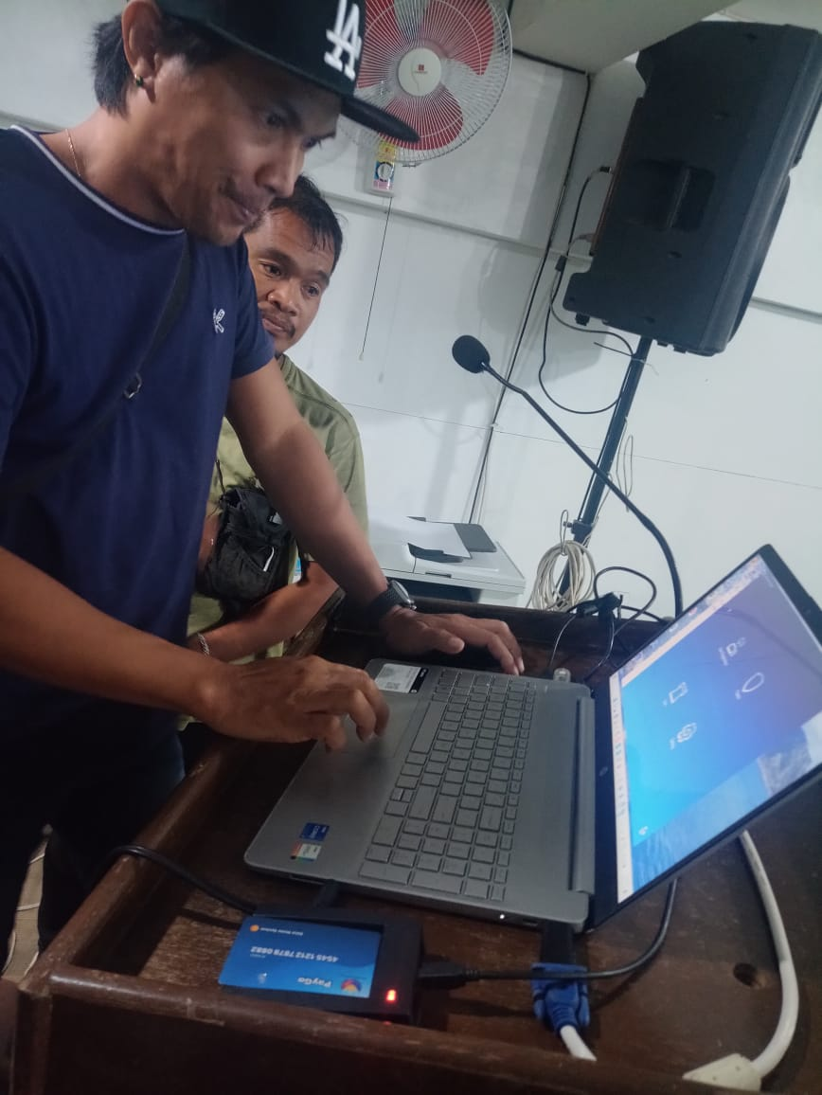
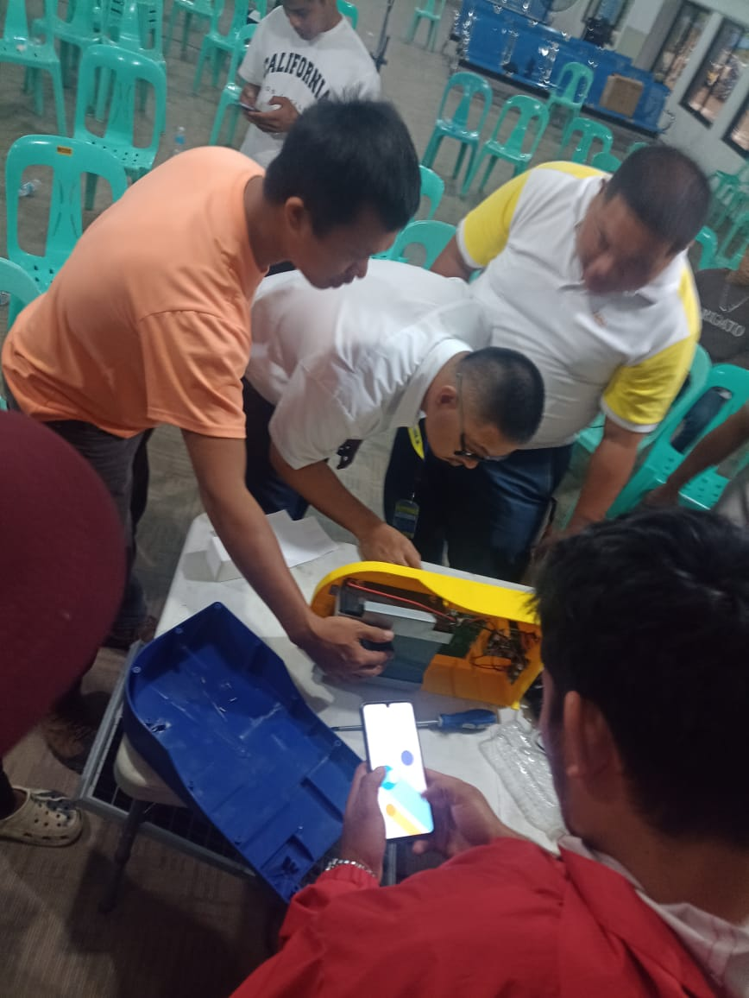
3pm onwards until 5 pm individual training for software and actual opening of shs units to introduce to each of hardware parts

Slide 7
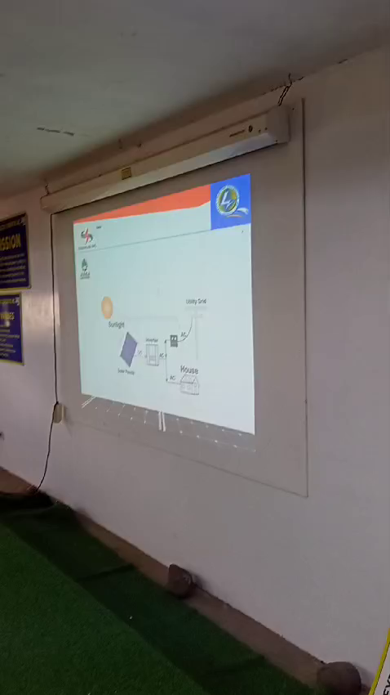

Slide 8
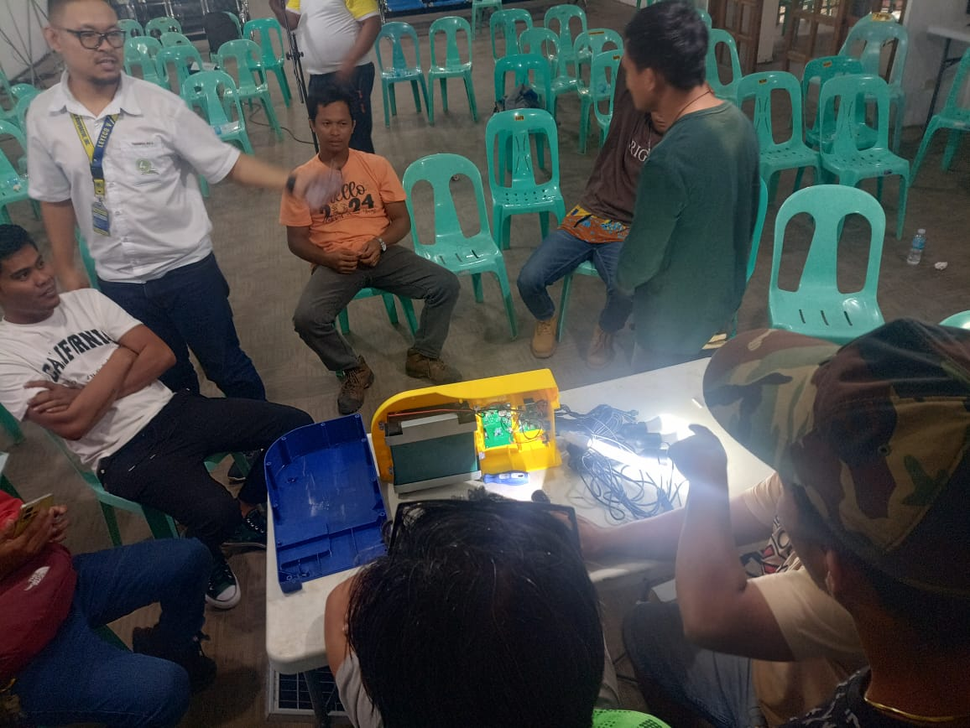
5:00 pm to 6:45pm decide us to overtime to tackle everything about hardware and leyeco wants to undertand all parts and how shs hardware works and impress about just 4 parts battery rfid pcp board , charge controller board and type c port board which are easy to troubleshoot

Slide 9
SHS Training
Day 2
AM
830-10 am Review on Basic on Solar Energy & others
10:00 am Snacks
10:30am-12:00pm
Review Basic on Solar Energy & others
12:00pm – 1:00pm – Lunch
PM
1:00PM - 3:30pm – RFID Activation & Loading
3:30pm – 3:45pm – Snacks
3:45pm – 5:30pm – Testing/ Q & A

Slide 10
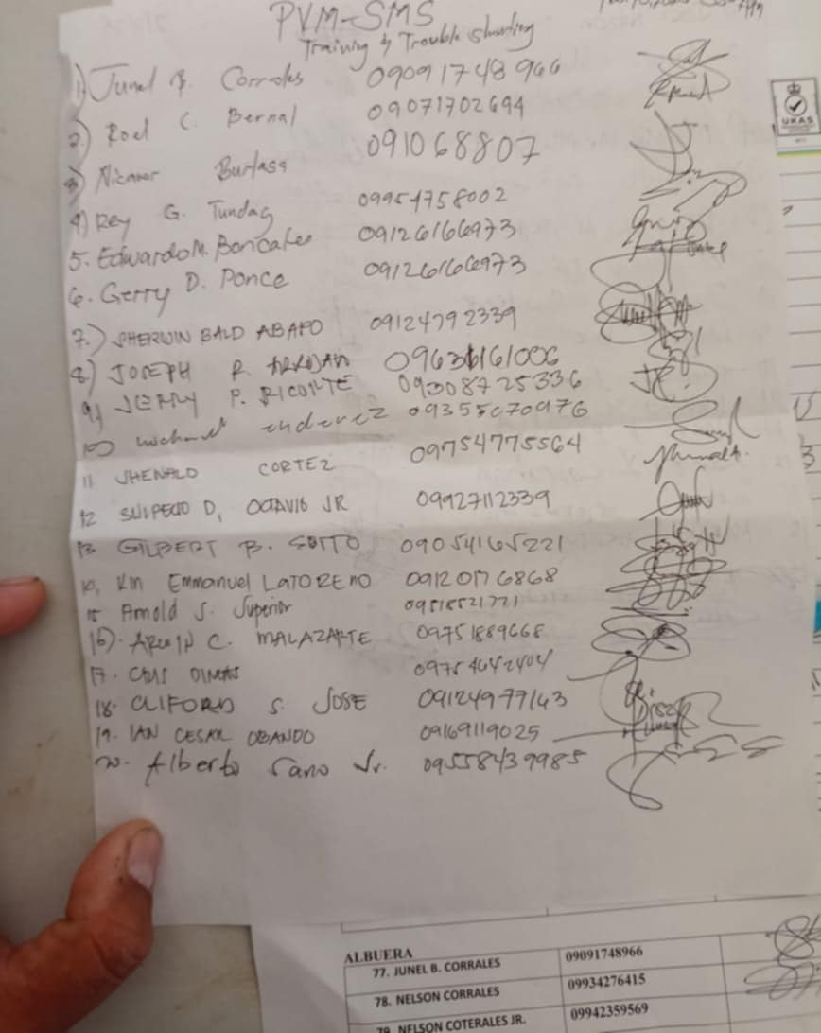
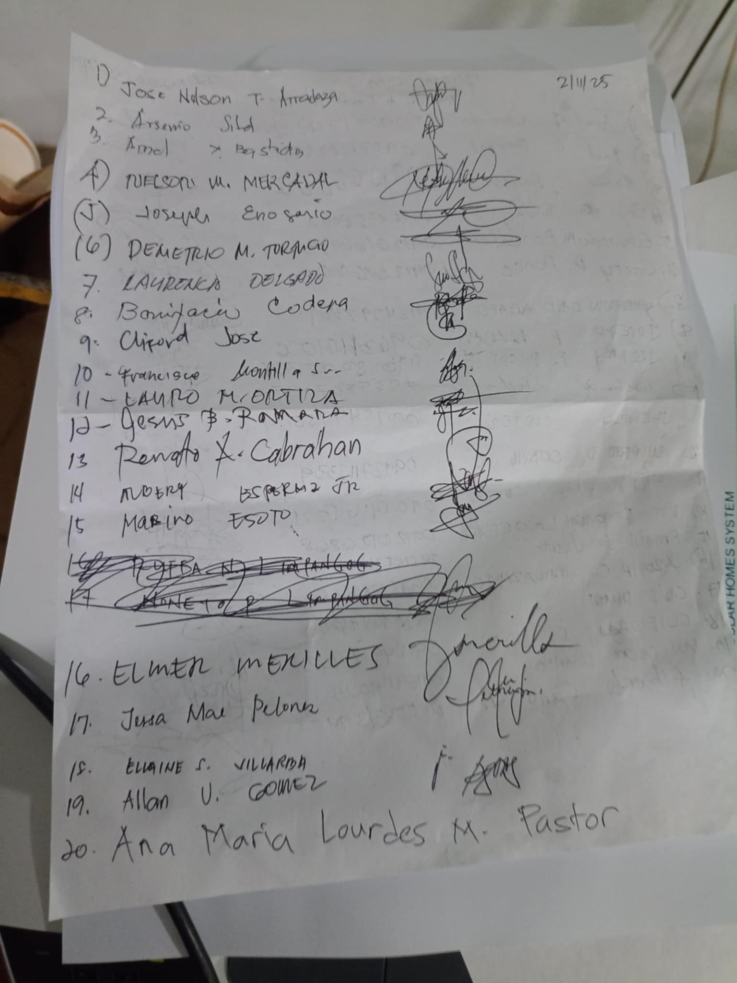
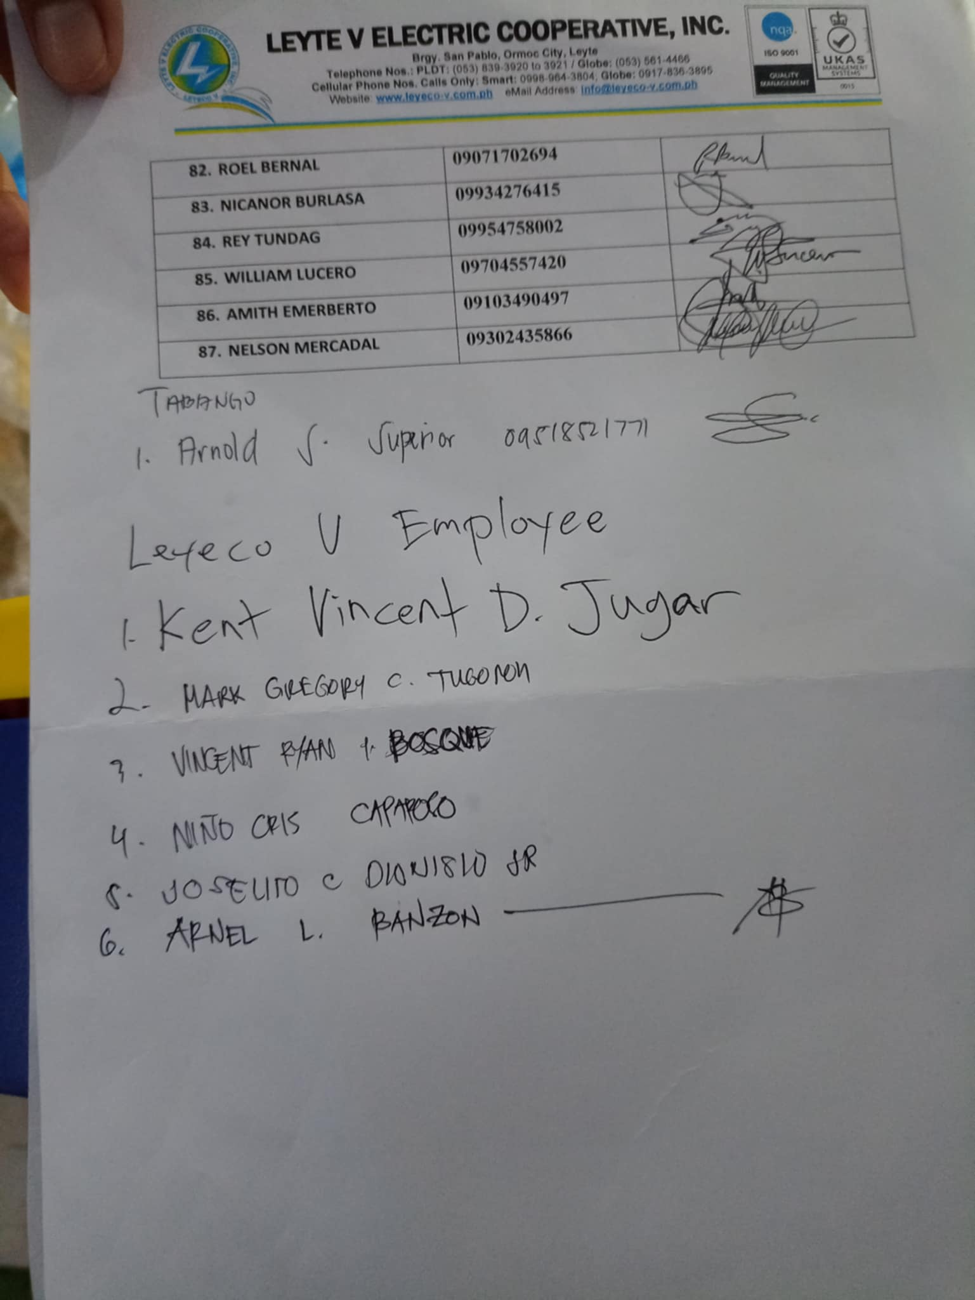
Day 2 morning 26 particapants later on ovetime participants on day 1 arrive in afternoon for continual learning of solar system training attendance total of 46 participants

Slide 11
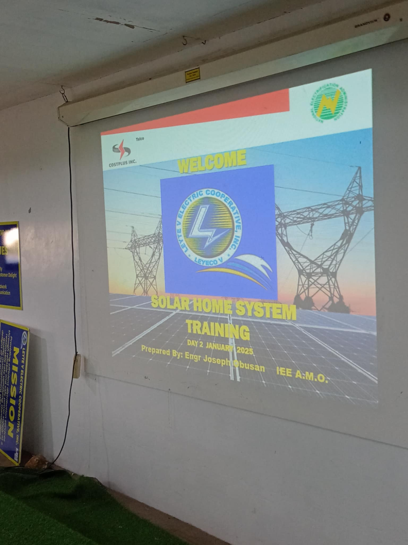

Slide 12
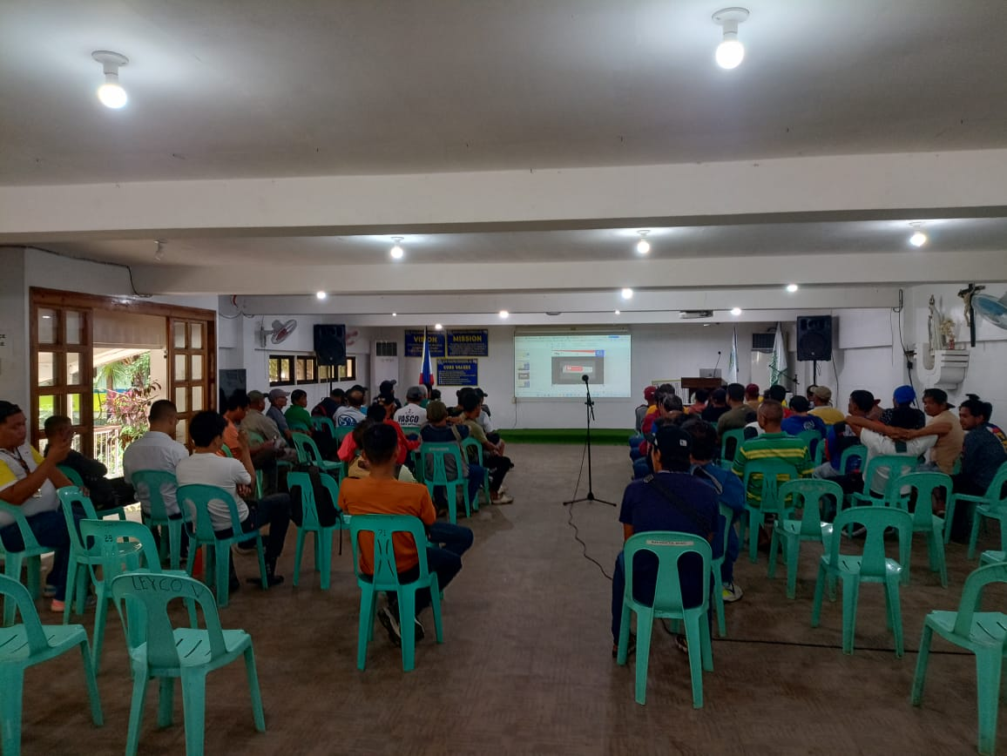
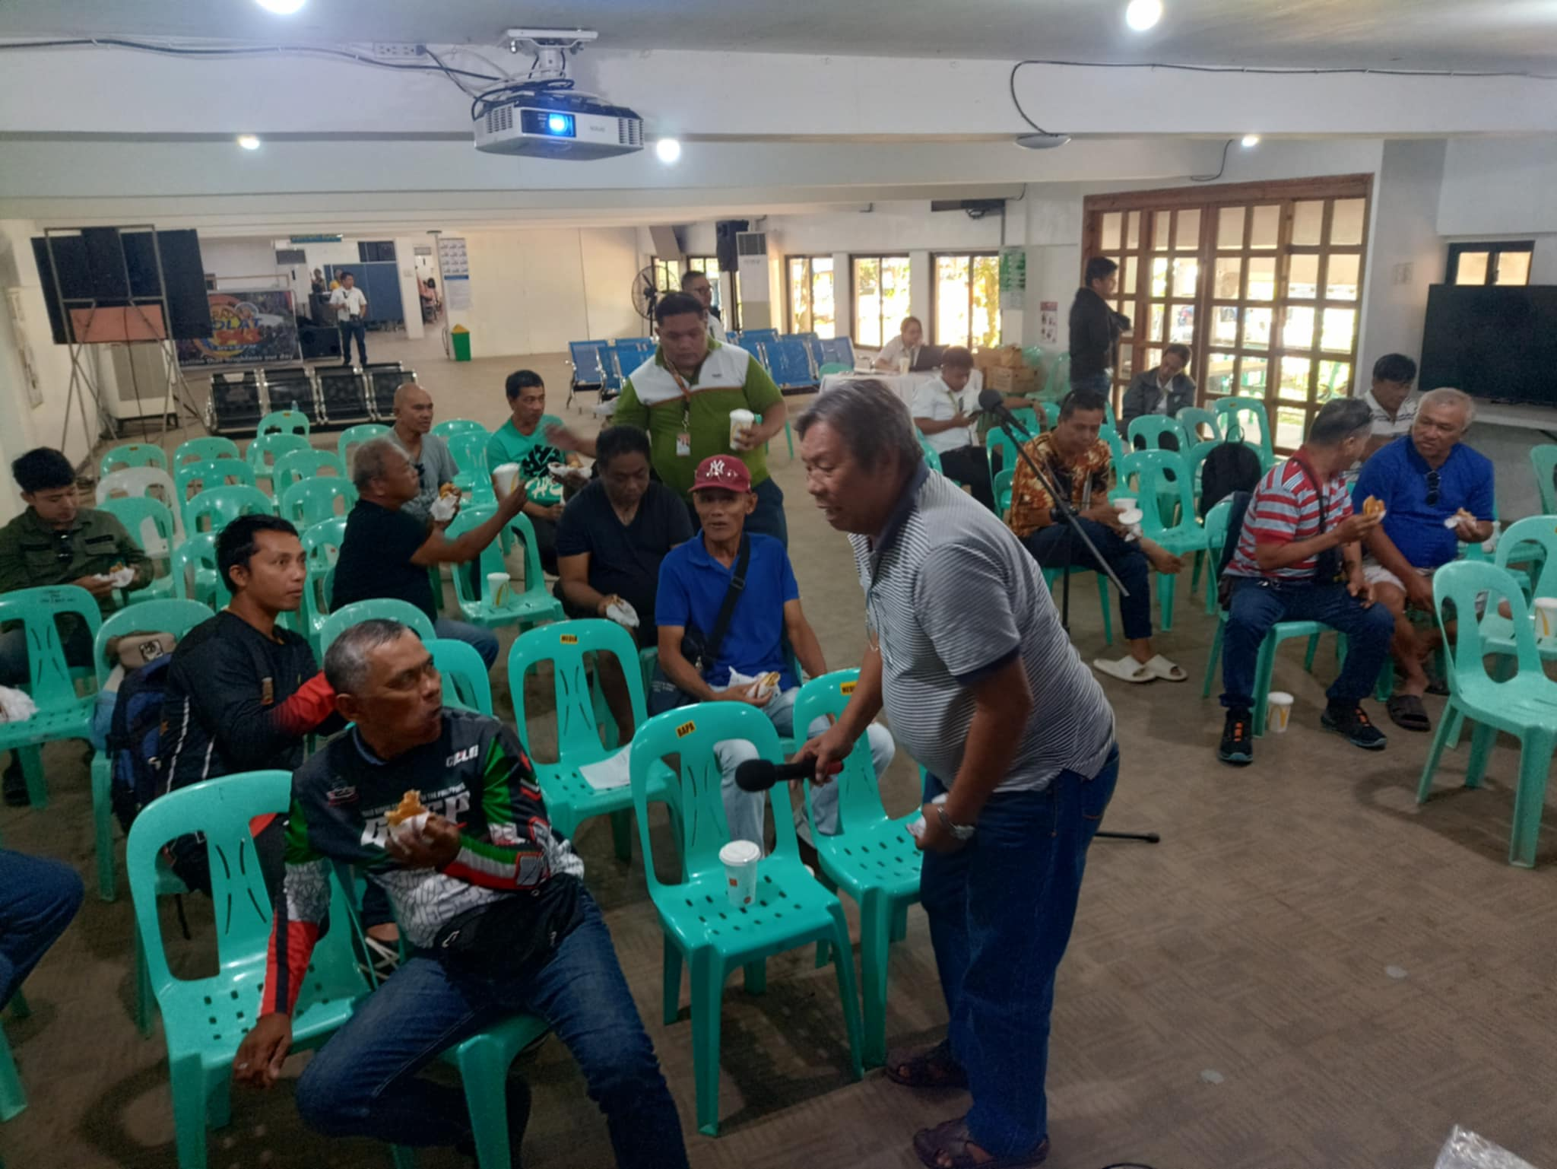
day 2 review on presentation and training more on hands on training of solar homes system software

Slide 13
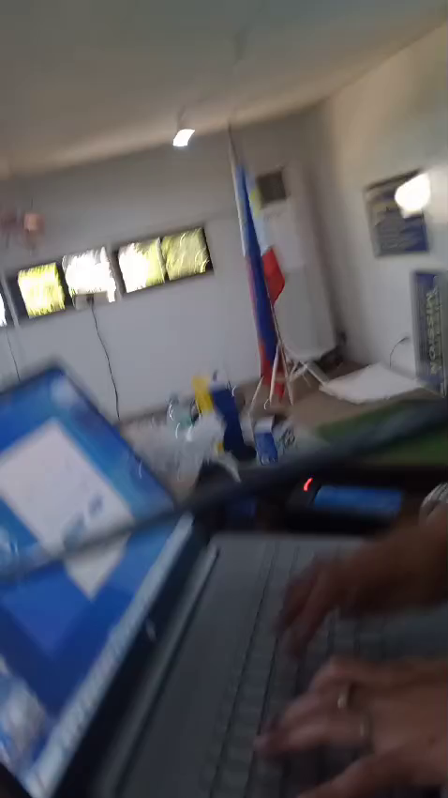

Slide 14
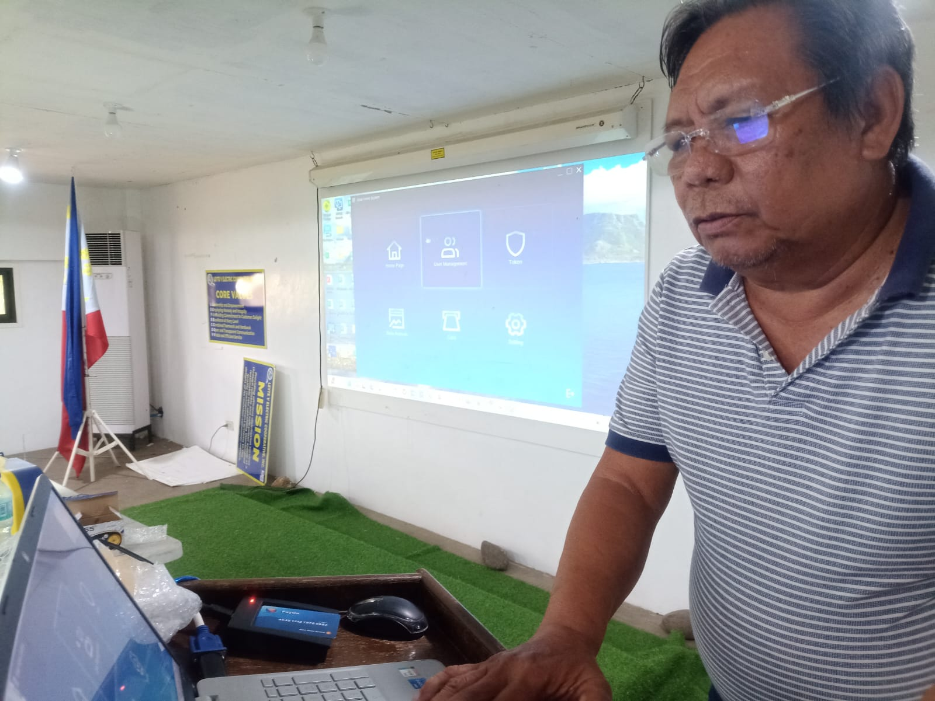
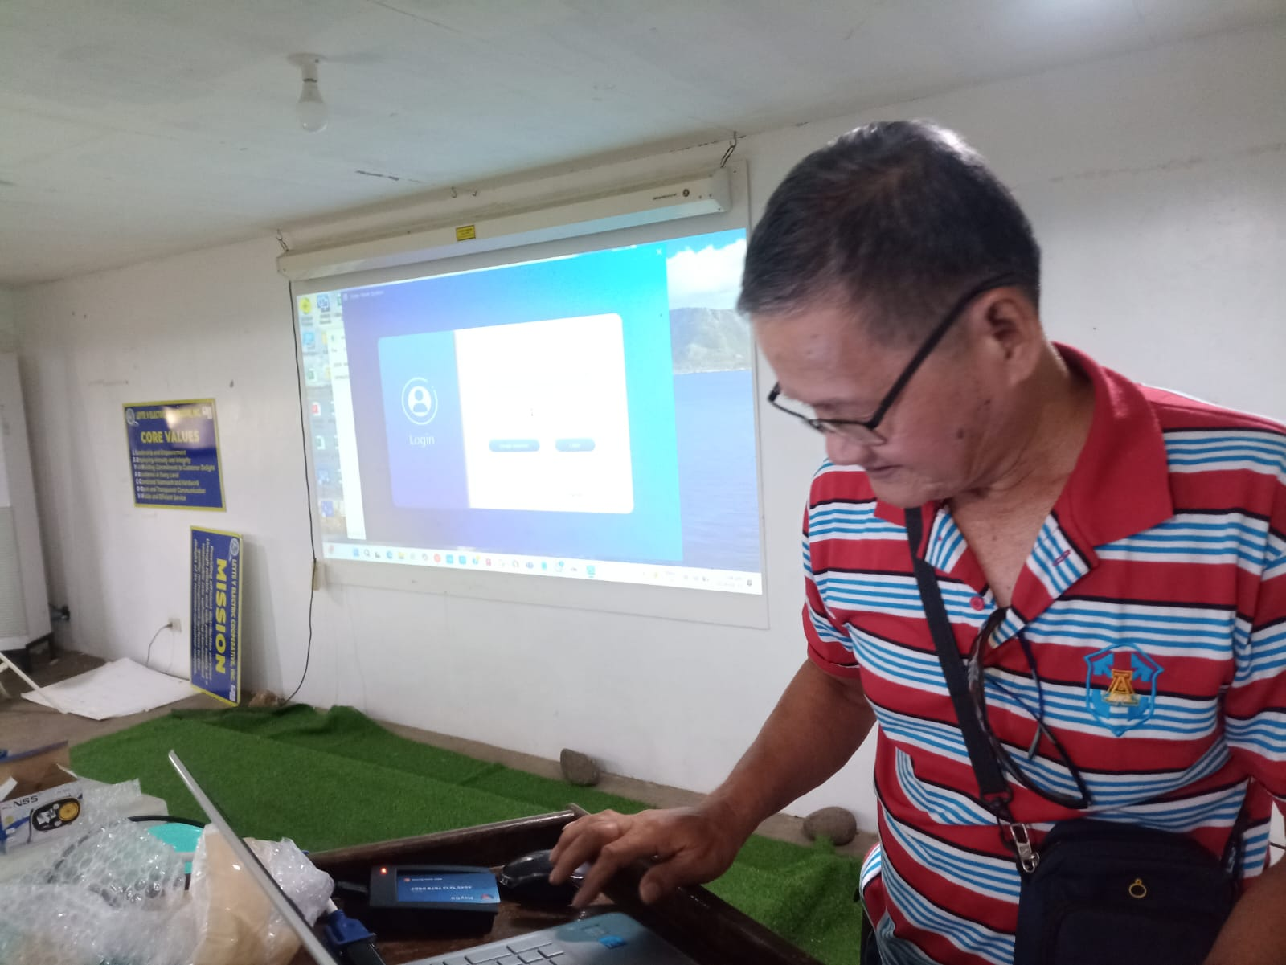
day 2 training individual Solar business units and team leader on solar homes system software loading token reset rfid card and module and access and understanding capacity of admin and operator account

Slide 15
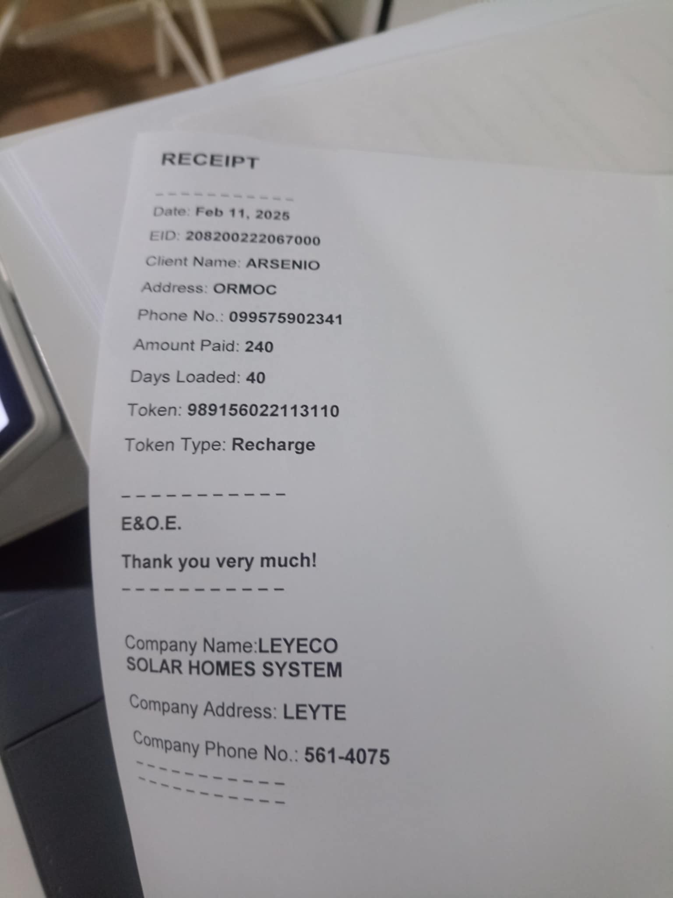
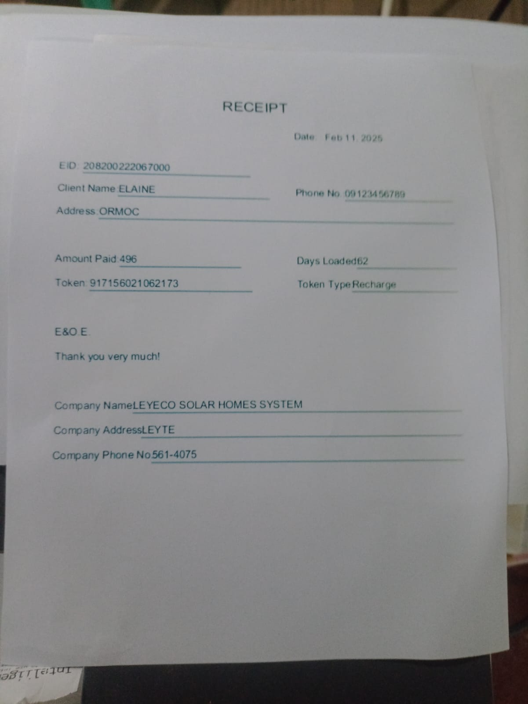
live printing of receipt while training each participants on solar homes system paygo software

Slide 16
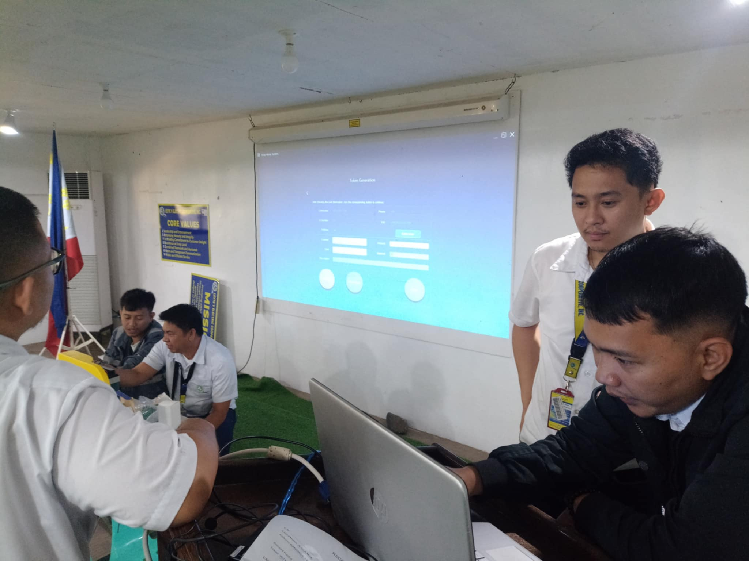
leyeco engineers and head technicians arrive to learn software

Slide 17
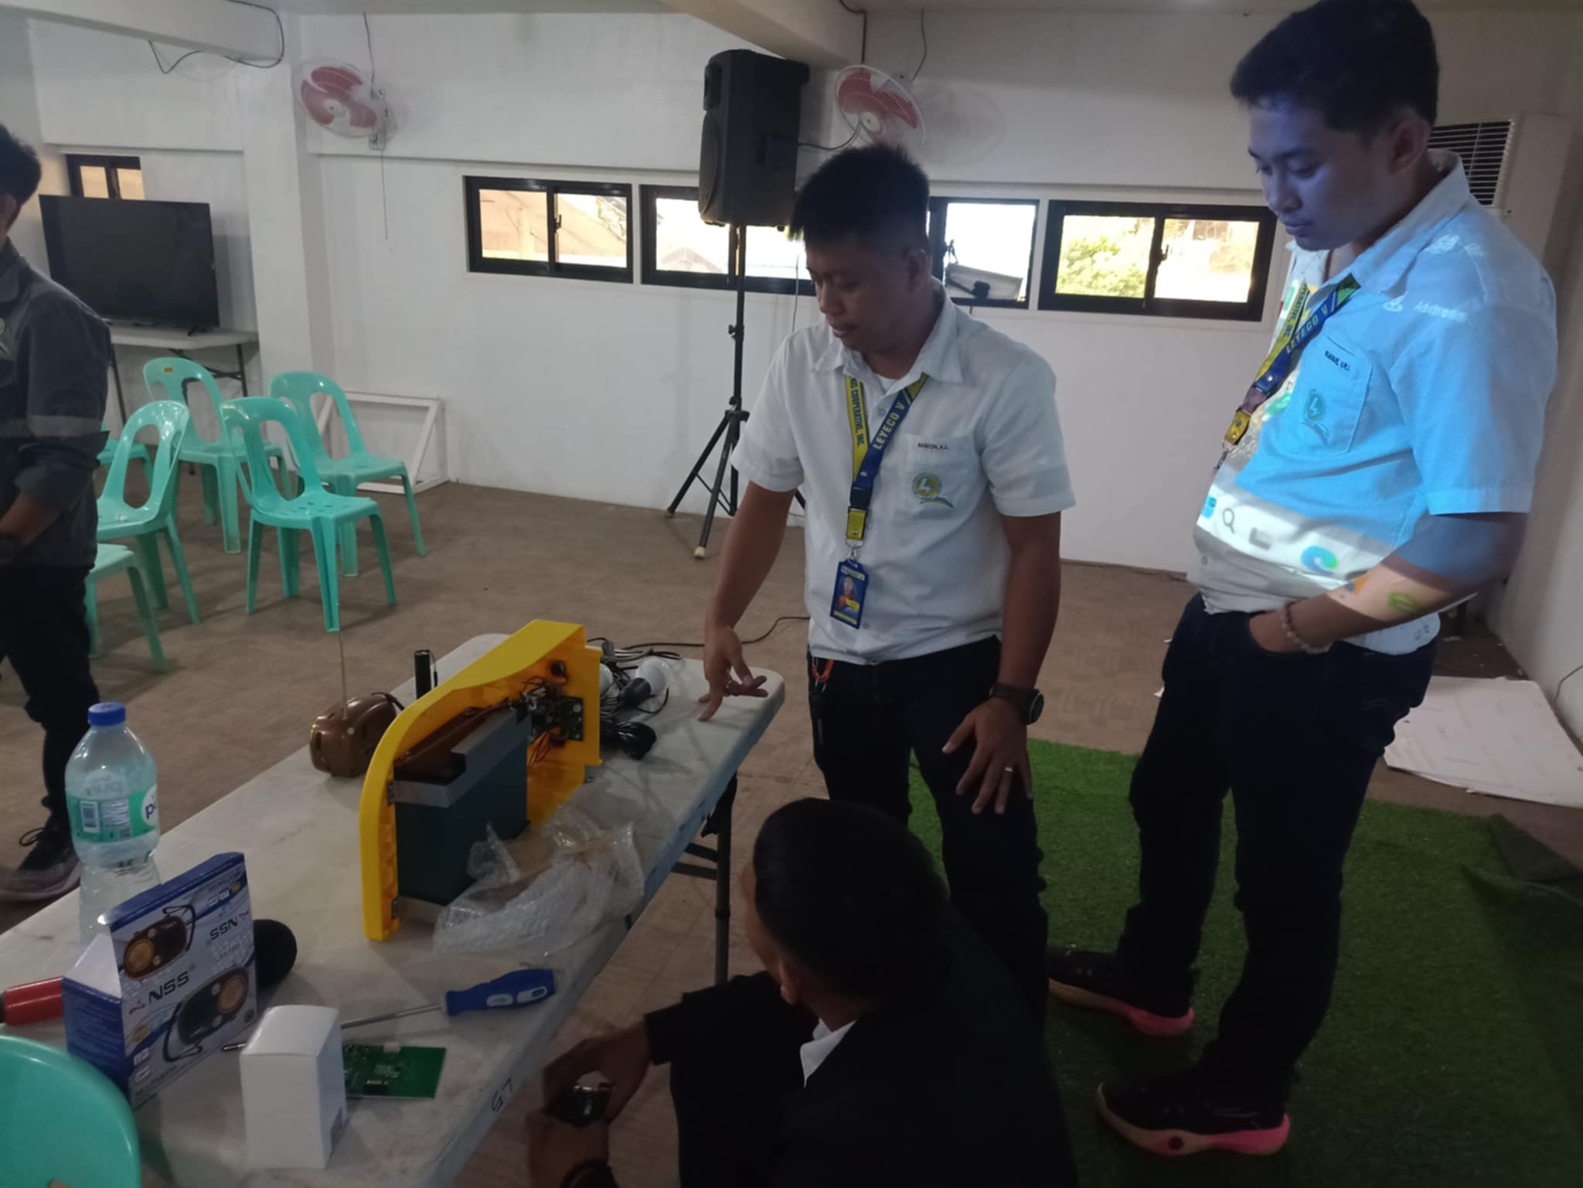
leyeco engineers and head of technicians learns hardware anatomy and troubleshoot of solar homes system

Slide 18
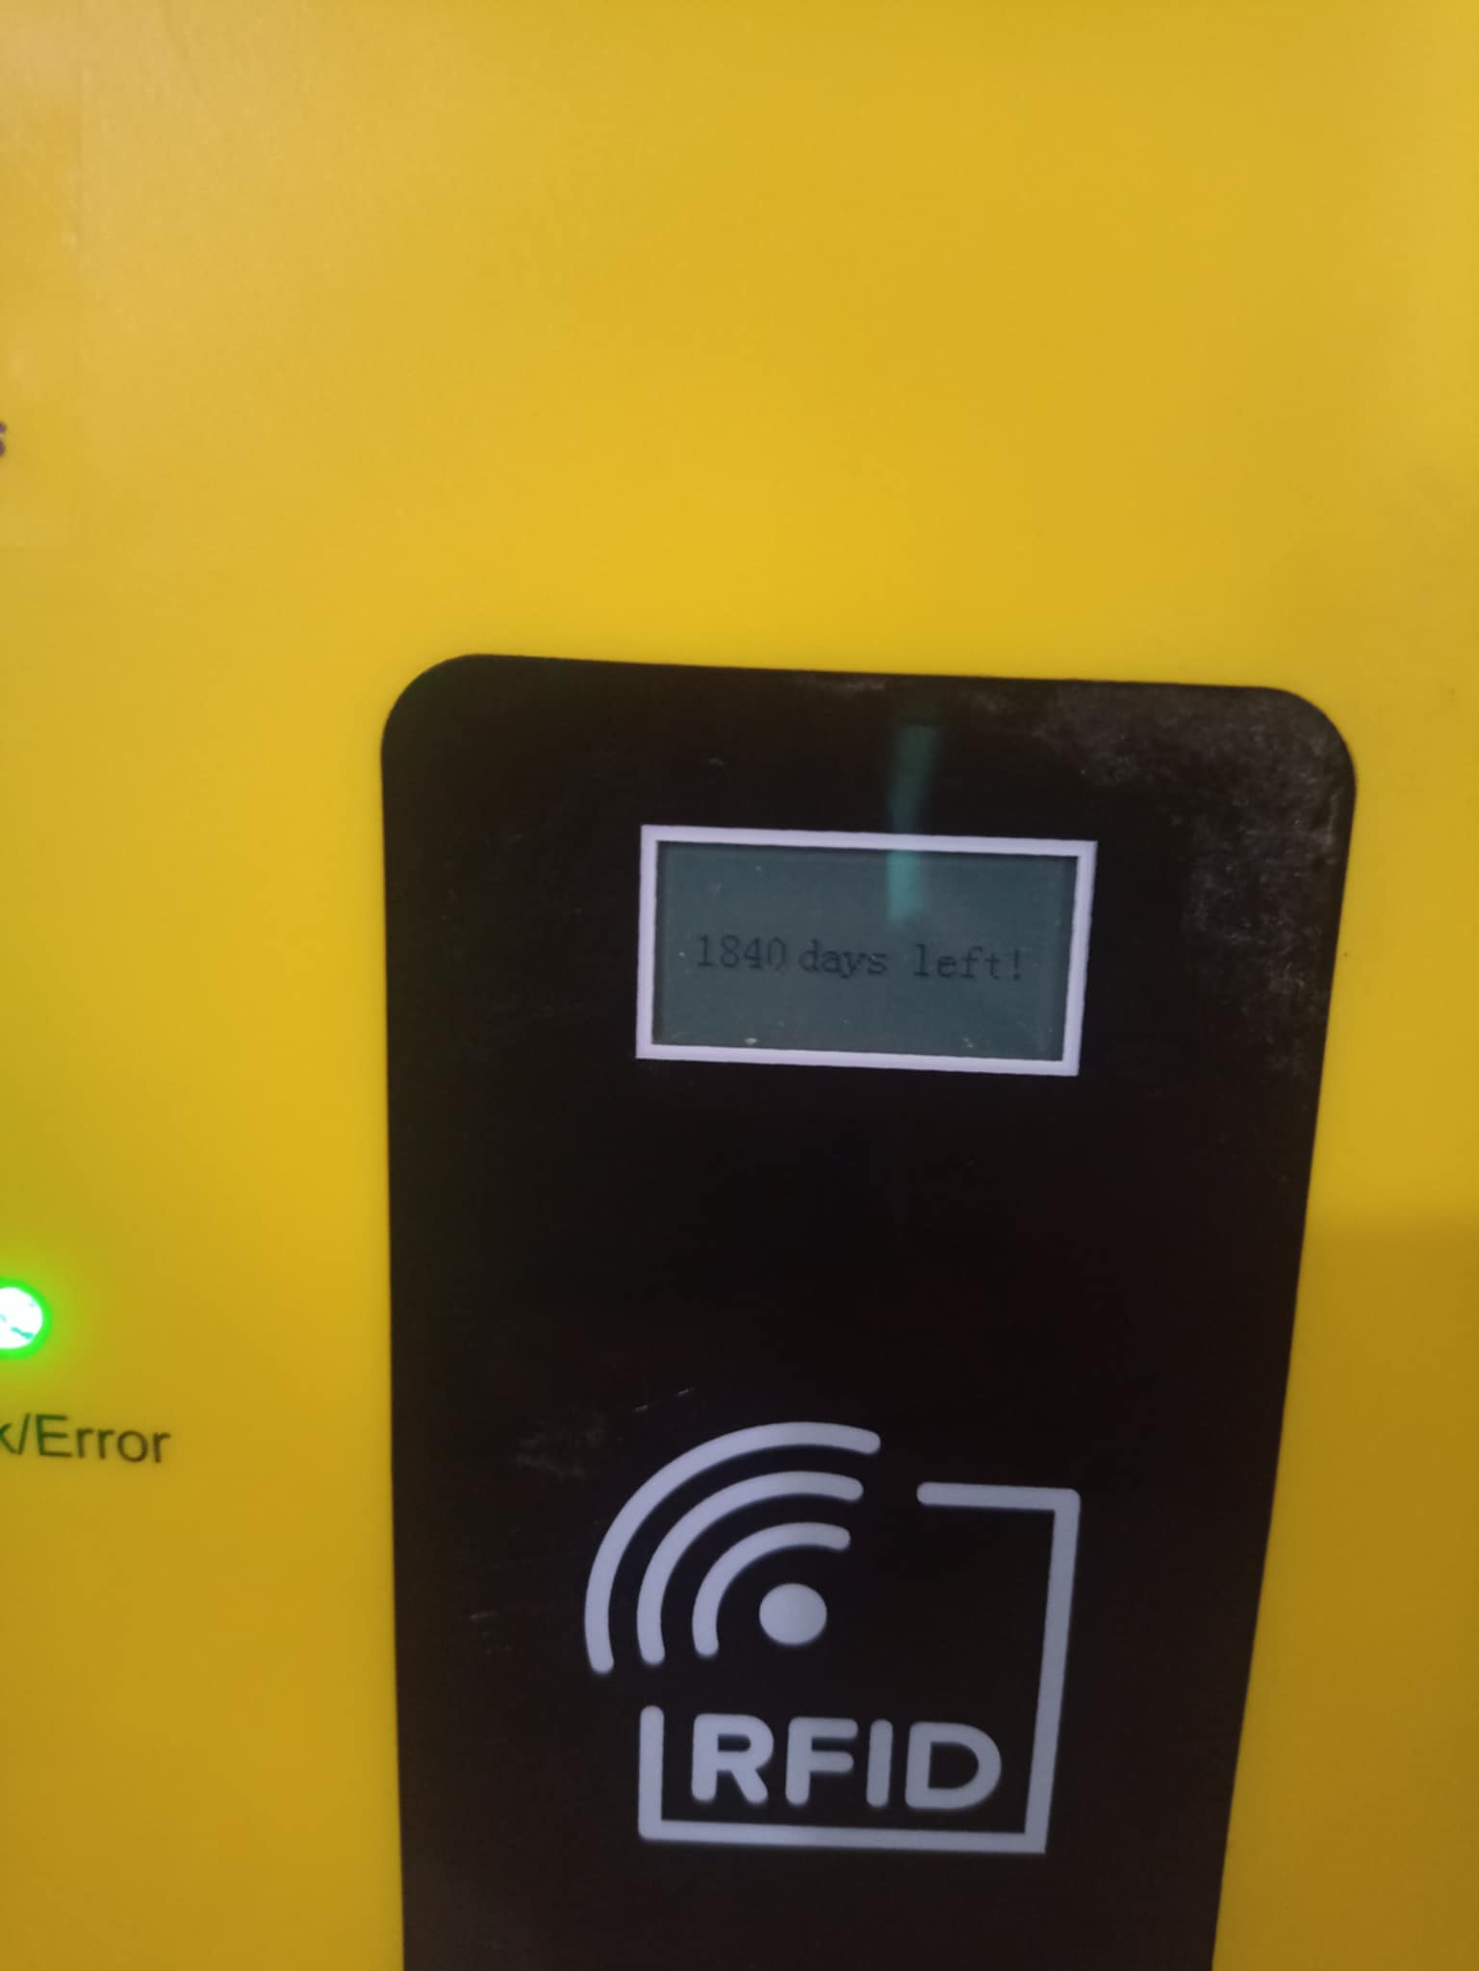
leyeco engineers and head of technicians load up to 5 years to test maximum limit of loading token

Slide 19
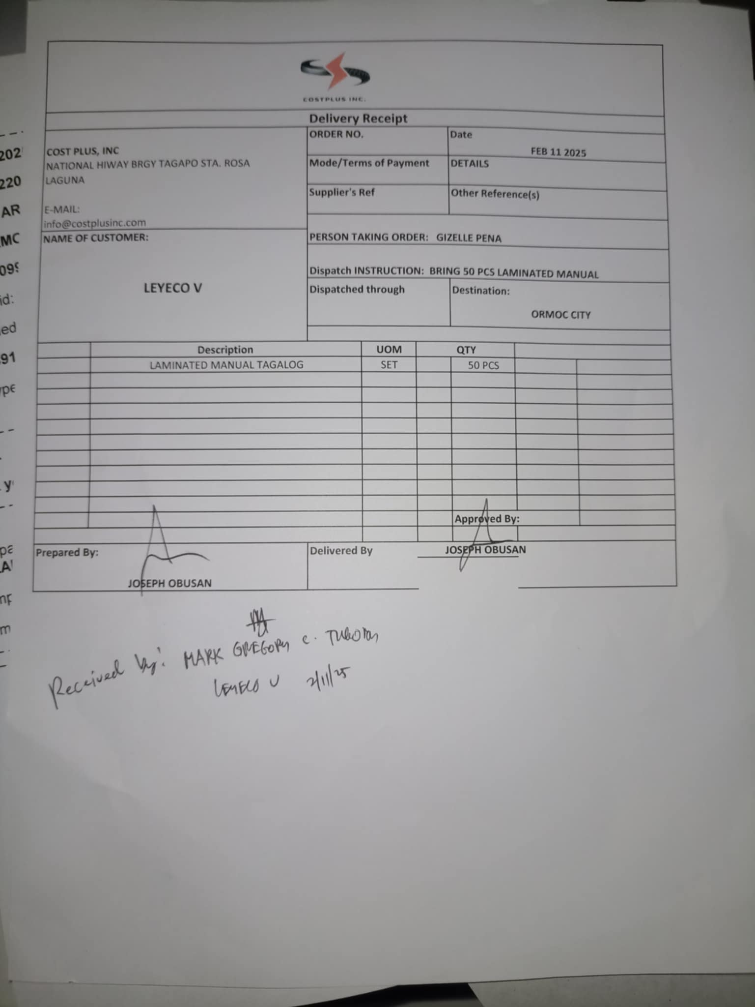
turn over 50 pcs shs manual to leyeco coop with receiving copy of dr

Slide 20
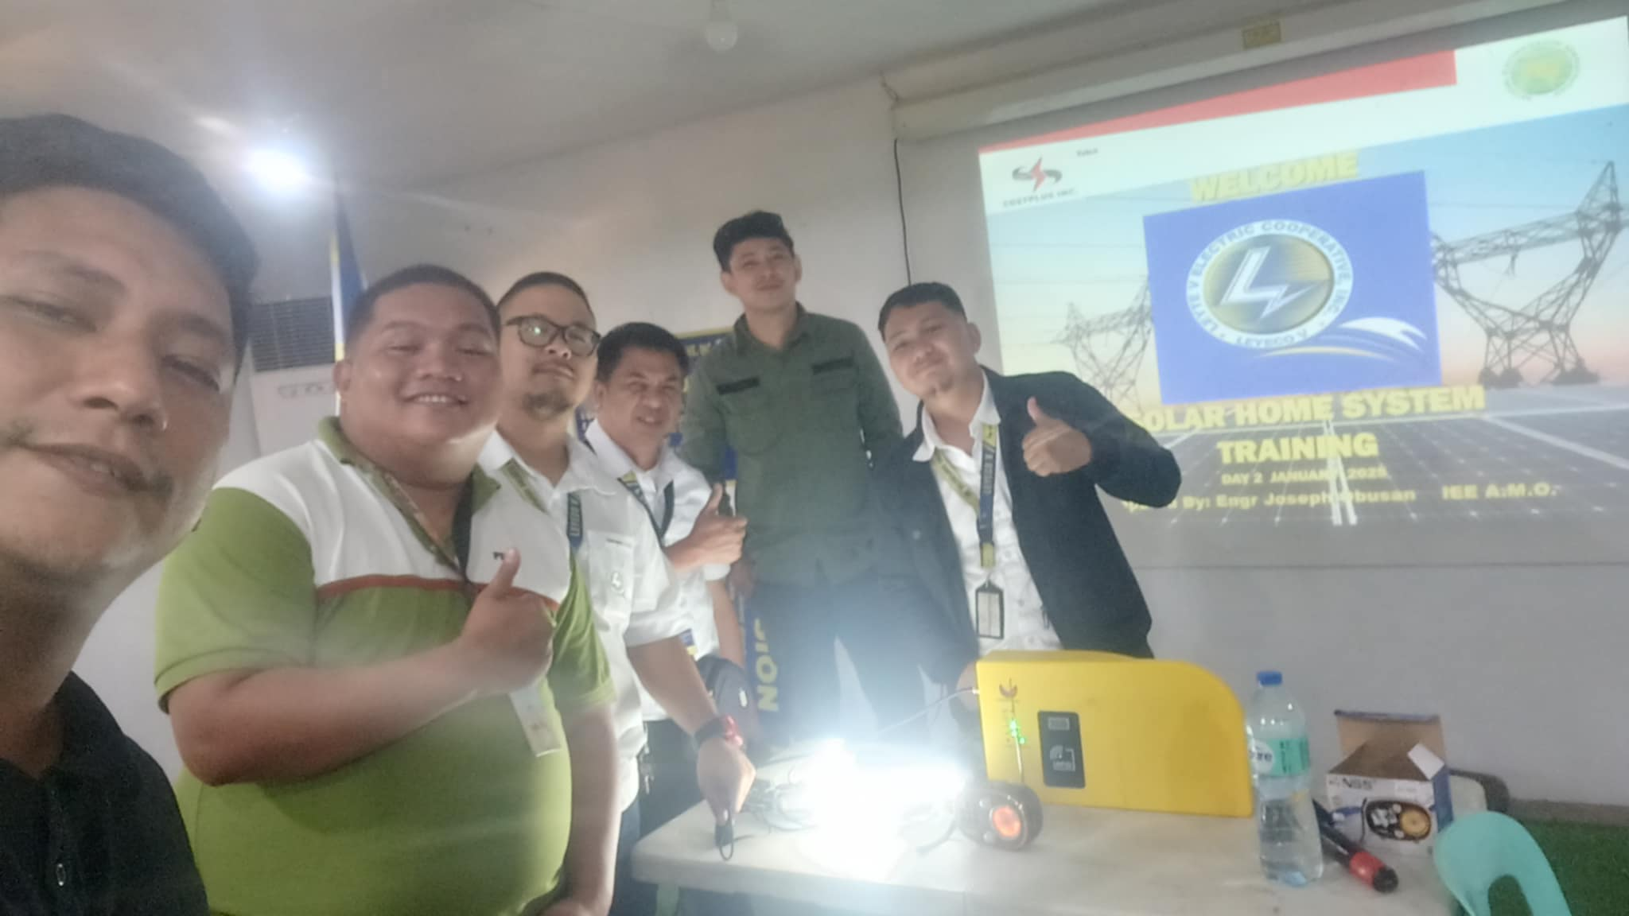
ending of training of LEYECO COOP

Slide 21
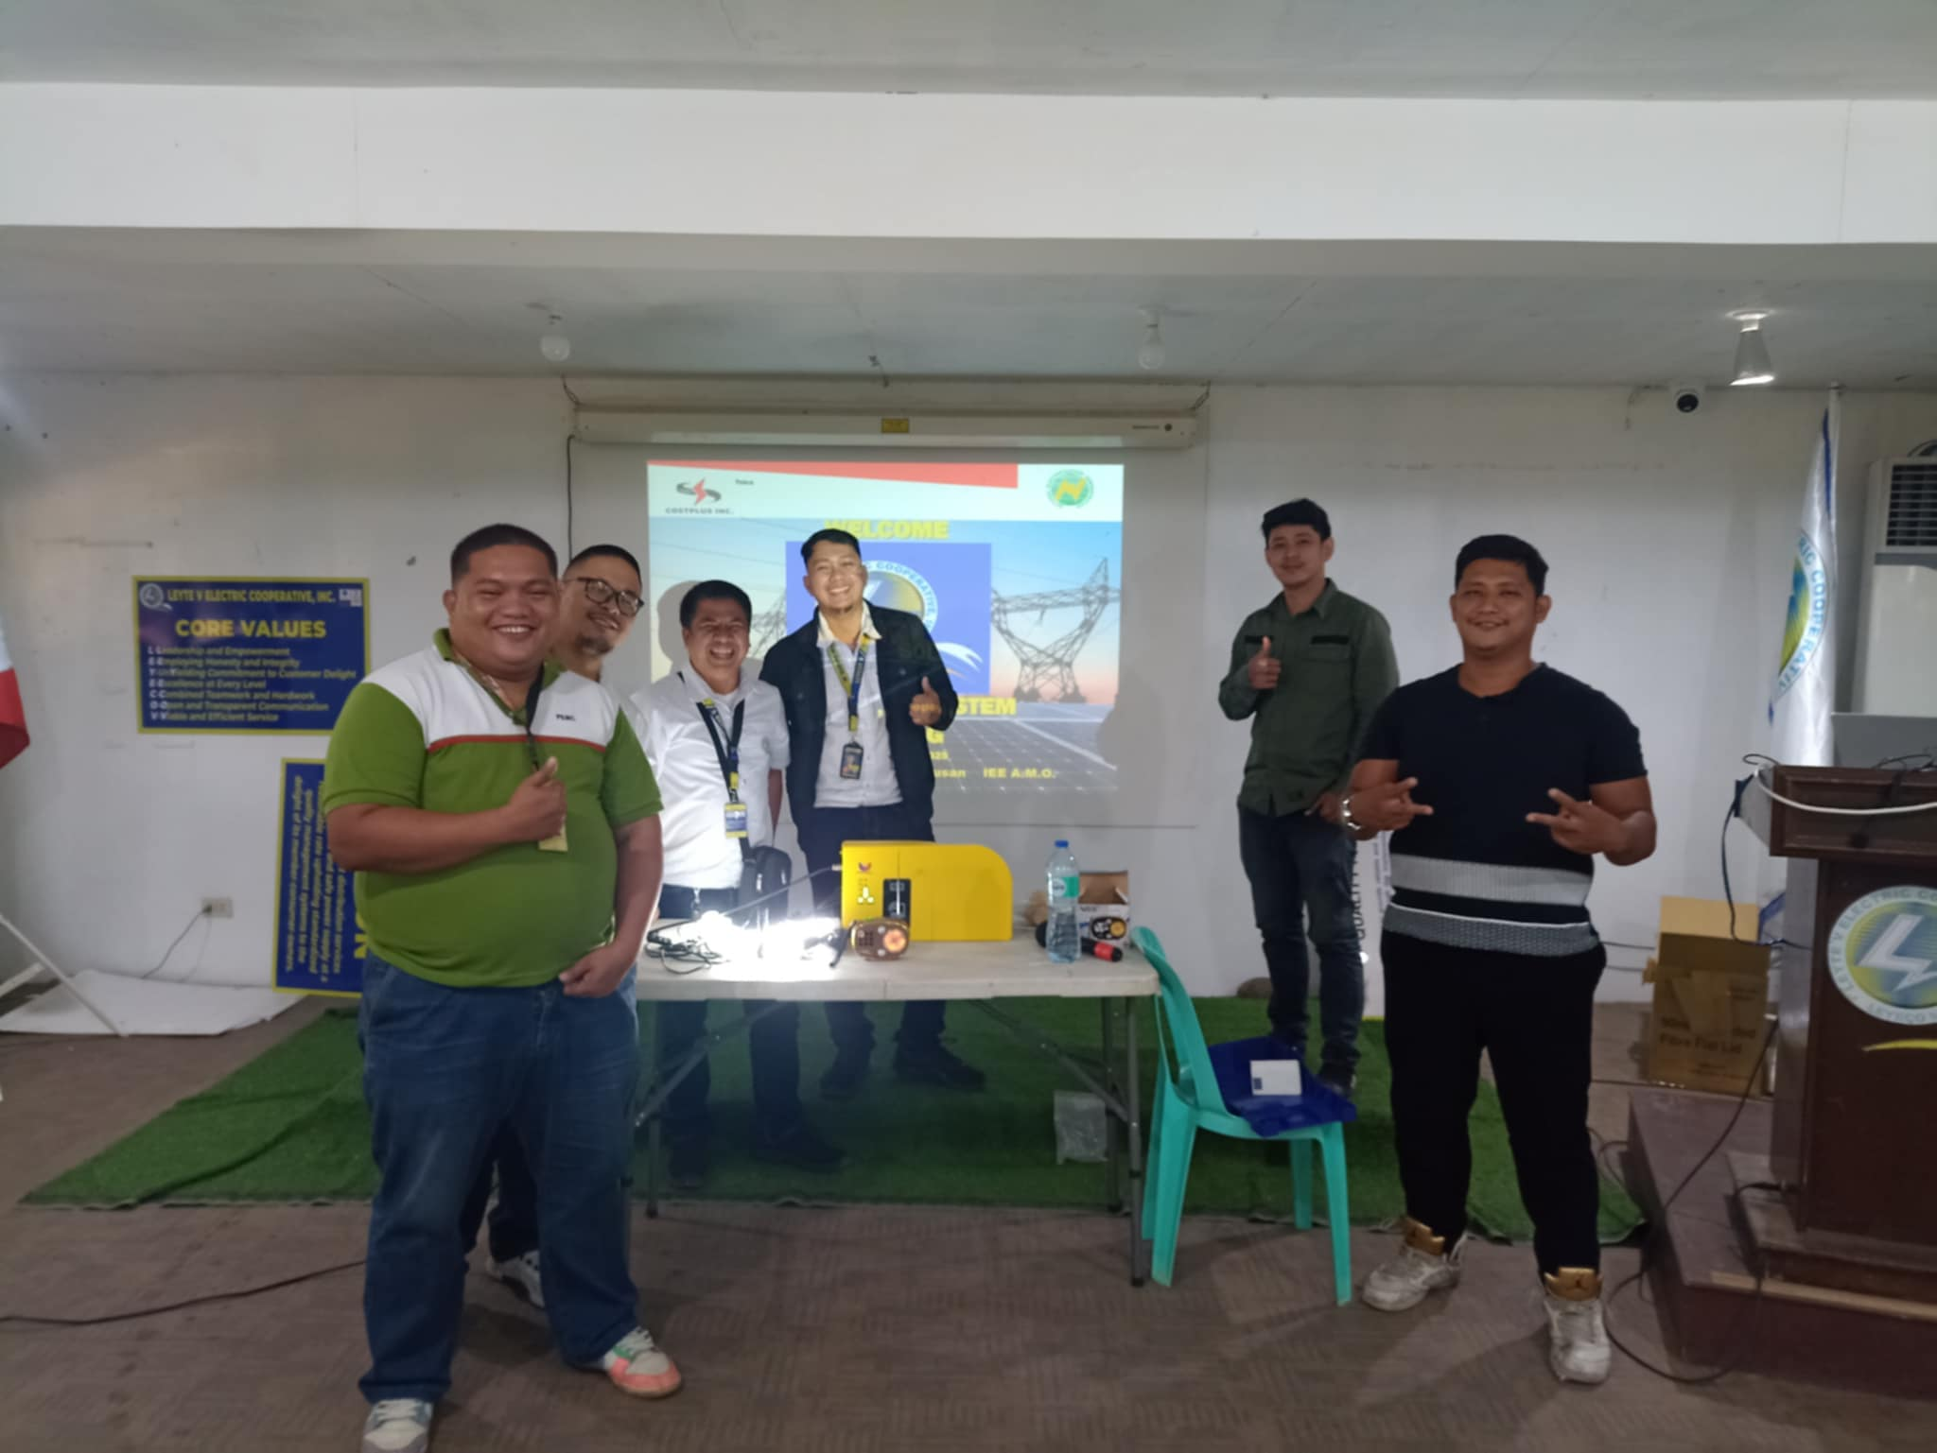
CPI technical with Leyeco engineers and team leaders

