Slide 1

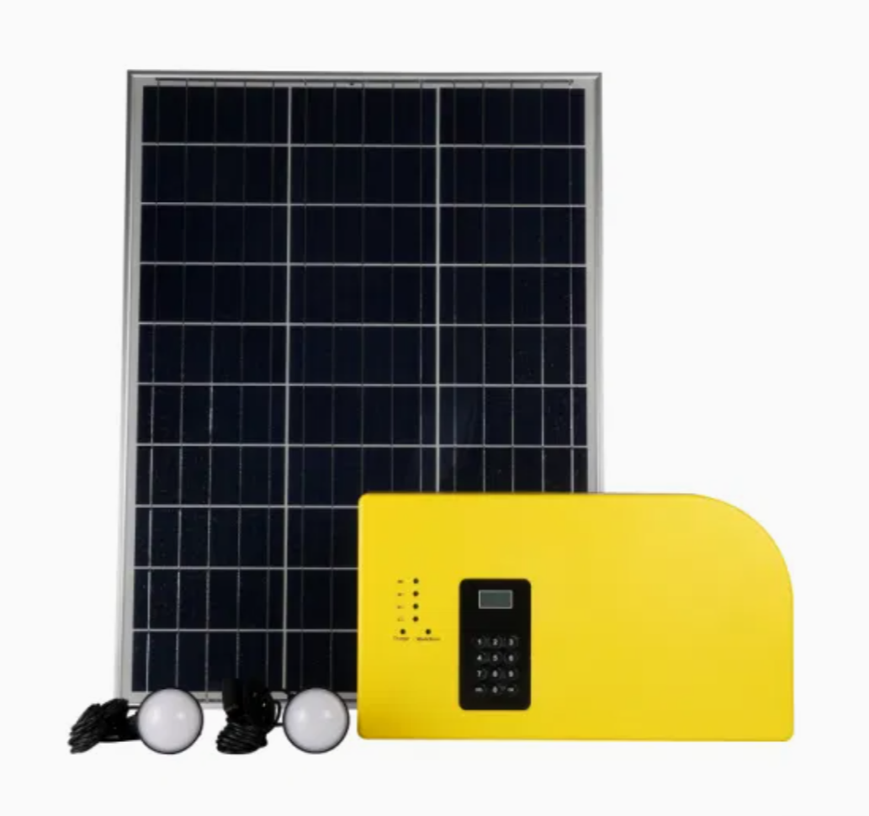
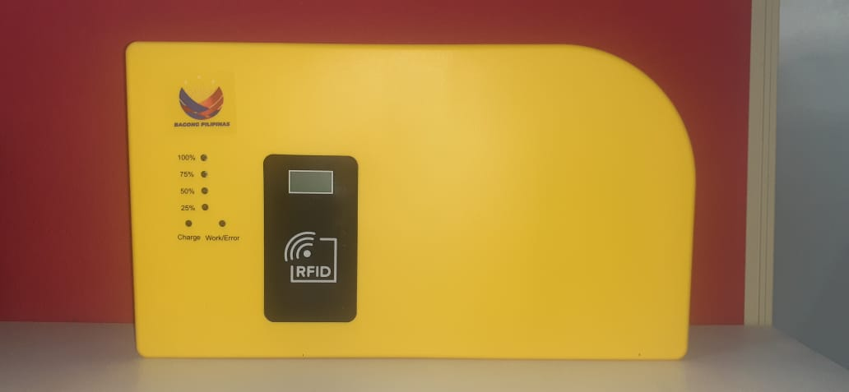
SOLAR HOME SYSTEM
LASURECO
TRAINING REPORT
Training Period:
February 27-28, 2025 (8am – 5pm)
Venue:
lasureco Main Office, Provicial capitol
b.O marawi, marawi city
Conducted & Prepared By:
Alfredo d. tarepe jr.

Slide 2
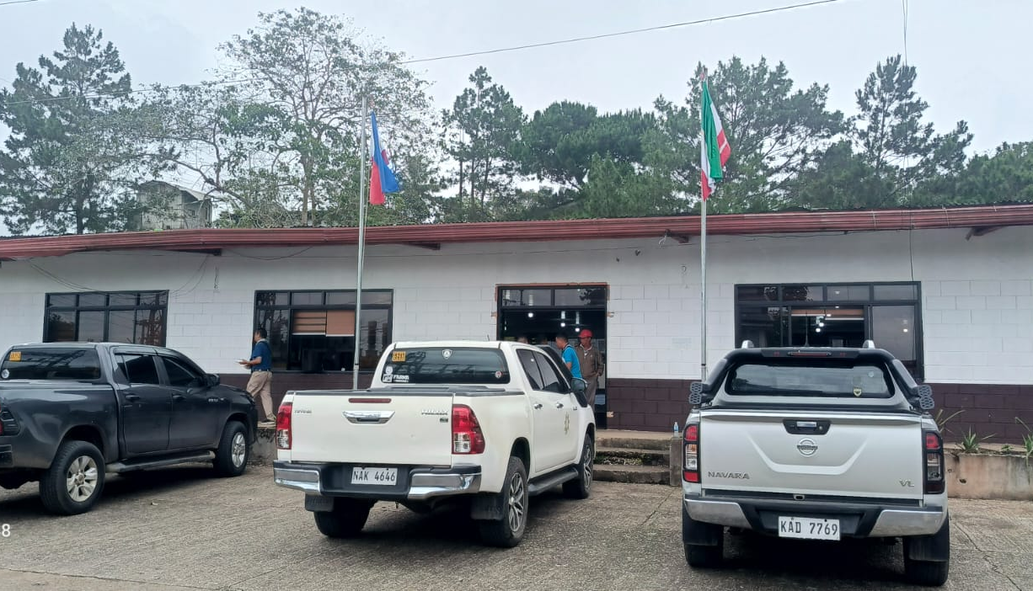

Slide 3
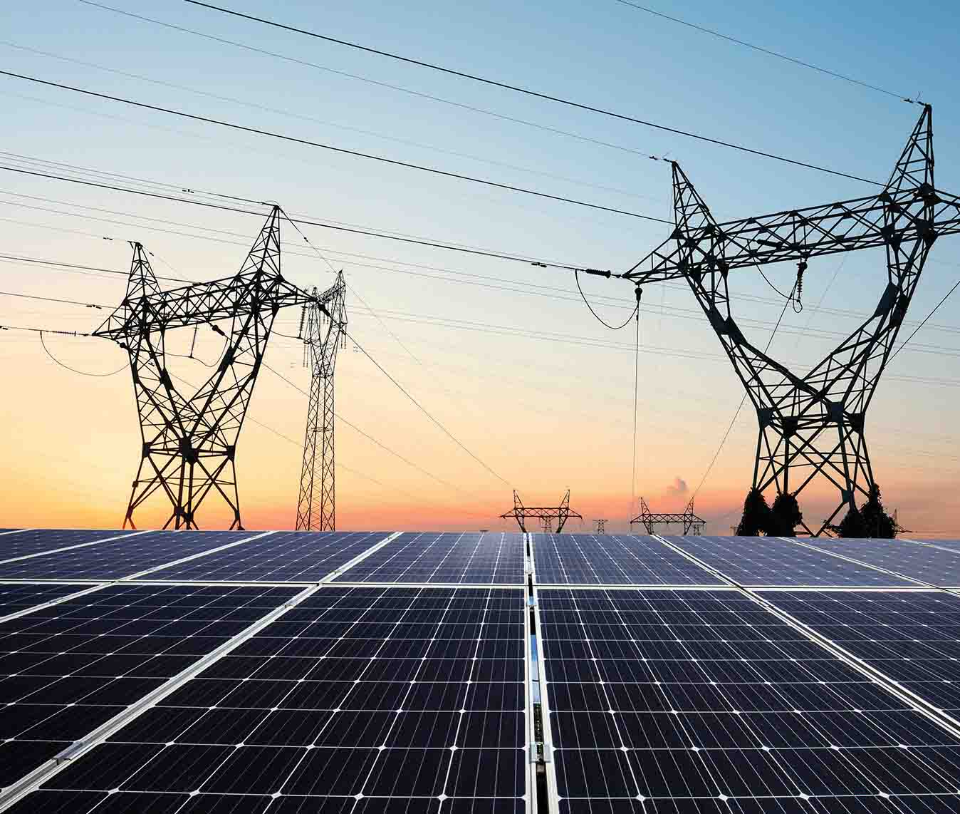
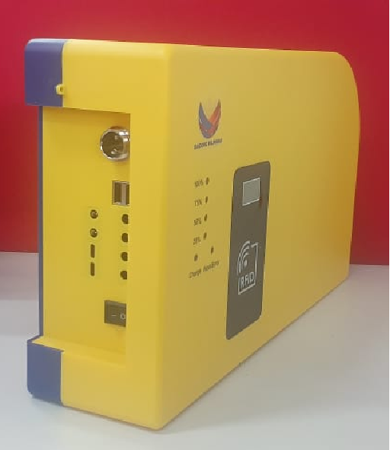
DAY 1
BASIC ON SOLAR ENERGY, SOLAR SYSTEM AND OTHERS
SYSTEM COMPONENTS AND FUNCTIONS
BASIC INSTALLATION AND OPERATION
RFID ACTIVATION AND LOADING SYSTEM
MAINTENANCE AND TROUBLESHOOTING
WARRANTY
INSTALLATION EVALUATION

Slide 4

TRAINING PHOTOS

Slide 5
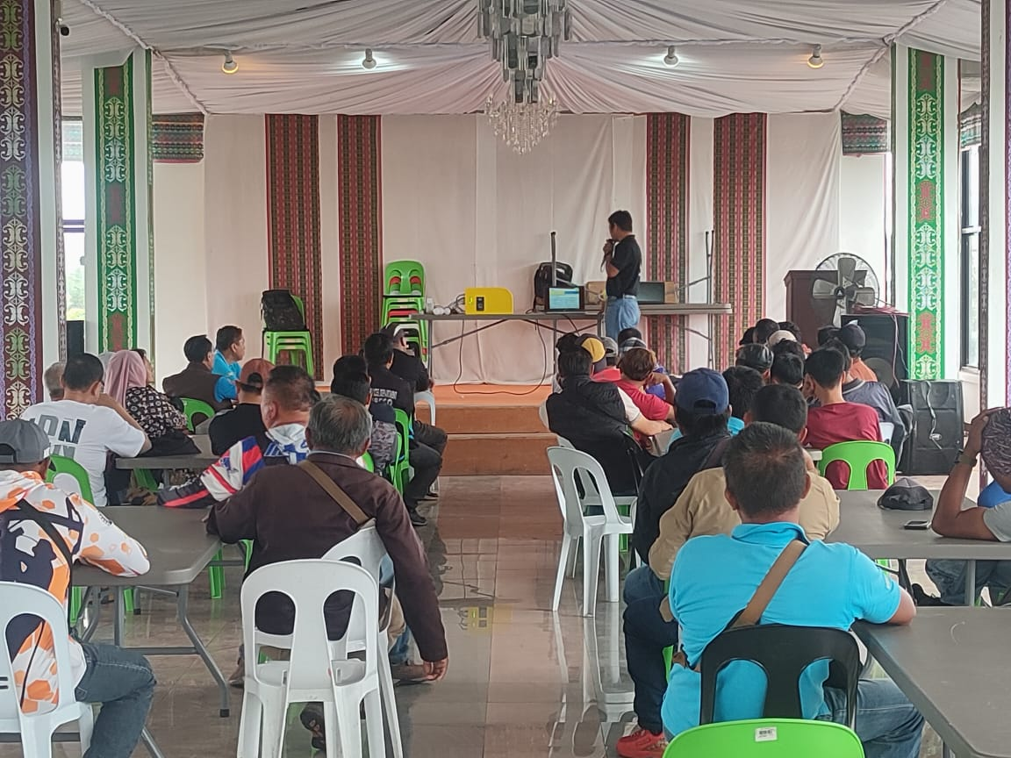
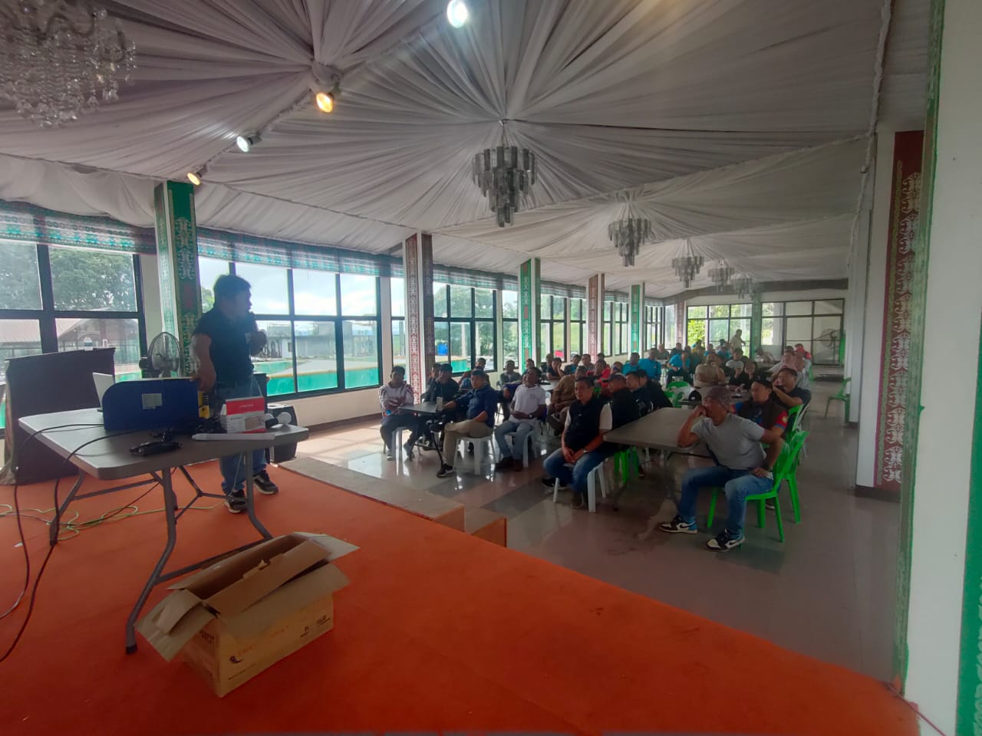

Slide 6
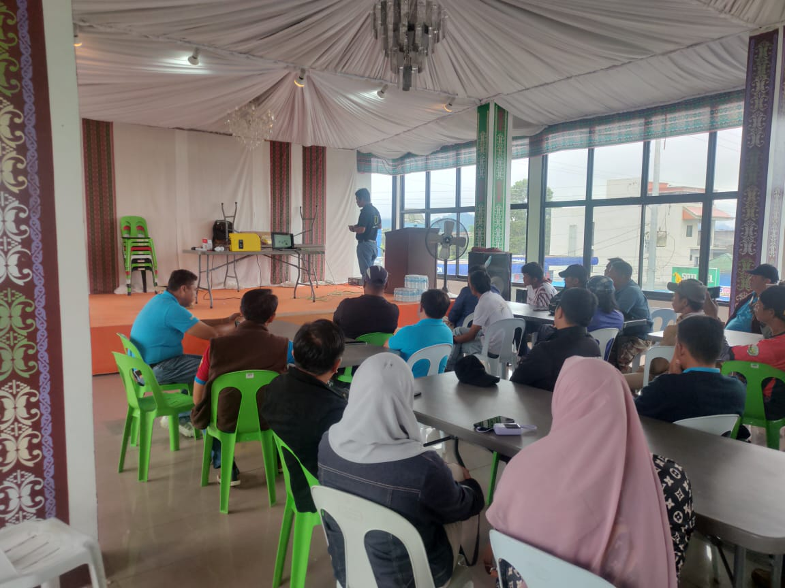
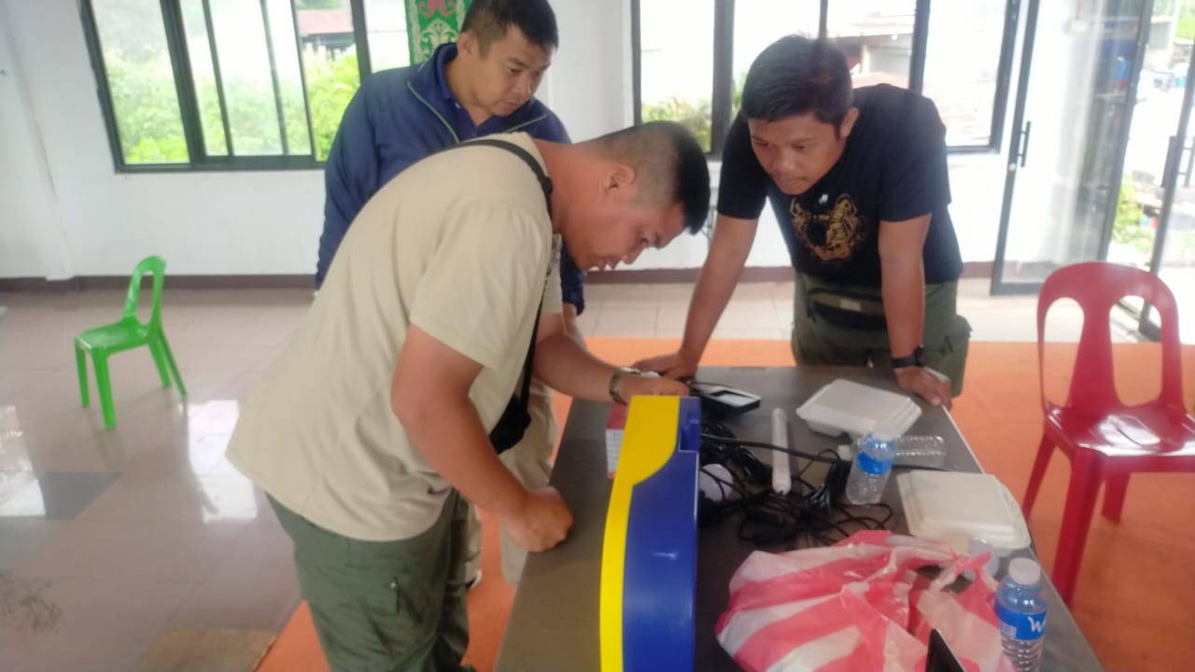

Slide 7
ATTENDANCE SHEET
PARTICIPANTS & ATTENDEES : 80

Slide 8
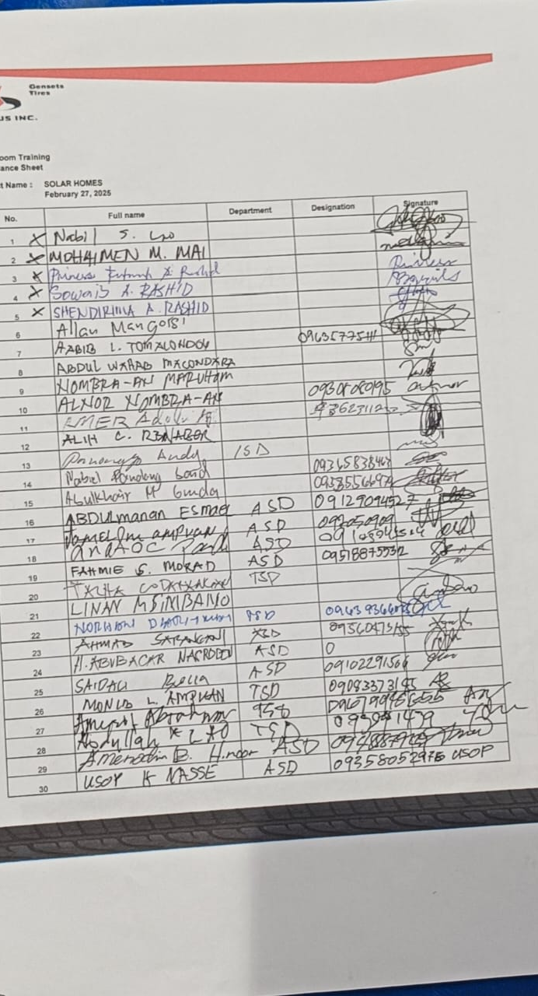
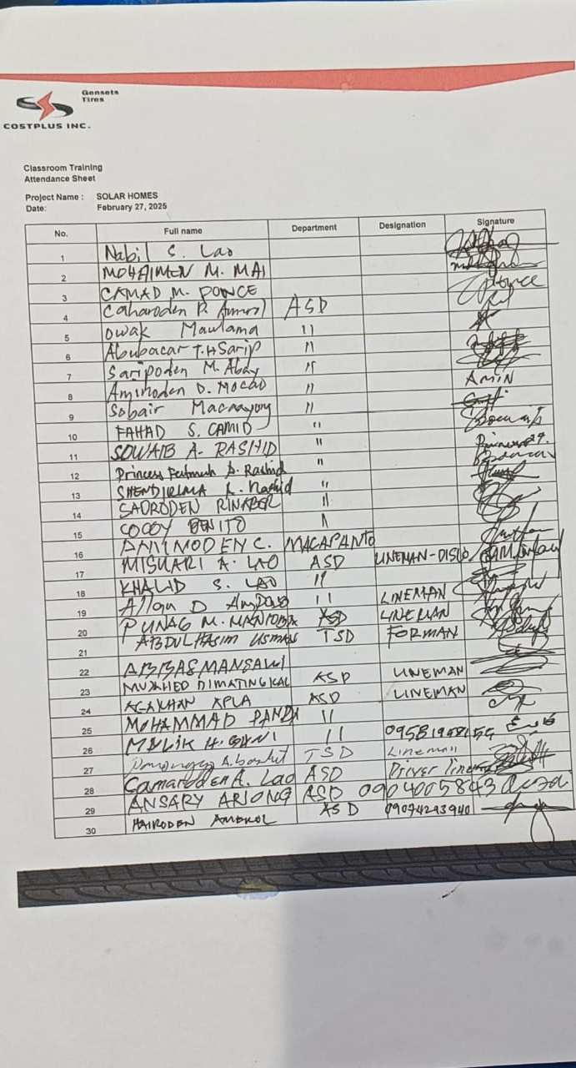
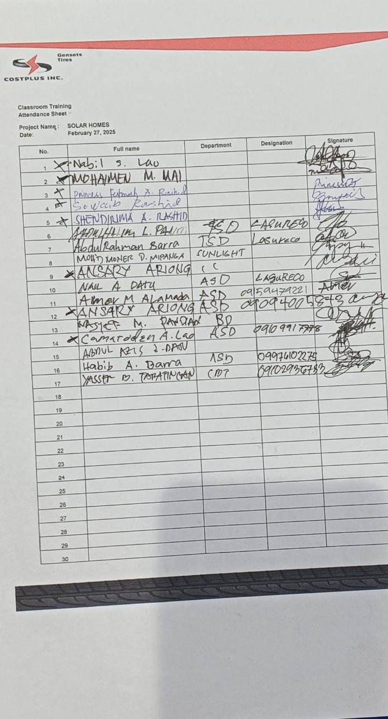

Slide 9
DAY 2
WORKSHOP OF RFID ACTIVATION, LOADING SYSTEM, SIMULATION OF COMMON ERRORS AND OTHER ADVANCED TROUBLESHOOTING
WORKSHOP OF SOLAR HOME SYSTEM COMPONENT AND FUNCTIONALITIES
COMPLETE REVIEW OF SOLAR HOME SYSTEM

Slide 10
TRAINING PHOTOS

Slide 11
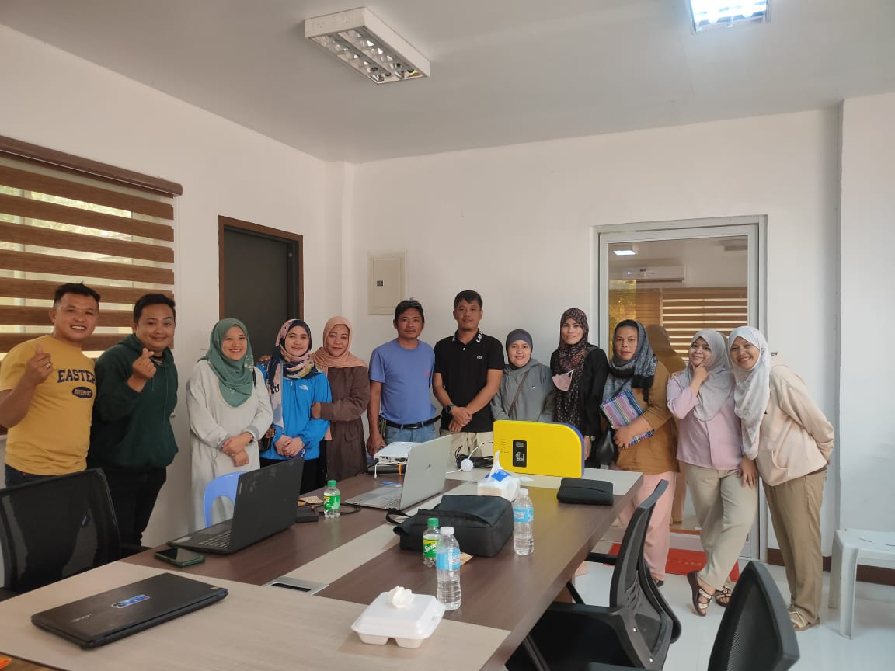
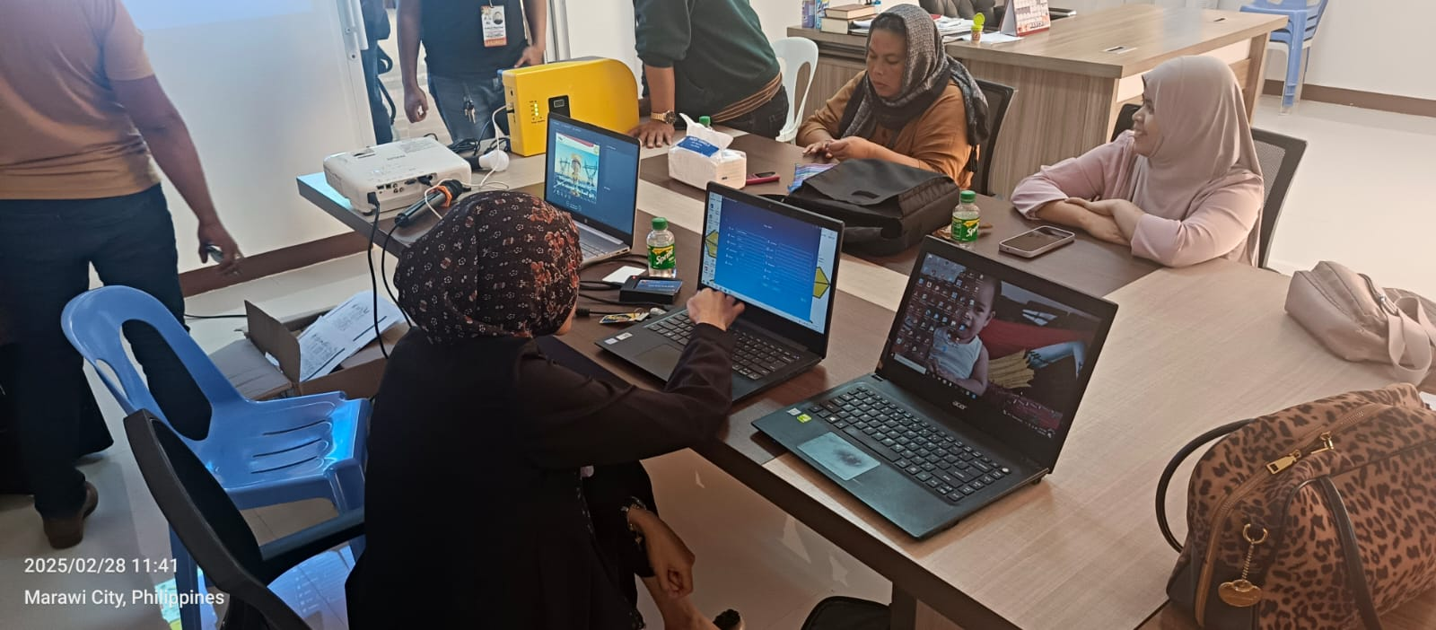

Slide 12
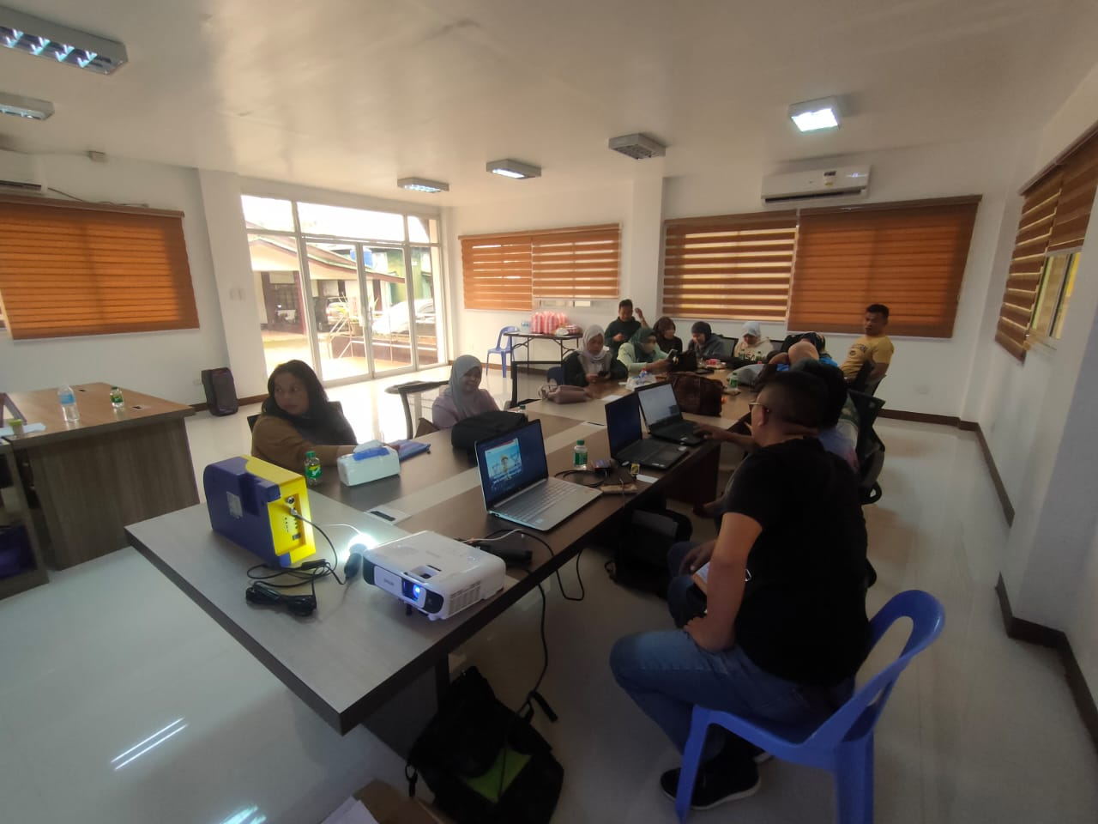
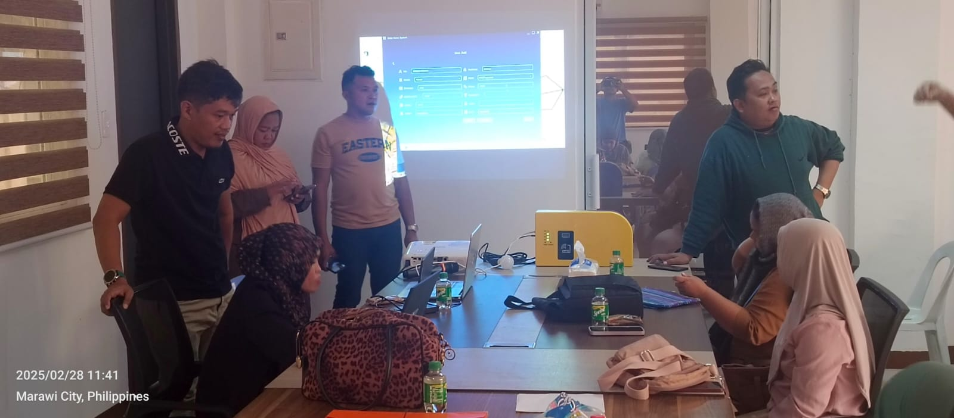

Slide 13
ATTENDANCE SHEET
PARTICIPANTS & ATTENDEES ADMIN : 17

Slide 14
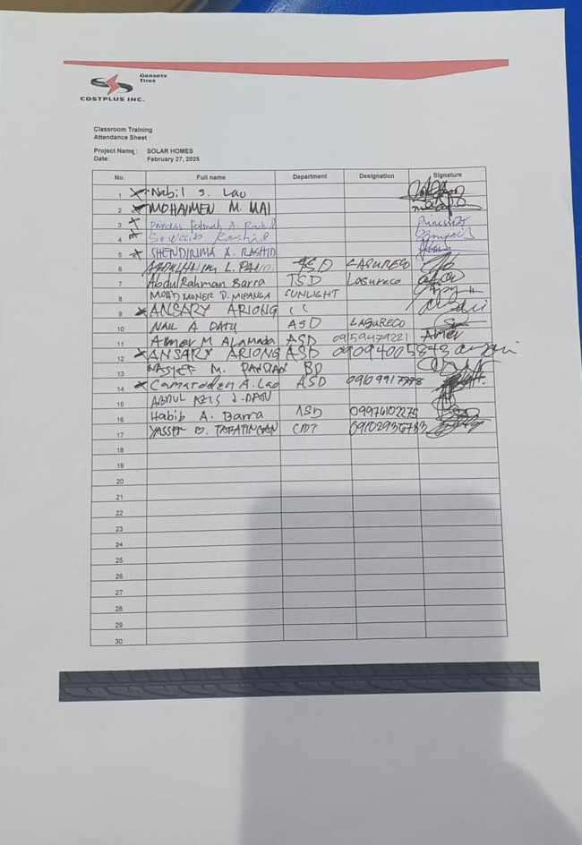

Slide 15
THANK YOU
PREPARED BY :
ALFREDO D.TAREPE JR
SENIOR TECHNICAL ENGINEER II

