Slide 1



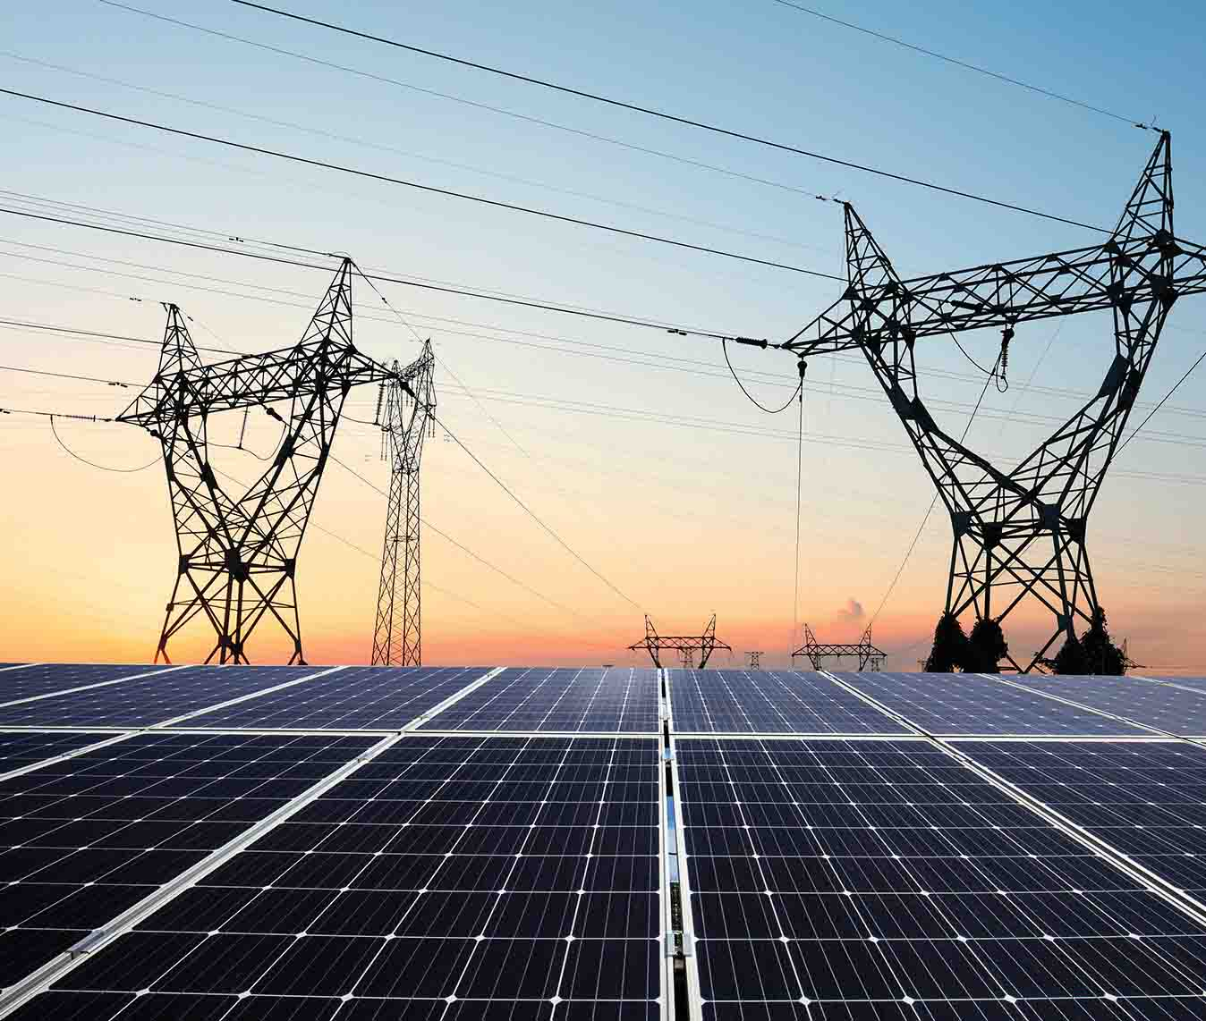
WELCOME
SOLAR HOME SYSTEM
2 DAYS TECHNICAL TRAINING
FEBRUARY 17 & 18 2025
Prepared By:
Denise Dinglasan
Engr Joseph Obusan IEE A.M.O.

Slide 2
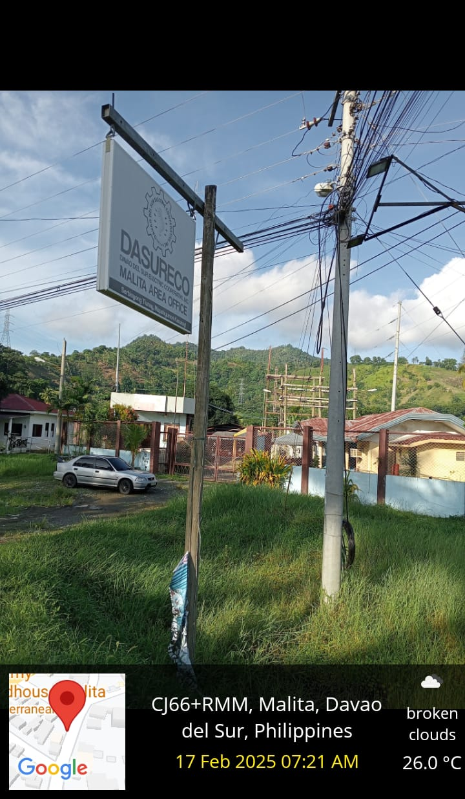

Slide 3
SHS Training
Day 1
AM
830:00am –10:00am Basic on Solar Energy & others
10:00am –10:30am Snacks
10:45am-12:00pm – Basic Installation & others
12:00pm – 1:00pm – Lunch
PM
1:00pm – 3:30pm – RFID Activation & Loading
3:30pm – 3:45pm – Snacks
3:45pm – 5:00pm – Testing/ Q & A

Slide 4
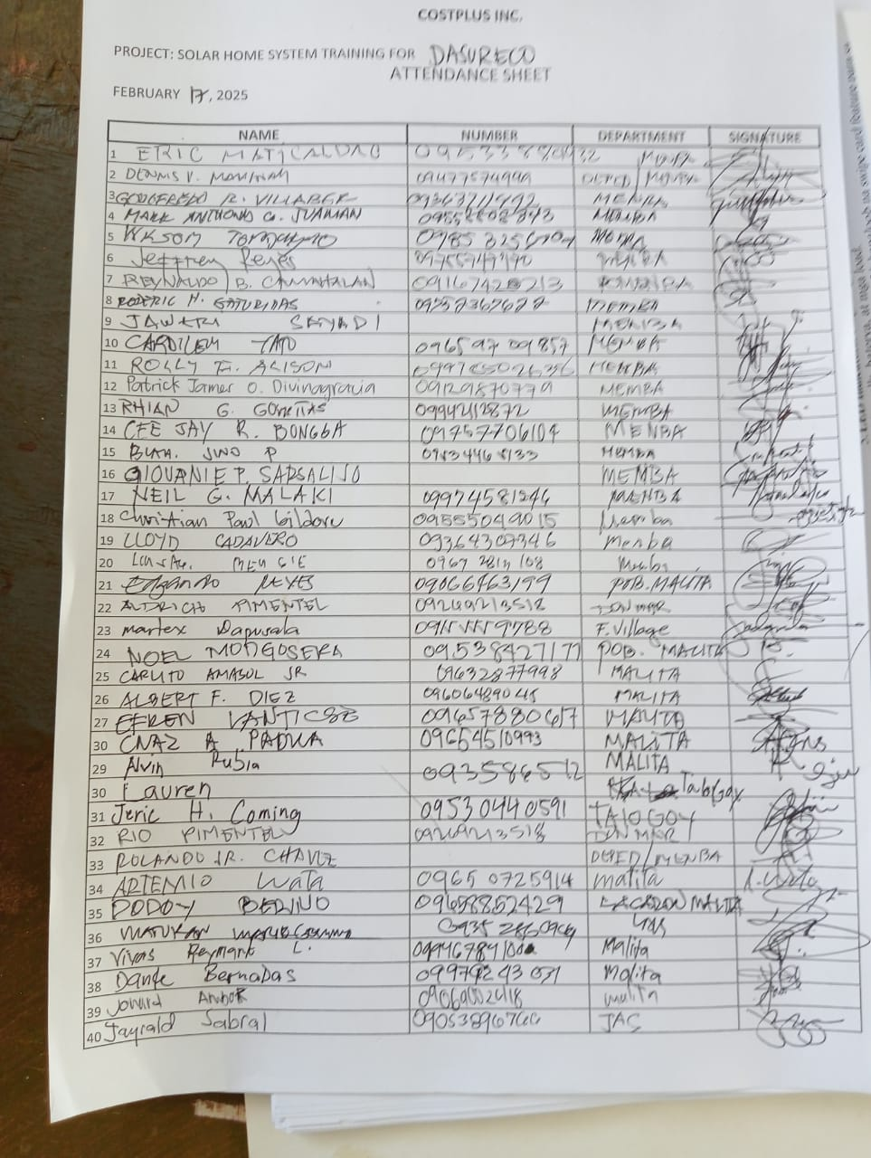
DAY 1 PARTICIPANTS 44 TOTAL DAY 2 64 PARTICIPANTS

Slide 5
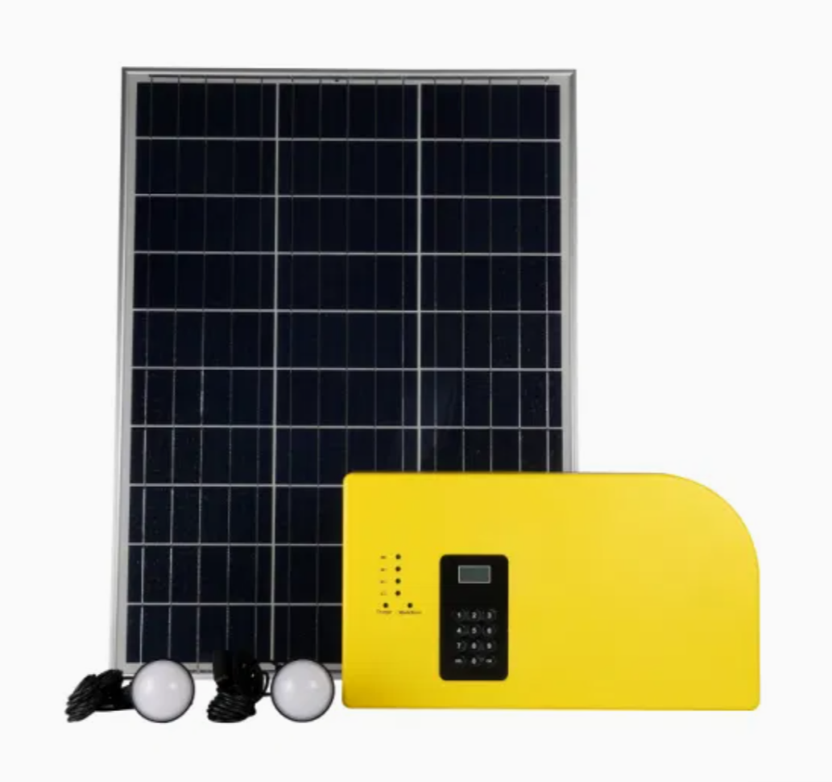
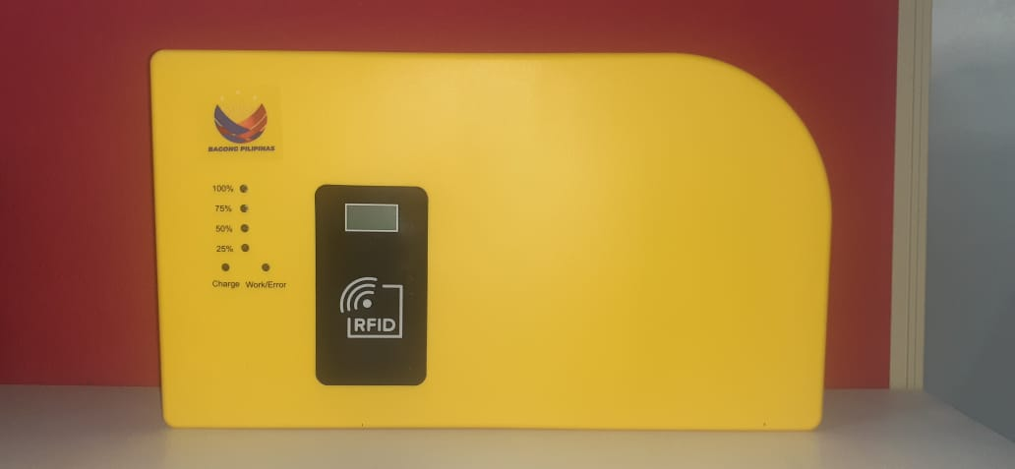
Solar Home System

Slide 6
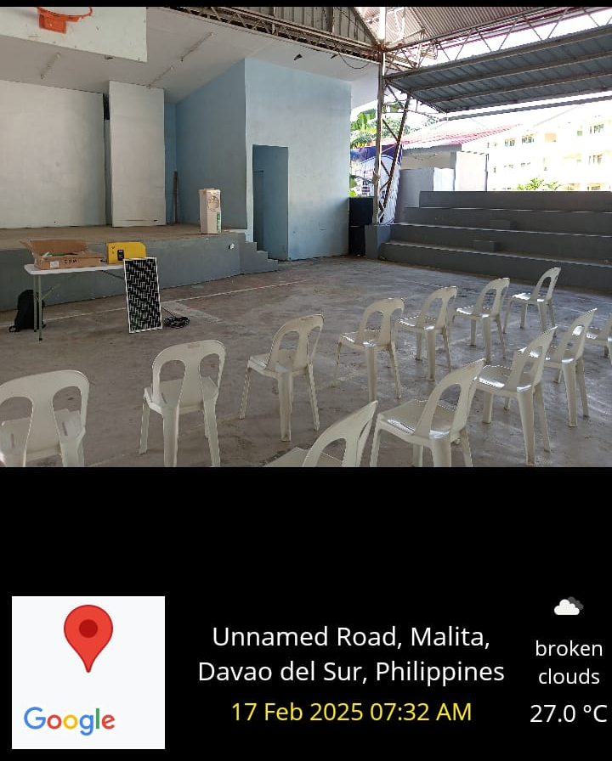
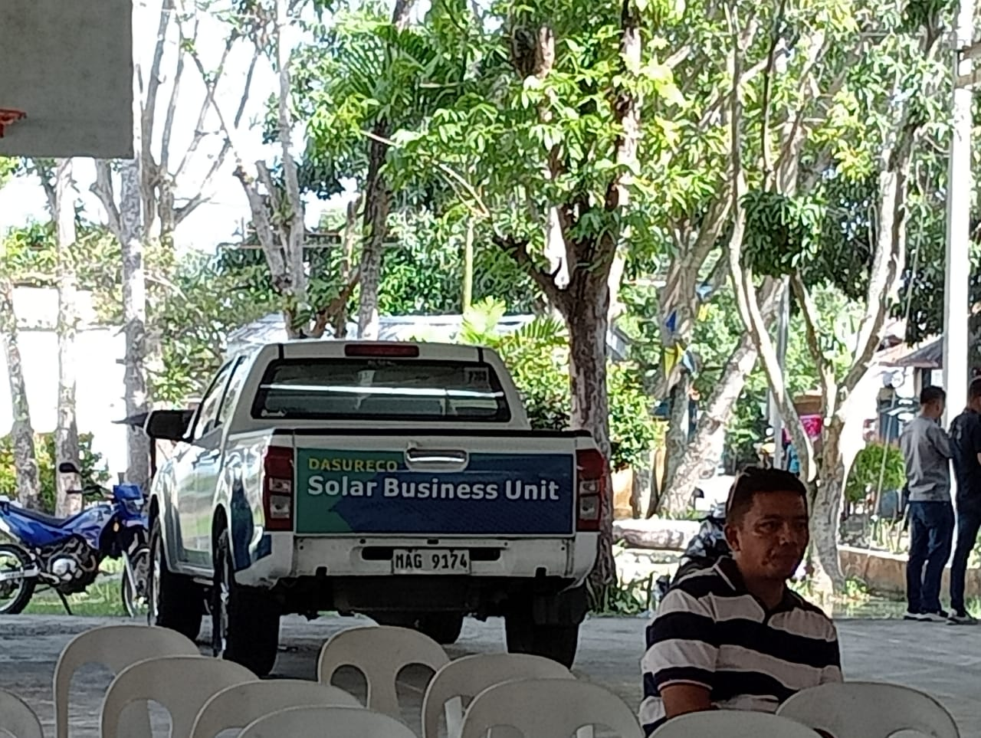
EALRY PREPARATION OF SHS EQUIPMENT AND WAITING FOR PARTICIPANTS DUE TO EARLY MORNING MEETING WITH DASURECO TEAM AND ALSO SOLAR BUSINESS UNITS

Slide 7
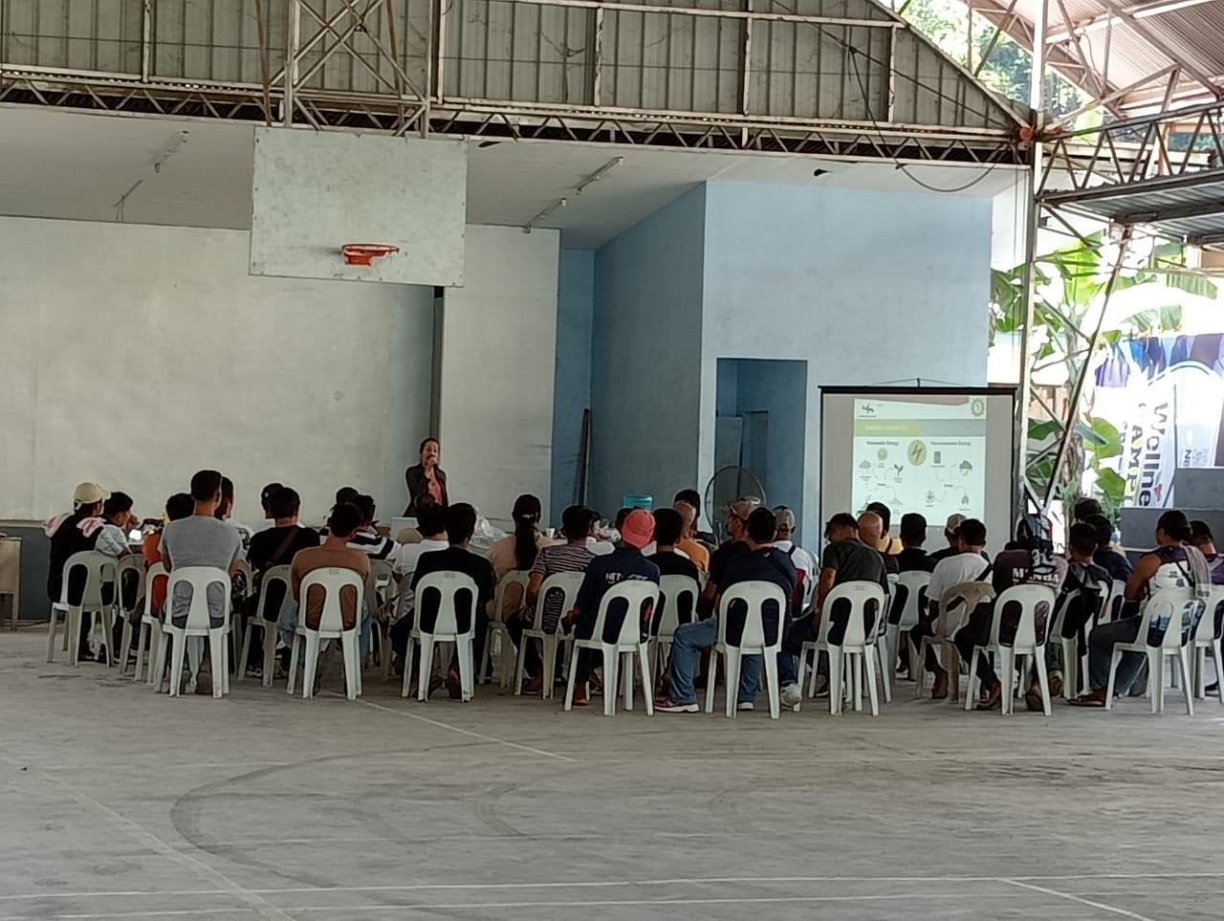
INTRODUCTION OF COSTPLUS PRODUCT : SOLAR HOMES SYSTEM TO DASURECO SOLAR BUSSINESS UNITS
DISCUSSION OF SOLAR HOMES SYSTEM TO PARTICIPANTS
DEMONSTRATION OF SOLAR HOMES SYSTEM AND HOW IT OPERATES

Slide 8
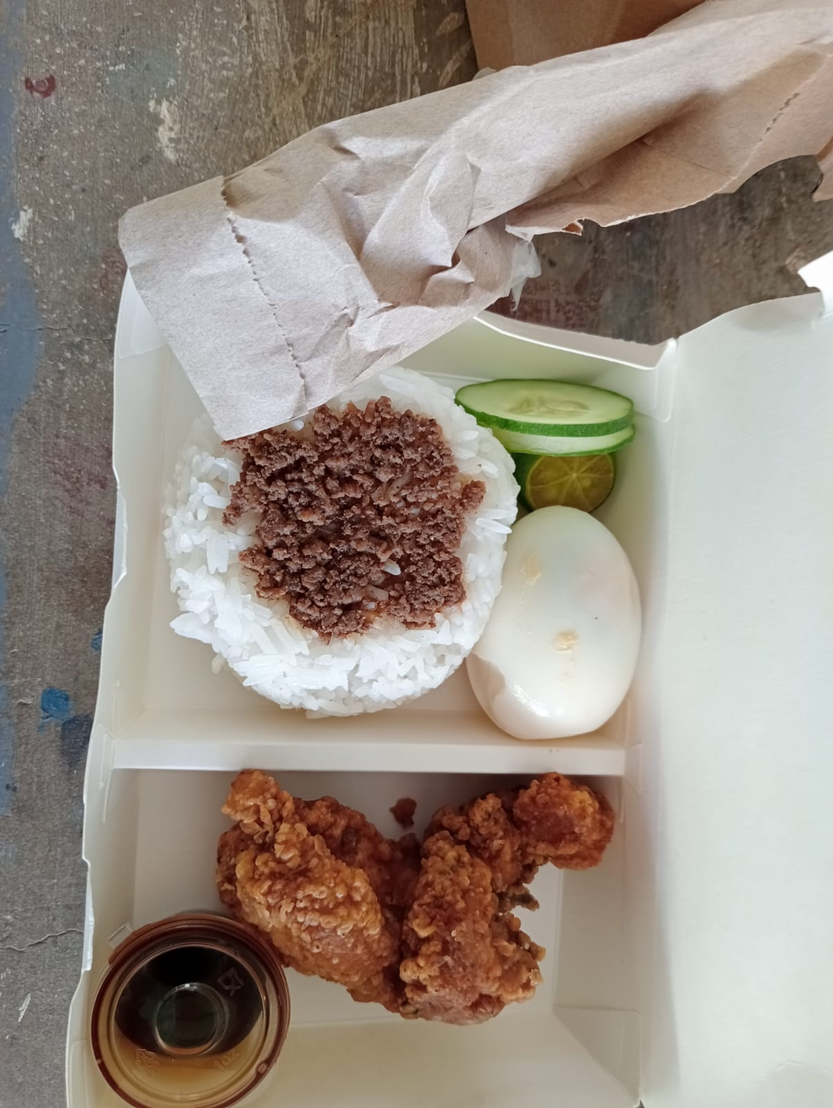
LUNCH PROVIDED DASURECO TRAINING

Slide 9
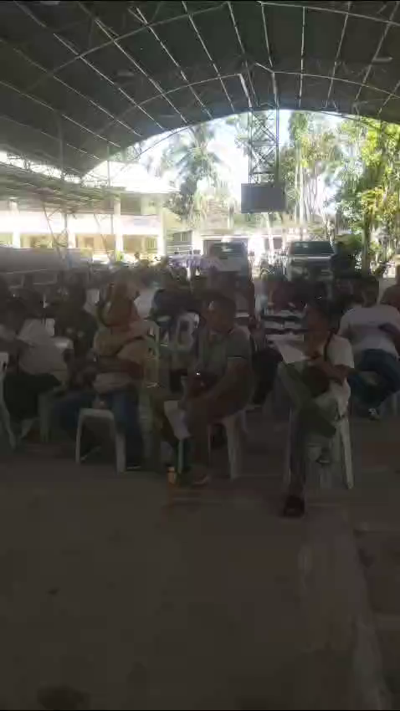
ACTUAL -VIDEO OF PRESENTATION OF SOLAE HOMES SYSTEM TO ITS DASURECO SOLAR BUSSINESS UNITS PARTICIPANTS

Slide 10
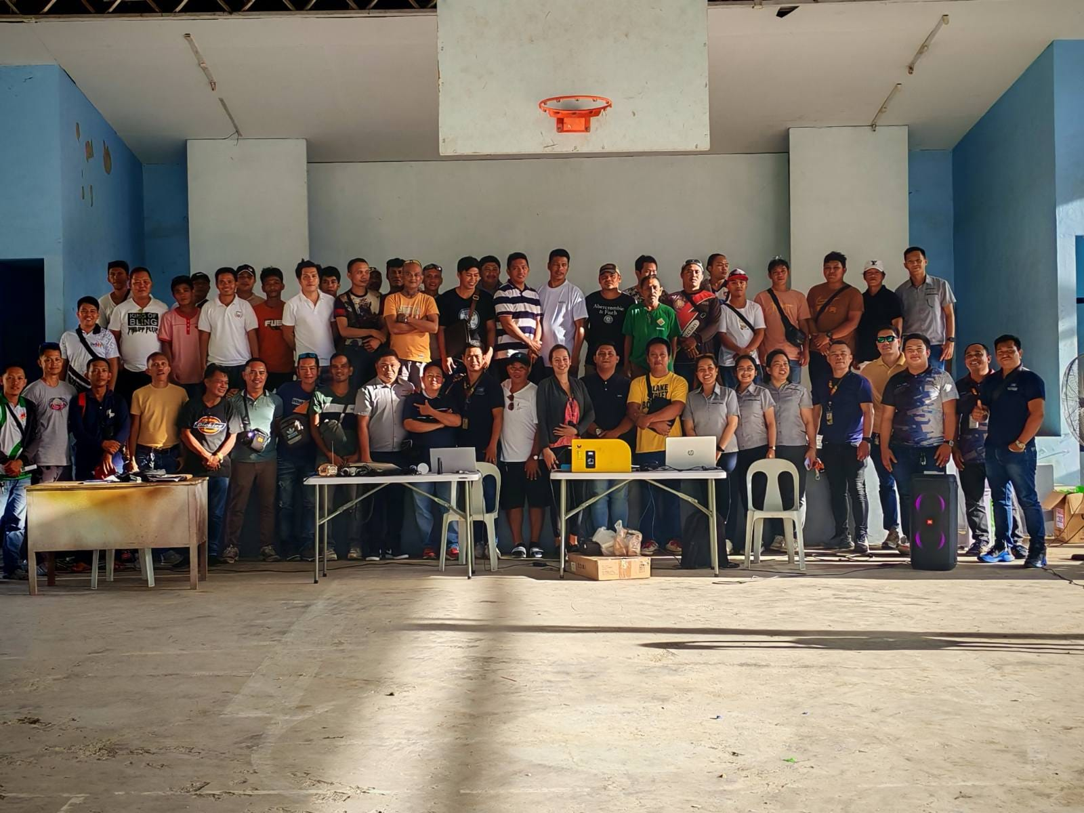
DAY 1 ACTIIVITY
1. INTRODUCTION OF SOLAR HOMES SYSTEM
2 DEMONSTRATION OF HOW SOLAR HOMES SYTEM WORKS
3. QUESTIONS AND ANSWER

Slide 11
SHS Training
Day 2
AM
830:00am –10:00am Review on Basic on Solar Energy & others
10:00am –10:30am Snacks
10:45am-12:00pm – Review on Basic Installation & others
12:00pm – 1:00pm – Lunch
PM
1:00pm – 3:30pm – RFID Activation & Loading
3:30pm – 3:45pm – Snacks
3:45pm – 5:00pm –generate token hands on training /
Testing/ Q & A

Slide 12
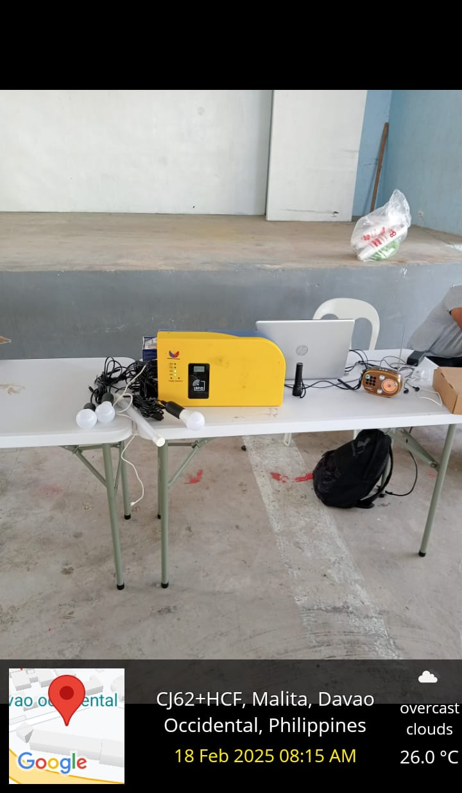
DAY2 TECHNICAL TRAINING STARTS WITH REVIEW ON SOLAR HOMES SYSTEM AND HOW IT WORKS
DASURECO HAS EXISTING SOLAR HOMES SYSTEM FROM DIFFERENT SUPPLIER AND THUS COMPARISON OF FUNCTIONS AND CAPACITY FROM SOLAR HOMES SYSTEM TO DASURECO EXISITING SOLAR SET UP

Slide 13
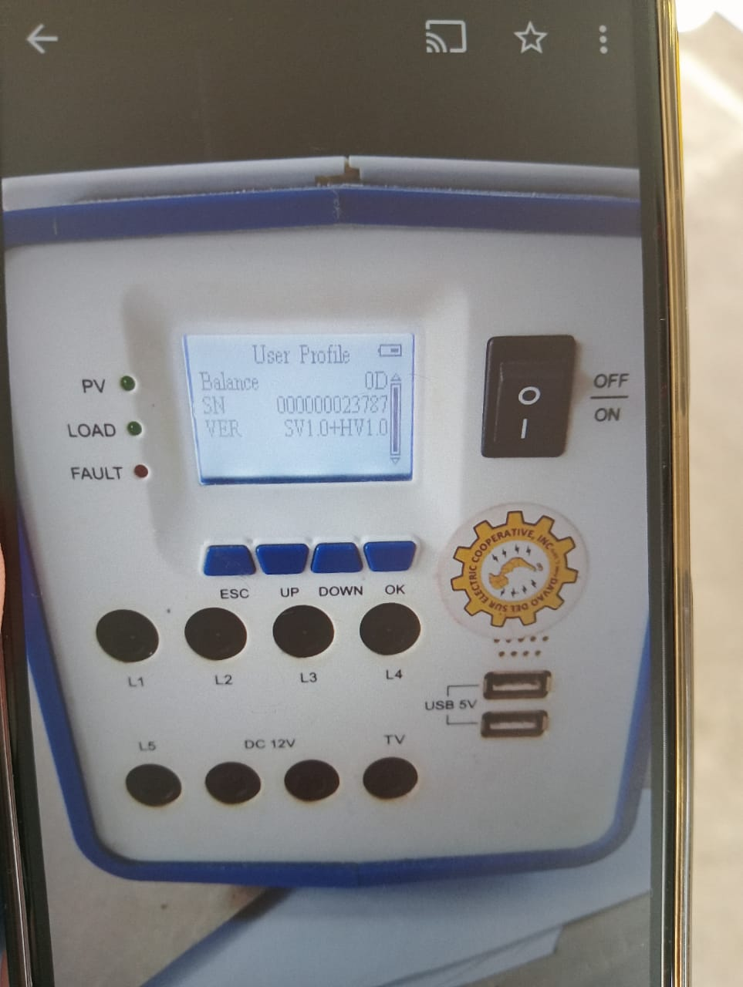
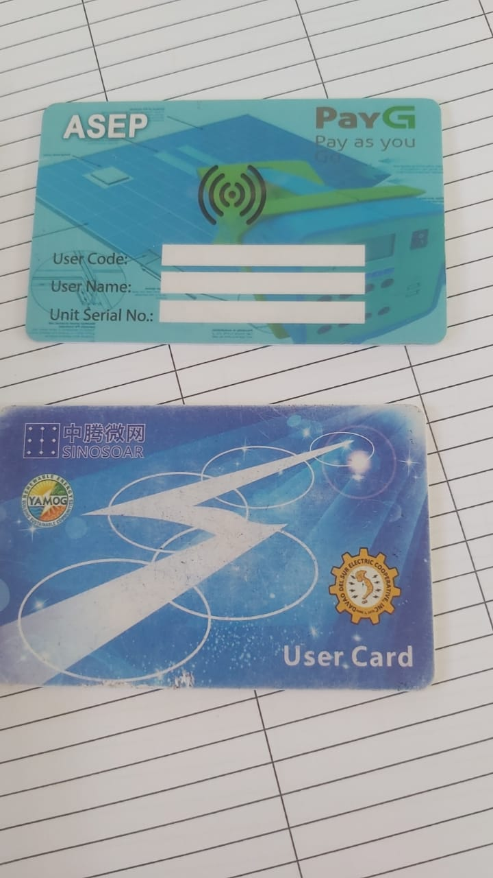
DASURECO EXISTING SOLAR MODULE AND RFID CARD

Slide 14
LUNCH PROVIDED DASURECO TRAINING

Slide 15
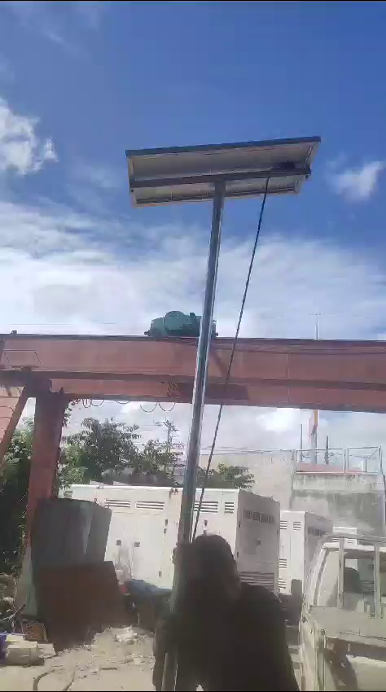
ACTUAL VIDEO PRESENTATION ON
UPGRADED DESIGN OF COST PLUS SOLAR BRACKET VERSION 4

Slide 16
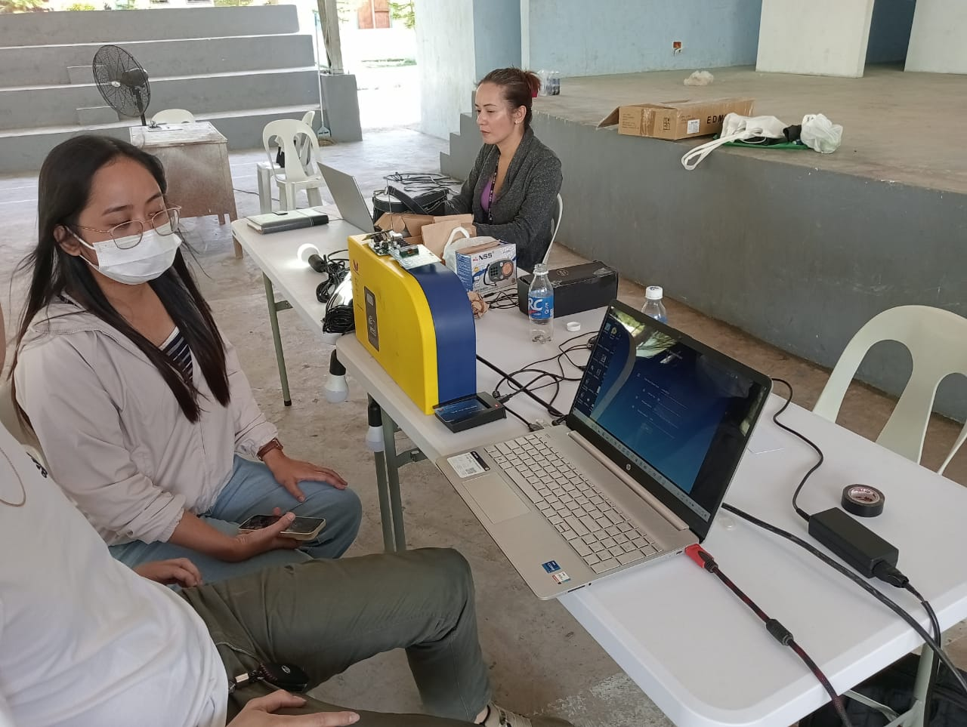
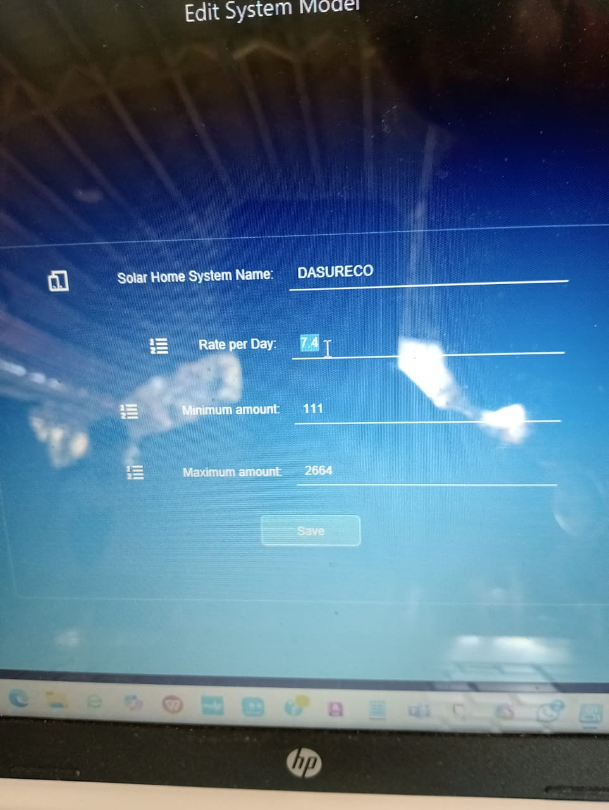
ACTUAL TECHNICAL TRAINING OF DASURECO TECHNICAL HEAD
& TEAM LEADERS ALSO

Slide 17
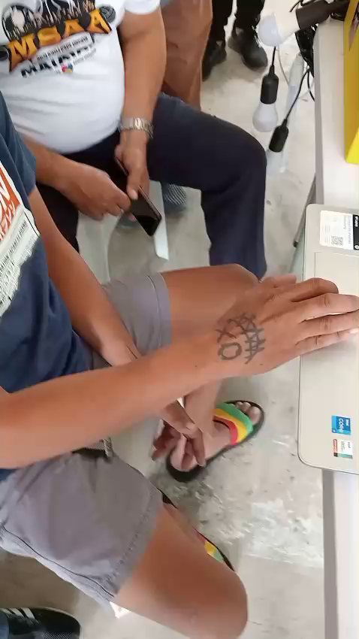
SBU UINITS ACTUAL TECHNICAL TRAINING FOR LOADING TOKEN

Slide 18
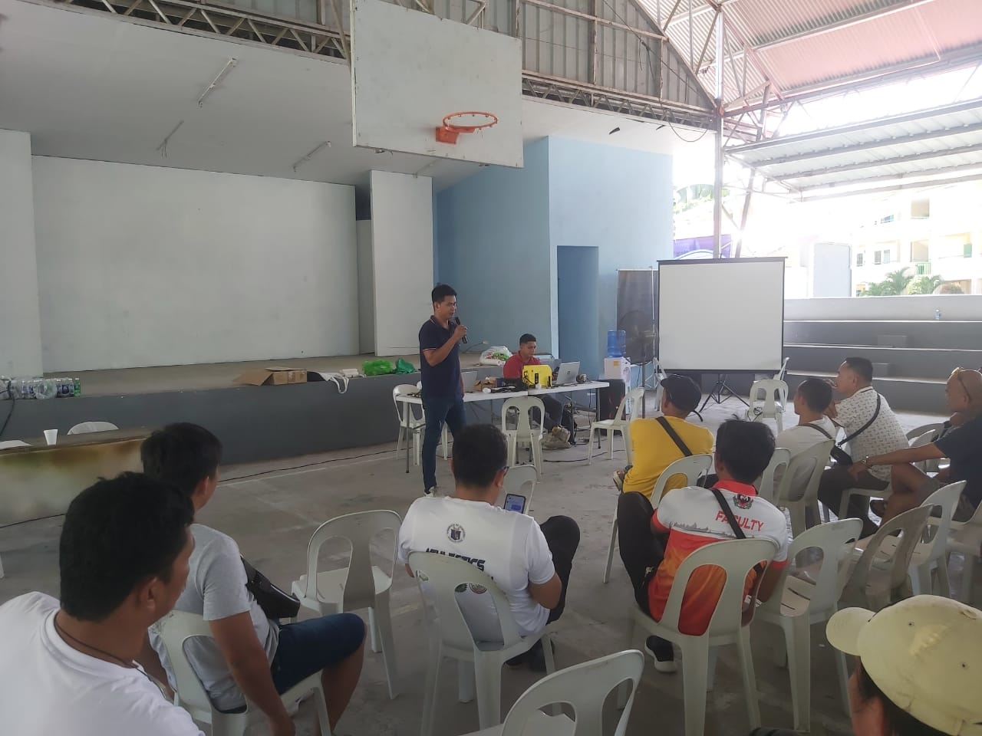
DAY2 BEFORE ENDING OF TRAINING SBU MEMBER AND ITS LEADERS SUGGEST FOR OPEN FORUM FOR SOLAR HOMES YSTEM

Slide 19
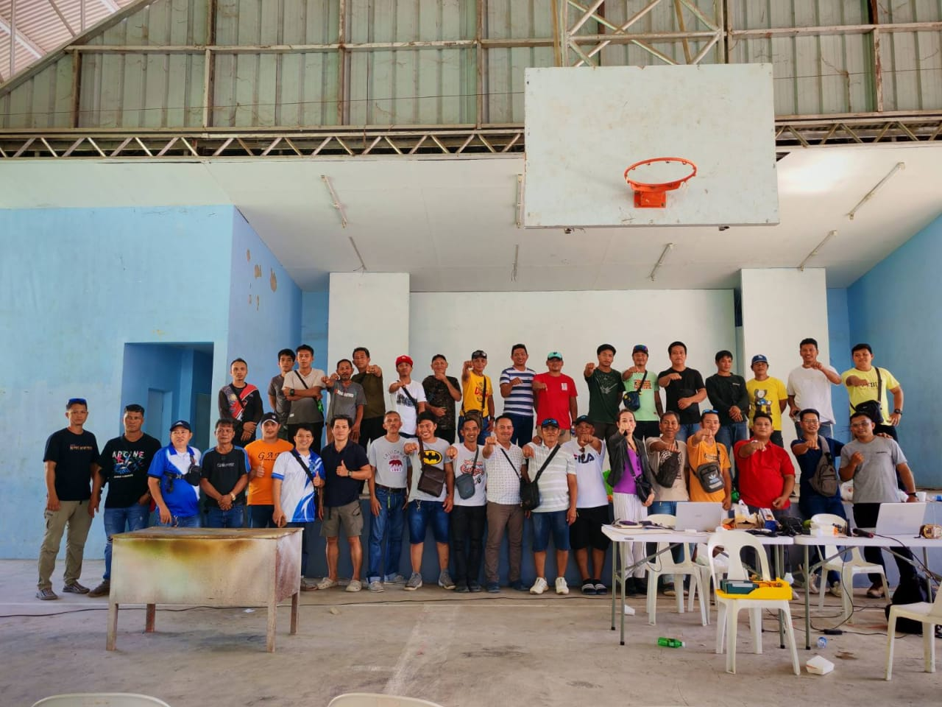
DASURECO 2 DAYS SOLAR HOMES SYSTEM TRAINING SUCCESSFUL

