Slide 1

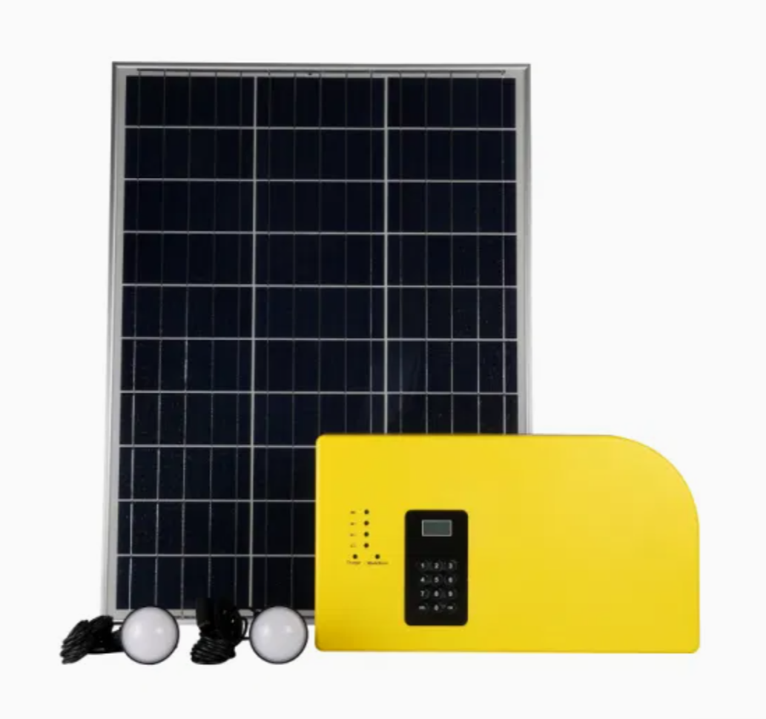
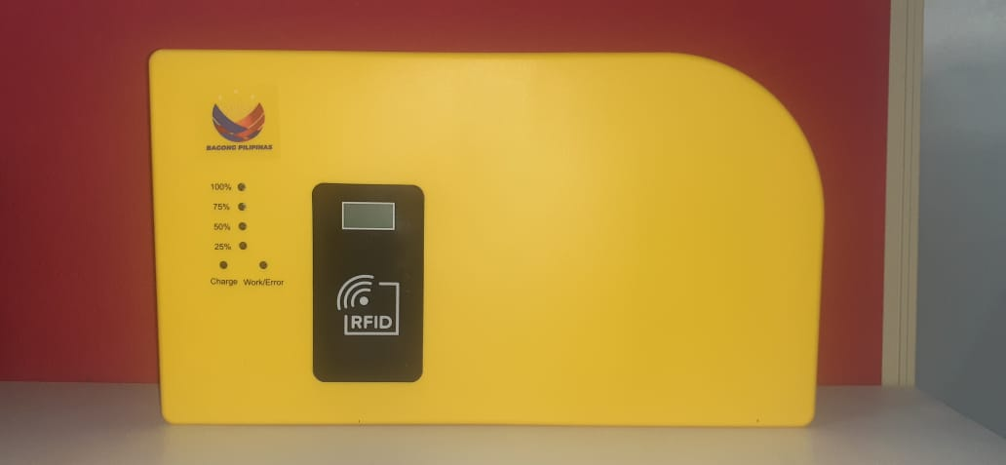
SOLAR HOME SYSTEM
COTELCO
TRAINING REPORT
Training Period:
MARCH 25, 2025 (8Am – 5pm)
Venue:
COTELCO Main Office, Brgy. Manubuan,
Matalam, cotabato
Conducted & Prepared By:
AMIR R. MUDAG

Slide 2


Slide 3

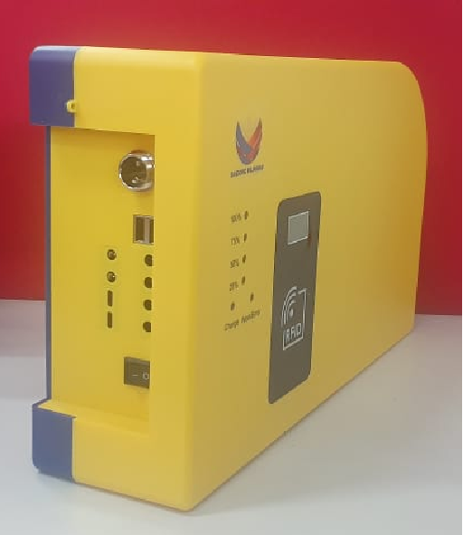
TRAINING TOPICS
BEST LOCATION FOR INSTALLATION
INSTALLATION TECHNIQUES
TESTING AND COMMISSIONING
CREDIT LOADING PROCESS
MCO INSTRUCTION
ADVANCED TROUBLESHOOTING
EXPORT AND DATA BACK-UP
INSTALLATION EVALUATION

Slide 4

TRAINING PHOTOS

Slide 5
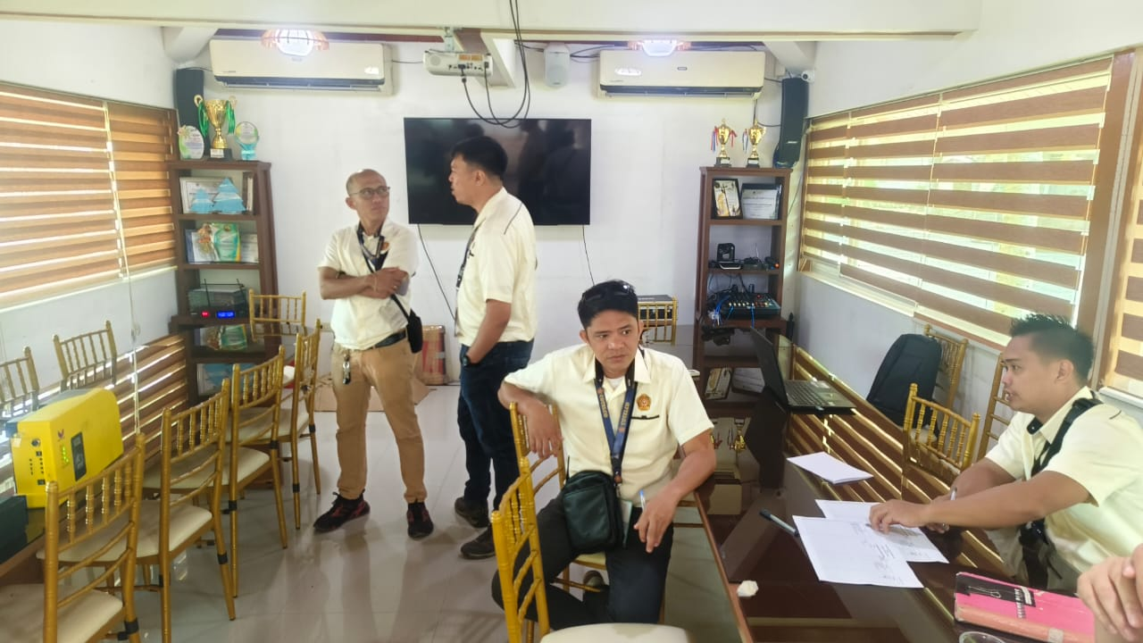
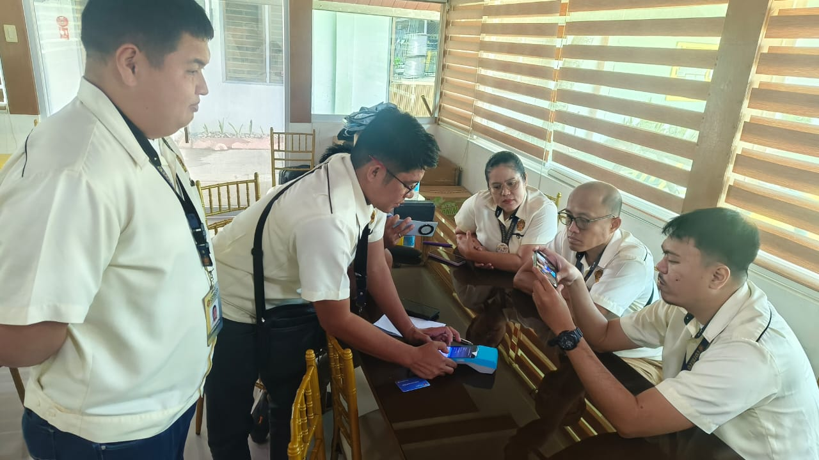

Slide 6
PARTICIPANT’S
TOTAL ATTENDEES : 9

Slide 7
THANK YOU

