Slide 1

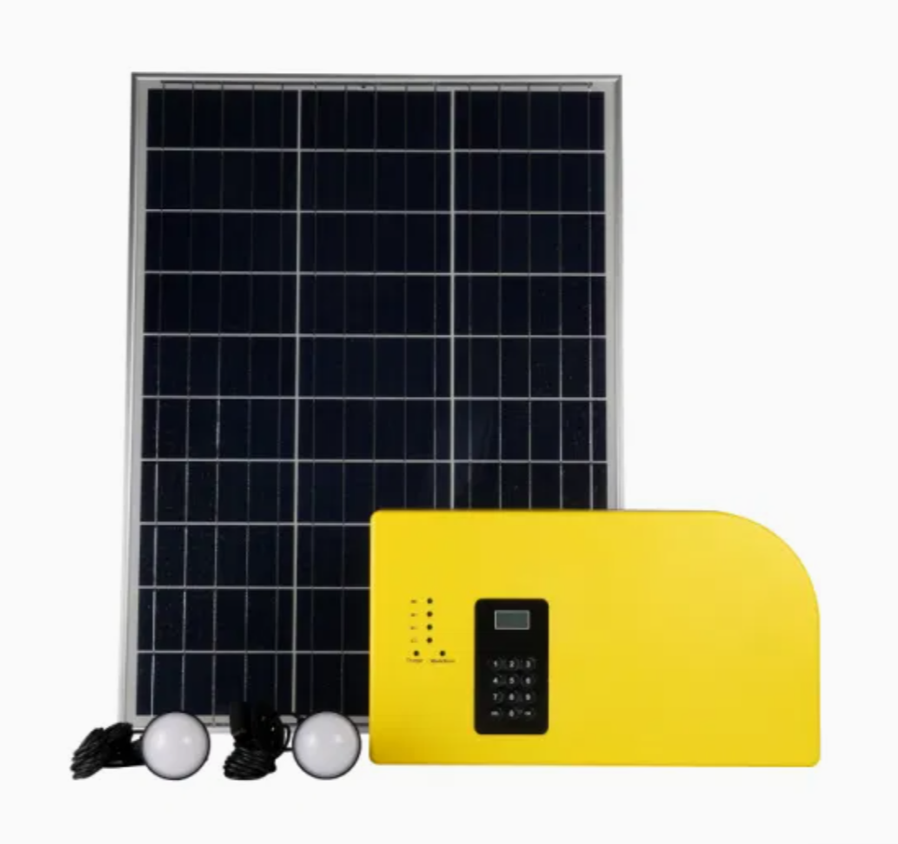
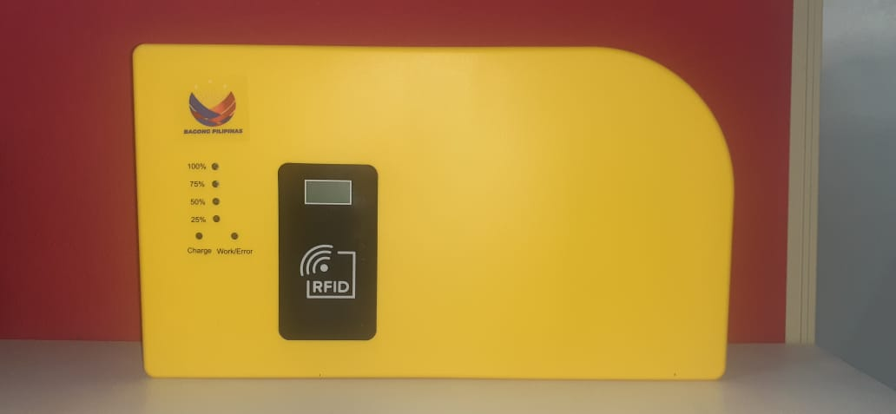
SOLAR HOME SYSTEM
COTELCO PPALMA
TRAINING REPORT
Training Period:
MARCH 29, 2025 (8Am – 5pm)
Venue:
COTELCO PPALMA, GREEN VALLETY,
POB. 8, MIDSAYAP, COTABATO
Conducted & Prepared By:
AMIR R. MUDAG

Slide 2


Slide 3

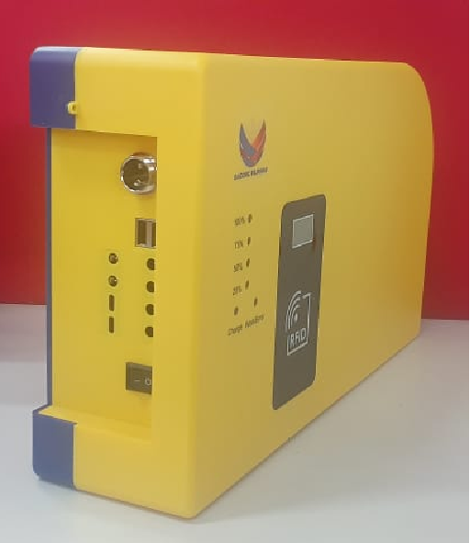
TRAINING TOPICS
BEST LOCATION FOR INSTALLATION
INSTALLATION TECHNIQUES
TESTING AND COMMISSIONING
CREDIT LOADING PROCESS
MCO INSTRUCTION
ADVANCED TROUBLESHOOTING
EXPORT AND DATA BACK-UP
INSTALLATION EVALUATION
PROPER MAINTENANCE OF MODULE ,WIRES AND SOLAR PANEL

Slide 4

TRAINING PHOTOS

Slide 5
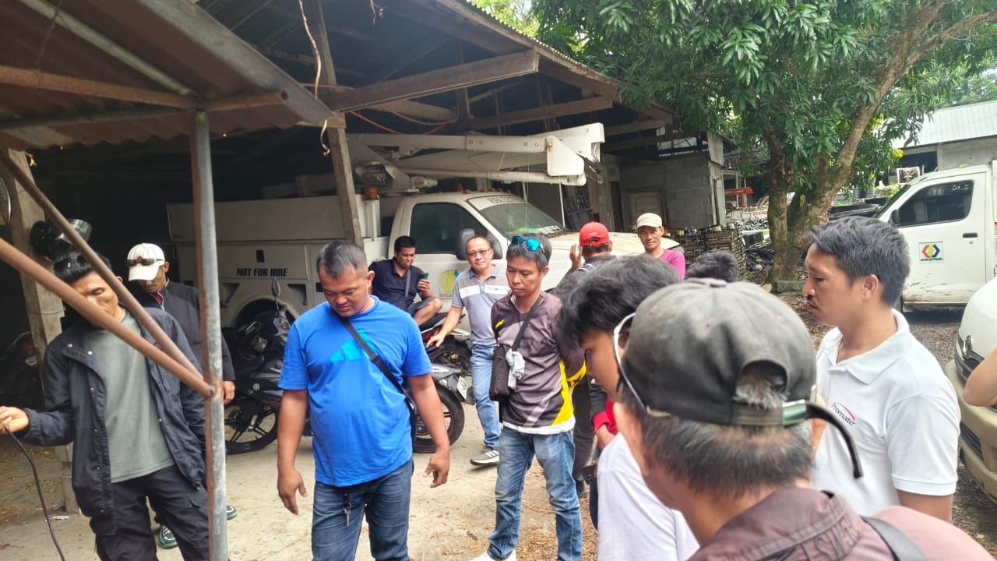

Slide 6
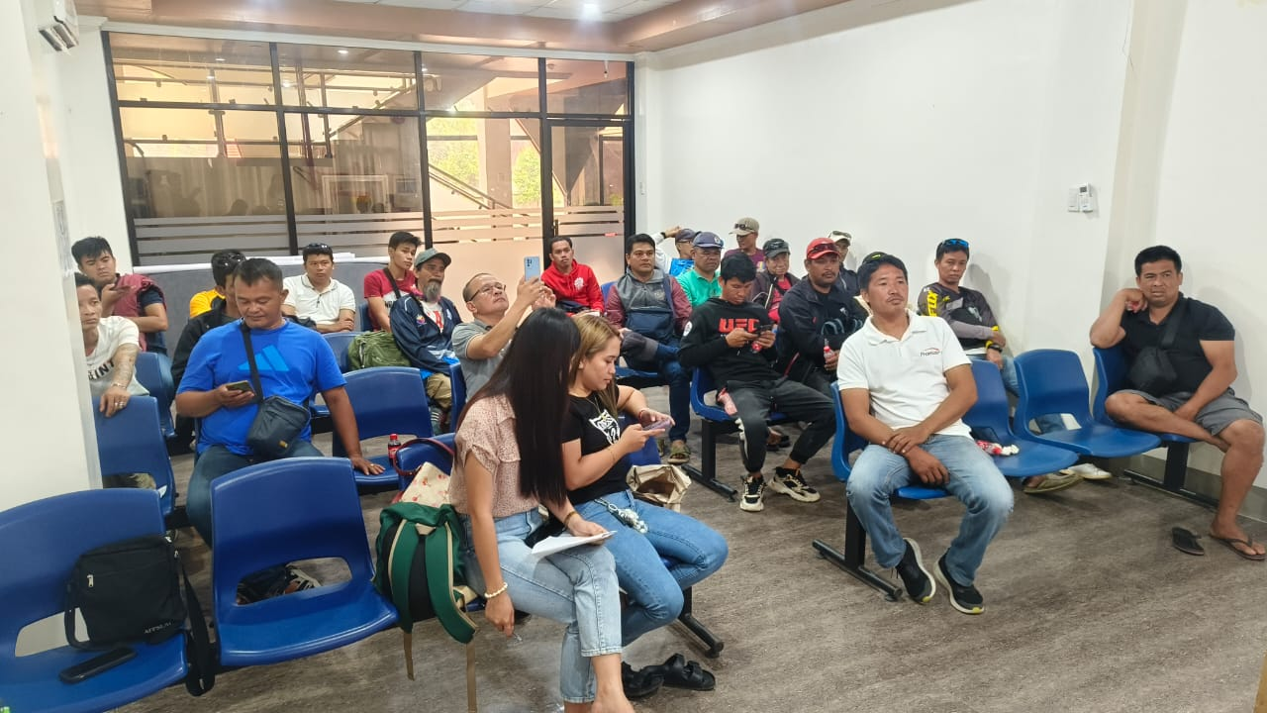

Slide 7
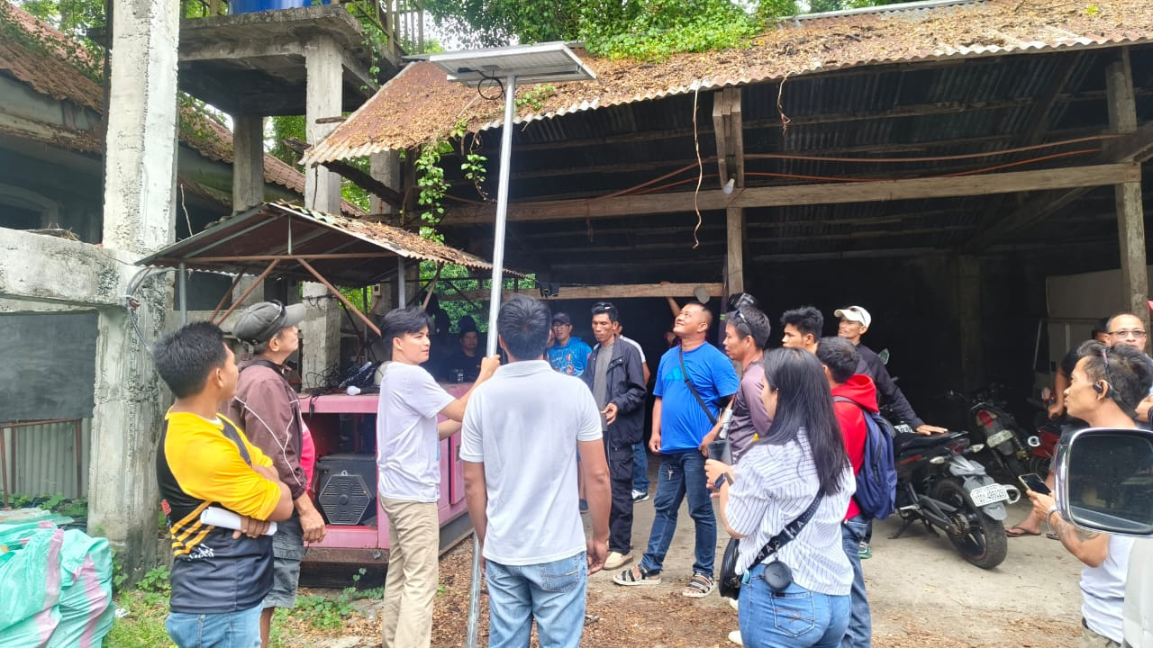

Slide 8
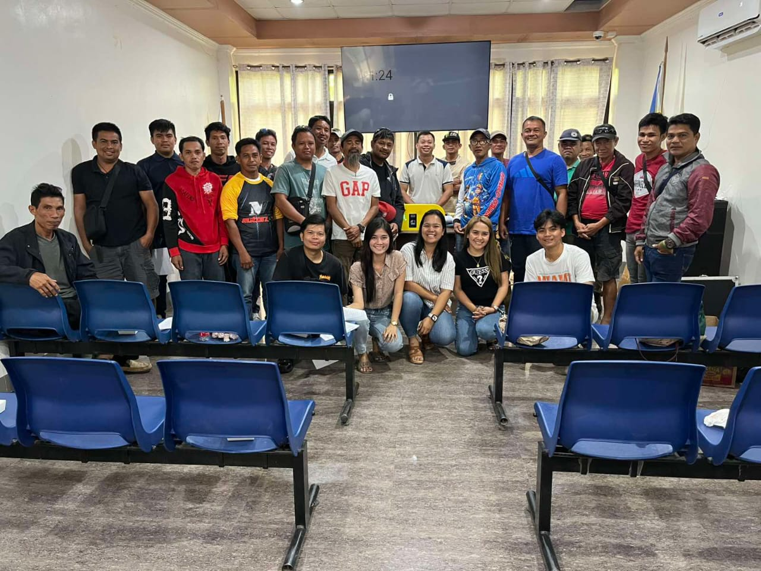

Slide 9
PARTICIPANT’S
TOTAL ATTENDEES : 27

Slide 10
THANK YOU

