Slide 1


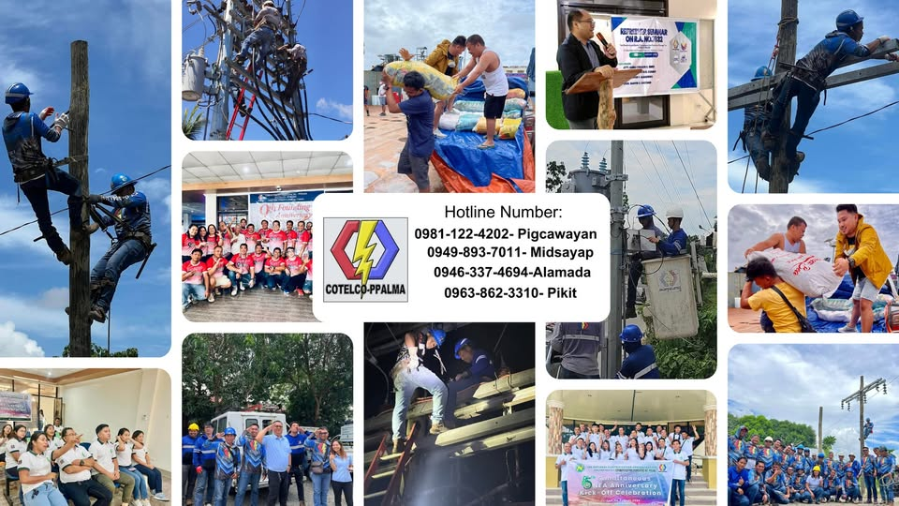
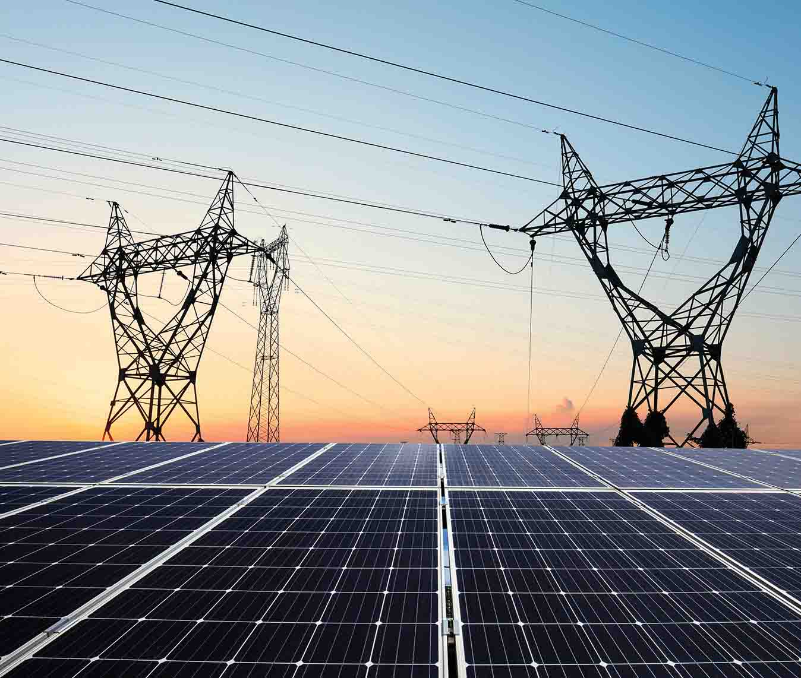
WELCOME
SOLAR HOME SYSTEM
COTELLCO PPALMA
2 DAYS TRAINING
FEBRUARY 24 & 25 2025
Prepared By:
Engr Joseph Obusan IEE A.M.O.

Slide 2
SHS Training
Day 1
AM
830:00am –10:00am Basic on Solar Energy & others
10:00am –10:30am Snacks
10:45am-12:00pm – Basic Installation & others
12:00pm – 1:30pm – Lunch
PM
1:30pm – 3:30pm – RFID Activation & Loading
3:00pm – 3:30pm – Snacks
3:45pm – 5:00pm –generate token hands on training /
Testing/ Q & A

Slide 3
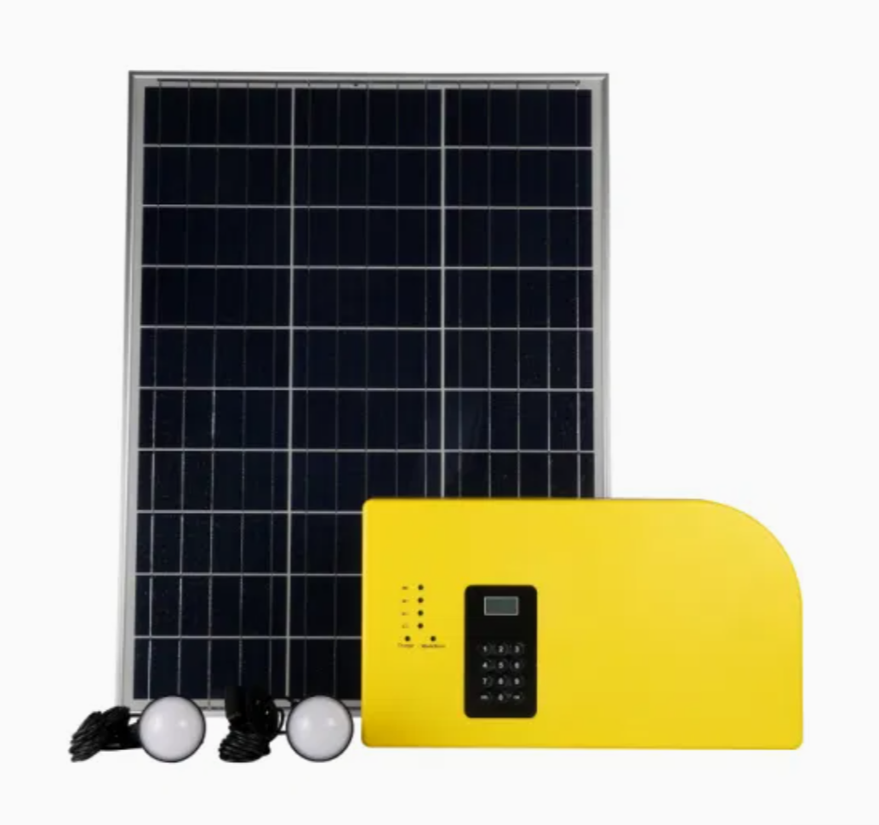
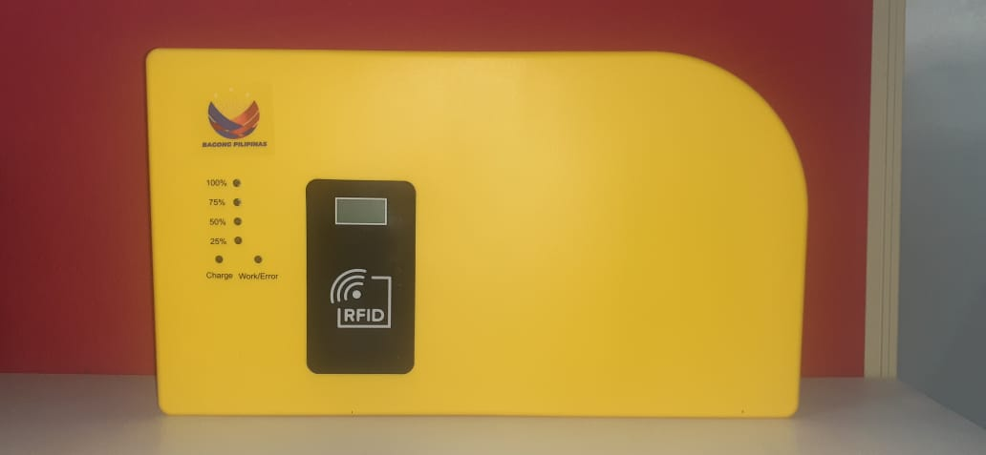
Solar Home System

Slide 4
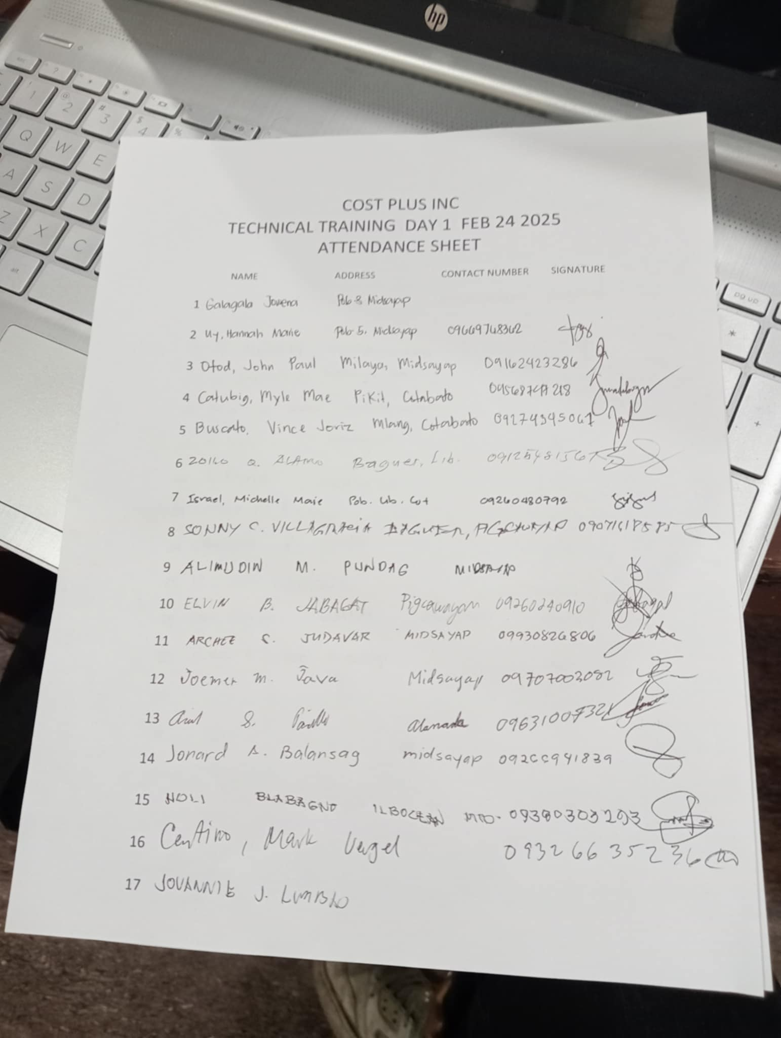
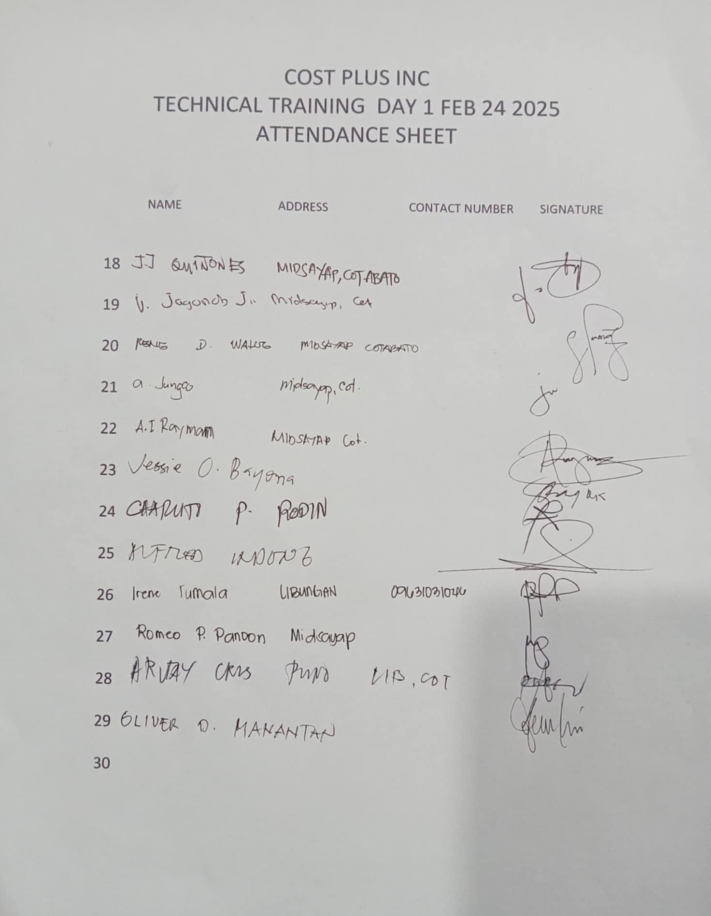
COTTELCO PPALMA DAY1 TRAINING TOTAL OF 30 PARTICIPANTS
CPI - ADS

Slide 5
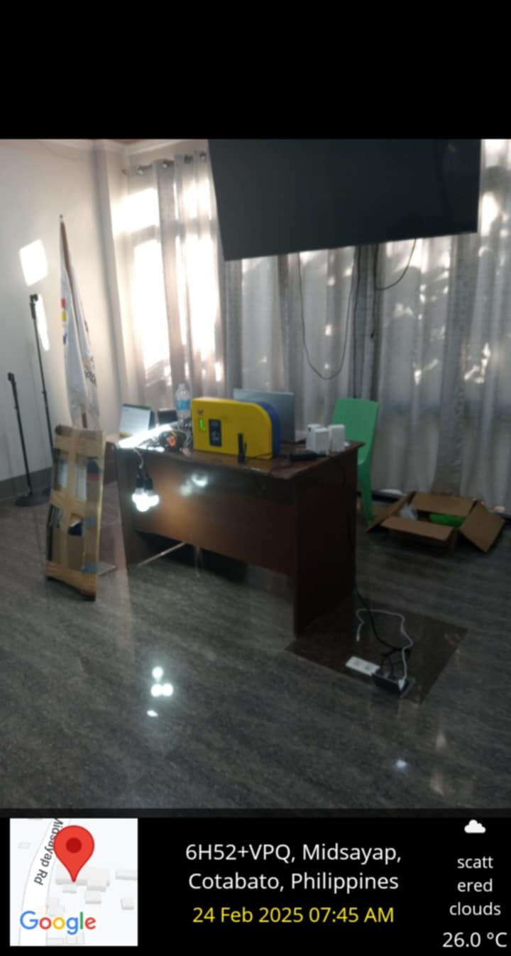
EARLY ARRIVAL AND PREPARATION OF SOLAR HOMES EQUIPMENT FOR PRESENTATION OF DAY 1 TECHNICAL TRAINING FOR COTTELCO PPALMA
COTELCO PPALMA 1ST TIME TO IMPLEMENT SOLAR HOMES SYSTEM TO MIDSAYAP COTABATO
CPI - ADS

Slide 6
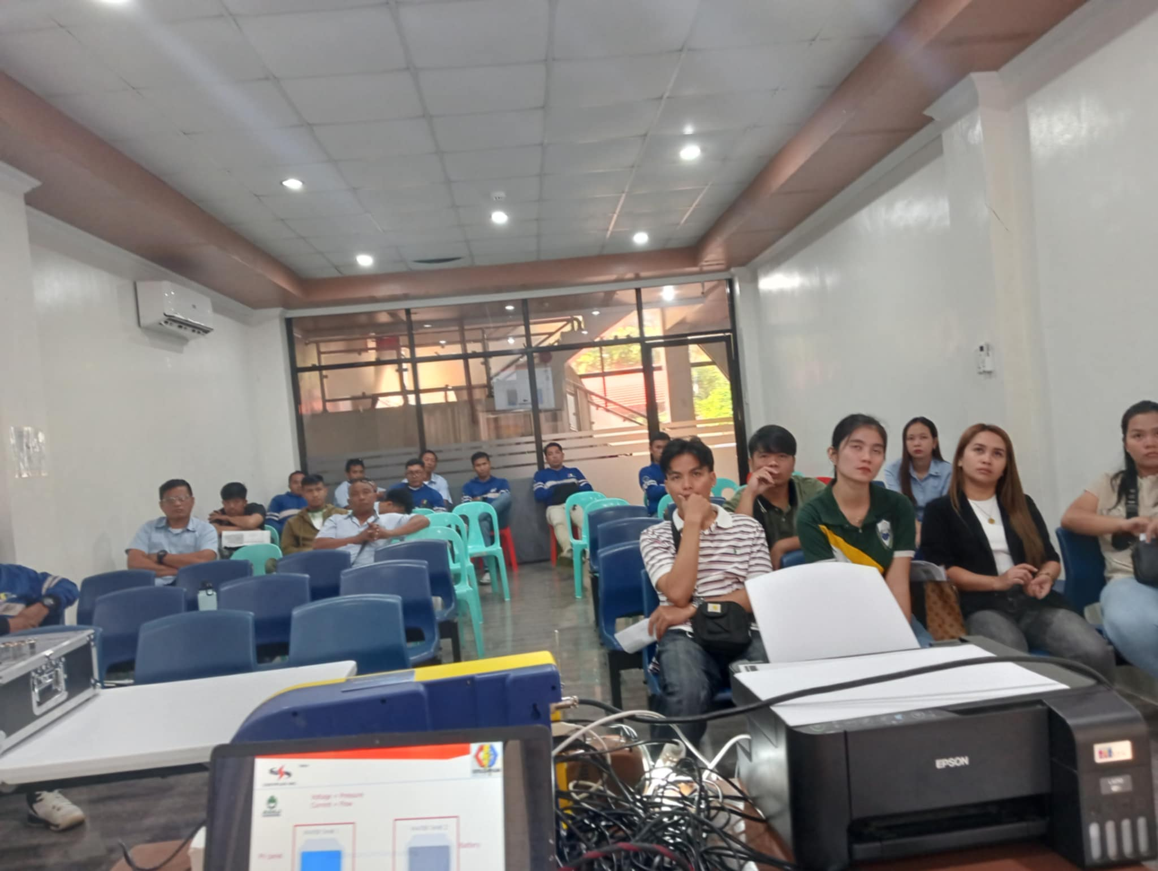
DAY 1 OF TRAINING FOCUS ON INTRODUCTION OF SOLAR HOMES SYSTEM TRAINING AND ITS COMPONENTS
ACTUAL DEMONSTRATION OF HOW SOLAR HOMES SYSTEM WORKS
CPI - ADS

Slide 7
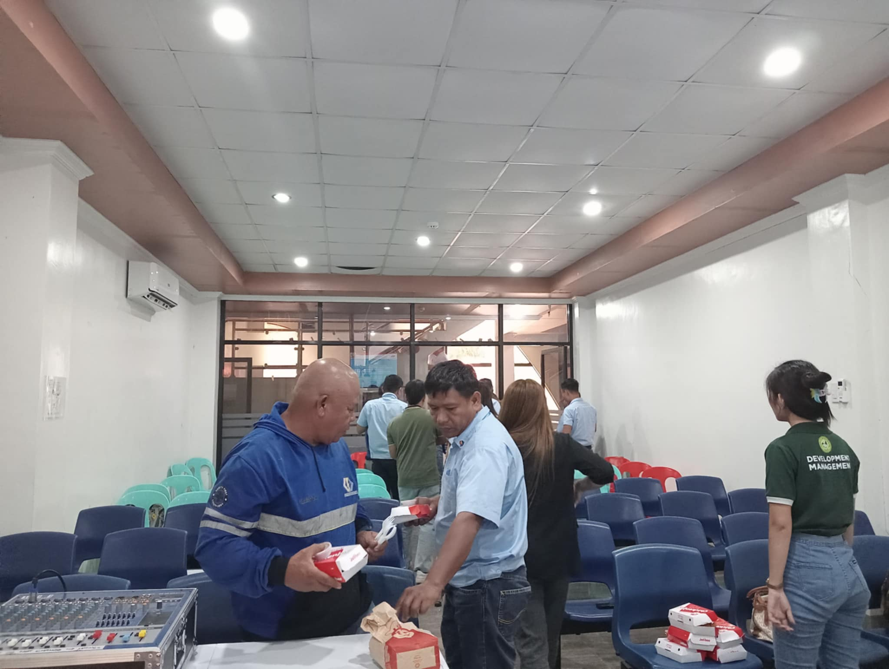
DA1 AND DAY2 DISTRIBUTION OF MEALS ARE FROM FASTFOOD CHAIN JOLLIBEE
CPI - ADS

Slide 8
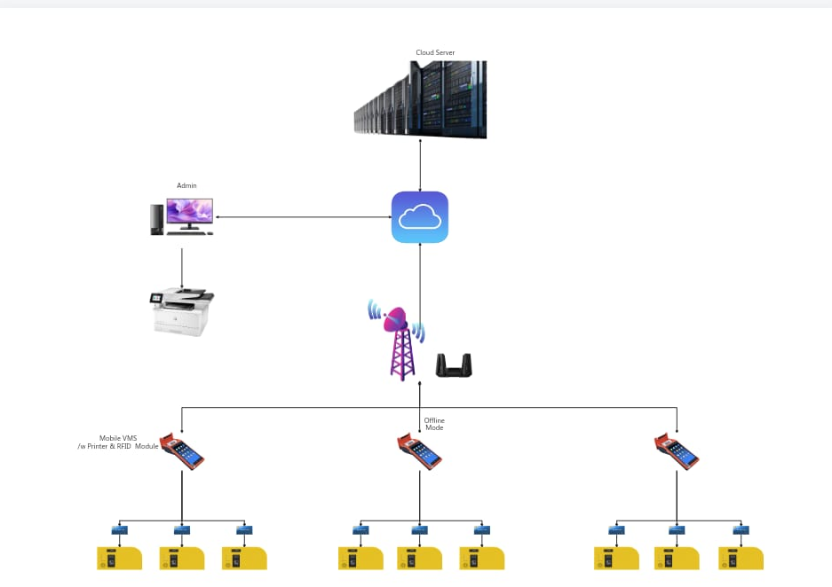
SOLAR BUSSINESS UNITS OF COTELCO PPALMA ARE VERY INTERESTED WITH POS( POINT OF SALE ) CAPACITY AND ITS ROLE ON SOLAR HOMES SYSTEM SO I DISCUSS WHAT POS DOES AND ITS ADVANTAGES FOR LOADING PROCESS TO BENEFICIARIES
CPI - ADS

Slide 9
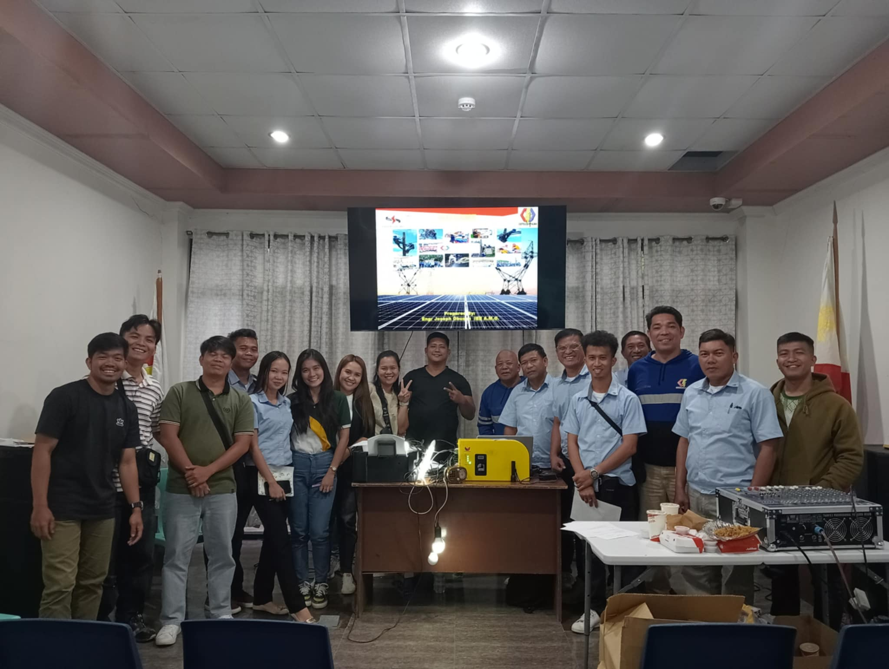
DAY 1 TECHNICAL TRAINING FOR COTELCO PALMA SOLAR BUSINESS UNITS AND TECHNICAL HEADS ARE SUCCESSFULL
CPI - ADS

Slide 10
SHS Training
Day 2
AM
830:00am –10:00am Review Basic on Solar Energy & others
10:00am –10:30am Snacks
10:45am-12:00pm – Review Basic Installation & others
12:00pm – 1:30pm – Lunch
PM
1:30pm – 3:30pm – Hands on training RFID Activation & Loading
3:45pm – 5:30pm –Troubleshoot actual training /
Testing/ Q & A

Slide 11
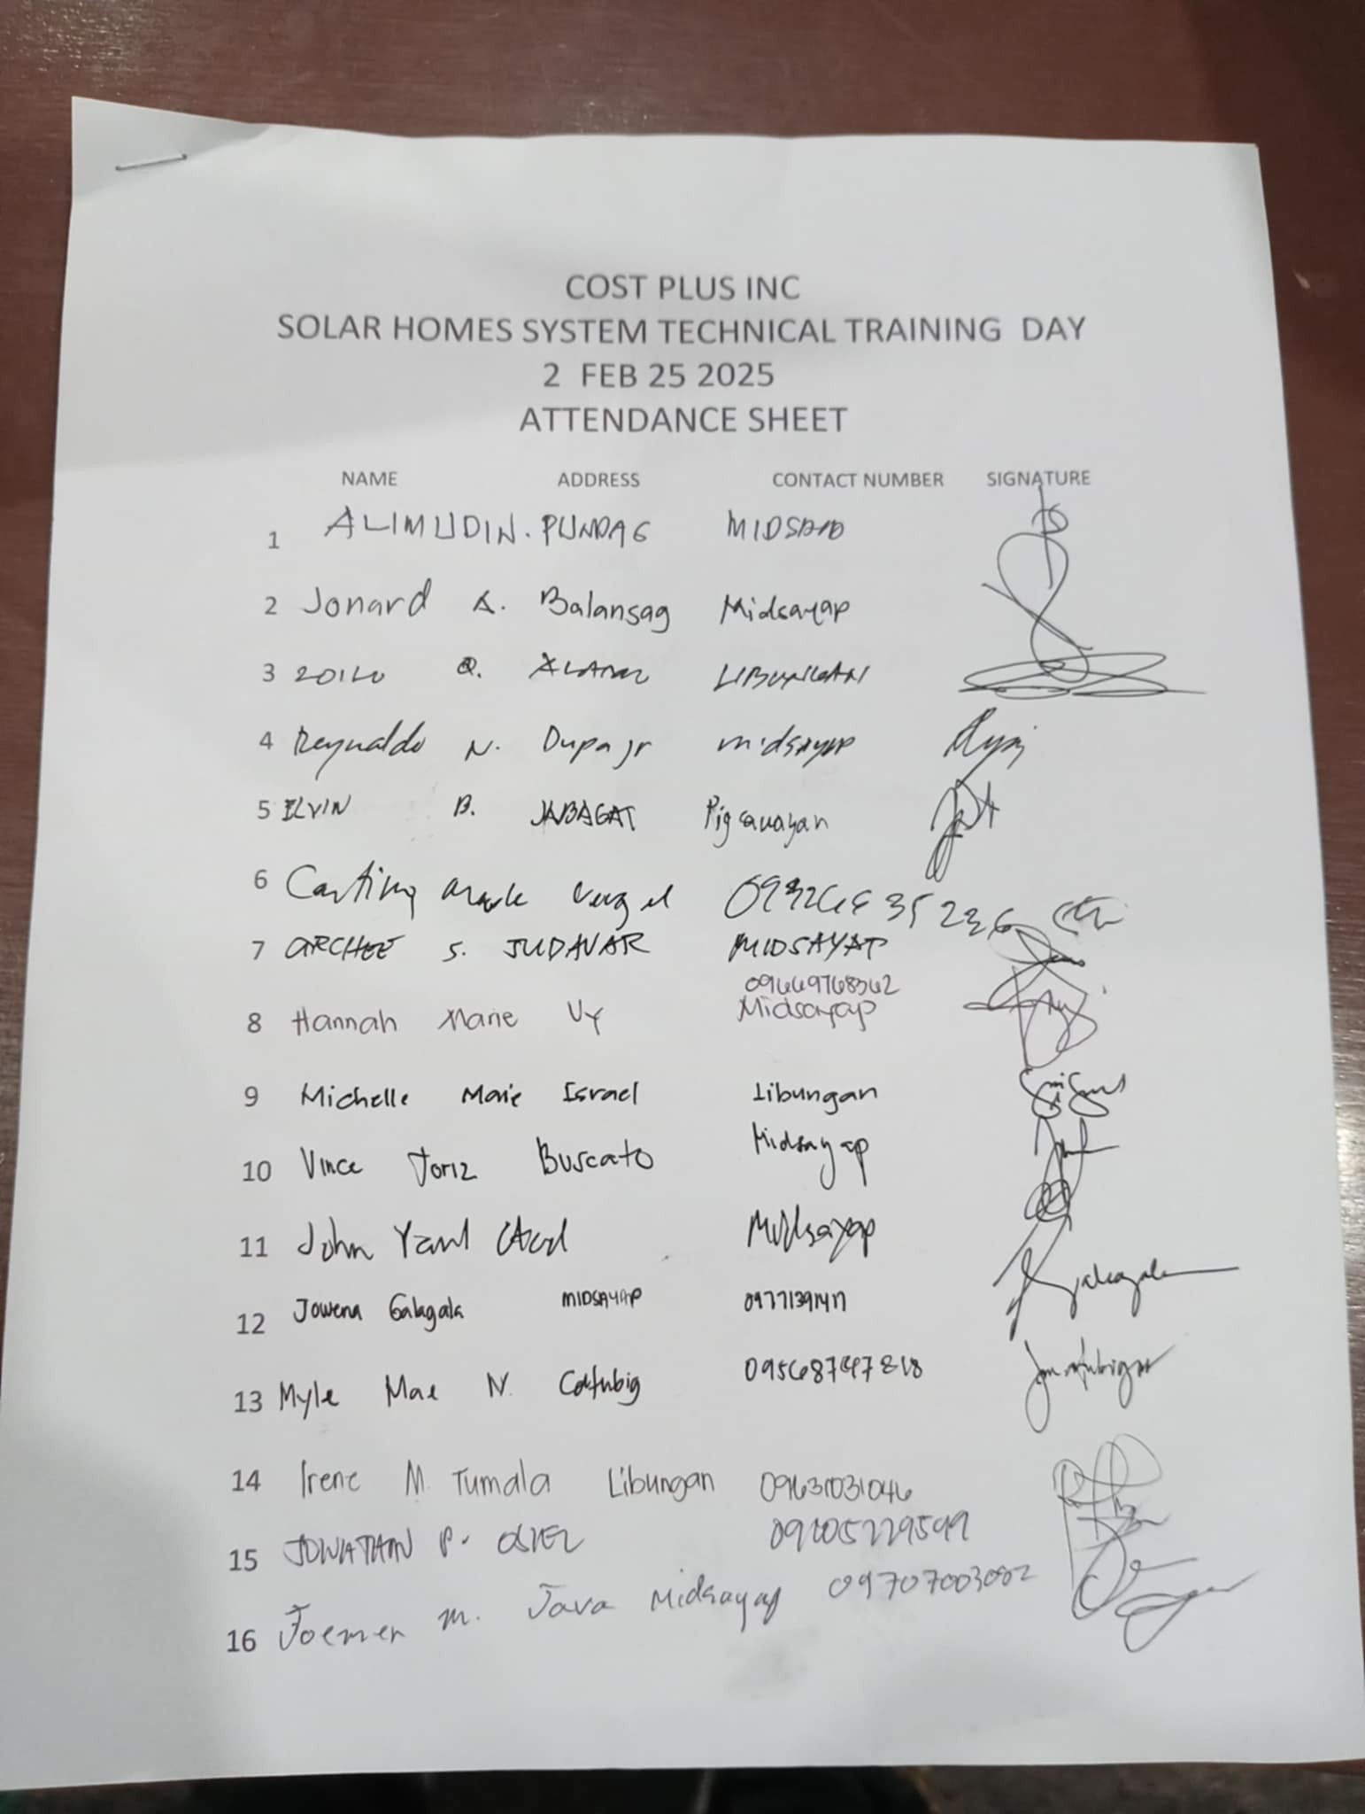
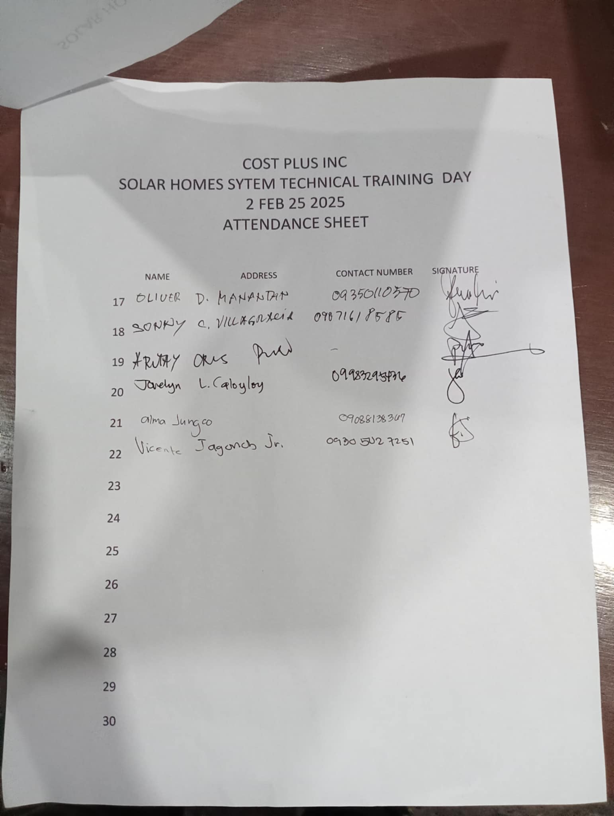
DAY 2 ATTENDANCE INITIALLY 22 PARTICIPANTS AND OTHERS COME LATER THAT DAY
CPI - ADS

Slide 12
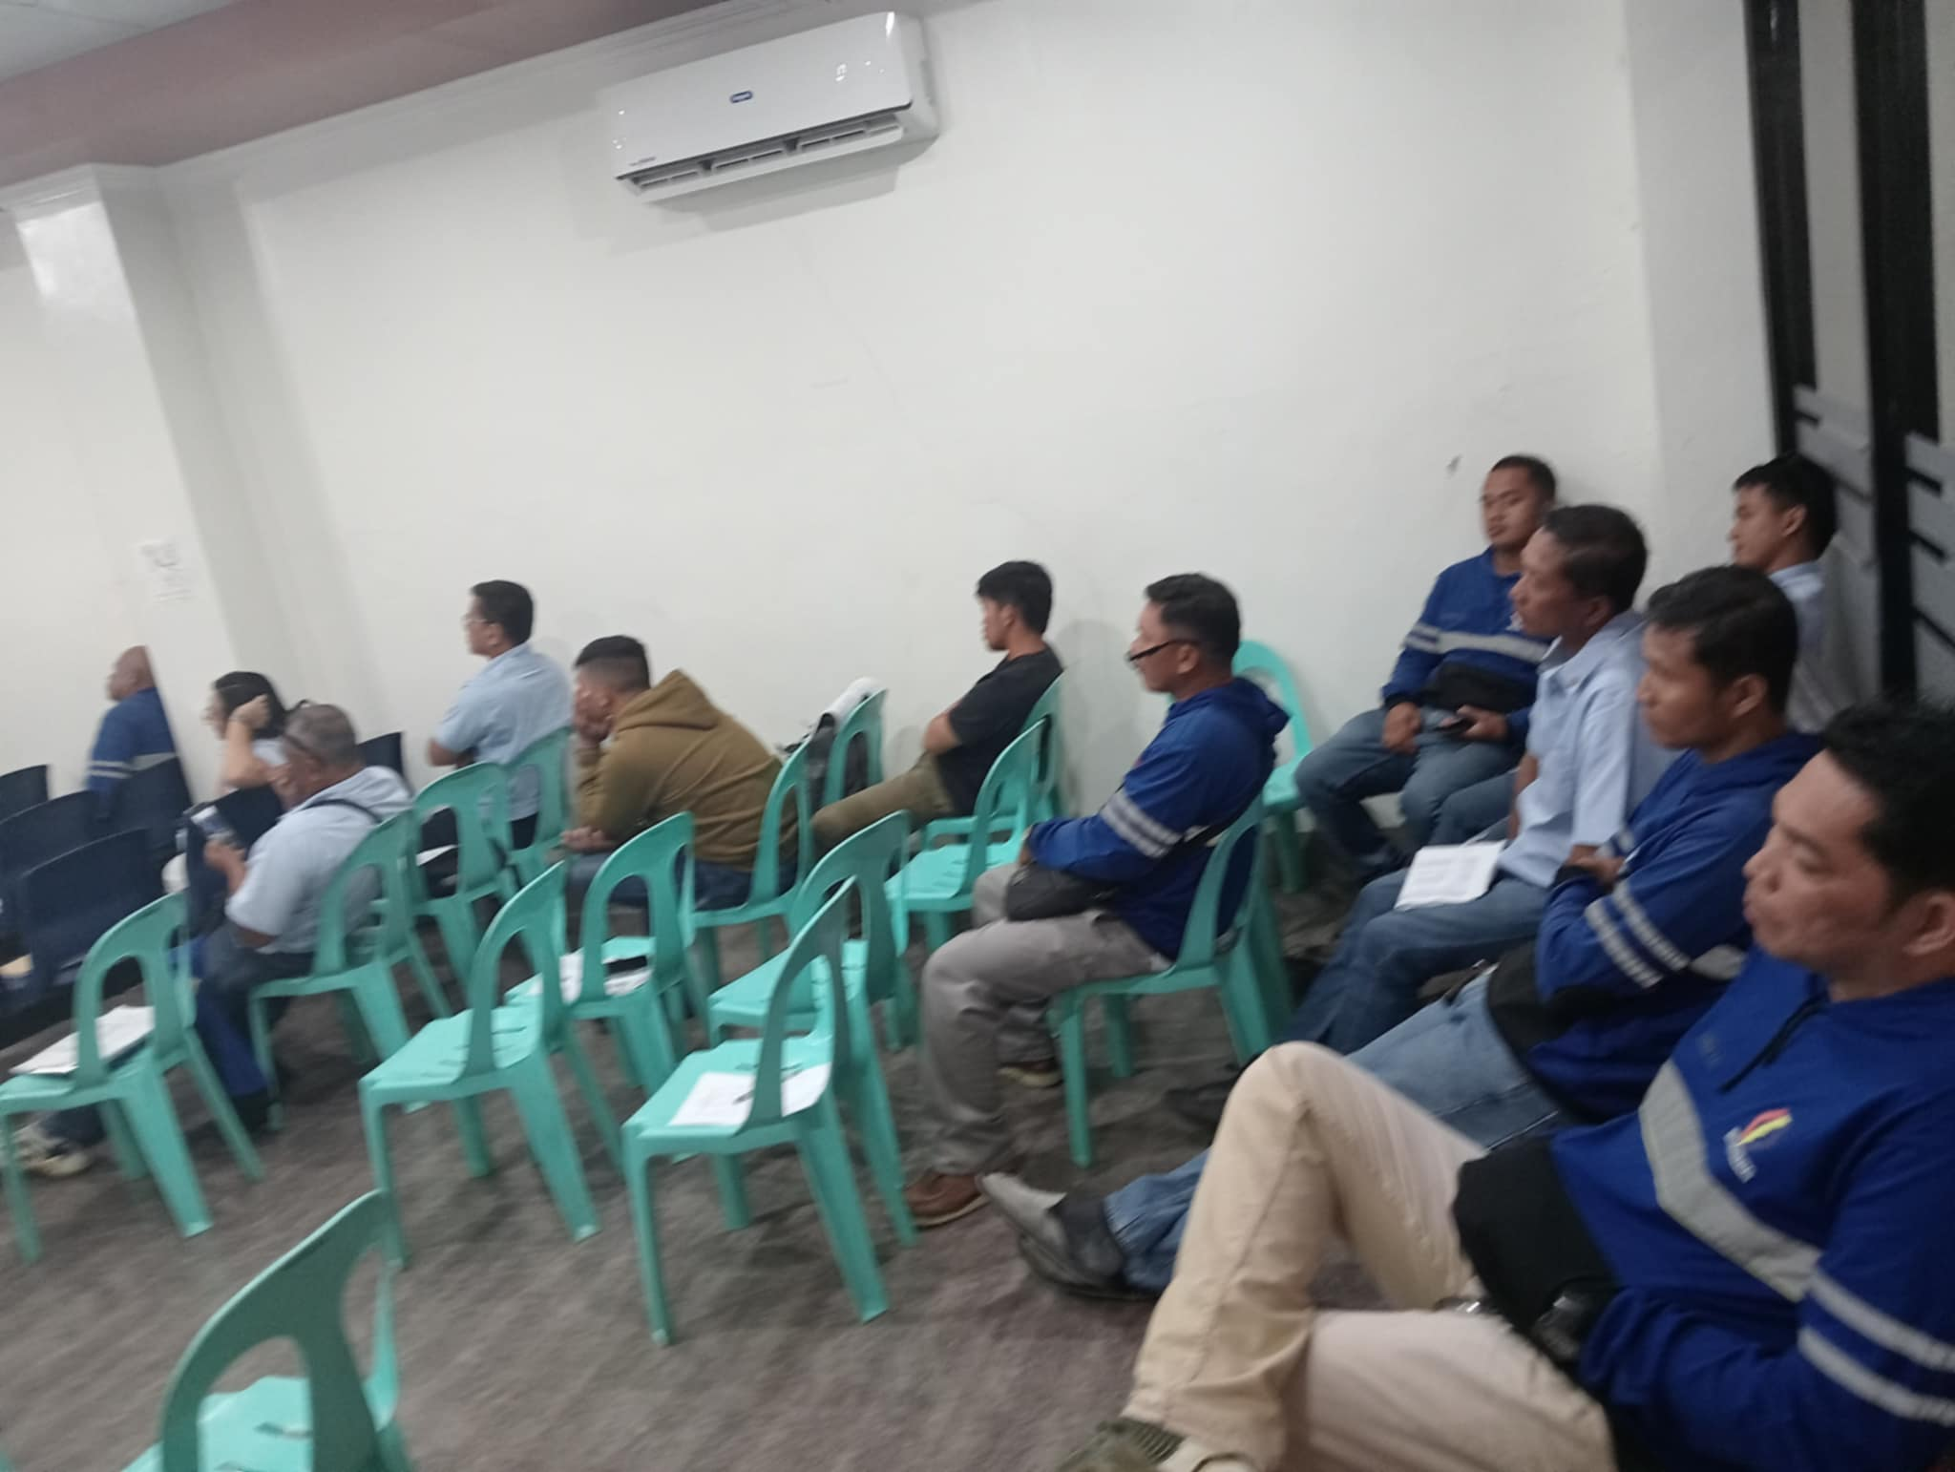
DAY 2 TECHNICAL TRAINING FOCUS ON HANDS ON EACH PARTICIPANTS OF COTELCO PPALMA TRAIN FOR LOADING TOKEN AND TROUBLESHOOT
CPI - ADS

Slide 13
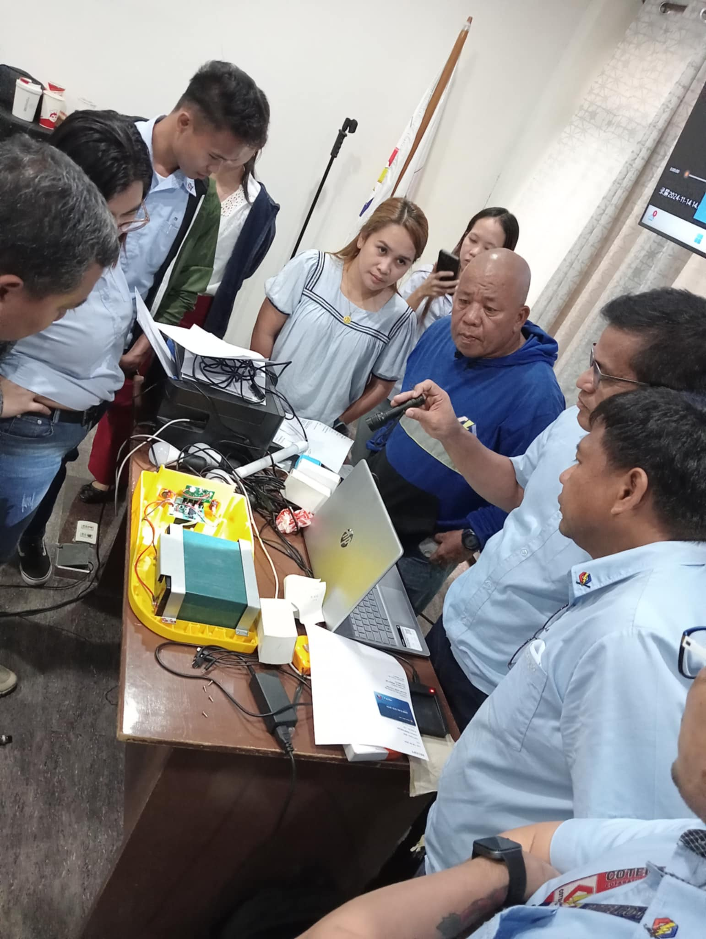
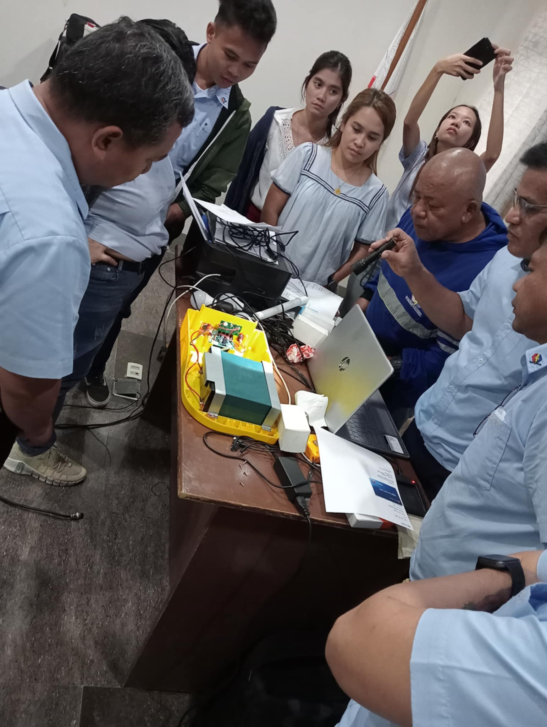
TECHNICAL TEAM ALSO DISCUSS HOW COTELCO PPALMA COOP PROTECT SHS AND BRAINSTORMING ON PREVENSION OF TAMPERING FOR SOLAR HOMES SYSTEM UNITS ONCE SHS ARE IMPLEMENTED TO MIDSAYAP COTABATO BENEFICIARIES
CPI - ADS

Slide 14
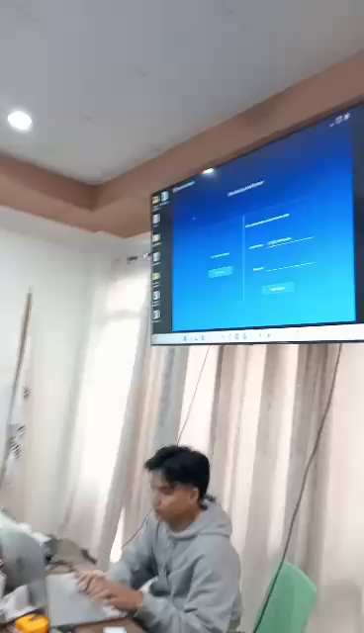
IN DEPTH TROUBLESHOOT OF ONE PAY GO SOFTWARE INCLUDING BACK UP SYSTEM AND RESTORE
INDIVIDUAL TRAINING OF PARTICIPANTS OF COTELCO PPALMA ARE DONE IN DAY 2 TECHNICAL TRAINING INCLUDING
SETTING OF SYSTEM MODEL
REGISTRATION OF BENEFICIARIES
LOADING TOKEN
PRINTING RECEIPTS
GENERATING RESET TOKEN
BASIC TROUBLESHOOT AND INDEPTH TROUBLESHOOT OF PAYGO SOFTWARE AND HOW SYSTEM WORKS
CPI - ADS

Slide 15
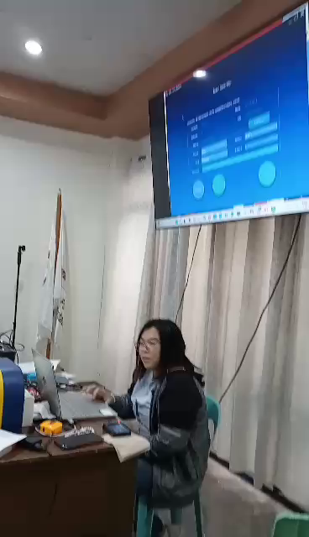
COTELCO PPALMA TECHNICALS ACTUAL TRAINING FOR SOLAR HOMES SYSTEM PAYGO SOFTWARE
INDIVIDUAL TRAINING FOR REGISTERING
OF BENEFICIARIES , LOADING TOKEN , GENERATING RESET TOKEN
PRINTING RECEIPTS ARE DONE IN DAY 2 TECHNICAL TRAINING
CPI - ADS

Slide 16
DA1 AND DAY2 DISTRIBUTION OF MEALS ARE FROM FASTFOOD CHAIN JOLLIBEE
CPI - ADS

Slide 17
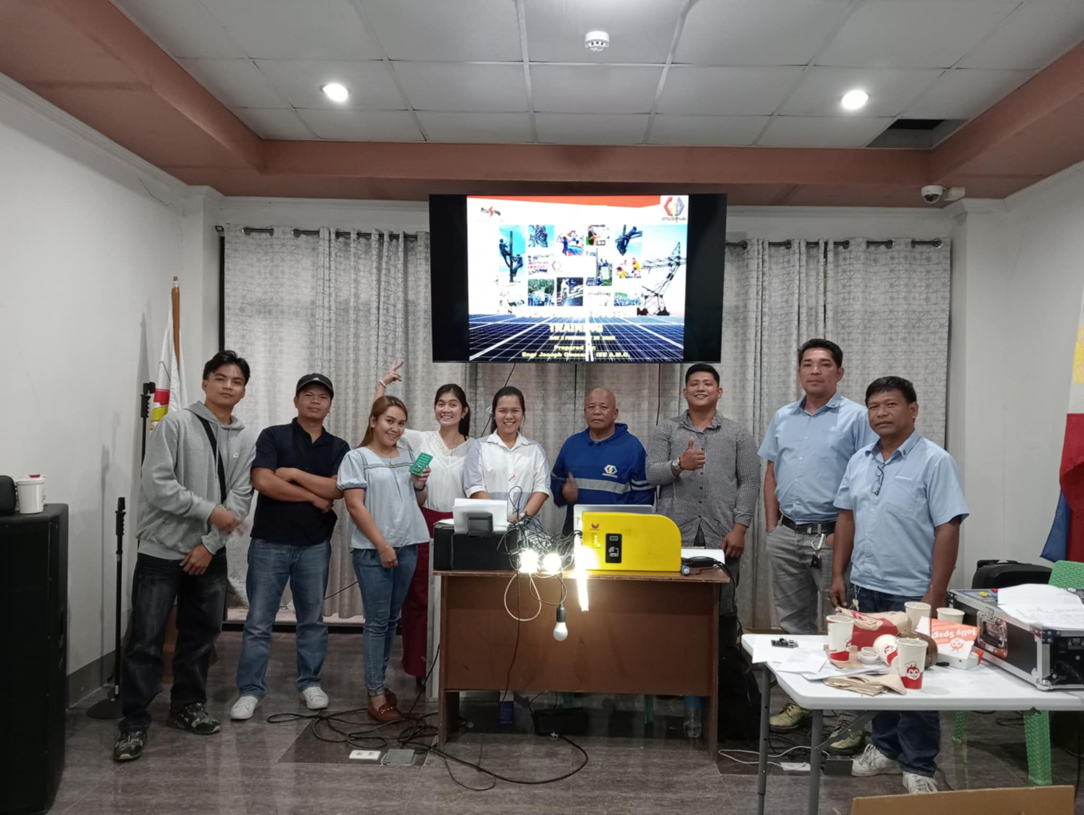
DAY 2 HANDS ON TRAINING FOR COTELCO PPALMA TECHNICALS AND SOLAR BUSSINESS UNITS ARE SUCCESSFUL
CPI - ADS

